Slide 1
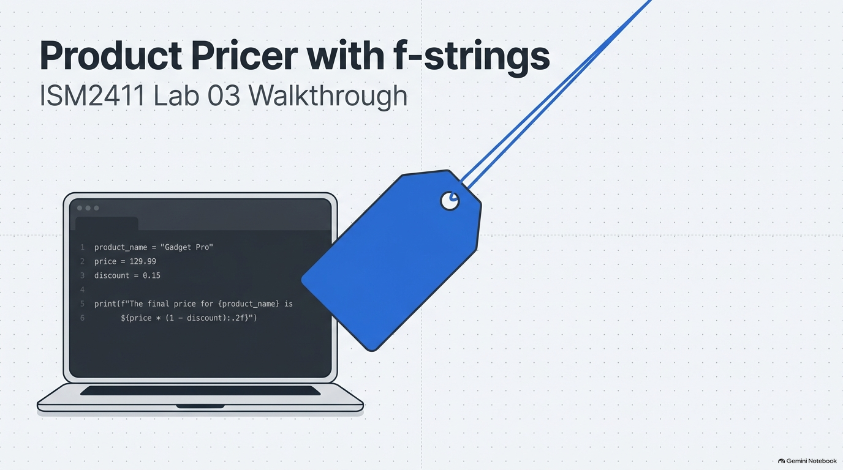
Notes:
SLIDE 1 — INTRO
SAY: "Lab 3 — the Product Pricer. This is the first lab where you build something that looks like a real tiny tool, not just a print statement. Four variable types, f-string formatting, user input, and a small business calculation — margin — all in one file called pricer.py."
SLIDE NOTES
This is the title/cold-open slide.
The on-screen code preview (product_name, price, discount, and a final-price f-string with a :.2f spec) is illustrative branding for the deck, not the actual Exercise 1 starter code — the real file uses product/unit_price/quantity/in_stock. Don't let students copy this preview verbatim; it's just here to signal "we're building a pricer."
Transition: everything from here builds inside one file, pricer.py, with # comments separating each exercise — say that up front so students create the file now.

Slide 2
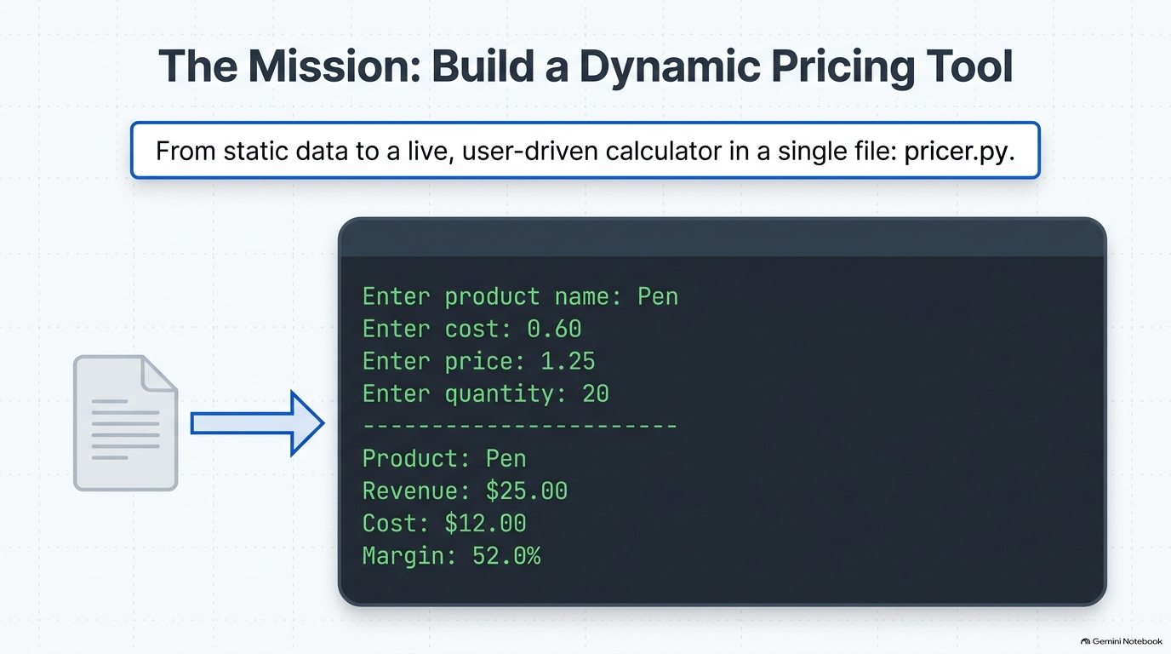
Notes:
SLIDE 2
Frame the arc for the whole lab before touching any exercise.
SAY: students move from static, hardcoded data (Exercise 1) to f-string formatting (Exercise 2) to a live, user-driven calculator (Exercise 3) to a full five-line business report computing margin (Exercise 4) — all inside the single file pricer.py. That's the throughline: raw values -> formatted text -> dynamic input -> a real business metric.
The terminal mock on this slide (Enter product name / cost / price / quantity, then Product/Revenue/Cost/Margin) is a composite preview of where the file ends up, using Pen at $1.25, cost $0.60, quantity 20, for a 52.0% margin — that specific Pen example doesn't appear in the current 5-exercise script (it was originally the take-home Stretch A comparison), so don't promise students the script will literally print a "Cost:" line; the real Exercise 4 output prints Product/Price/Qty/Revenue/Margin for the Notebook example. Use this slide only to sell the destination — a live pricing calculator — not as an exact preview of Exercise 4's output.

Slide 3
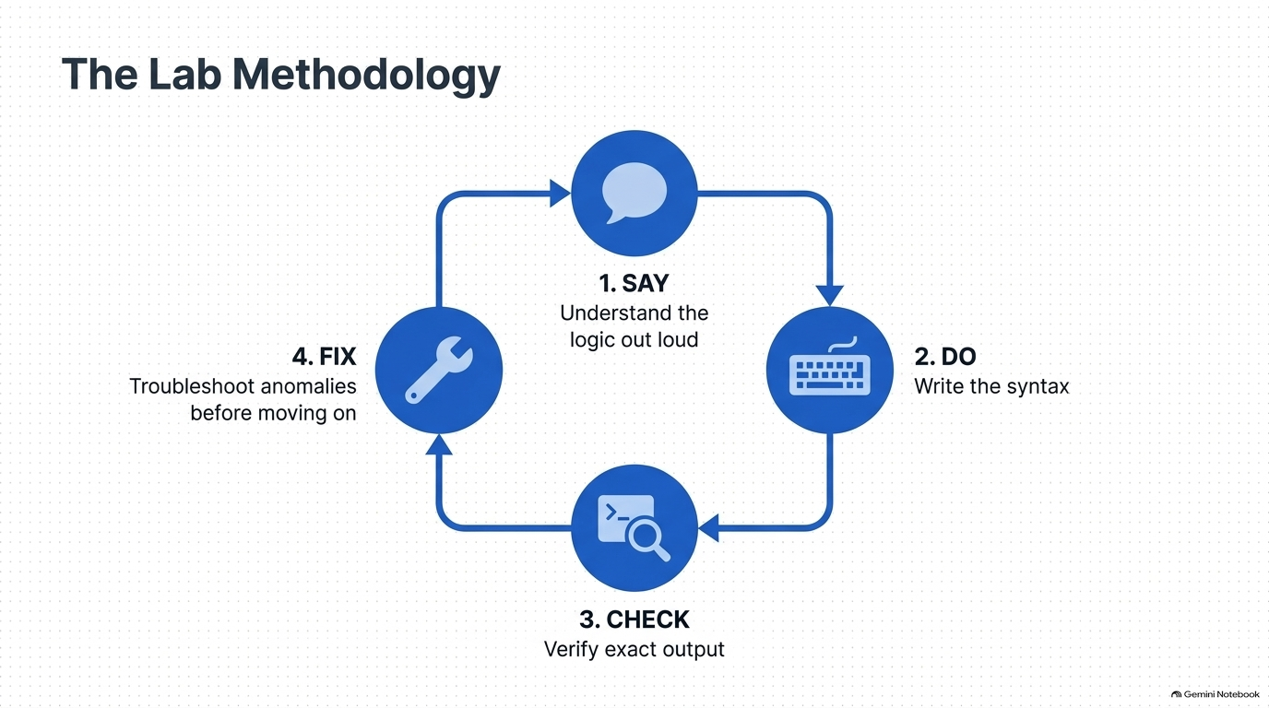
Notes:
SLIDE 3
The lab's operating loop for every exercise, all the way through the lab: SAY it, DO it, CHECK the exact output, FIX it if it doesn't match — then move on.
This is the "How to Use This Script" section made visual.
Say it explicitly before Exercise 1 starts: "Everything gets built inside one file, pricer.py, with comments separating each exercise — that's the exact submission format required."
Emphasize CHECK is not optional — students should be comparing their terminal output character-for-character against the expected block before moving to the next exercise, and FIX means diagnosing the actual error message rather than guessing.

Slide 4
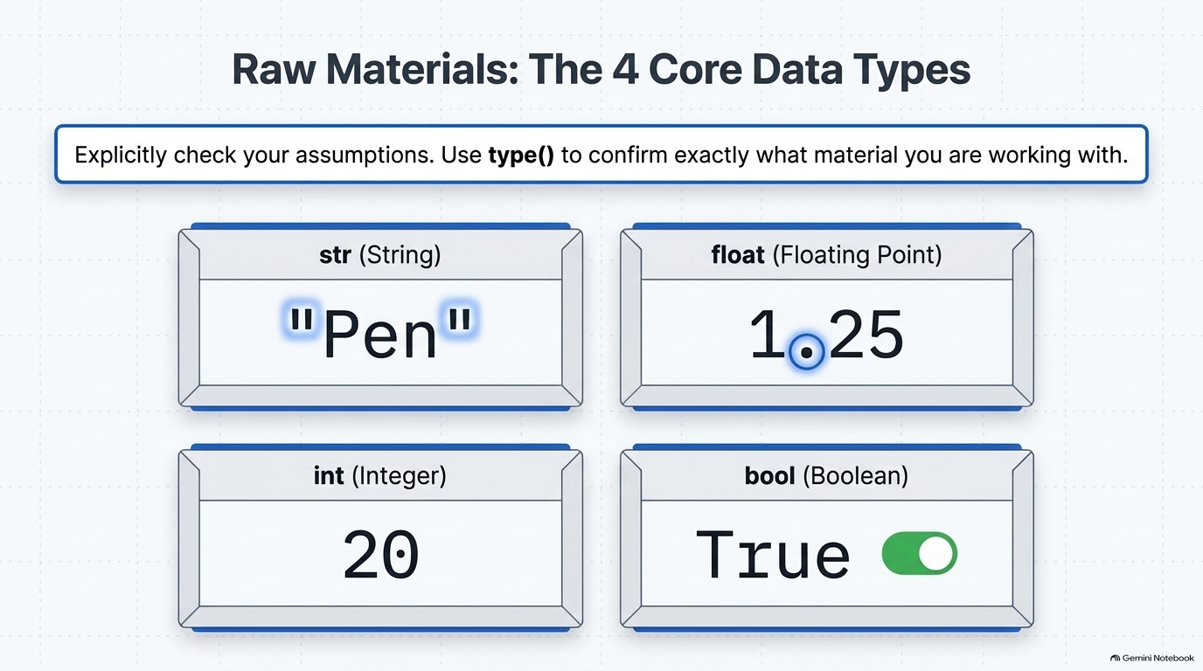
Notes:
SLIDE 4 — EXERCISE 1 — Variables and Types
SAY: "Four variables, four different data types — and we confirm each type explicitly with type(), rather than assuming."
DO: In pricer.py:
# Exercise 1: variables and types
product = "Notebook"
unit_price = 4.99
quantity = 12
in_stock = True
print(type(product))
print(type(unit_price))
print(type(quantity))
print(type(in_stock))
python3 pricer.py
CHECK:
<class 'str'>
<class 'float'>
<class 'int'>
<class 'bool'>
Four distinct types, matching exactly what you'd expect from how each value is written: quotes mean string, a decimal point means float, a whole number means int, True/False means bool.
SLIDE NOTES
Note the slide's product/price example ("Pen", 1.25) is just decorative branding for the four data-type cards — the real Exercise 1 values are Notebook/4.99/12/True. Keep the class names on the live terminal, not this slide, as the CHECK reference.

Slide 5
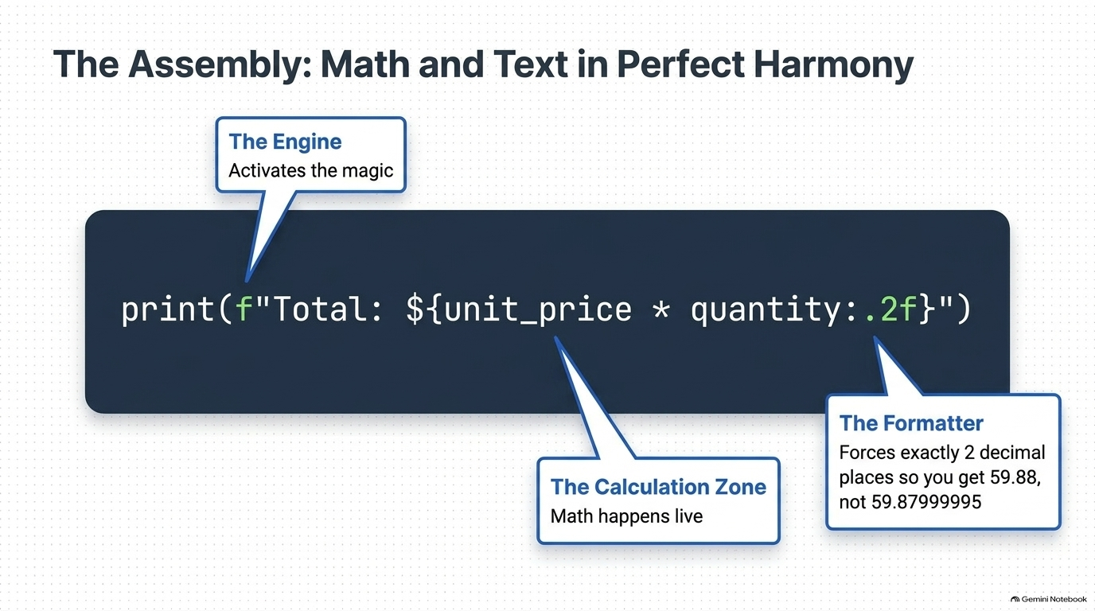
Notes:
SLIDE 5 — EXERCISE 2 — f-string Practice
SAY: "Now format those four variables into one readable sentence, computing the total right inside the f-string."
DO:
# Exercise 2: f-string practice
print(f"{quantity} units of {product} at ${unit_price} each = ${unit_price * quantity:.2f}")
python3 pricer.py
CHECK:
12 units of Notebook at $4.99 each = $59.88
SAY: "Notice {unit_price * quantity:.2f} — the calculation happens directly inside the curly braces, and :.2f forces exactly two decimal places on the result, so 59.88 prints cleanly instead of risking something like 59.879999999999995 from floating-point math."
SLIDE NOTES
This slide's anatomy callouts map directly onto that line: the f-prefix / opening brace is "the engine" that activates interpolation, unit_price * quantity inside the braces is "the calculation zone" — math happens live, right inside the string — and the :.2f suffix is "the formatter," forcing exactly two decimal places so the result prints as 59.88 instead of risking a floating-point artifact like 59.879999999999995. Say that distinction explicitly; it's the core takeaway of this exercise.

Slide 6
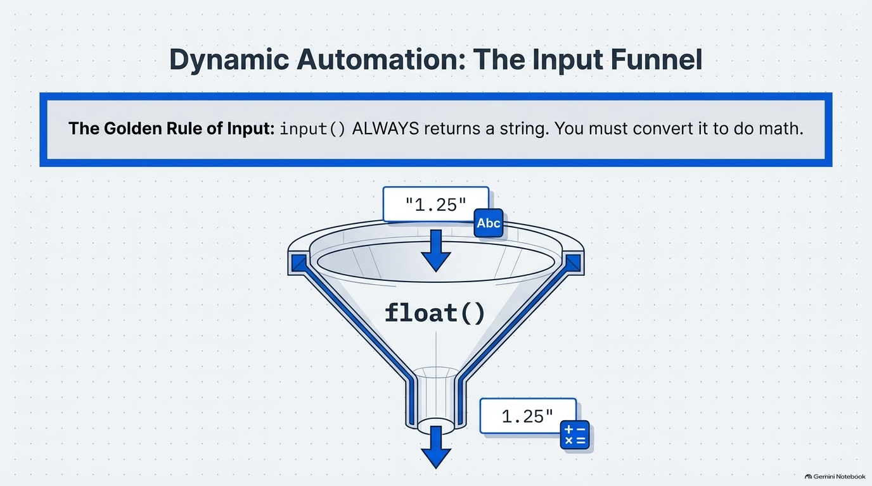
Notes:
SLIDE 6 — EXERCISE 3 — Input Version
SAY: "Same summary line, but now the three values come from the user at runtime instead of being hardcoded."
DO:
# Exercise 3: input version
product_in = input("Product name: ")
price_in = float(input("Unit price: "))
quantity_in = int(input("Quantity: "))
print(f"{quantity_in} units of {product_in} at ${price_in} each = ${price_in * quantity_in:.2f}")
python3 pricer.py
Type Pen, 1.25, and 20 at the three prompts.
CHECK:
Product name: Pen
Unit price: 1.25
Quantity: 20
20 units of Pen at $1.25 each = $25.00
FIX: If you get ValueError: could not convert string to float, you likely typed non-numeric text at the price prompt — input() always returns a string, and float(...) needs that string to actually look like a number.
SLIDE NOTES
This is the slide's "Golden Rule of Input": input() ALWAYS returns a string — visualized here as the raw string "1.25" dropping into a float() funnel and coming out as the number 1.25. Say that rule out loud before running the code, so the float(...) and int(...) wrappers around input() don't look arbitrary.

Slide 7
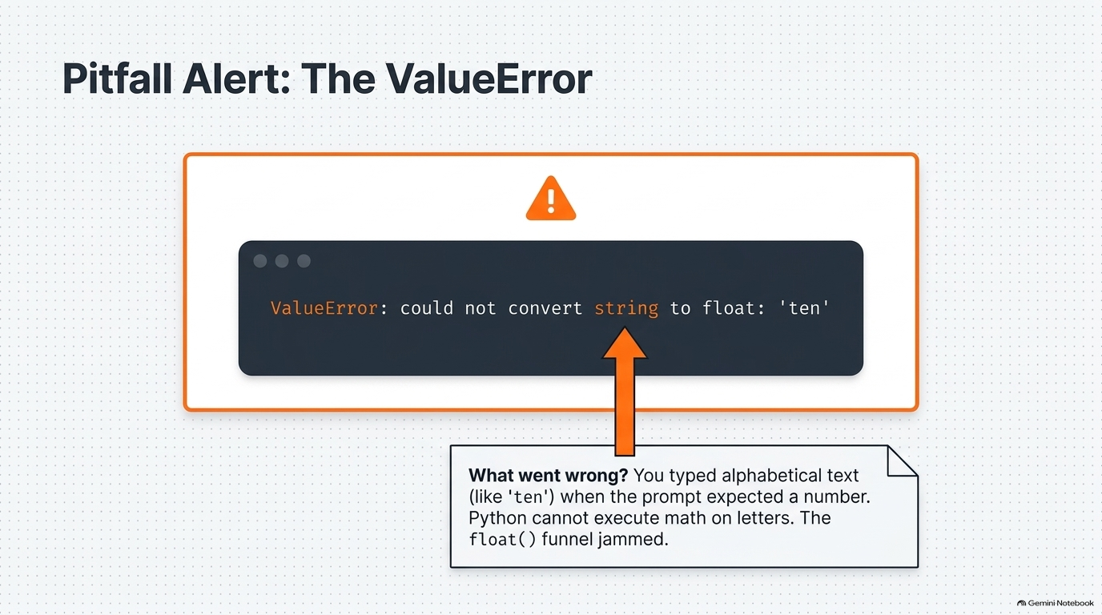
Notes:
SLIDE 7 — EXERCISE 3 — Input Version
FIX: If you get ValueError: could not convert string to float, you likely typed non-numeric text at the price prompt — input() always returns a string, and float(...) needs that string to actually look like a number.
SLIDE NOTES
This is the FIX for Exercise 3, shown as its own slide because it's the first real error students will hit in the lab.
The slide's example error is ValueError: could not convert string to float: 'ten' — walk through why: the student typed the word "ten" instead of the digit 10 at the "Unit price:" prompt, so float() received a string it cannot parse as a number and the float() conversion ("funnel" from the previous slide) jams. Have students deliberately reproduce this error once so the message is familiar, then re-run with a numeric value to confirm the fix.

Slide 8
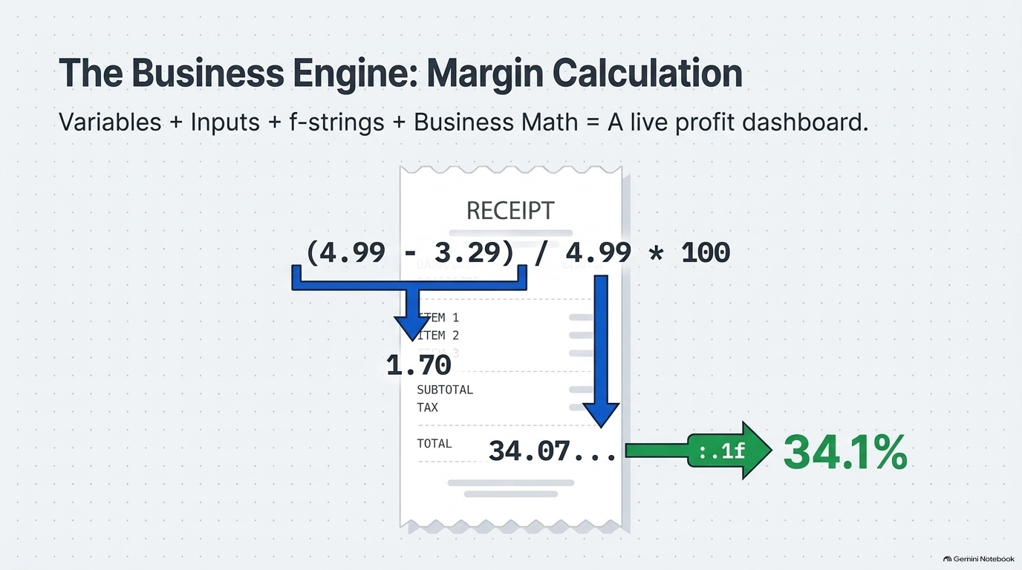
Notes:
SLIDE 8 — EXERCISE 4 — Multi-Variable Product Card
SAY: "Now a five-line formatted report, including a business calculation you haven't done yet this semester: margin — the percentage of revenue that's profit."
DO:
# Exercise 4: multi-variable product card
unit_cost = 3.29
revenue = unit_price * quantity
margin = (unit_price - unit_cost) / unit_price * 100
print(f"Product: {product}")
print(f"Price: ${unit_price:.2f}")
print(f"Qty: {quantity}")
print(f"Revenue: ${revenue:.2f}")
print(f"Margin: {margin:.1f}%")
python3 pricer.py
CHECK:
Product: Notebook
Price: $4.99
Qty: 12
Revenue: $59.88
Margin: 34.1%
SAY: "Trace the margin formula out loud before trusting the output: (4.99 - 3.29) / 4.99 * 100 — that's 1.70 / 4.99, roughly 0.3407, times 100 is 34.07, and :.1f rounds that to one decimal place: 34.1."
SLIDE NOTES
This slide is the exact margin trace students should say out loud before trusting the output — it's on the receipt graphic: (4.99 - 3.29) / 4.99 * 100. That's 1.70 / 4.99, roughly 0.3407, times 100 is 34.07, and the :.1f format spec rounds that to one decimal place: 34.1. Make every student narrate this arithmetic once; it's the first real business formula of the course and the anchor for Reflection-adjacent understanding.

Slide 9
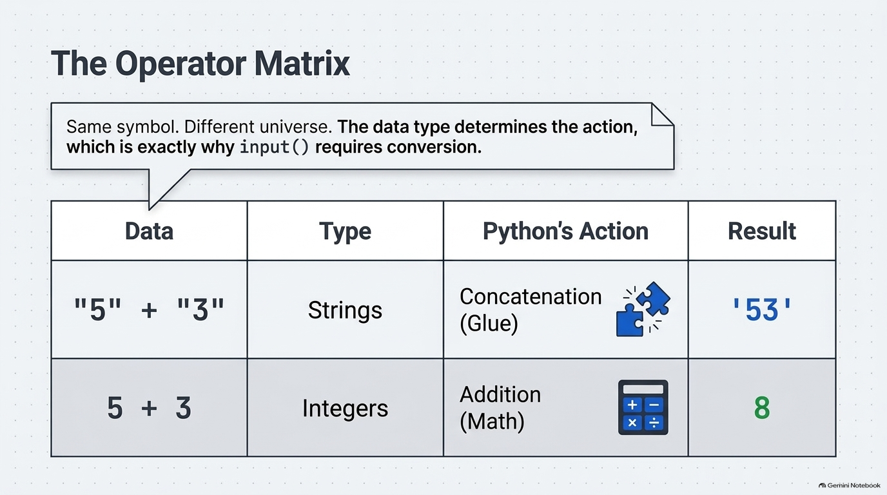
Notes:
SLIDE 9
Exercise 5 — Type Investigation, core observation (part of 6:10–7:50).
This is the payoff table for the interactive-interpreter session: same + symbol, two completely different behaviors depending on operand type.
SAY, once the interpreter has printed both results: "Write down exactly what you're seeing: \"5\" + \"3\" produces '53' — that's concatenation, gluing two strings end to end, because both sides are strings. 5 + 3 produces 8 — plain addition, because both sides are integers. Same + symbol, completely different behavior, entirely determined by the types on either side."
Tie this explicitly back to Exercise 3: input() always returns a str, so if you skip the float()/int() wrapper, you get silent string concatenation instead of a math error in some cases (or a crash in others) — this table is the reason those wrappers exist.

Slide 10
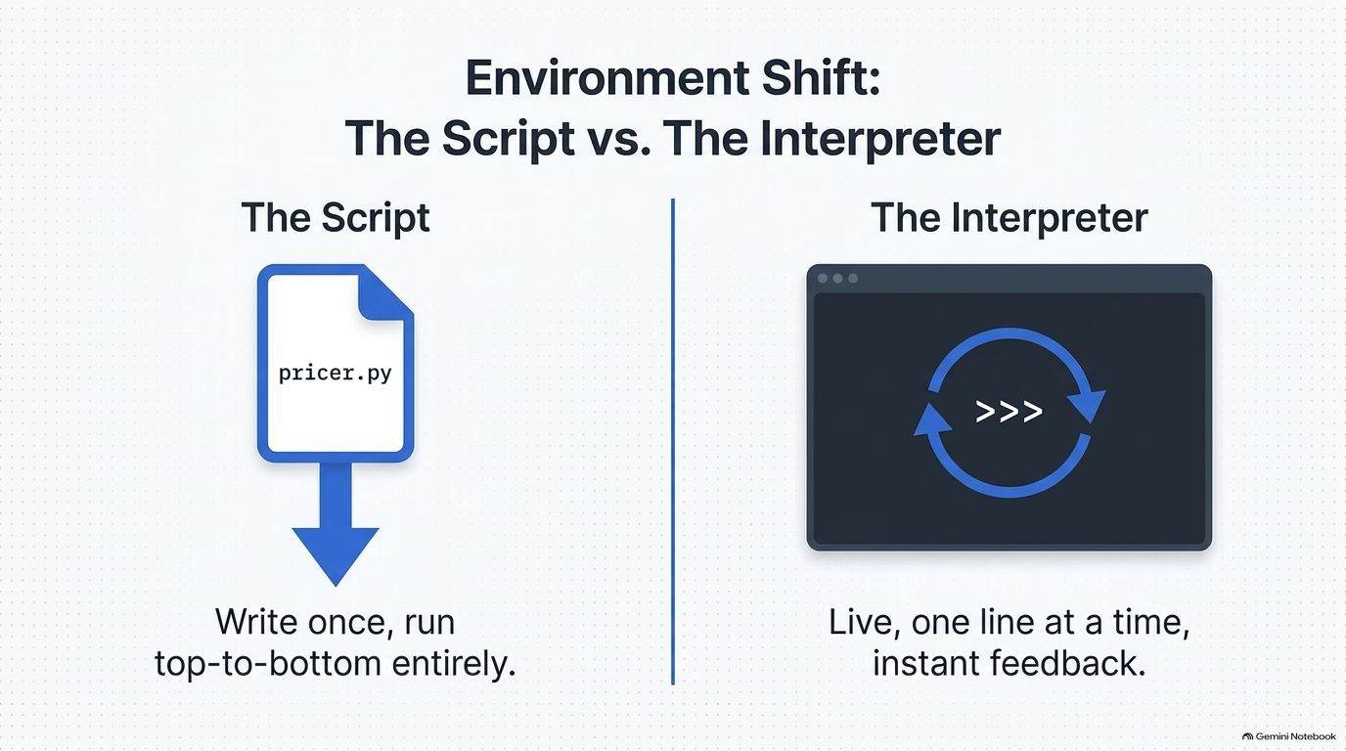
Notes:
SLIDE 10 — EXERCISE 5 — Type Investigation
SAY: "Now a completely different environment — the Python interactive interpreter, where you type one line at a time and see the result immediately, with no file at all."
DO:
python3
>>> type("12")
>>> type(12)
>>> type(12.0)
>>> type(True)
>>> "5" + "3"
>>> 5 + 3
>>> exit()
CHECK:
>>> type("12")
<class 'str'>
>>> type(12)
<class 'int'>
>>> type(12.0)
<class 'float'>
>>> type(True)
<class 'bool'>
>>> "5" + "3"
'53'
>>> 5 + 3
8
SAY: "Write down exactly what you're seeing: \"5\" + \"3\" produces '53' — that's concatenation, gluing two strings end to end, because both sides are strings. 5 + 3 produces 8 — plain addition, because both sides are integers. Same + symbol, completely different behavior, entirely determined by the types on either side."
SLIDE NOTES
This slide's script-vs-interpreter contrast ("write once, run top-to-bottom entirely" vs. "live, one line at a time, instant feedback") is exactly the framing to give before students open python3 — make sure they understand they are leaving pricer.py entirely for this exercise, with no file involved, and that the type()/string-concatenation results from this REPL session feed directly into the written observations required in the CHECK on the following table slide.

Slide 11
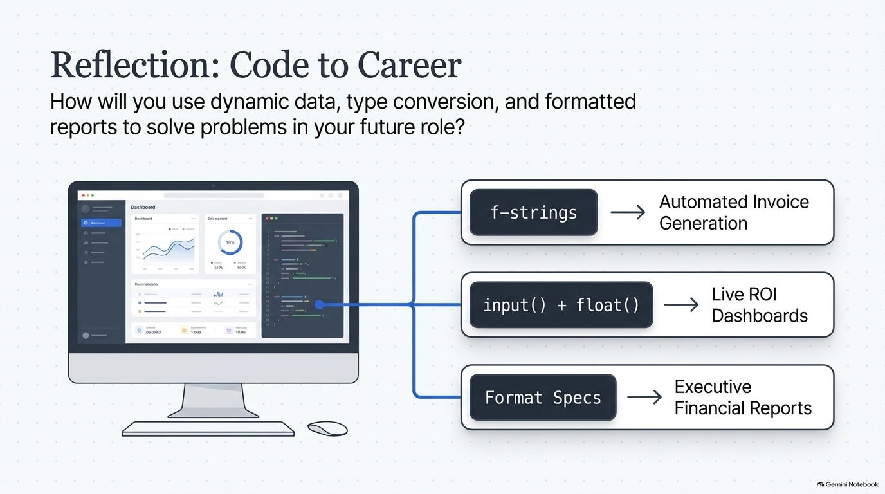
Notes:
SLIDE 11 — REFLECTION QUESTIONS
DO: Answer honestly:
1. What happened when you ran Exercise 3 and forgot to convert the price from string to float? Describe the exact error message and explain why it occurred in your own words.
2. In Exercise 5, "5" + "3" returned "53" instead of 8. Why does Python do this, and how does it explain why input() must always be converted before doing math?
3. How would you use variables, types, and f-strings to build a real tool for a task in your future career? Describe a specific scenario in 2–3 sentences.
CHECK: Question 2's answer should connect directly back to Exercise 5's observation: input() always returns a str, and + on two strings concatenates rather than adds — exactly the behavior you just saw, which is why Exercise 3 required float(...) and int(...) wrappers around every input() call.
SLIDE NOTES
This slide's three career-application examples — f-strings -> automated invoice generation, input()+float() -> live ROI dashboards, format specs -> executive financial reports — are illustrative prompts for Question 3, not required answers; students should write their own specific 2–3 sentence scenario rather than copy one of these verbatim.

Slide 12
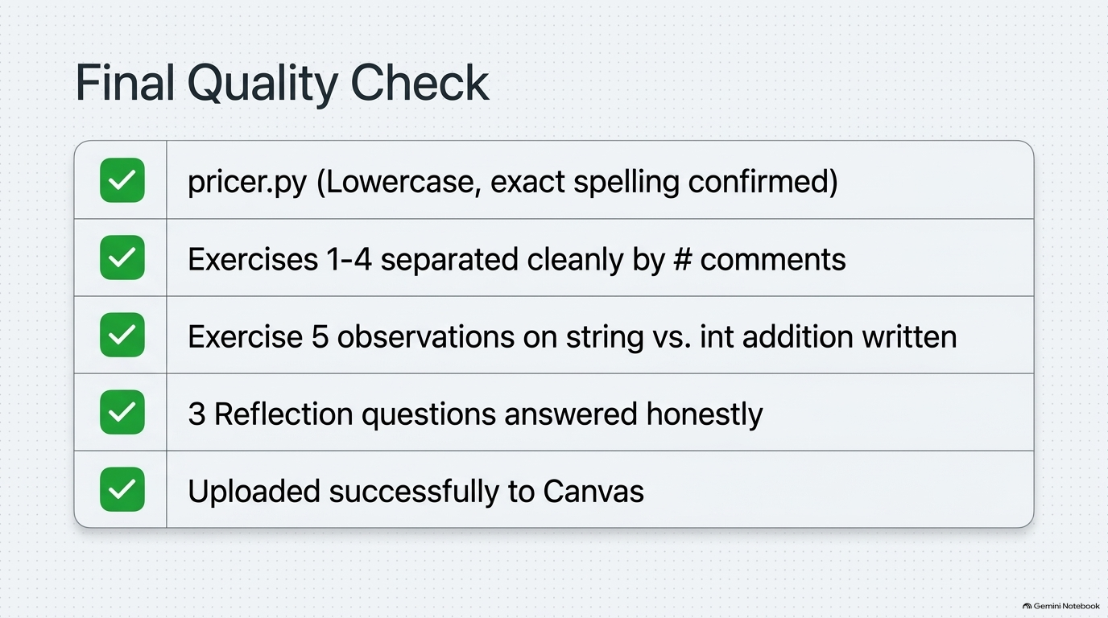
Notes:
SLIDE 12 — SUBMISSION CHECKLIST
• [ ] pricer.py — filename matches exactly, lowercase
• [ ] Exercises 1–4 present as one runnable script, with # comments separating each exercise
• [ ] Exercise 5's written observations about "5" + "3" vs 5 + 3
• [ ] Three reflection questions answered honestly
• [ ] Submitted to Canvas
SLIDE NOTES
Walk every item on screen before uploading to Canvas:
Close the lab by re-stating the one file, one script rule: everything above lives inside pricer.py — there is no separate reflection file or interpreter transcript to submit; the Exercise 5 observations and the three reflection answers both belong as comments (or a clearly separated section) inside pricer.py itself, per the # comment convention used for Exercises 1–4.

