Slide 1
DNS/DSP presentation
(a sequential version)
-All the variables are dimensionless
A tangent hyperbolic law is applied in the wall normal direction
Periodic conditions are applied in the streamwise and spanwise directions

Slide 2
History of the DNS Code
1997: Fluid solver from Paolo Orlandi (a sequential version)
Preliminary steps
Preliminary studies for the heat transfer
DNS/DPS code with heat transfer and two-way coupling
I- Development of fluid energy equation solver and introduction of the heat transfer between phases.
Development of lagrangian particle tracking : start of the studies on particle dispersion and deposition (drag, lift and electrostatistics forces are taken into account)
Towards a heated turbulent channel flow from a (bibliography analysis)
(B. Arcen, Phd Student )
II- The two coupling effect
(R.Vernet, Master, 2005)
(P. Rambaud, Phd Student)
[R. Reigner, A. Collin,
B. Arcen (Master)]
1997
2001
2003
2006
2012: Towards a parallelized version ?

Slide 3
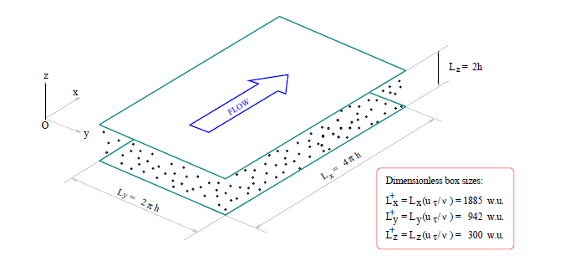
Lagrangian particle tracking in a turbulent flow: theory

Slide 4
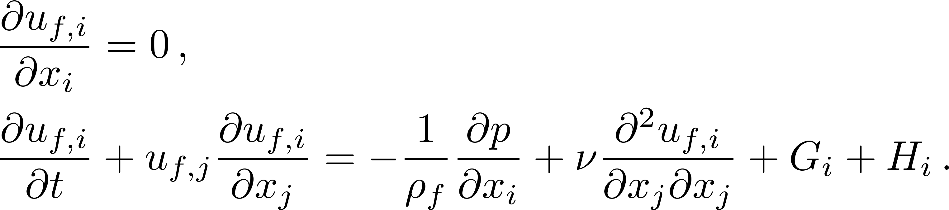
Governing equations and numerical methods
For the carrier phase
+ Boundary conditions [no-slip, non penetrating and periodicity conditions]
G_{i} is the forcing term needed to keep a constant flow rate
H_{i} is the momentum coupling term (feedback from the particles)
  Numerical methods :
    Fractional step method (Verzicco & Orlandi, 1996)
    Second order finite difference schemes,
    Crank-Nicolson / third order Runge-Kutta.
::<number>::

Slide 5
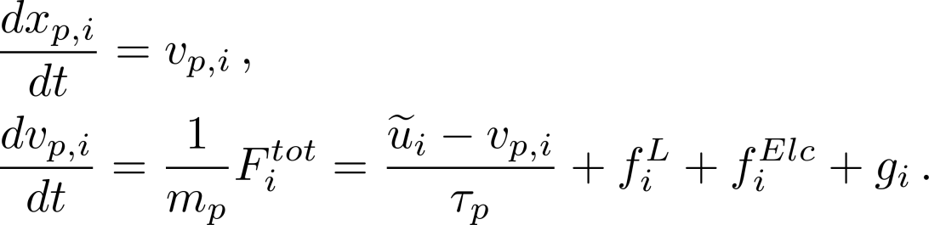
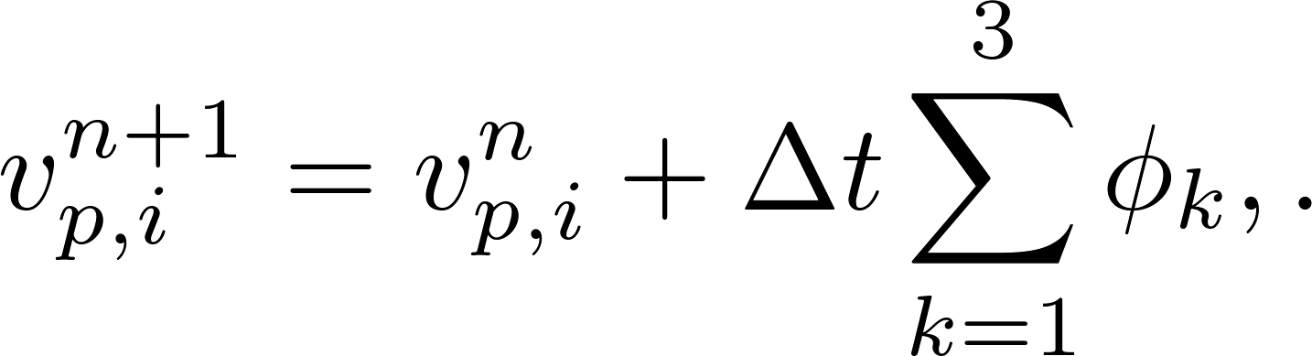
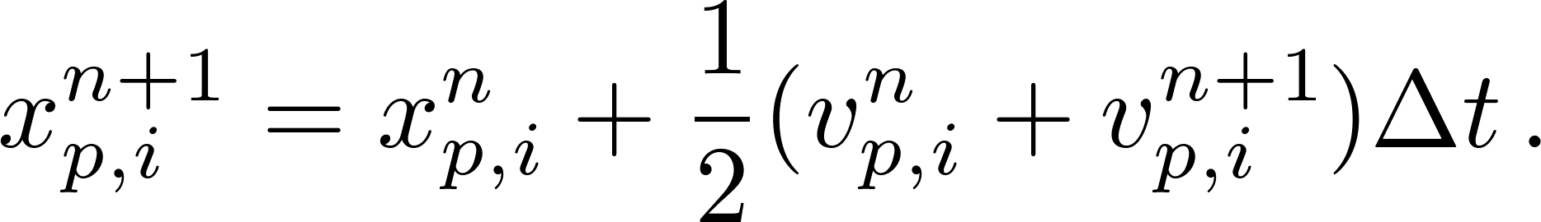
For the dispersed phase
+ Boundary conditions (particle/wall collision and periodicity conditions)
where f^{L} is the lift force and f^{Elc} is the electrostatic force .Note that the forces are corrected to take the presence of the wall into account !
  Numerical methods :
    Third order Runge-Kutta for the velocity,
    Trapezoidal method for the position (for each RK sub-steps)
::<number>::

Slide 6
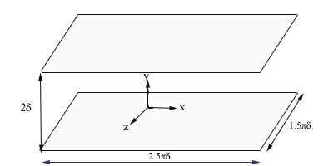
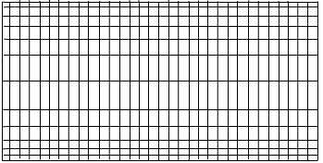
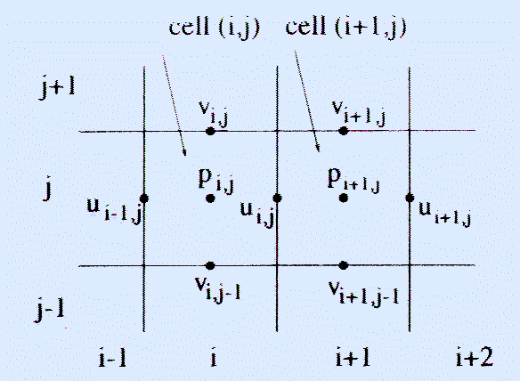
Flow characteristics
•
•
Computational Domain:
•
Mesh:
–
Tangent hyperbolic law in (oy)
–
Periodic conditions
in Ox et Oz
directions

Slide 7
Hermit interpolation
64 equations
64 unknows

Slide 8
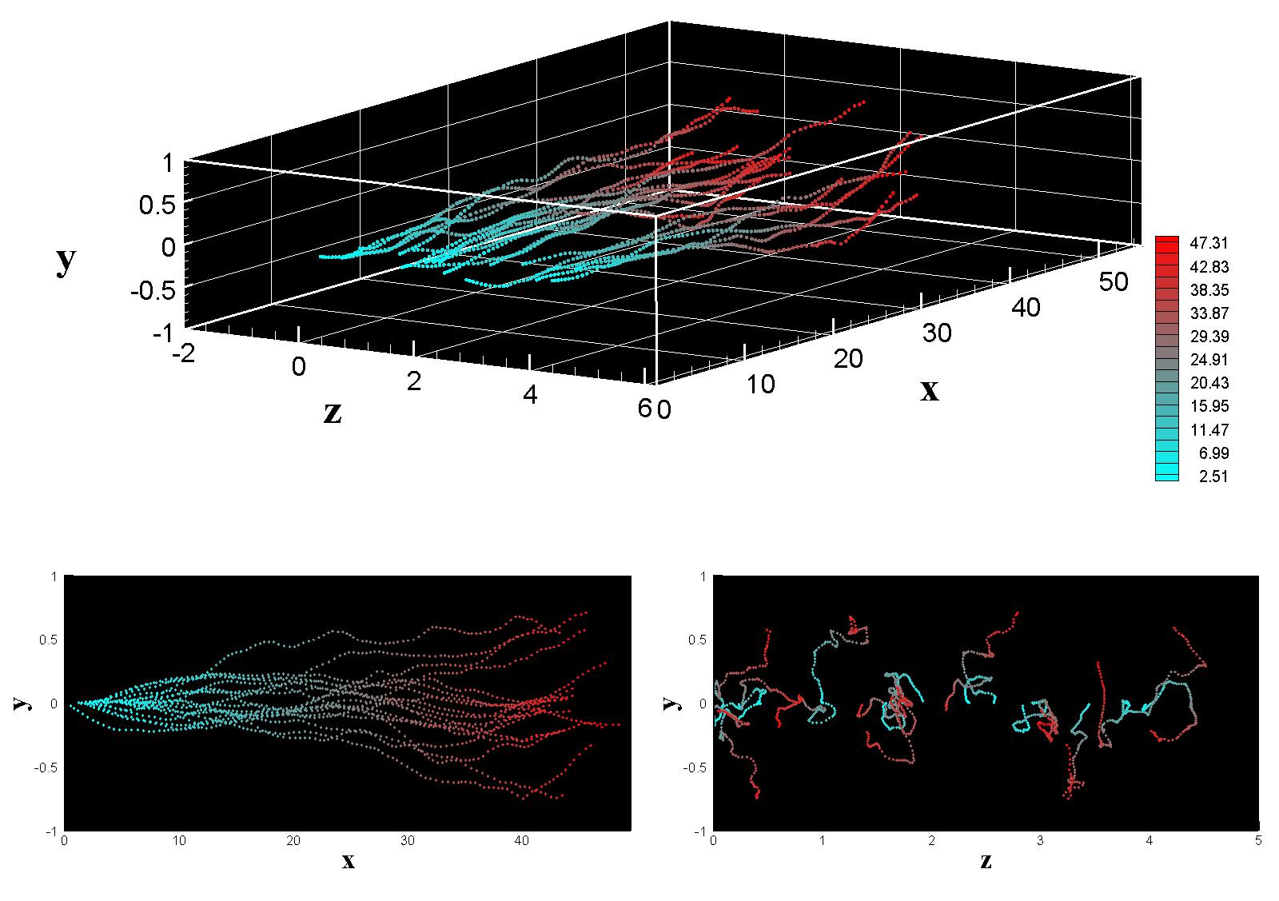
What can do the present code (see INPUT5)
Solid particles:
  - Track particles in a turbulent flow under one-coupling assumption
  Heated particle laden channel flow (imposed temperature at each wall) can be computed
  ♦Solve the fluid energy equation
  ♦Simulate the heat transfer between the fluid and dispersed phases (one-way coupling)
  - Can simulate two-way momentum coupling (not fully validated)
Fluid particles:
♦Track fluid particles in a turbulent flow

Slide 9
What can do the present code ( Cont’d…)
Post processing (statistics computation)
  For the fluid
    One point statistics:
      - Mean, variance, skewness and flatness for the velocity and the pressure
      - Mean, variance of the temperature
      - Turbulent heat fluxes
    Two time statistics:
    - time decorrelation of the fluid velocity and temperature
      ♦ eulerian point of view (at fixed point)
      ♦ lagrangian point of view (following fluid particles) time scales
      Development of post processing programs
    ♦ Computation of the budget elements of the Reynolds transport equation
    Calculation of the spatial correlation
    ♦ Coherent structures (criteria Q, λ2, ) and swirling strength

Slide 10
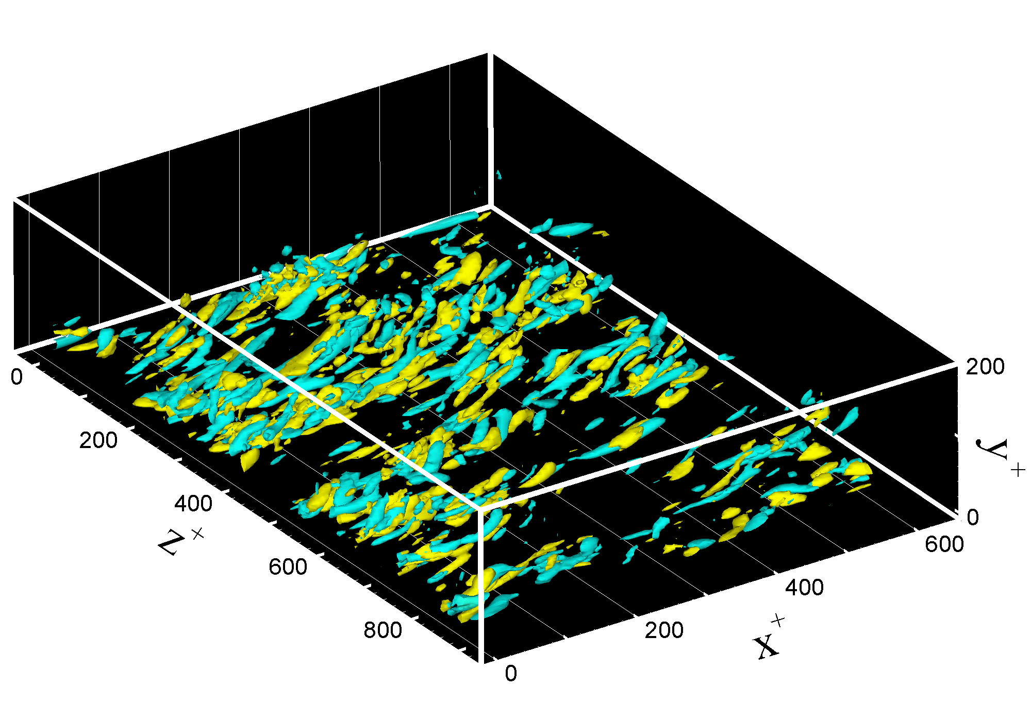
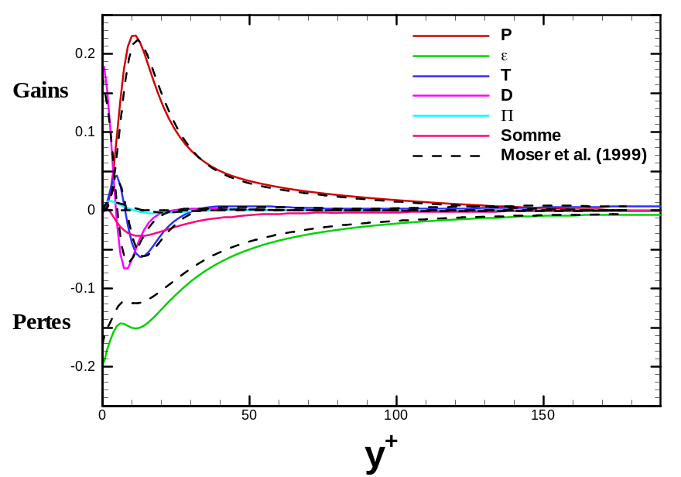
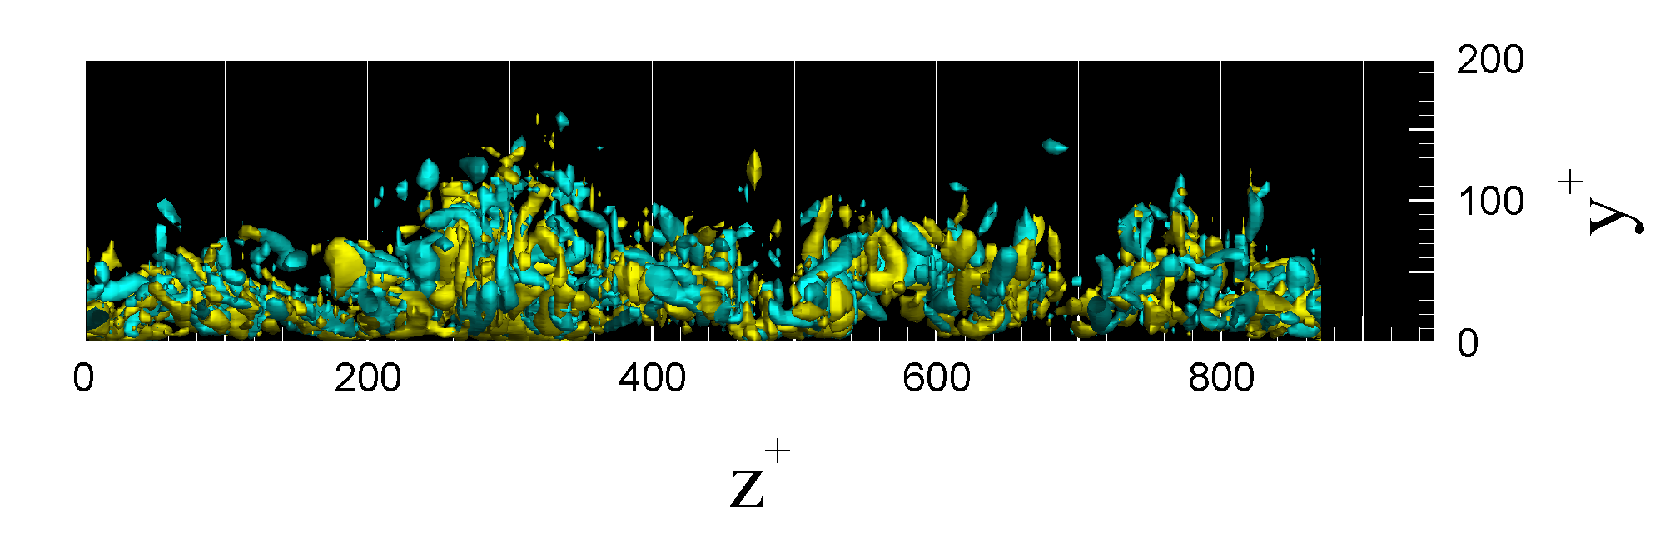
What can do the present code ( Cont’d…)
Post processing (statistics computation)
T.K.E. Balance
Q criteria

Slide 11
What can do the present code ( Cont’d…)
Post processing (statistics computation)
For the solid particles:
  ♦concentration, mean and variance for the velocity and temperature.
  ♦Triple velocity correlations.
Fluid-particle statistics :
Velocity ant temperature covariances
Mean and variance of the relative velocity
For the fluid at solid particle location (‘fluid seen”)
  One point statistics:
    - mean, variance for the velocity and the temperature of the fluid seen
    Two time statistics:
        - time decorrelation of the fluid velocity and temperature seen by particles.
::<number>::

Slide 12
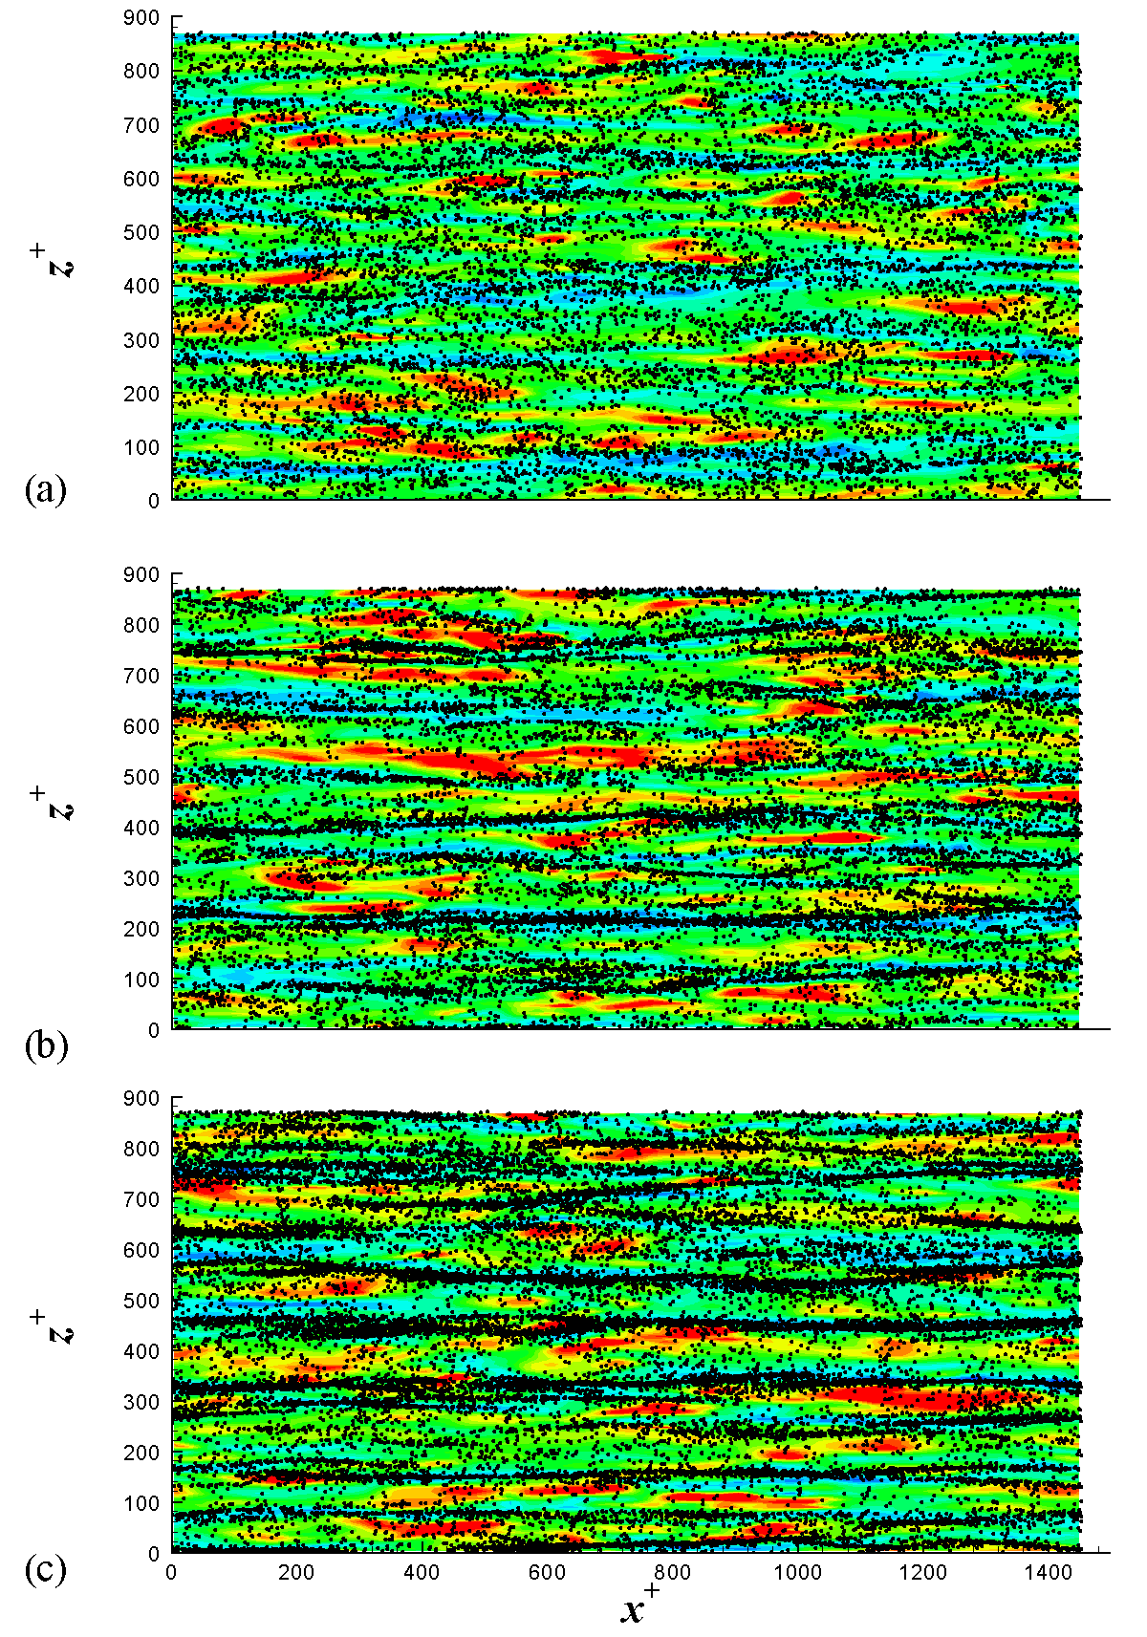
For the fluid at solid particle location
(‘fluid seen”)
Instantaneous particle distribution
in (x,z)-slice (1< y+ < 4.2 ) for three
particle inertia

Slide 13
What are the next steps ?
Physical objectives
  Introduce particle/particle interaction (collision and agglomeration)
  Validate the two way momentum coupling and introduce the Thermal two-way coupling
  Increase the Reynolds numbers
Numerical objectives
  Parallelization of the DNS/DSP code in order to compute the higher Reynolds number channel flow

Slide 14
Lagrangian tracking : algorithm

Slide 15
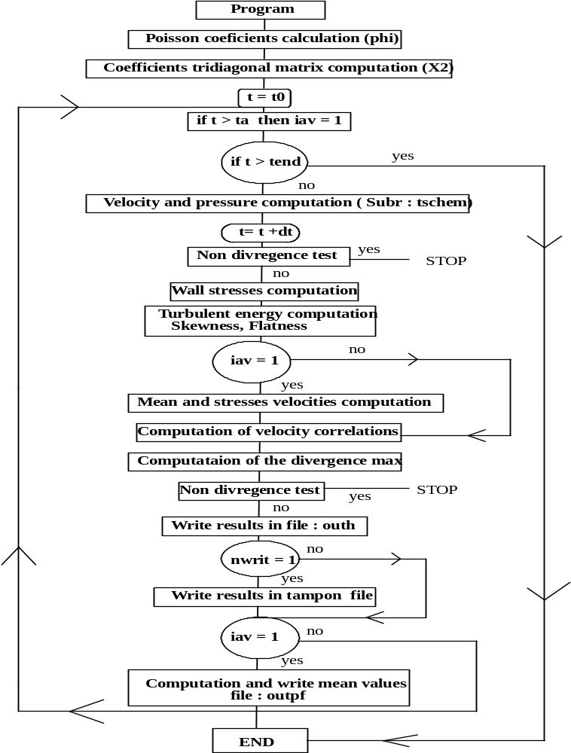
Particle_package
(located in partmain.f and called by sub time_scheme)
if t= t0_part then
- Particle Initialisation
If t ≥ t0_part then
- Solve particle equation of motion
- Compute particles statistics

Slide 16
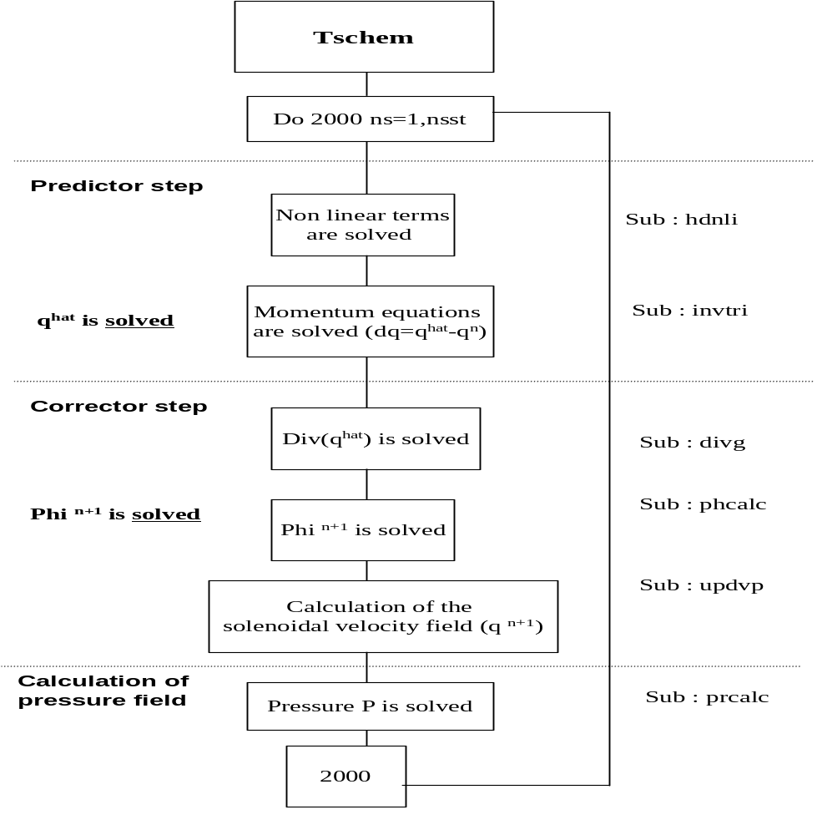
Solve particle Equation of Motion ( in sub Time_scheme)
Particle equation of motion is solved for each Runge-Kutta sub-steps (nsst = 1,3)
Call to particle-package

Slide 17
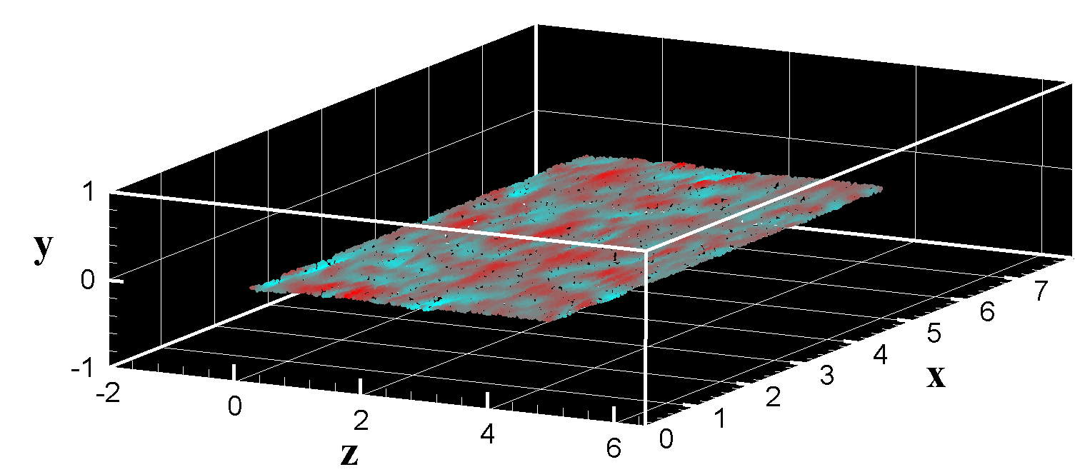
Particle initialisation
Subroutine particle_initialisation in partini.f
Initialize the particle location in the channel
  There are six different ways to do it (e.g. in a slab parallel to the wall)
Initialize the particle velocity
  Initial particle velocity = velocity of fluid interpolated at the particle location (Hermite Interpolation)

Slide 18
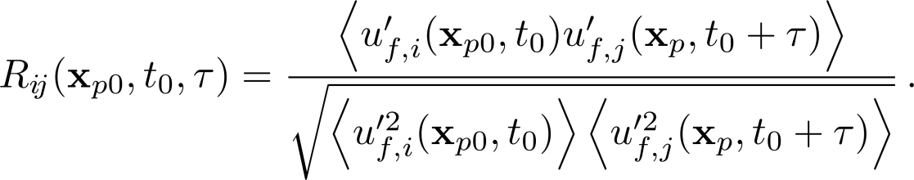
Time-integration of the particle equation of motion and statistics
Subroutine particle_package in partmain.f
Interpolation of the fluid velocity at particle location (Hermite)
Compute the forces acting on the particles
Update the particle velocity
Update particle position knowing the new velocity
Apply boundary conditions for the particle (wall collision and periodicity)
In particle-Package, there are also:
Call to a lagrange_velo_stat to compute the one point particle statistics (mean, variance of the particle velocity, fluid-particle covariance, etc.),
Call to dispersion_routine to compute two-time statistics (time decorrelation of the fluid seen by particles)

Slide 19
Particle package algorithm
Solve the NS equations
t ≥ t0_part
yes
t = t0_part
yes
Particle initialization(partini.f)
Fluid velocity interpolation at particle location (partinter.f)
Force computation (partdrag.f & partlift.f)
Update particle velocity
(partlagrange.f)
Update particle position
(partlagrange.f)
Apply boundary conditions if necessary
Compute particle statistics

Slide 20
Difficulties experienced by Jean-Baptiste
Coupling Thetis and the lagrangian tracking
  Link between the time-integrator used for the NS equations and the time-integrator used for the particle equation of motion
Interpolation of the fluid velocity at particle location (Hermite)
  The formula is quite cumbersome
Computation of the two-time statistics (it was an important issue)
  Statistics are computed over particle which were initially in the same wall-parallel slab

