Slide 1
Discovering Knowledge in Data Daniel T. Larose, Ph.D.
Chapter 10 Hierarchical and k-Means Clustering
Prepared by James Steck and Eric Flores

Slide 2
Clustering Task
Clustering refers to grouping records, observations, or tasks into classes of similar objects
Cluster is collection records similar to one another
Records in one cluster dissimilar to records in other clusters
Clustering is unsupervised data mining task
Therefore, no target variable specified
Clustering algorithms segment records and maximize homogeneity in subgroups
Similarity to records outside cluster minimized

Slide 3
Clustering Task (cont’d)
For example, Nielsen PRIZM, developed by Claritas, Inc. provides demographic profiles of geographic areas, according to zip code
PRIZM segmentation system clusters zip codes in terms of lifestyle types
Example: Clusters identified for 90210 Beverly Hills, CA
Cluster 01: Upper Crust Estates
“The nation’s most exclusive address, Upper Crust is the wealthiest lifestyle in America, a Haven for empty-nesting couples between the ages of 45 and 64. No segment has a higher concentration of residents earning over $100,000 a year and possessing a postgraduate degree. And none has a more opulent standard of living.”
Cluster 03: Movers and Shakers
Cluster 04: Young Digerati
Cluster 07: Money and Brains
Cluster 16: Bohemian Mix

Slide 4
Clustering Task (cont’d)
Clustering Tasks in Business and Research
Target marketing for niche product, without large marketing budget
Accounting auditing: Segment behavior into benign and suspicious categories
As a dimension-reduction tool when data set has hundreds of attributes
Gene expression clustering, where genes exhibit similar characteristics
Clustering often performed as preliminary step in data mining process
Clustering results used as input to other data mining techniques

Slide 5
Clustering Task (cont’d)
Applying cluster analysis to enormous databases helpful
Reduces search space for downstream algorithms
Cluster analysis addresses similar issues encountered in classification
Similarity measurement
Recoding categorical variables
Standardizing and normalizing variables
Number of clusters

Slide 6
Clustering Task (cont’d)
Measuring Similarity
Euclidean Distance measures distance between records
where
represent the m attribute value of two records
Other distance measurements include City-Block Distance and Minkowski Distance

Slide 7
Clustering Task (cont’d)
“Different From” function measures similarity between categorical attributes
Substitute different(x,y) for each categorical attribute in Euclidean Distance function
Normalizing data enhances performance of clustering algorithms
Use Min-max Normalization or Z-Score Standardization

Slide 8
Clustering Task (cont’d)
Clustering identifies groups of highly-similar records
Algorithms construct clusters where between-cluster variation (BCV) large, as compared to within-cluster variation (WCV)
Analogous to concept behind analysis of variance
Between-cluster variation:
Within-cluster variation:
Figure 10.1

Slide 9
Hierarchical Clustering Methods
Clustering algorithms either Hierarchical or Non-Hierarchical
Hierarchical
Treelike cluster structure (dendogram) created through recursive partitioning (Divisive Methods) or combining (Agglomerative Methods) existing clusters
Divisive Methods
All records initialized into single cluster
At each iteration, most dissimilar record split off into separate cluster
Continues until each record represents single cluster

Slide 10
Hierarchical Clustering Methods (cont’d)
Agglomerative Methods
Each observation initialized to become own cluster
At each iteration two closest clusters aggregated together
Number of clusters reduced by one, each step
Eventually, all records combined into single cluster
Agglomerative more popular hierarchical method
Therefore, focus remains on this approach
Measuring distance between records straightforward once recoding and normalization applied
However, how is distance between clusters determined?

Slide 11
Hierarchical Clustering Methods (cont’d)
Distance Between Clusters
Several criteria examined to determine distance between clusters, A and B
Single Linkage
Known as Nearest-Neighbor Approach
Minimum distance between any record in cluster A, and any record in cluster B
Cluster similarity based on most similar records from each cluster
Tends to form long, slender clusters
Sometime heterogeneous records clustered together

Slide 12
Hierarchical Clustering Methods (cont’d)
Complete Linkage
Known as Farthest-Neighbor Approach
Maximum distance between any record in cluster A, and any record in cluster B
Cluster similarity based on most dissimilar records from each cluster
Compact, sphere-like clusters formed
All records in cluster within given diameter of other records
Average Linkage
Designed to reduce dependence of cluster-linkage to extreme values, such as most similar or dissimilar

Slide 13
Hierarchical Clustering Methods (cont’d)
Measure is average distance of records in cluster A, from records in cluster B
Resulting clusters have approximately equal within-cluster variability
Next, linkage methods examined using small data set
2 5 9 15 16 18 25 33 33 45

Slide 14
Single-Linkage Clustering
To begin, each record assigned to own cluster
Single-linkage seeks minimum distance between any two records, in separate clusters
Step 1: Minimum cluster distance is between clusters {33} and {33}. Distance = 0, clusters combined
Step 2: Clusters {15} and {16} combined, where distance = 1
Step 3: Cluster {15, 16} combined with cluster {18}
Step 4: Clusters {2} and {5} combined
2 | 5 | 9 | 15 | 16 | 18 | 25 | 33 | 33 | 45
2, 5
15, 16
33, 33
15, 16, 18

Slide 15
Single-Linkage Clustering (cont’d)
2 | 5 | 9 | 15 | 16 | 18 | 25 | 33 | 33 | 45
Agglomeration continues similarly Steps 4 – 9
Above, last cluster {2, 5, 9, 15, 16, 18, 25, 33, 33, 45} contains all records in data set
2, 5
15, 16
33, 33
2, 5, 9
15, 16, 18
2, 5, 9, 15, 16, 18
2, 5, 9, 15, 16, 18, 25
2, 5, 9, 15, 16, 18, 25, 33, 33
2, 5, 9, 15, 16, 18, 25, 33, 33, 45

Slide 16
Complete-Linkage Clustering
Complete-linkage explored using sample data
2 5 9 15 16 18 25 33 33 45
Distance among records in two clusters farthest from each other minimized
Step 1: Each cluster contains single record
No difference between single and Complete-linkage
Clusters {33} and {33} combined
Step 2: Clusters {15} and {16} combined
No difference between single and Complete-linkage

Slide 17
Complete-Linkage Clustering (cont’d)
Step 3: Complete-linkage diverges from Single-linkage
Farthest neighbors between {15, 16} and {18} are 15 and 18, distance = 3
Clusters {2} and {5} also have distance = 3
Algorithm silent regarding ties
Result, {2, 5} arbitrarily chosen
Complete-linkage procedure continues for Steps 4 – 9, until all records contained in same cluster

Slide 18
Complete-Linkage Clustering (cont’d)
Figure illustrates Complete-linkage agglomerative clustering on sample data
2 | 5 | 9 | 15 | 16 | 18 | 25 | 33 | 33 | 45
2, 5
15, 16
33, 33
2, 5, 9
15, 16, 18
25, 33, 33
2, 5, 9, 15, 16, 18
25, 33, 33, 45
2, 5, 9, 15, 16, 18, 25, 33, 33, 45

Slide 19
k-Means Clustering
k-Means effective at finding clusters in data
k-Means Algorithm
Step 1: Analyst specifies k = number of clusters to partition data
Step 2: k records randomly assigned to initial clusters
Step 3: For each record, find cluster center
Each cluster center “owns” subset of records
Results in k clusters, C1, C2, ...., Ck
Step 4: For each of k clusters, find cluster centroid
Update cluster center location to centroid
Step 5: Repeats Steps 3 – 5 until convergence or termination

Slide 20
k-Means Clustering (cont’d)
Nearest criterion in Step 3 typically Euclidean Distance
Determining Cluster Centroid
Assume n data points (a₁, b₁, c₁), (a₂, b₂, c₂), ..., (a_{n}, b_{n}, c_{n})
Centroid of points is center of gravity of points
Located at point (Σ a_{i}/n, Σ b_{i}/n, Σ c_{i}/n)
For example, points (1, 1, 1), (1, 2, 1), (1, 3, 1), and (2, 1, 1) have centroid

Slide 21
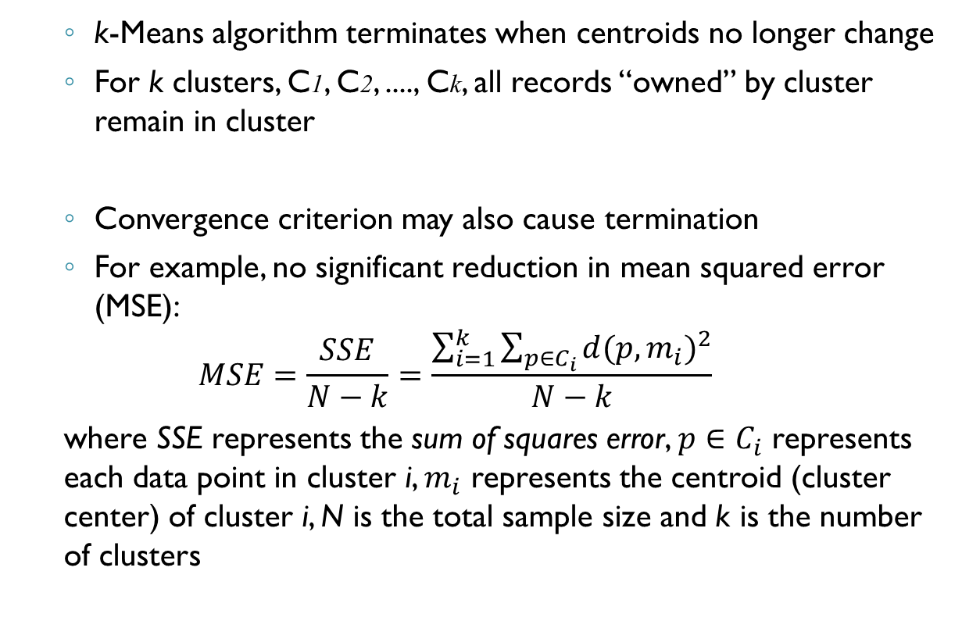
k-Means Clustering (cont’d)
k-Means algorithm terminates when centroids no longer change
For k clusters, C1, C2, ...., Ck, all records “owned” by cluster remain in cluster
Convergence criterion may also cause termination
For example, no significant reduction in mean squared error (MSE):
$$MSE=\frac{SSE}{N−k}=\frac{\sum_{i=1}^{k}{\sum_{p∈C_{i}}{{d(p,m_{i})}^{2}}}}{N−k}$$
where SSE represents the sum of squares error, $p∈C_{i}$ represents each data point in cluster i, $m_{i}$ represents the centroid (cluster center) of cluster i, N is the total sample size and k is the number of clusters

Slide 22
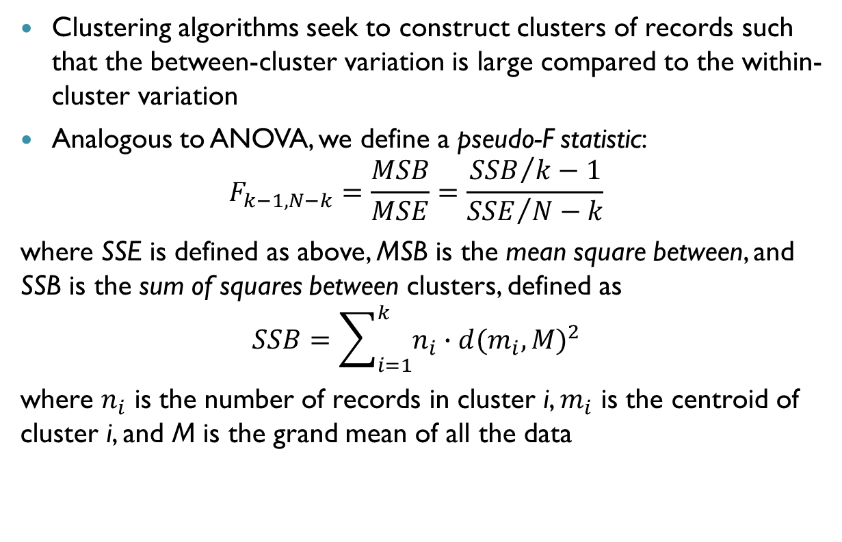
k-Means Clustering (cont’d)
Clustering algorithms seek to construct clusters of records such that the between-cluster variation is large compared to the within-cluster variation
Analogous to ANOVA, we define a pseudo-F statistic:
$$F_{k−1,N−k}=\frac{MSB}{MSE}=\frac{{SSB}/k−1}{{SSE}/N−k}$$
where SSE is defined as above, MSB is the mean square between, and SSB is the sum of squares between clusters, defined as
$$SSB=\sum_{i=1}^{k}{n_{i}∙{d(m_{i},M)}^{2}}$$
where $n_{i}$ is the number of records in cluster i, $m_{i}$ is the centroid of cluster i, and M is the grand mean of all the data

Slide 23
k-Means Clustering (cont’d)
MSB represents the between-cluster variation and MSE represents the within-cluster variation
“Good” cluster has large pseudo-F statistic – where the between cluster variation is large, compared to within-cluster variation
As K-means algorithm proceeds, MSB increases, MSE decreases, and F increases

Slide 24
Example of k-Means Clustering at Work
Assume k = 2 to cluster following data points
Step 1: k = 2 specifies number of clusters to partition
Step 2: Randomly assign k = 2 cluster centers
For example, m₁ = (1, 1) and m₂ = (2, 1)
First Iteration
Step 3: For each record, find nearest cluster center
Euclidean distance from points to m₁ and m₂ shown
a | b | c | d | e | f | g | h
(1, 3) | (3, 3) | (4, 3) | (5, 3) | (1, 2) | (4, 2) | (1, 1) | (2, 1)
Point | a | b | c | d | e | f | g | h
Distance from m₁ | 2.00 | 2.83 | 3.61 | 4.47 | 1.00 | 3.16 | 0.00 | 1.00
Distance from m₂ | 2.24 | 2.24 | 2.83 | 3.61 | 1.41 | 2.24 | 1.00 | 0.00
Cluster Membership | C₁ | C₂ | C₂ | C₂ | C₁ | C₂ | C₁ | C₂

Slide 25
Example of k-Means Clustering at Work (cont’d)
Step 4: For k clusters, find cluster centroid, update location
Cluster 1 = [(1 + 1 + 1)/3, (3 + 2 + 1)/3] = (1, 2), Cluster 2 = [(3 + 4 + 5 + 4 + 2)/5, (3 + 3 + 3 + 2 + 1)/5] = (3.6, 2.4)
Figure shows movement of clusters m1 and m2 (triangles) after first iteration of algorithm
5
4
3
2
1
0
0 1 2 3 4 5 6

Slide 26
Example of k-Means Clustering at Work (cont’d)
Step 5: Repeats Steps 3 – 4 until convergence or termination
Second Iteration
Repeat procedure for Steps 3 – 4
Again, for each record find nearest cluster center m1 = (1, 2) or m2 = (3.6, 2.4)
Table below shows how h moved to cluster 1
Point | a | b | c | d | e | f | g | h
Distance from m₁ | 2.00 | 2.83 | 3.61 | 4.47 | 1.00 | 3.16 | 0.00 | 1.00
Distance from m₂ | 2.24 | 2.24 | 2.83 | 3.61 | 1.41 | 2.24 | 1.00 | 0.00
Cluster Membership | C₁ | C₂ | C₂ | C₂ | C₁ | C₂ | C₁ | C₁

Slide 27
Example of k-Means Clustering at Work (cont’d)
Cluster centroids updated to m1 = (1.25, 1.75) or m2 = (4, 2.75)
After Second Iteration, cluster centroids shown to move slightly
5
4
3
2
1
0
0 1 2 3 4 5 6

Slide 28
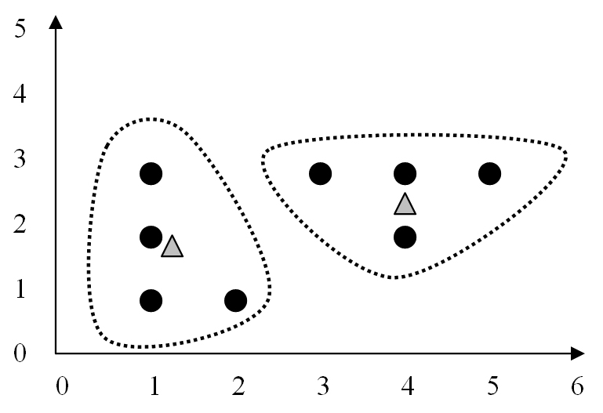
Example of k-Means Clustering at Work (cont’d)
Third (Final) Iteration
Repeat procedure for Steps 3 – 4
Now, for each record find nearest cluster center m1 = (1.25, 1.75) or m2 = (4, 2.75)
This time, no records shift cluster membership
Centroids remain unchanged, therefore algorithm terminates

Slide 29
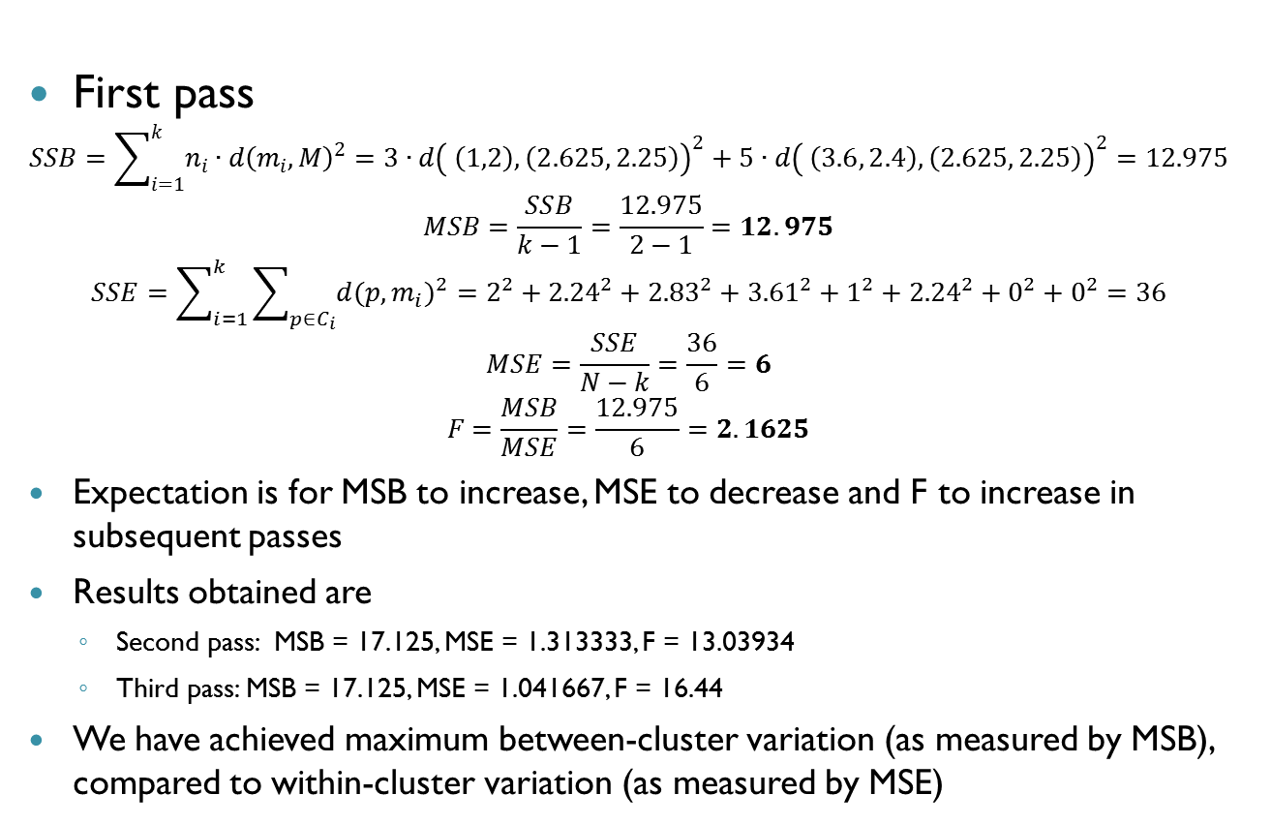
Behavior of MSB, MSE and pseudo-F as the k-means algorithm proceeds
First pass
$$SSB=\sum_{i=1}^{k}{n_{i}∙d{\left(m_{i},M\right)}^{2}}=3∙{d\left( \left(1,2\right), \left(2.625, 2.25\right)\right)}^{2}+5∙{d\left( \left(3.6, 2.4\right), \left(2.625, 2.25\right)\right)}^{2}=12.975$$
$$MSB=\frac{SSB}{k−1}=\frac{12.975}{2−1}=12.975$$
$$SSE=\sum_{i=1}^{k}{\sum_{p∈C_{i}}{{d(p,m_{i})}^{2}}}=2^{2}+{2.24}^{2}+{2.83}^{2}+{3.61}^{2}+1^{2}+{2.24}^{2}+0^{2}+0^{2}=36$$
$$MSE=\frac{SSE}{N−k}=\frac{36}{6}=6$$
$$F=\frac{MSB}{MSE}=\frac{12.975}{6}=2.1625$$
Expectation is for MSB to increase, MSE to decrease and F to increase in subsequent passes
Results obtained are
Second pass: MSB = 17.125, MSE = 1.313333, F = 13.03934
Third pass: MSB = 17.125, MSE = 1.041667, F = 16.44
We have achieved maximum between-cluster variation (as measured by MSB), compared to within-cluster variation (as measured by MSE)

Slide 30
Example of k-Means Clustering at Work (cont’d)
Summary
k-Means not guaranteed to find to find global maximum pseudo-F
Instead, local minimum found
Invoking algorithm using variety of initial cluster centers improves probability of achieving global maximum
One approach places first cluster at random point, with remaining clusters placed far from previous centers (Moore)
What is appropriate value for k?
Potential problem for applying k-Means
Analyst may have a priori knowledge of k

Slide 31
Example of k-Means Clustering at Work (cont’d)
Outer loop to algorithm possible
Cycles through different k values
Results compared, selecting solution with largest F statistic
Alternatively, other clustering algorithms like BIRCH can select optimal number of clusters
What attributes to use as input?
Some attributes likely more relevant than others
Apply axis-stretching methods for quantifying attribute relevance discussed in Chapter 7
In Chapter 11 we examine Kohonen networks, related to artificial neural networks

Slide 32
Application of k-Means Clustering Using SAS Enterprise Miner
k-Means algorithm in SAS Enterprise Miner analyzes churn data set
Uses FASTCLUS procedure, a version of k-Means
Data set contains 20 attributes with 3,333 records
Target variable describes if customer left company (“churned”)
9 attributes passed to algorithm, with k = 3
Categorical
International Plan, Voice Main Plan
Numeric (values Normalized)
Account Length, Voice Mail Messages, Day Minutes, Evening Minutes, Night Minutes, International Minutes, Customer Service Calls
Min-Max Normalization was applied to all numerical variables

Slide 33
Application of k-Means Clustering Using SAS Enterprise Miner (cont’d)
Three clusters uncovered vary significantly in size
Cluster 1: 92 records, Cluster 2: 2,411 records, and Cluster 3: 830 records
Cluster Profiling helps understand types of records comprising clusters
1

Slide 34
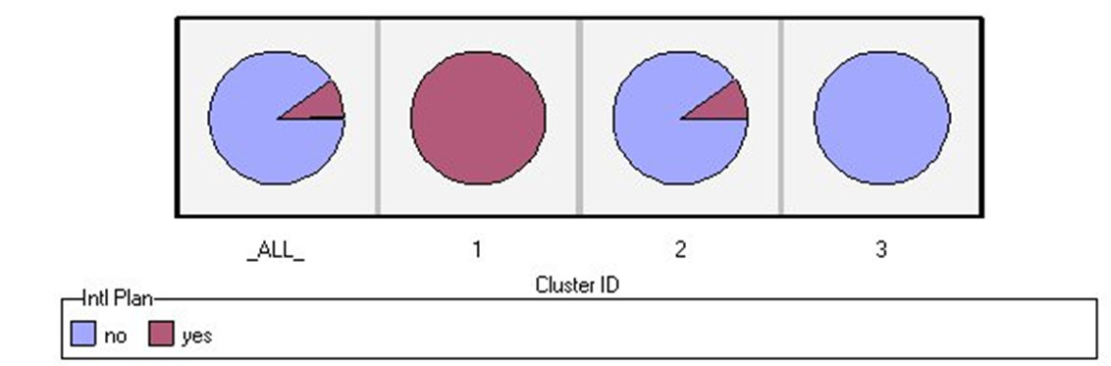
Application of k-Means Clustering Using SAS Enterprise Miner (cont’d)
Clustering results window from Enterprise Miner shows pie chart profile of International Plan across cluster membership
Cluster 1: All members adopted International Plan
Cluster 2: Fraction adopted plan
Cluster 3: None chose plan
Figure 10.7

Slide 35
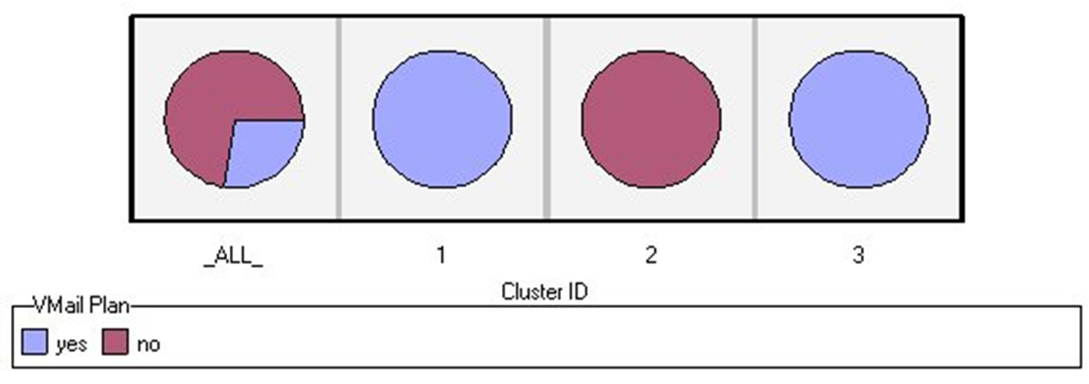
Application of k-Means Clustering Using SAS Enterprise Miner (cont’d)
Below, results show profile of Voice Mail Plan across cluster membership
Clusters 1 and 3: All members adopted Voice Mail Plan
Cluster 2: None chose plan
Figure 10.8
1

Slide 36
Application of k-Means Clustering Using SAS Enterprise Miner (cont’d)
k-Means discriminates records according to Voice Mail Plan field value
Divides data set perfectly among adopters and non-adopters
Algorithm relies heavily on categorical attributes
Mean values for numerical variables shows little variation across clusters (see table below)
Table 10.5
Cluster | Freq. | AcctLength_m | VMailMessage | DayMins_mm
1 | 92 | 0.4340639598 | 0.5826939471 | 0.5360015616
2 | 2411 | 0.4131940041 | 0 | 0.5126334451
3 | 830 | 0.4120730857 | 0.5731159934 | 0.5093940185
Cluster | EveMins_mm | NightMins_mm | IntMins_mm | CustServCalls
1 | 0.5669029659 | 0.4764366069 | 0.5467934783 | 0.1630434783
2 | 0.5507417372 | 0.4773586813 | 0.5119784322 | 0.1752615328
3 | 0.5564095259 | 0.4795138596 | 0.5076626506 | 0.1701472557

Slide 37
Application of k-Means Clustering Using SAS Enterprise Miner (cont’d)
Cluster Summary
Cluster 1: Sophisticated Users
Smallest group of customers
Adopted International and Voice Mail Plans
Cluster 2: The Average Majority
Largest segment of customer base
Some have adopted Voice Mail Plan
None have adopted International Plan
Cluster 3: Voice Mail Users
Medium-sized group
All have chosen Voice Mail Plan
None have adopted International Plan

Slide 38
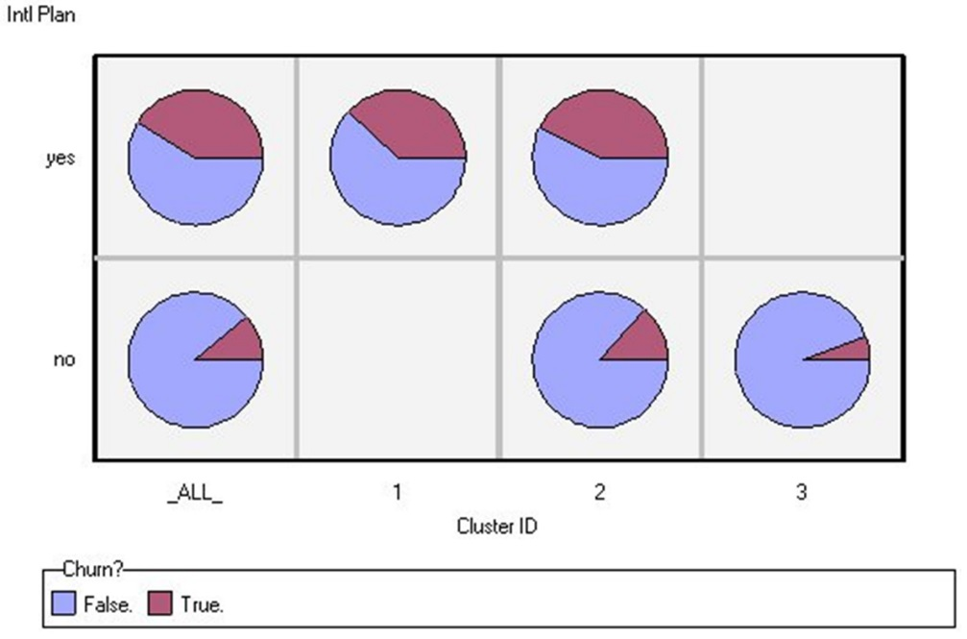
Using Cluster Membership to Predict Churn
Suppose clusters used to predict “churn” for classification
Proportion for those churning analyzed for each cluster
Diagram shows that proportion of churners higher for those adopting International Plan
Company should investigate why those adopting plan leaving company at higher rate
Figure 10.10

Slide 39
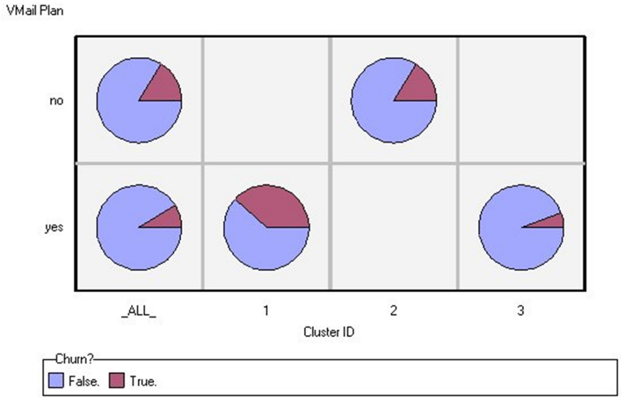
Using Cluster Membership to Predict Churn (cont’d)
Recall proportion of churners lower, for those participating in Voice Mail Plan
Figure confirms lower churn rate for customers in Cluster 3 (all adopters of Voice Mail Plan)
Figure 10.11

