Slide 1
ConfigMaps and Secrets: configuring applications

Slide 2
ConfigMaps
Applications can be configured using command line parameters, config files, Environment variables (MYSQL_ROOT_PASSWORD)
Baking files into the image is similar to hardcoding configuration, into the source code of the application, because it requires you to rebuild the image every time you want to change the config.
Using a volume is better, but still requires you to make sure, the file is written to the volume before the container is started.

Slide 3
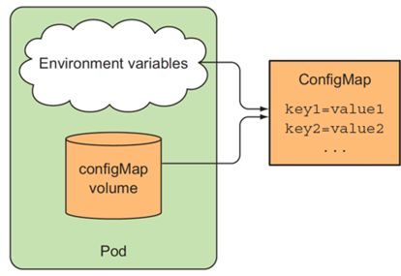
ConfigMaps
Kubernetes allows separating configuration options into a separate object called a ConfigMap, which is a map containing key/value pairs with the values ranging from short literals to full config files.

Slide 4

ConfigMaps
This creates a ConfigMap called fortune-config with the single entry sleep-interval =2
You can inspect the YAML descriptor for the ConfigMap created by using:
kubectl get configmap fortune-config – o yaml

Slide 5
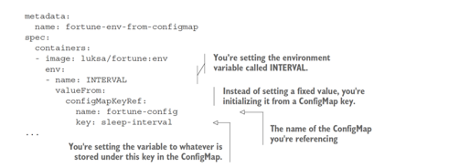
ConfigMaps

Slide 6
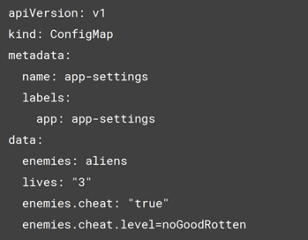
ConfigMap YAML file
vi config1.yml
kubectl create –f config1.yml

Slide 7
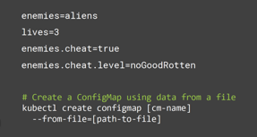
Defining key/value pairs in a File

Slide 8
Secrets
Secrets are much like ConfigMaps – they’re also maps that hold key-value pairs. They can be used the same way as a ConfigMap.
Use ConfigMaps to store non-sensitive, plain configuration data
Use a Secret to store any data that is sensitive in nature and needs to be kept under key

Slide 9
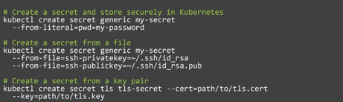
Creating a Secret

Slide 10
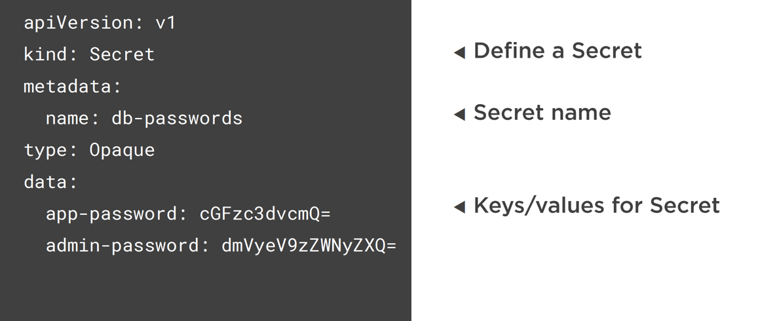
Creating a Secret

Slide 11
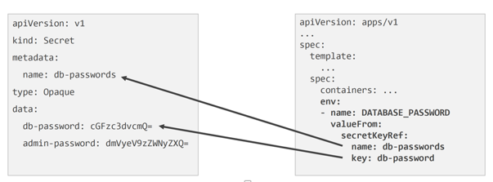
Accessing a Secret

