Slide 1




Markus Utke
Social Welfare in Budget Aggregation
Javier Cembrano
Rupert Freeman
Ulrike Schmidt-Kraepelin
(Universidad de Chile)
(University of Virginia)
(TU Eindhoven)
Notes:
This is the ALGA slide template.
You can pick a different logo variant by changing the title slide's layout (in Home > Slides > Layout).
Alternatively, you can change the title slide completely (e.g., to add another institute's logo) by using the Slide Master view.

Slide 2
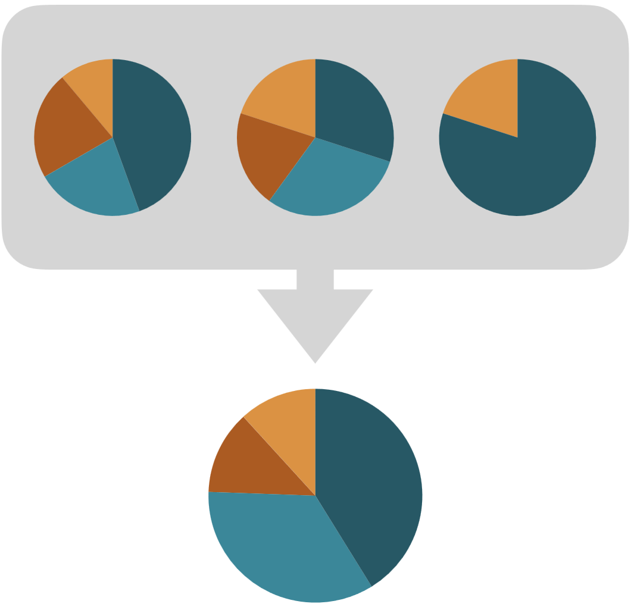
Budget Aggregation
Divisible resource (e.g., money, time)
Arbitrary allocation over alternatives
Each agent has a favorite allocation

Slide 3
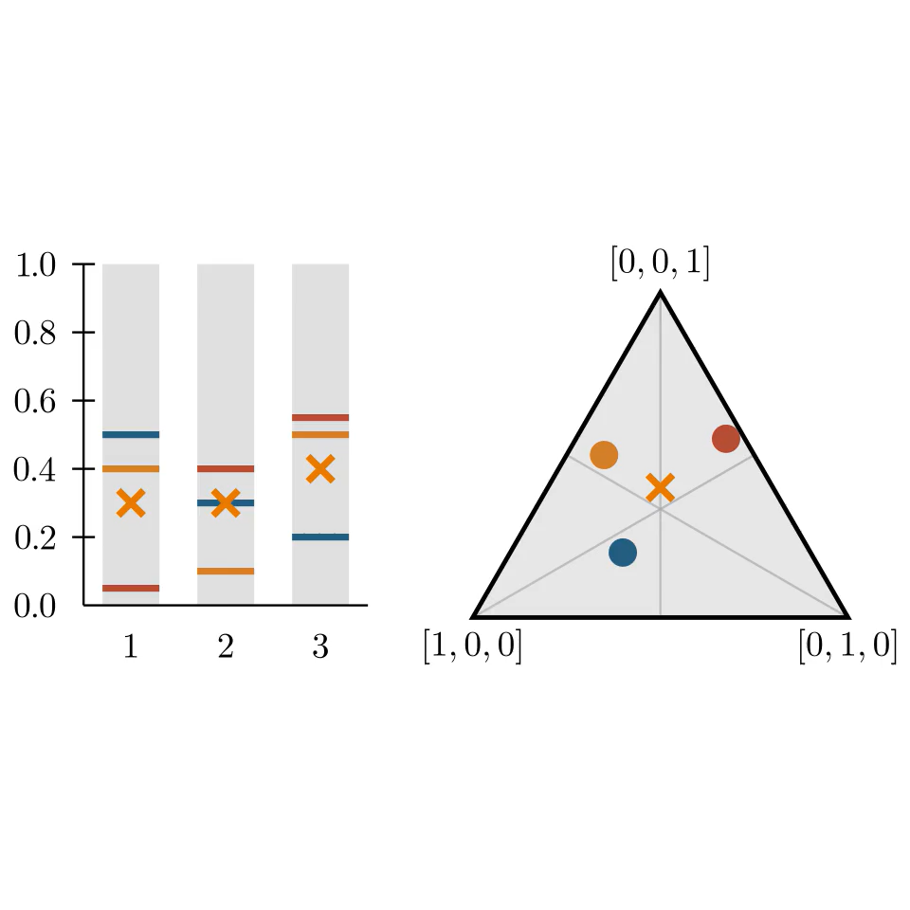
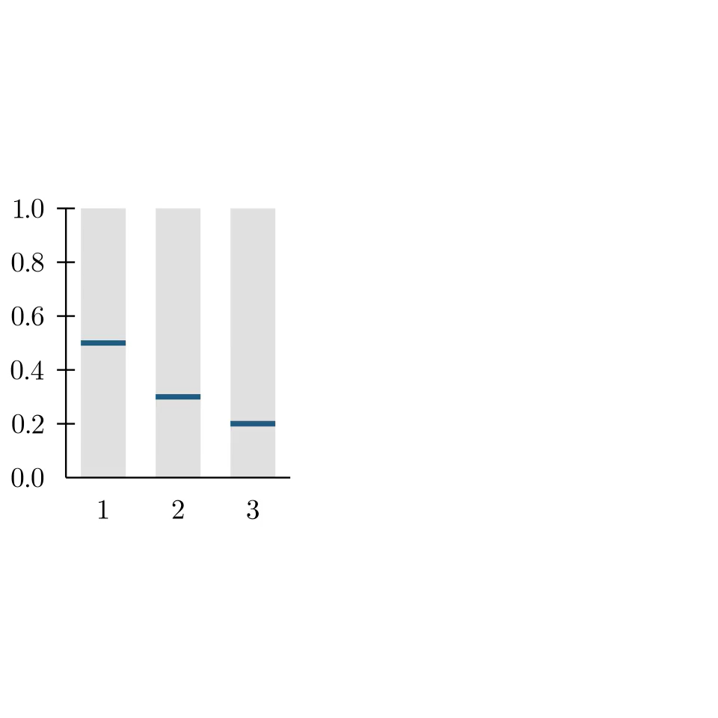
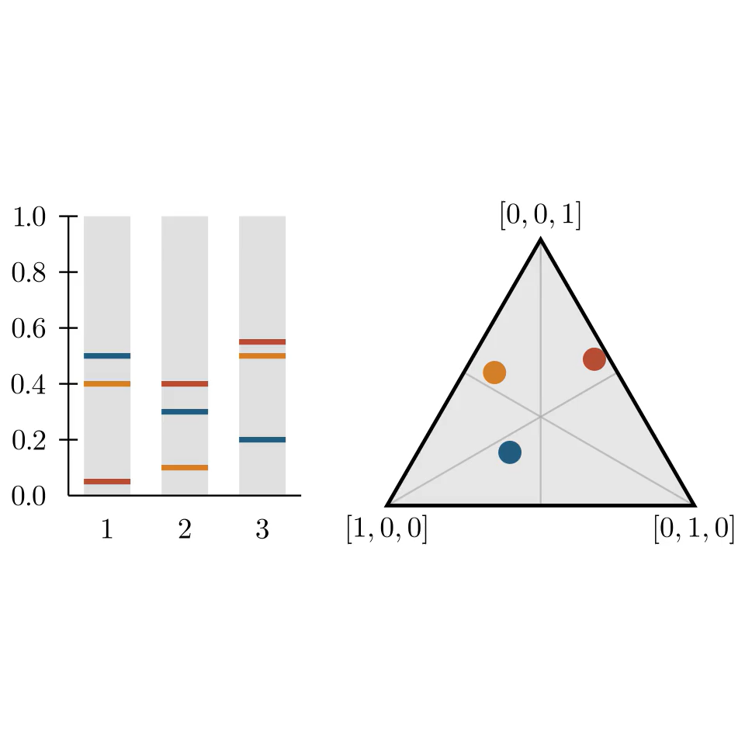



Model
Voters $N=\{1, …, n\}$
Alternatives $M=\{1, …, m\}$
Budget aggregation mechanism:
Input: votes $v_{i}∈{\left[0,1\right]}^{m}$ for all $i∈N$ with $\sum_{j∈M}{v_{ij}}=1$
Output: allocation $a∈{\left[0,1\right]}^{m}$ with $\sum_{j∈M}{a_{j}}=1$
Utility for voter $i$ from allocation $a$:
$$u_{i}\left(a\right)=\sum_{j∈M}{min⁡(v_{ij},a_{j})}$$
$$v_{1}=\left(0.5, 0.3, 0.2\right)$$
$$u_{1}\left(a\right)=0.3+0.3+0.2$$
$=0.8$

Slide 4
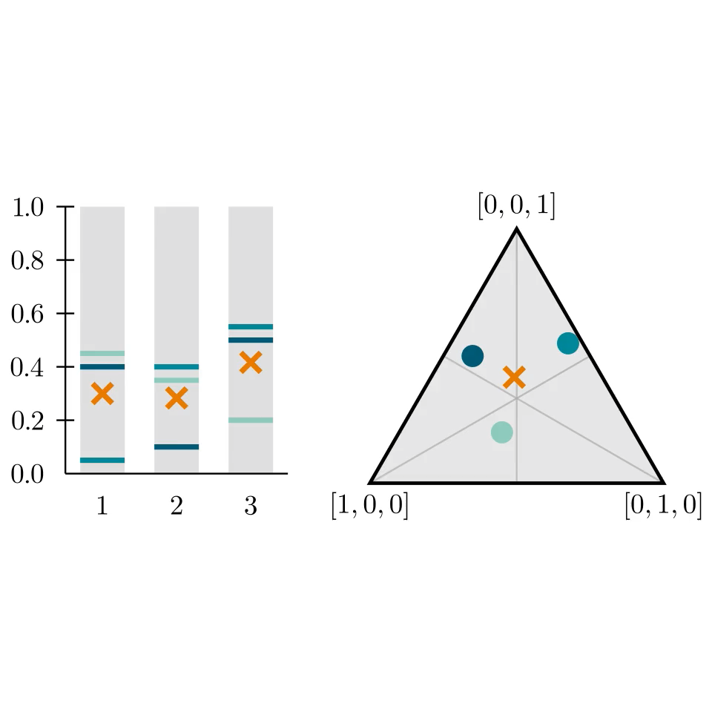
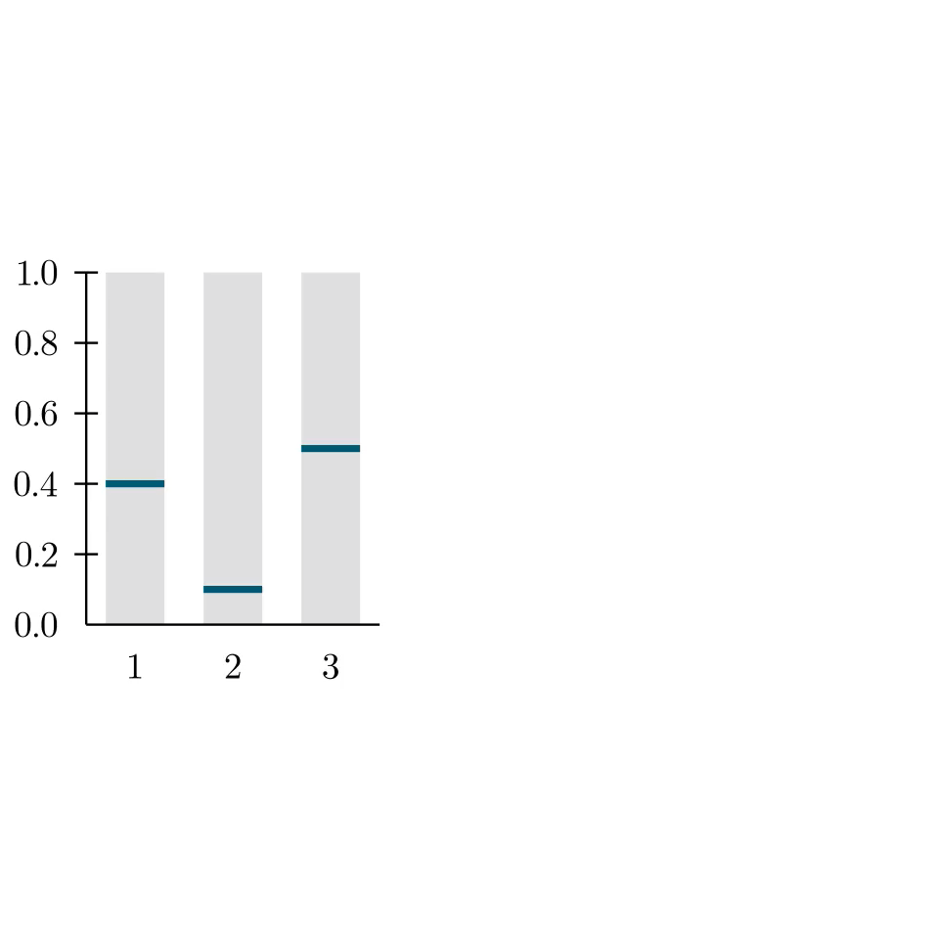
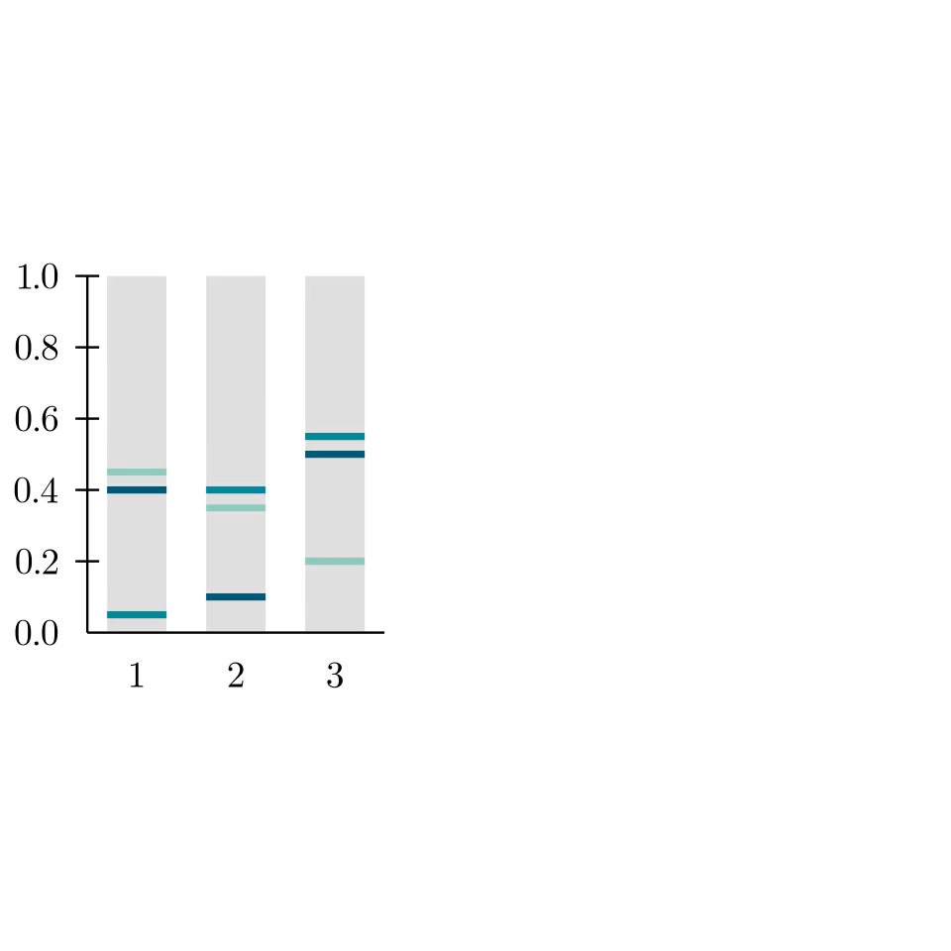
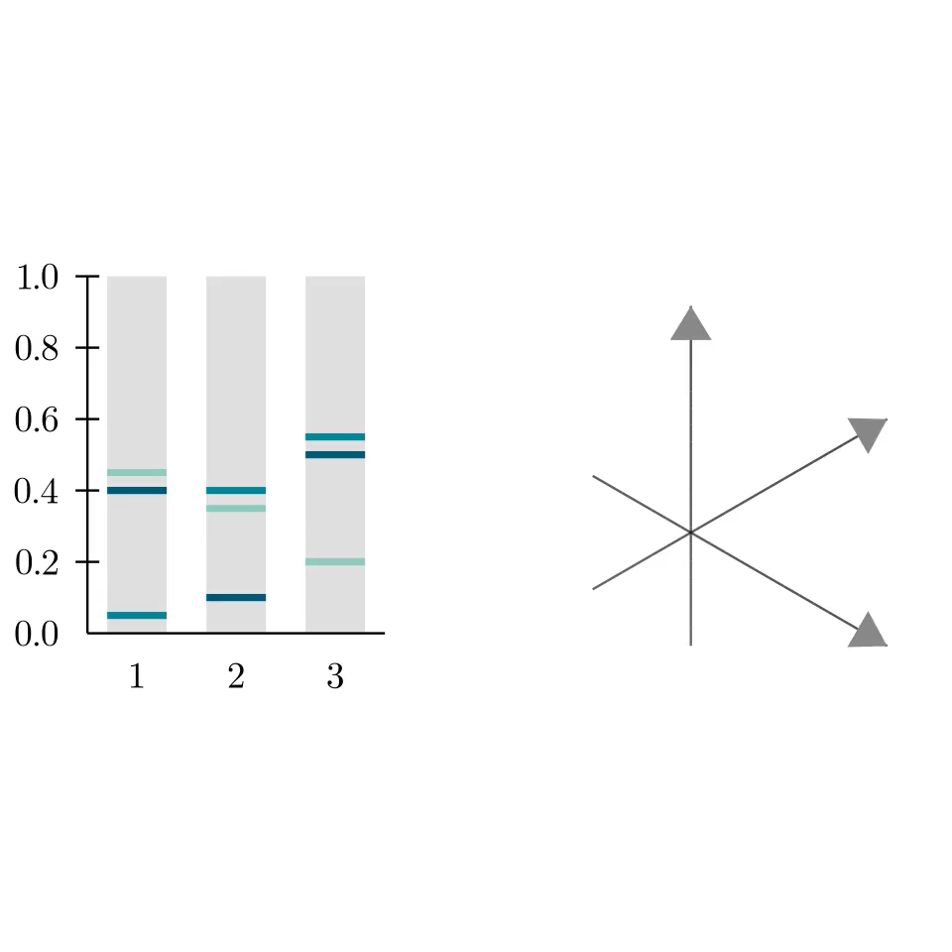
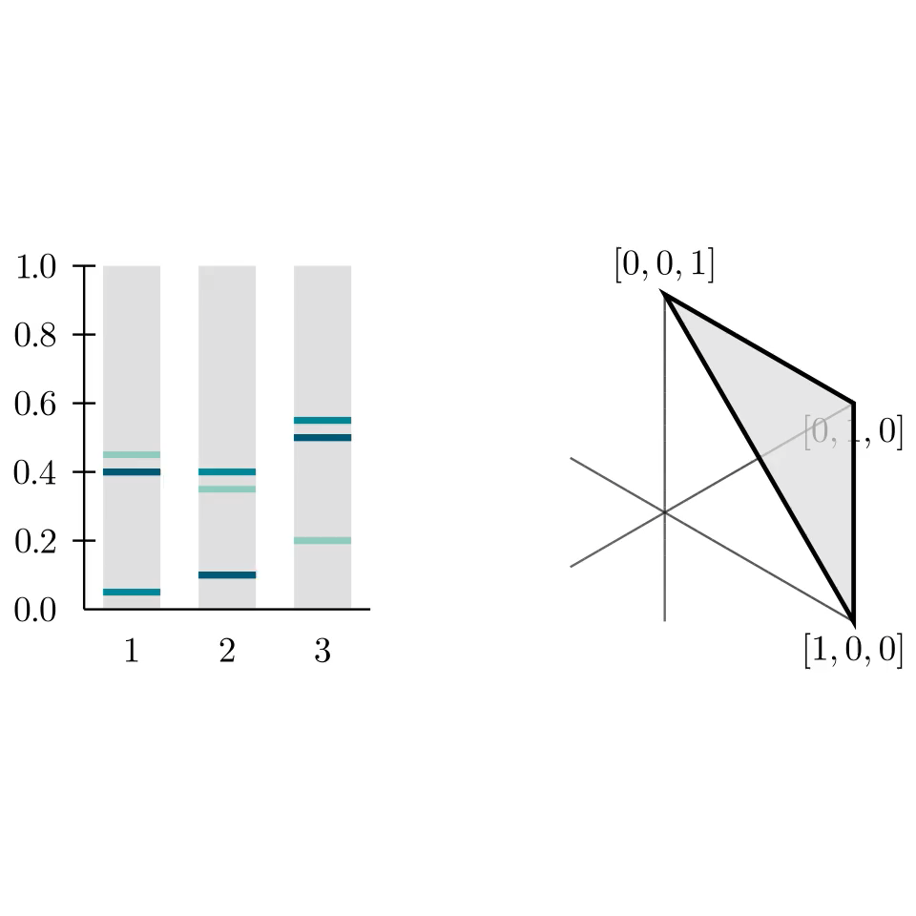
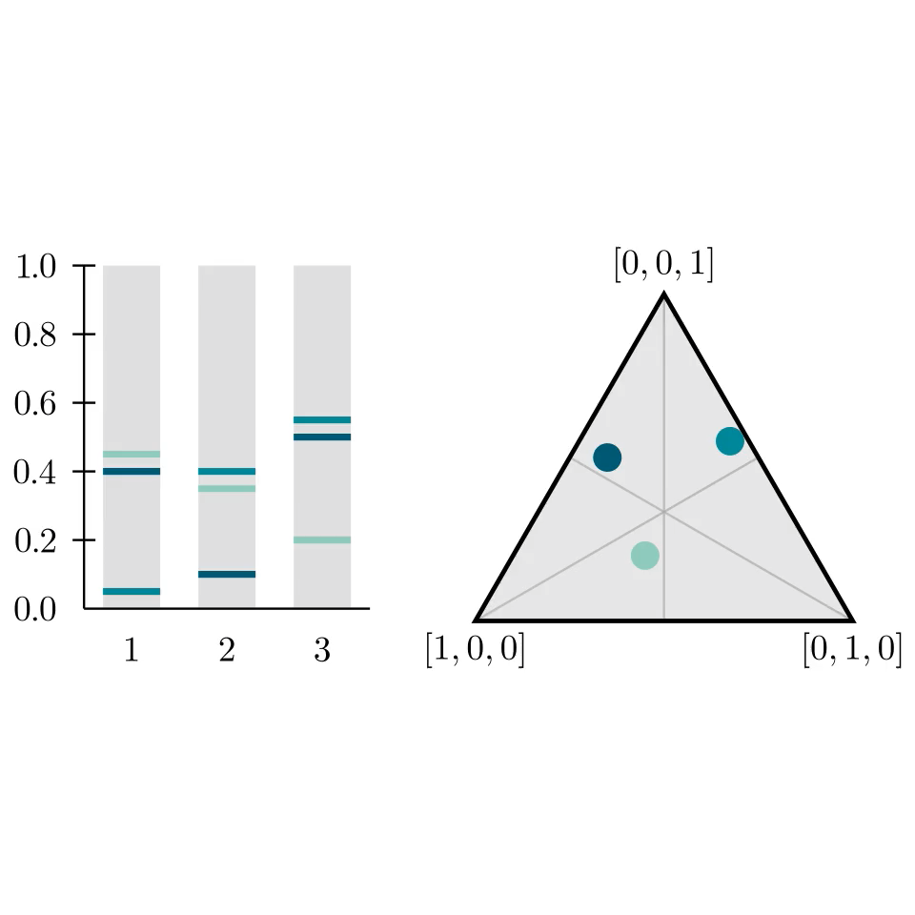


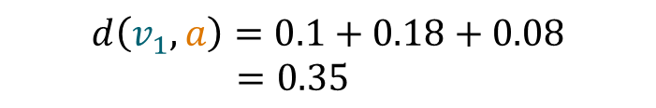
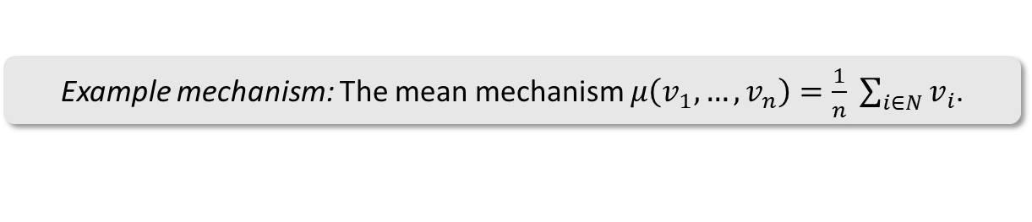
Model
Voters $N=\{1, …, n\}$
Alternatives $M=\{1, …, m\}$
Budget aggregation mechanism:
Input: votes $v_{i}∈{\left[0,1\right]}^{m}$ for all $i∈N$ with $\sum_{j∈M}{v_{ij}}=1$
Output: allocation $a∈{\left[0,1\right]}^{m}$ with $\sum_{j∈M}{a_{j}}=1$
$ℓ_{1}$-disutility for voter $v_{i}$ and allocation $a$:
$$d\left(v_{i}, a\right)=\sum_{j∈M}{|v_{ij}−a_{j}|}$$
$$v_{1}=\left(0.4, 0.1, 0.5\right)$$
$$d\left(v_{1}, a\right)=0.1+0.18+0.08$$
$=0.35$
Example mechanism: The mean mechanism $μ\left(v_{1},…,v_{n}\right)=\frac{1}{n} \sum_{i∈N}{v_{i}}$.

Slide 5
Social Welfare of Proportional Mechanisms

Slide 6
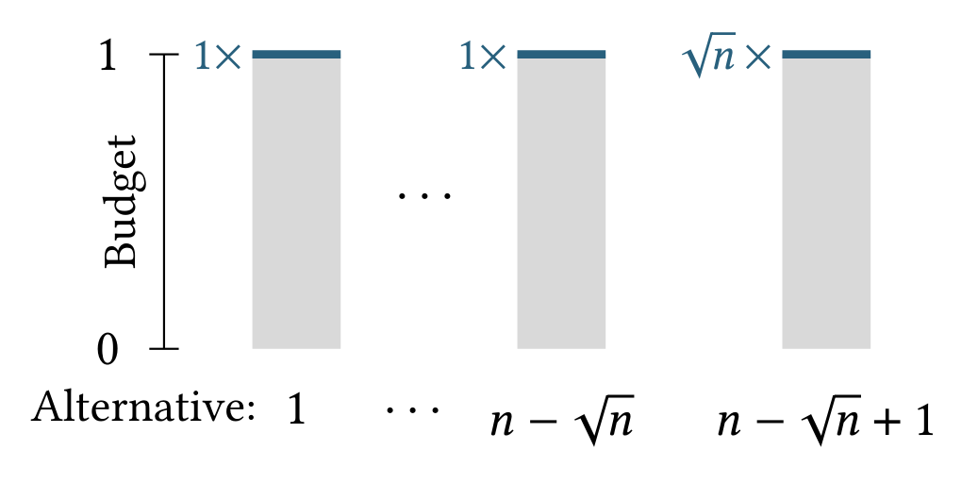
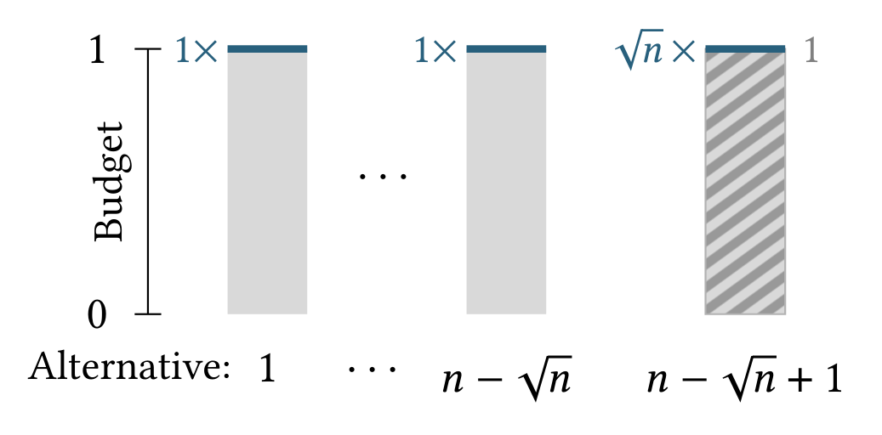
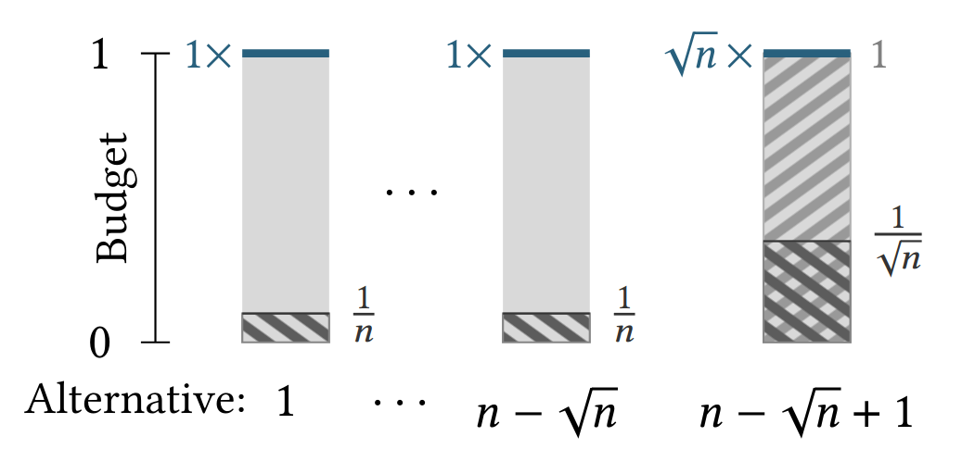
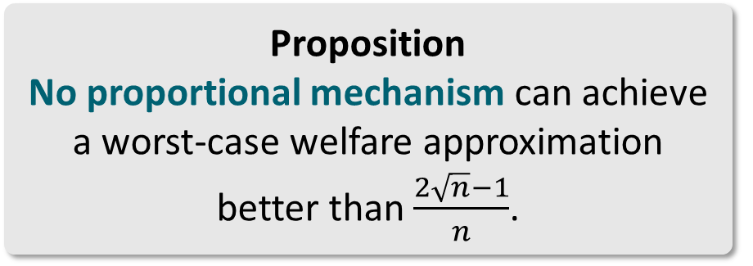
Welfare Approximation Lower Bound
Proposition
No proportional mechanism can achieve a worst-case welfare approximation better than $\frac{2\sqrt{n}−1}{n}$.

Slide 7
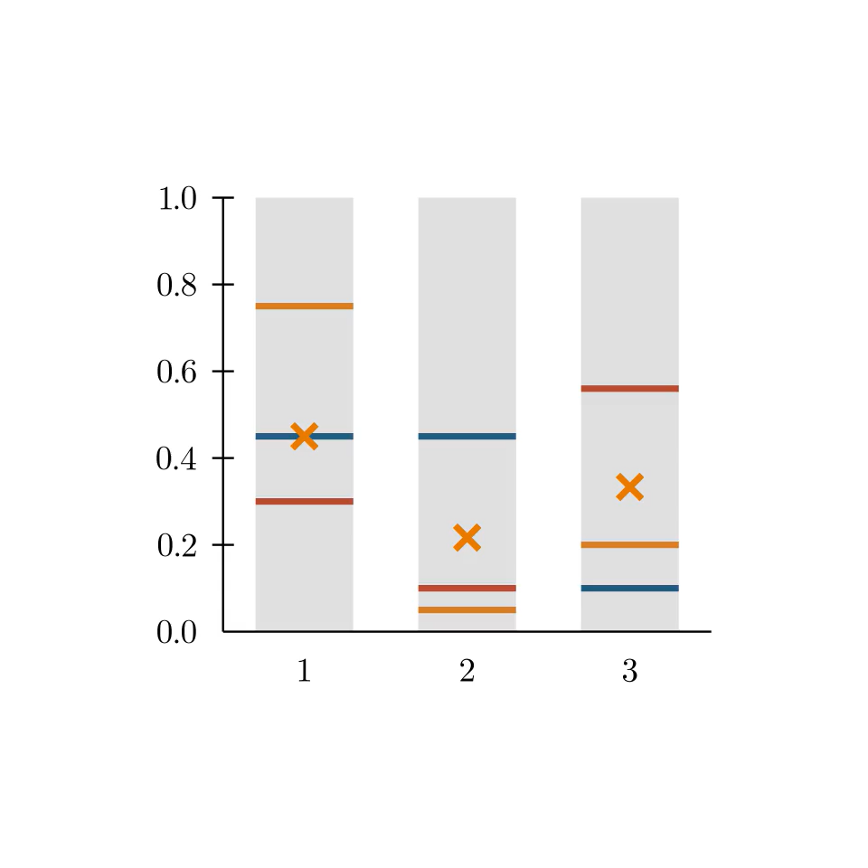
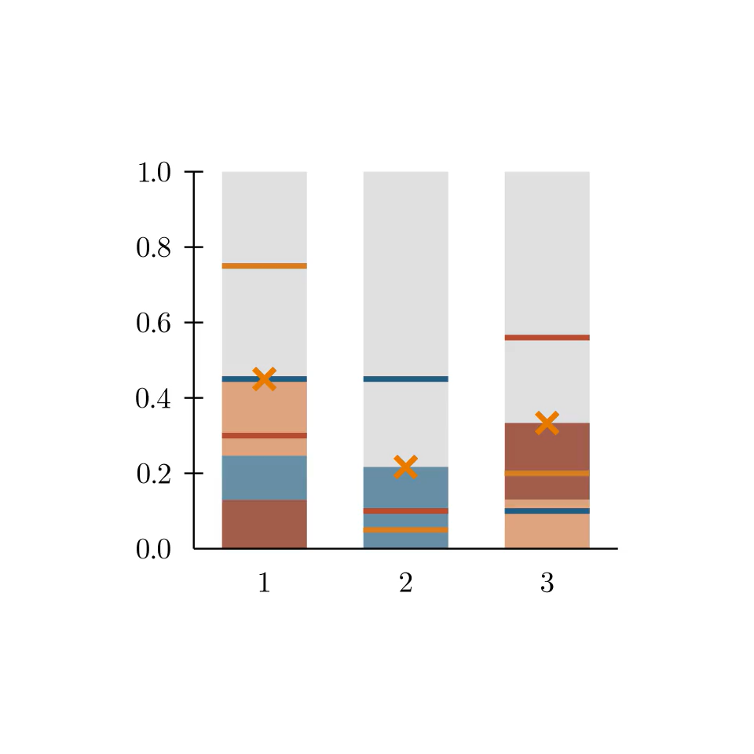
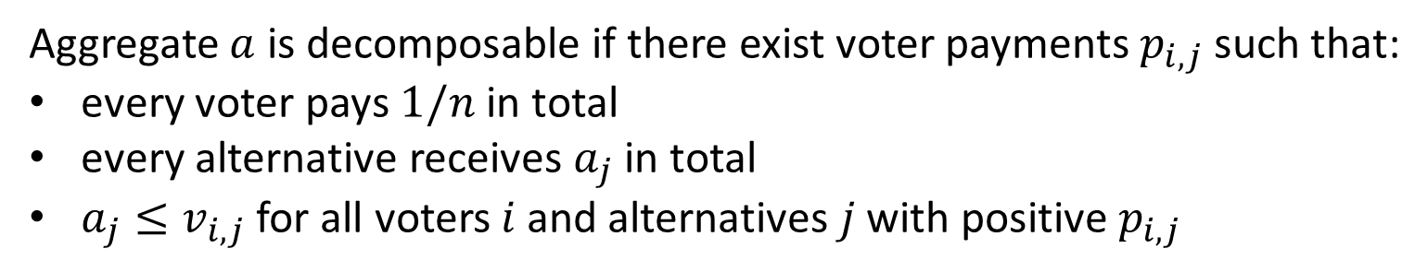
Decomposability
Aggregate $a$ is decomposable if there exist voter payments $p_{i,j}$ such that:
every voter pays $1/n$ in total
every alternative receives $a_{j}$ in total
$a_{j}≤v_{i,j}$ for all voters 𝑖 and alternatives 𝑗 with positive $p_{i,j}$
Theorem (Becker et al., AAMAS 2025)
Decomposable outcomes exist and can be computed in polynomial time.

Slide 8
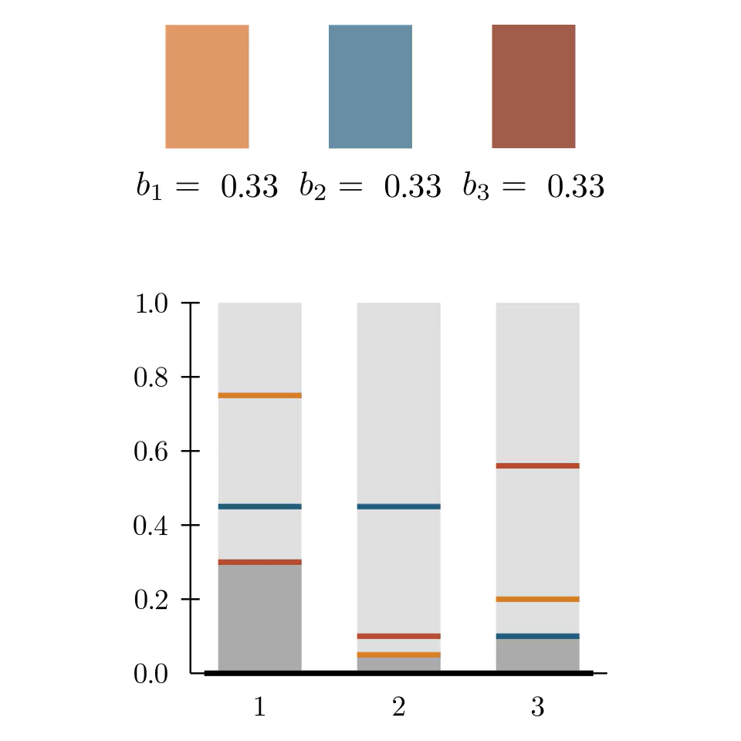
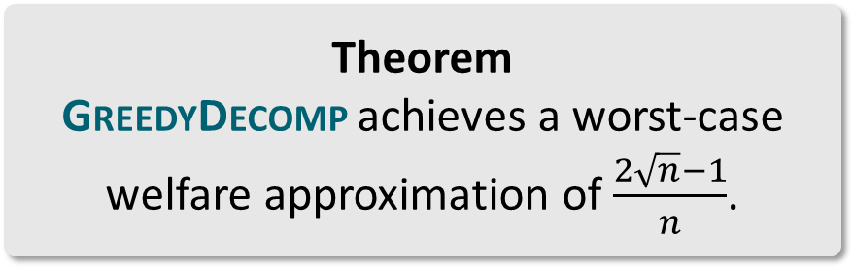
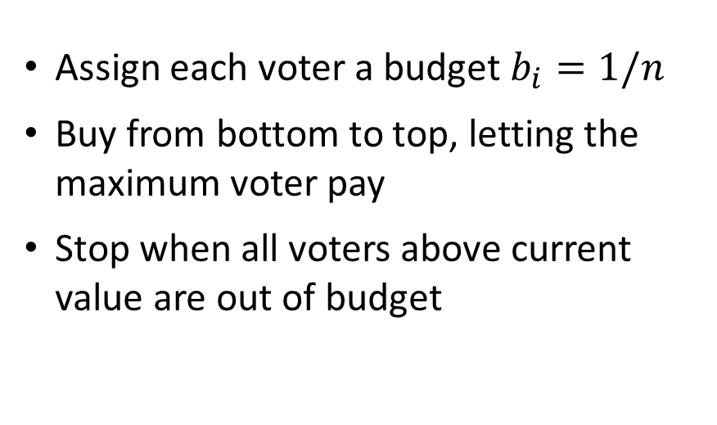
GreedyDecomp
Theorem
GreedyDecomp is anonymous, neutral and decomposable.
Assign each voter a budget $b_{i}=1/n$
Buy from bottom to top, letting the maximum voter pay
Stop when all voters above current value are out of budget
Theorem
GreedyDecomp achieves a worst-case welfare approximation of $\frac{2\sqrt{n}−1}{n}$.
Theorem
No mechanism can be truthful, neutral and decomposable.

Slide 9
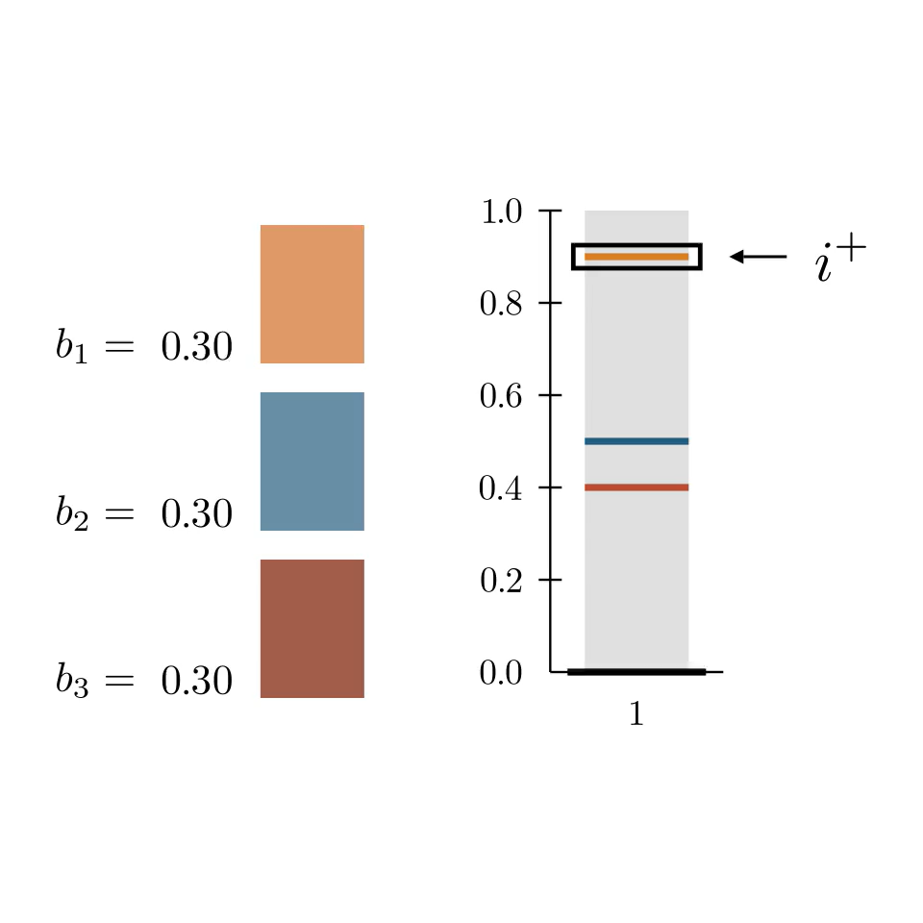
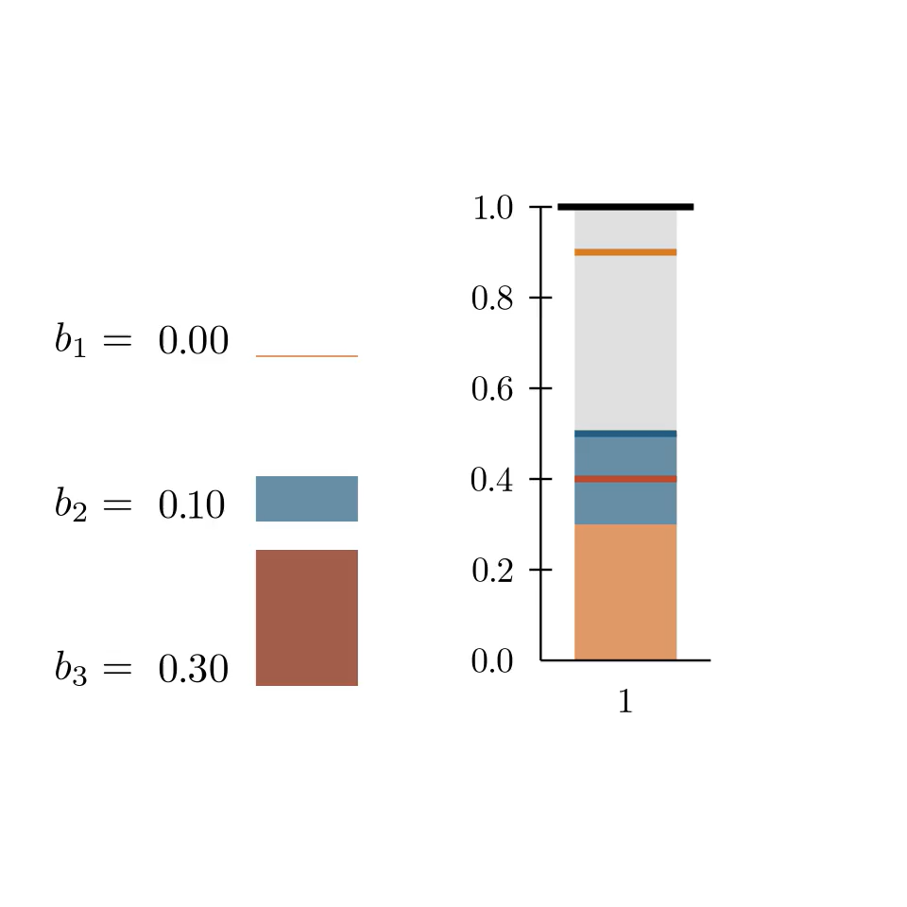
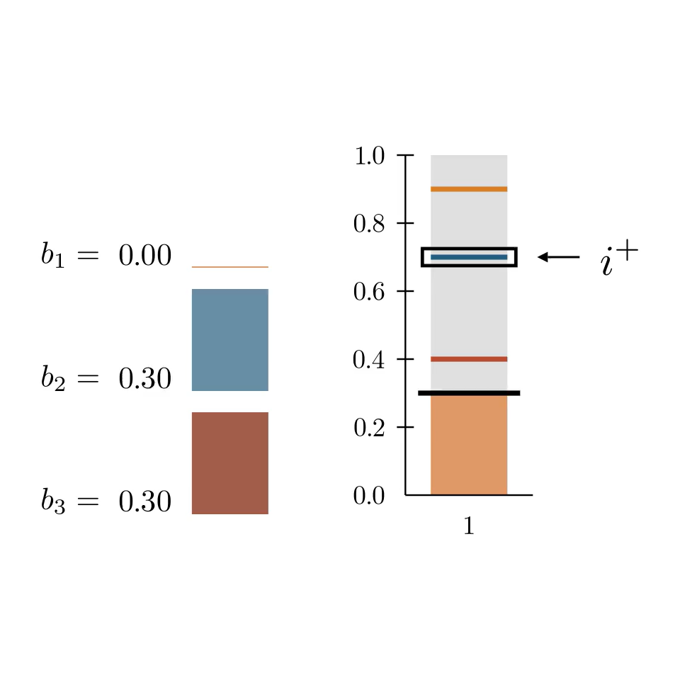
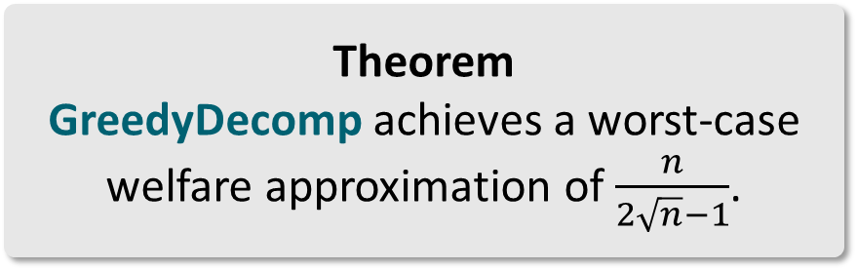
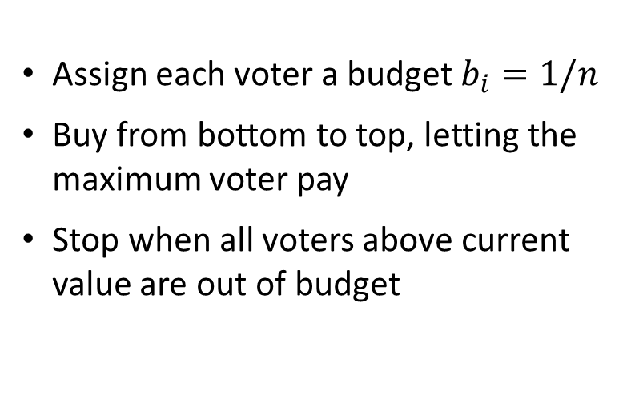
GreedyDecomp
Theorem
GreedyDecomp is anonymous, neutral and decomposable.
Assign each voter a budget $b_{i}=1/n$
Buy from bottom to top, letting the maximum voter pay
Stop when all voters above current value are out of budget
Theorem
GreedyDecomp achieves a worst-case welfare approximation of $\frac{n}{2\sqrt{n}−1}$.

Slide 10
Axioms

Slide 11


Anonymity and Neutrality
A mechanism is anonymous if the identities of the voters do not matter.
A mechanism is neutral if the identities of the alternatives do not matter.

Slide 12
Social Welfare of Truthful Mechanisms

Slide 13
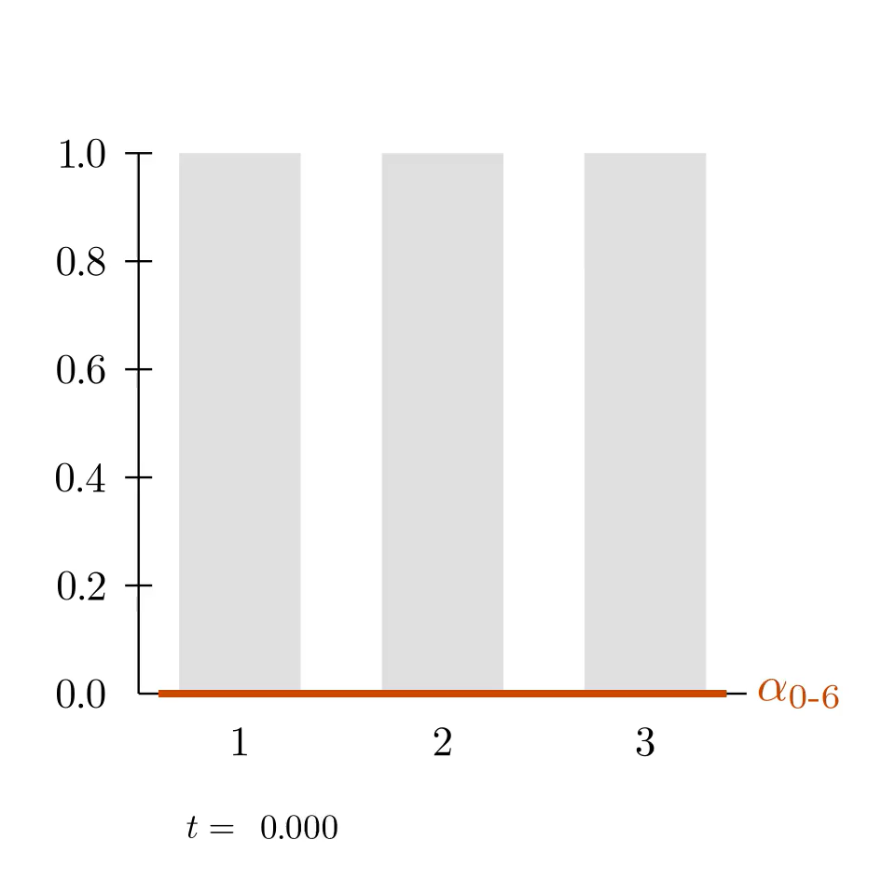
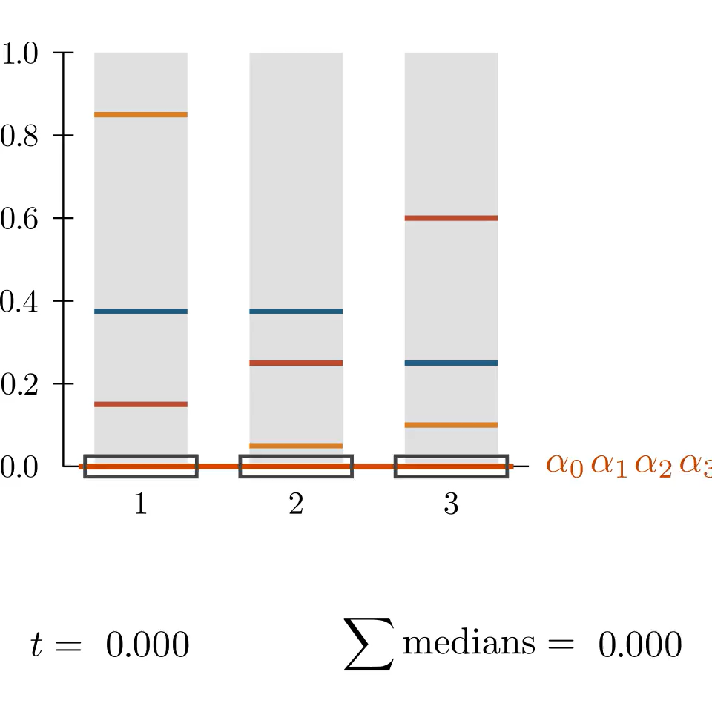
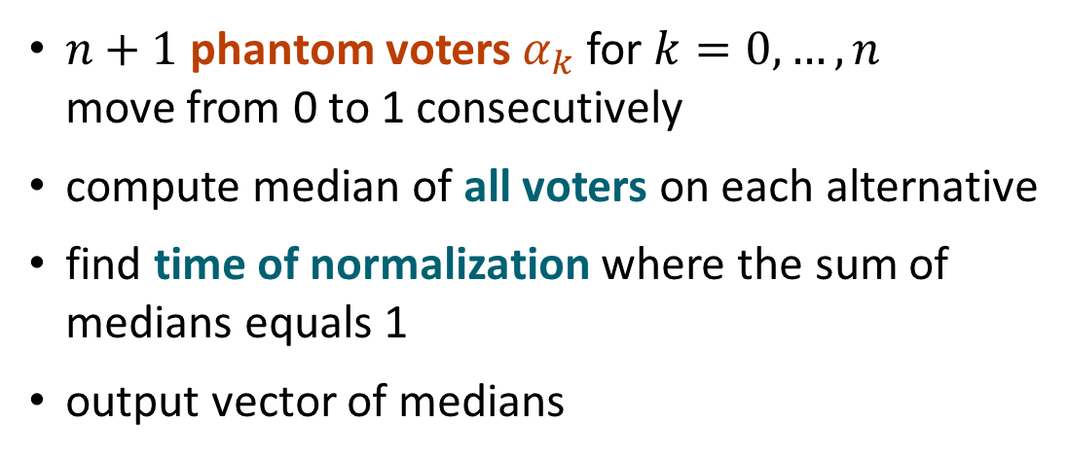
Util: A Truthful and Social Welfare Optimal Mechanism
(Freeman et al., JET 2021)
$n+1$ phantom voters $α_{k}$ for $k=0, …, n$ move from 0 to 1 consecutively
compute median of all voters on each alternative
find time of normalization where the sum of medians equals 1
output vector of medians
Theorem (Freeman et al., JET 2021)
Util maximizes social welfare.
Theorem (Freeman et al., JET 2021)
Any moving-phantom mechanism is truthful, anonymous and neutral.
Theorem (Freeman et al., JET 2021)
Util is truthful, anonymous and neutral.

Slide 14
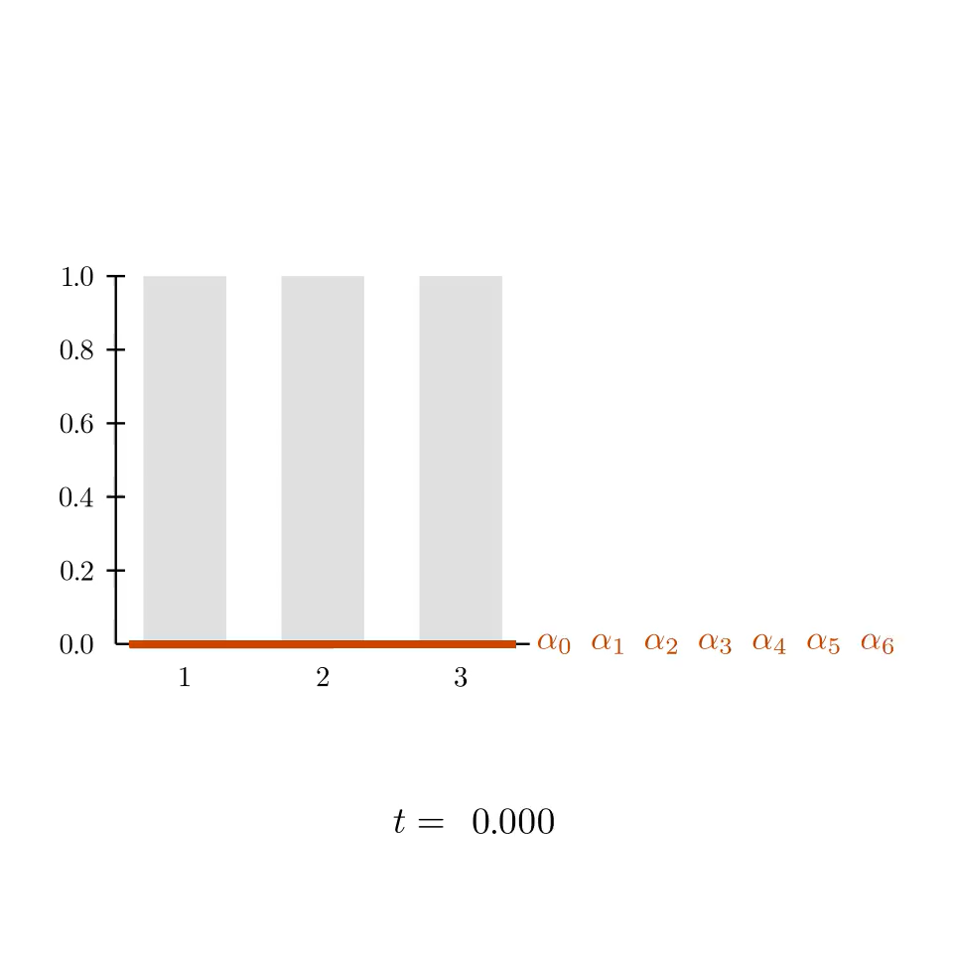
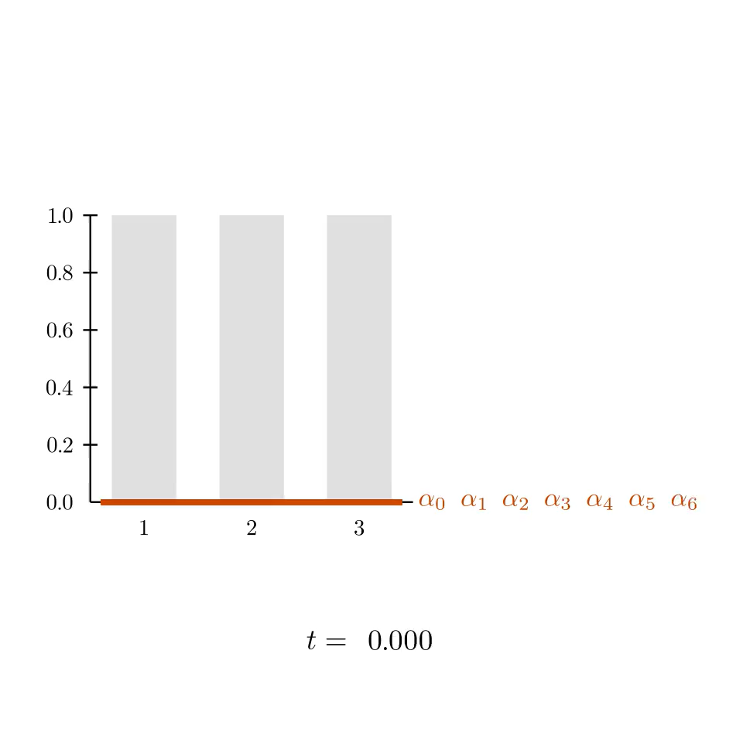
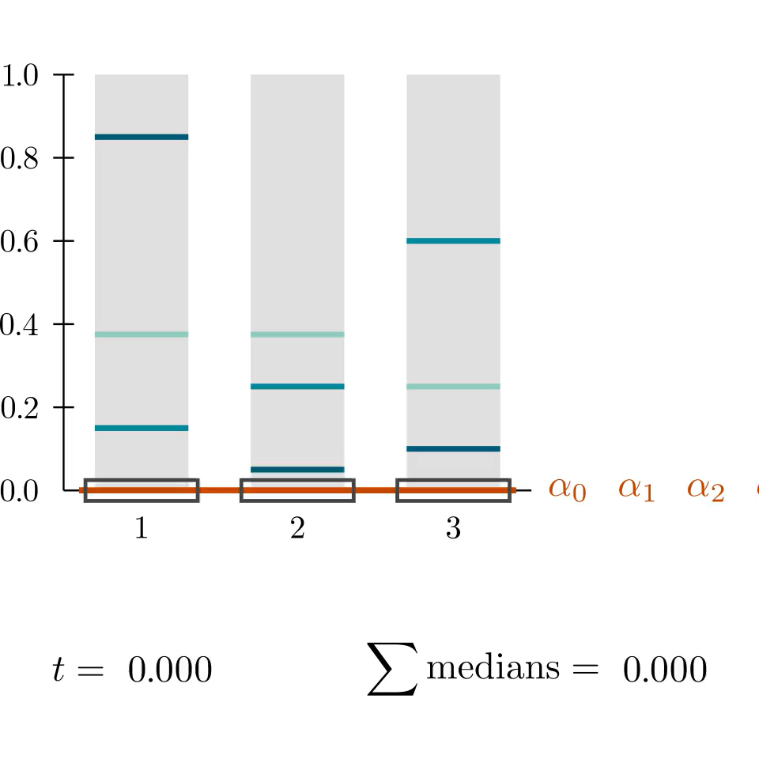
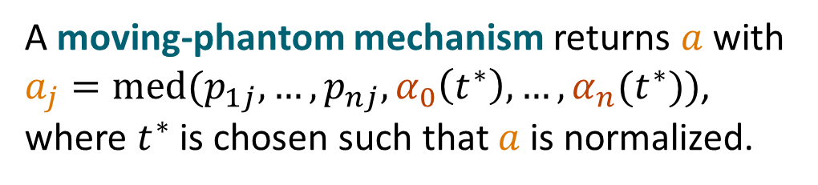
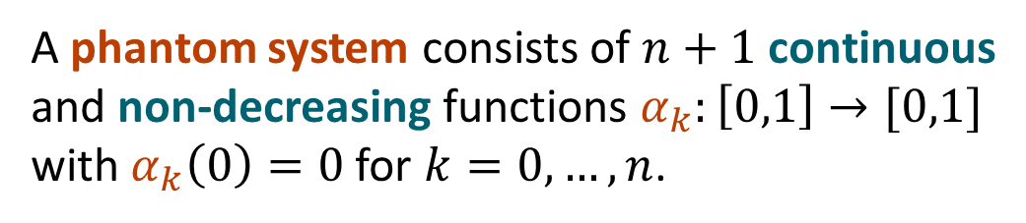
Moving-Phantom Mechanisms
(Freeman et al., JET 2021)
A phantom system consists of $n+1$ continuous and non-decreasing functions $α_{k}:\left[0,1\right]→[0,1]$ with $α_{k}\left(0\right)=0$ for $k=0, …, n$.
Util
A moving-phantom mechanism returns $a$ with $a_{j}=med(p_{1j},…,p_{nj}, α_{0}\left(t^{∗}\right), …, α_{n}(t^{∗}))$, where $t^{∗}$ is chosen such that $a$ is normalized.
Theorem (Freeman et al., JET 2021)
Any moving-phantom mechanism is truthful, anonymous and neutral.

Slide 15
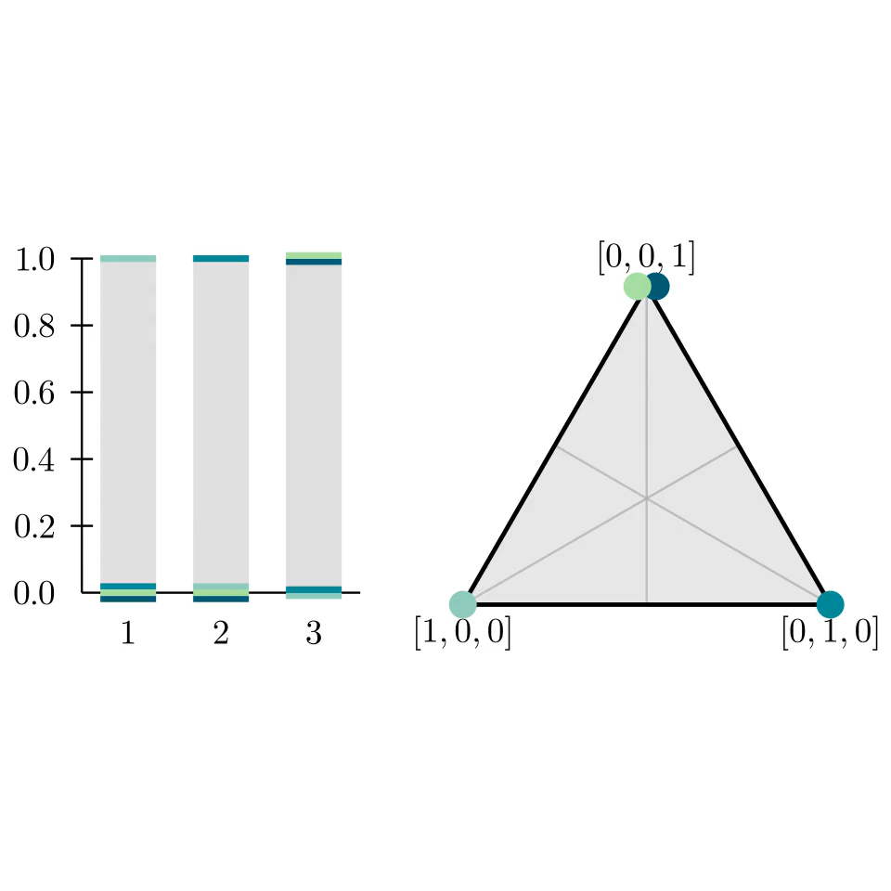
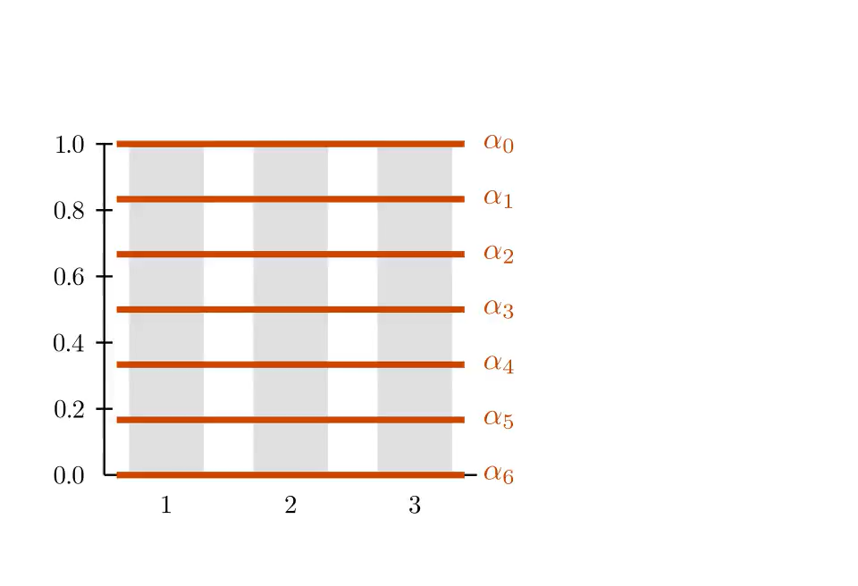
Single-Minded Proportionality
We call a voter single-minded, if they want to spend the whole budget on a single alternative.
A mechanism is single-minded proportional, if it returns the mean for any single-minded profile.
Theorem (Freeman et al., JET 2021)
There exist single-minded proportional moving-phantom mechanisms.

Slide 16
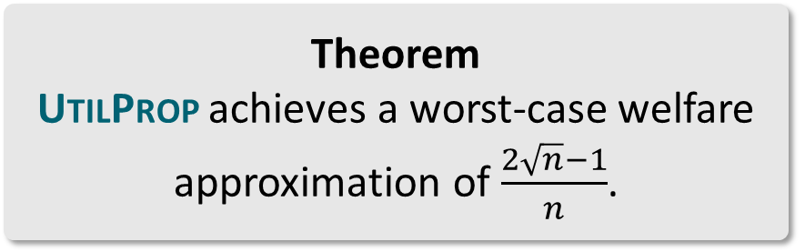
UtilProp
The UtilProp phantom mechanism is defined by the following moving-phantom system:
Theorem
UtilProp achieves a worst-case welfare approximation of $\frac{2\sqrt{n}−1}{n}$.

Slide 17
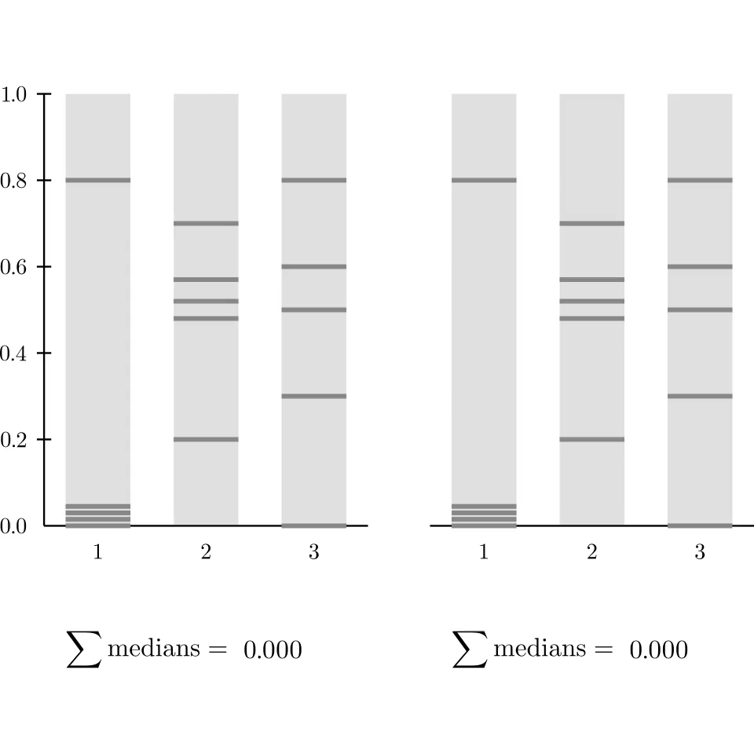
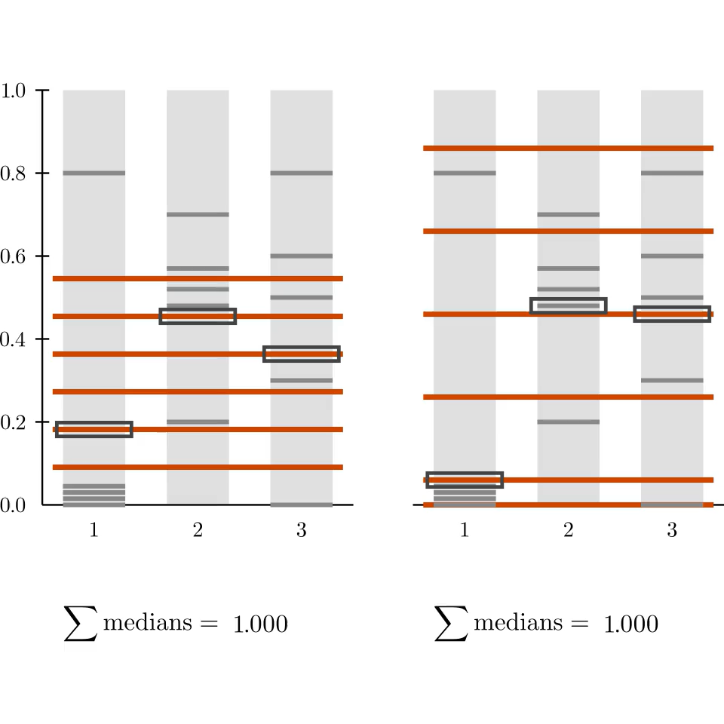


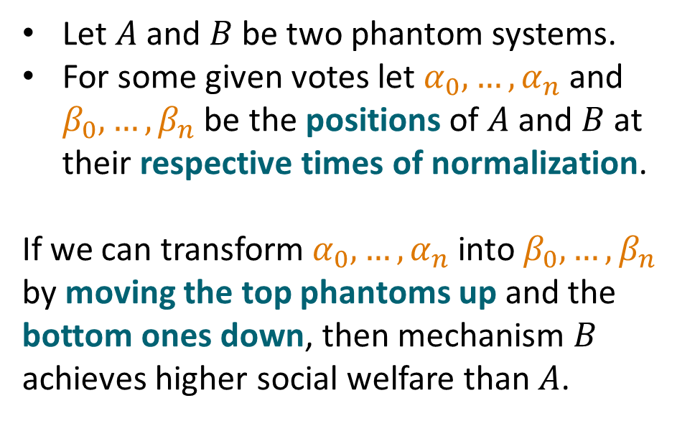
Phantom Domination Lemma
$$A$$
$$B$$
Let $A$ and $B$ be two phantom systems.
For some given votes let $α_{0},…,α_{n}$ and $β_{0},…,β_{n}$ be the positions of $A$ and $B$ at their respective times of normalization.
If we can transform $α_{0},…,α_{n}$ into $β_{0},…,β_{n}$
by moving the top phantoms up and the bottom ones down, then mechanism $B$ achieves higher social welfare than $A$.

Slide 18


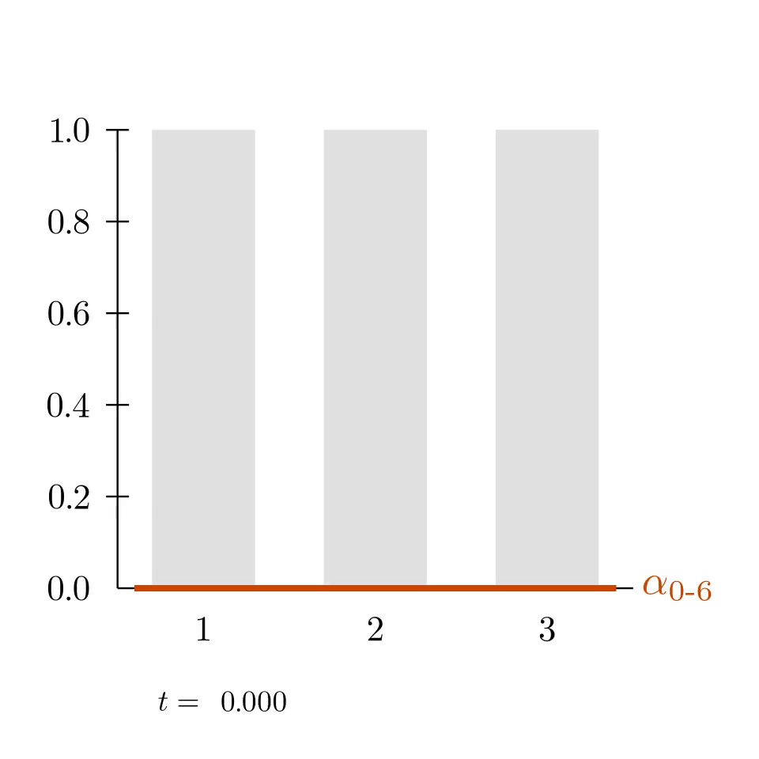


Moving-Phantom Mechanisms from the Literature
Util
UtilProp
IndependentMarkets
Ladder
PiecewiseUniform
GreedyMax
Fan
Constant

Slide 19
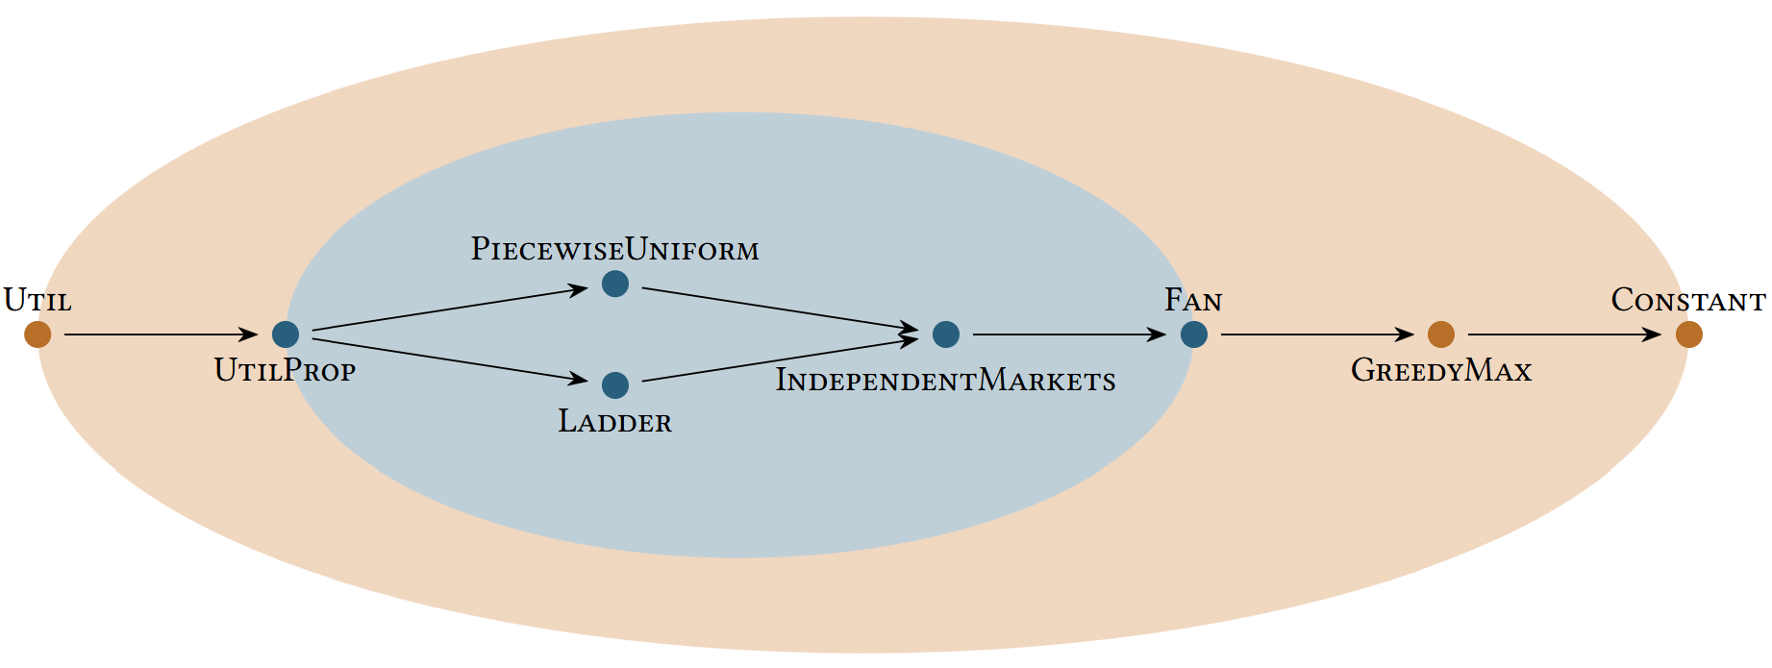
Phantom Domination Results
Mechanism $A$ dominates $B$, if the social welfare of $A$ is higher than of $B$ for every instance.
moving-phantom mechanisms
single-minded proportional moving-phantom mechanisms

Slide 20
Social Welfare in Budget Aggregation
Two new mechanisms achieve worst-case optimal welfare among single-minded proportional mechanisms:
UtilProp (truthful)
GreedyDecomp (decomposable)
Welfare-domination relationship among moving-phantom mechanisms:
moving-phantom mechanisms
single-minded proportional moving-phantom mechanisms

Slide 21
Thank you for your attention!

Slide 22
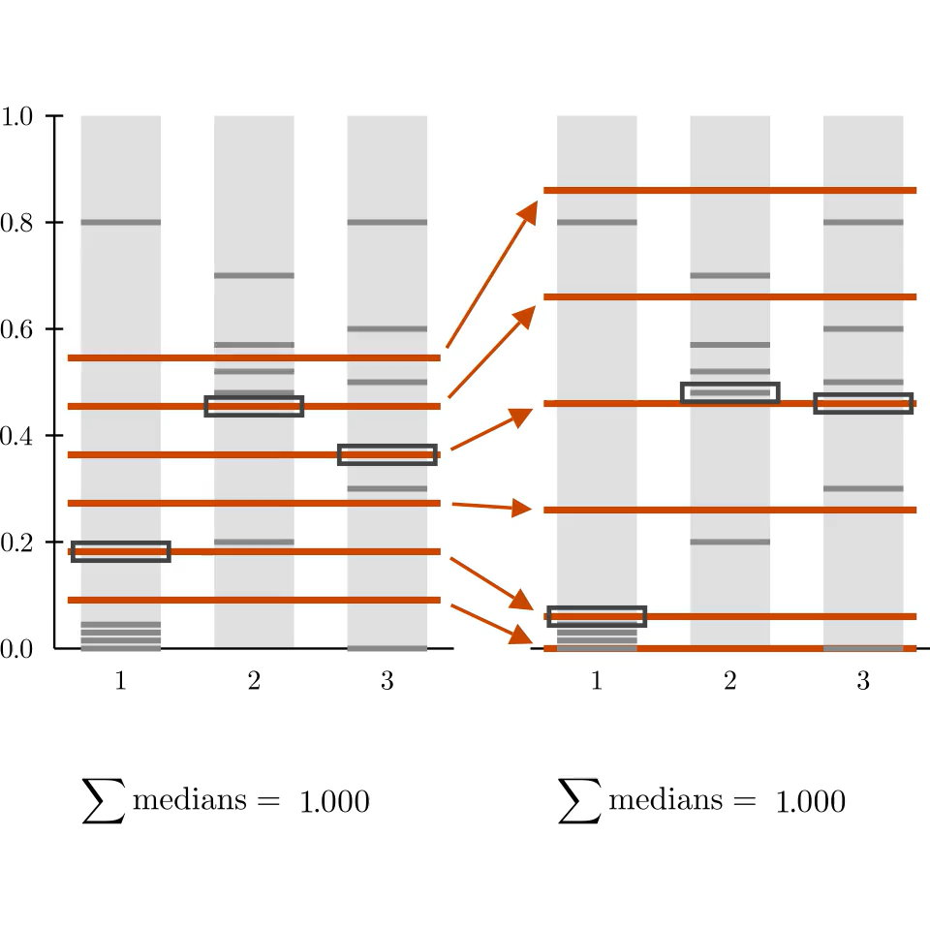
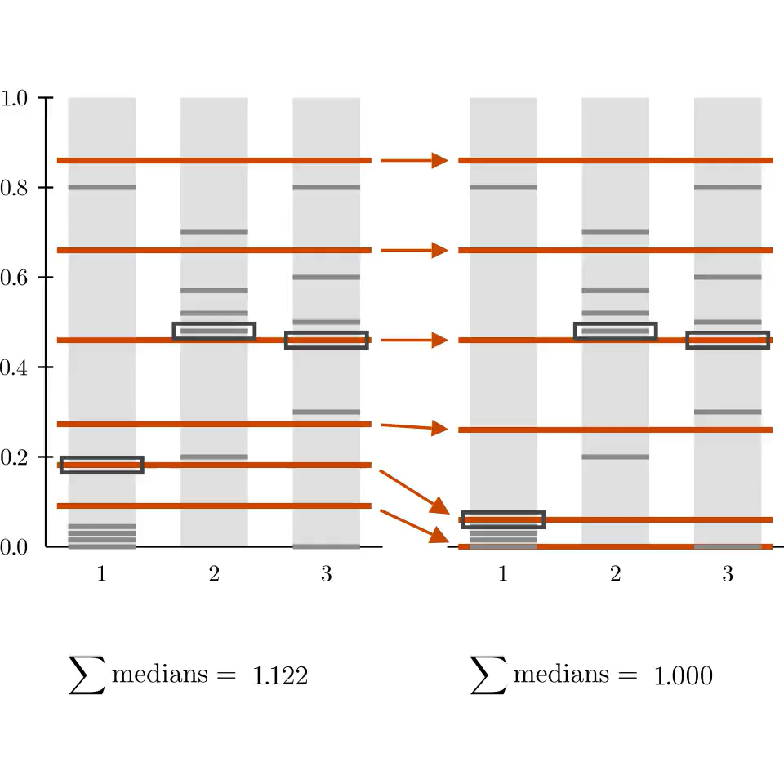
Phantom Domination Lemma
$$A$$
$$B$$
Let $A$ and $B$ be two phantom systems.
For some given votes let $α_{0},…,α_{n}$ and $β_{0},…,β_{n}$ be the positions of $A$ and $B$ at their respective times of normalization.
If we can transform $α_{0},…,α_{n}$ into $β_{0},…,β_{n}$
by moving the top phantoms up and the bottom ones down, then mechanism $B$ achieves higher social welfare than $A$.

Slide 23
References
R. Freeman, D. M. Pennock, D. Peters, and J. Wortman Vaughan, “Truthful aggregation of budget proposals,” Journal of Economic Theory, vol. 193, p. 105234, Apr. 2021.
H. Moulin, “On strategy-proofness and single peakedness,” Public Choice, vol. 35, no. 4, pp. 437–455, 1980.
F. Brandt, M. Greger, E. Segal-Halevi, and W. Suksompong, “Optimal Budget Aggregation with Star-Shaped Preferences.” arXiv, Oct. 2024.
I. Caragiannis, G. Christodoulou, and N. Protopapas, “Truthful Aggregation of Budget Proposals with Proportionality Guarantees,” in Proceedings of the 36th AAAI Conference on Artificial Intelligence (AAAI), Jun. 2022, pp. 4917–4924.
R. Freeman and U. Schmidt-Kraepelin, “Project-fair and truthful mechanisms for budget aggregation,” in Proceedings of the 38th AAAI Conference on Artificial Intelligence (AAAI), 2024, pp. 9704–9712.

