Slide 1
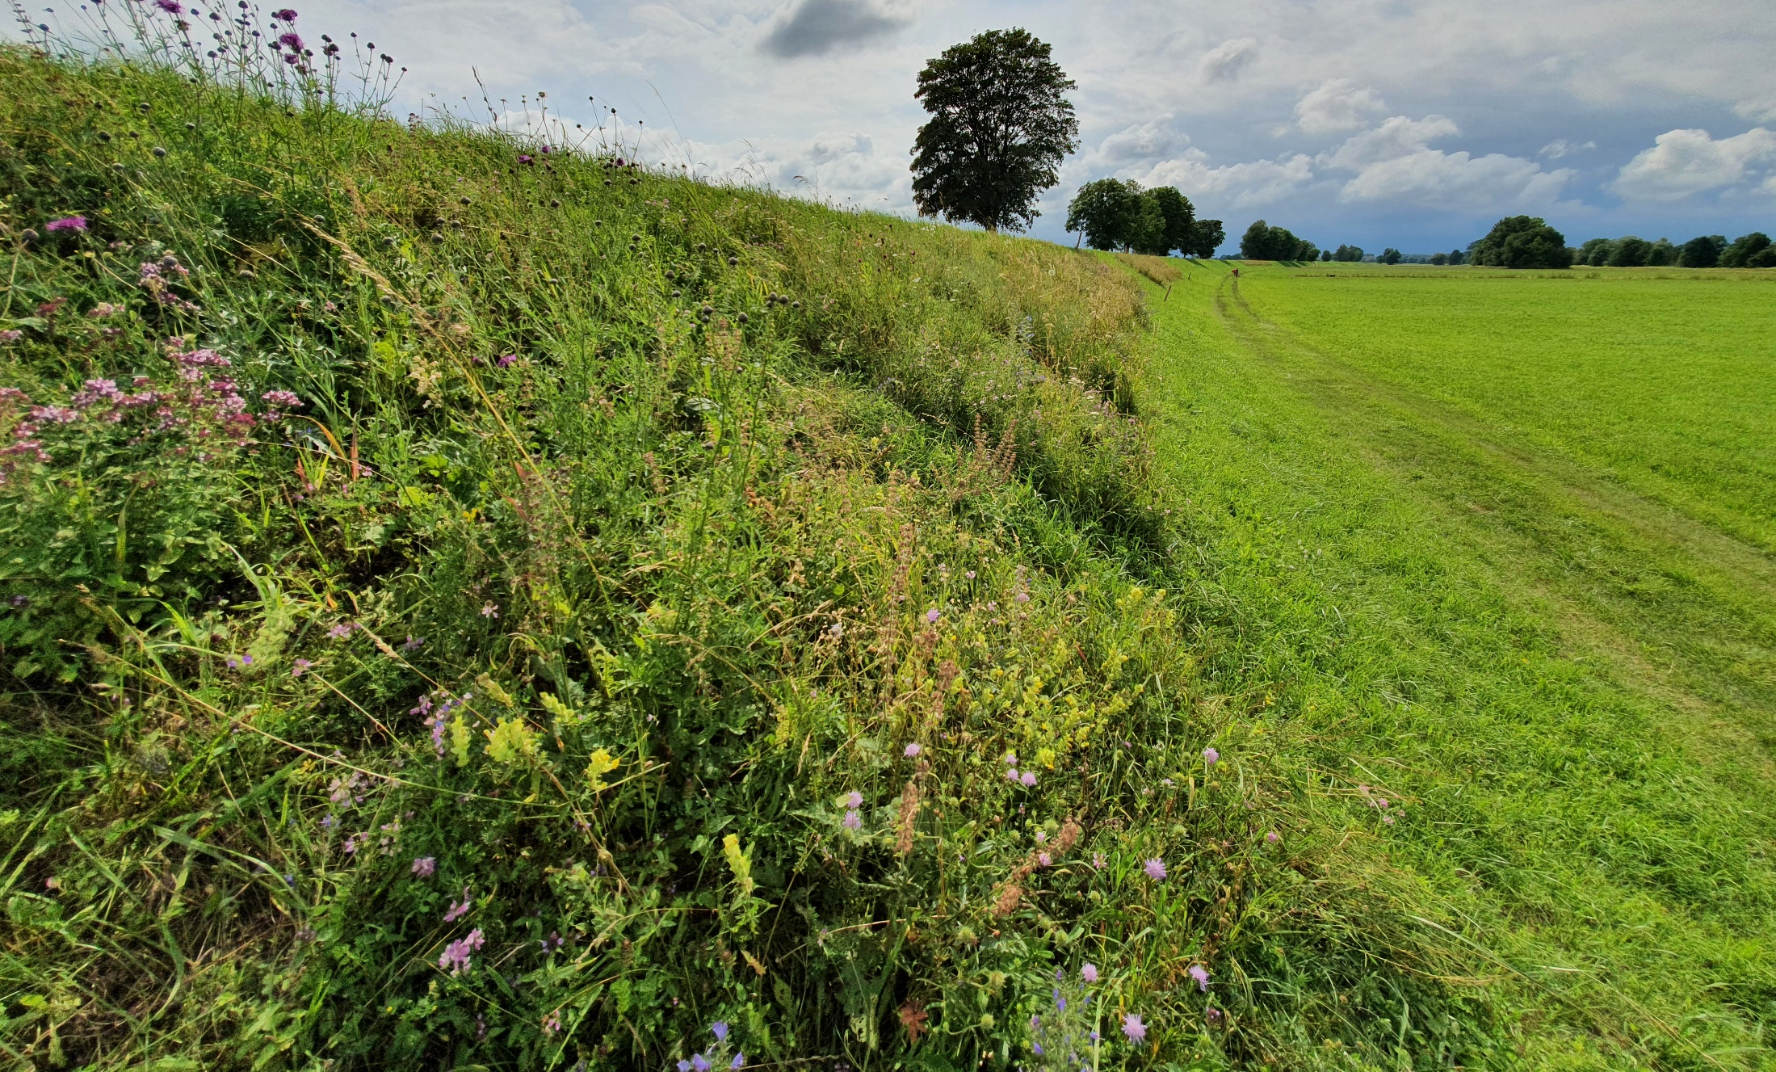
Southern dike
6 blocks
48 plots per block
North exposition of dike
South exposition of the dike
2m
71 m
Treatments | Levels
Soil type | 6
Seed mix | 4
Exposition | 2
48 plots per block
Markus Bauer

