Slide 1
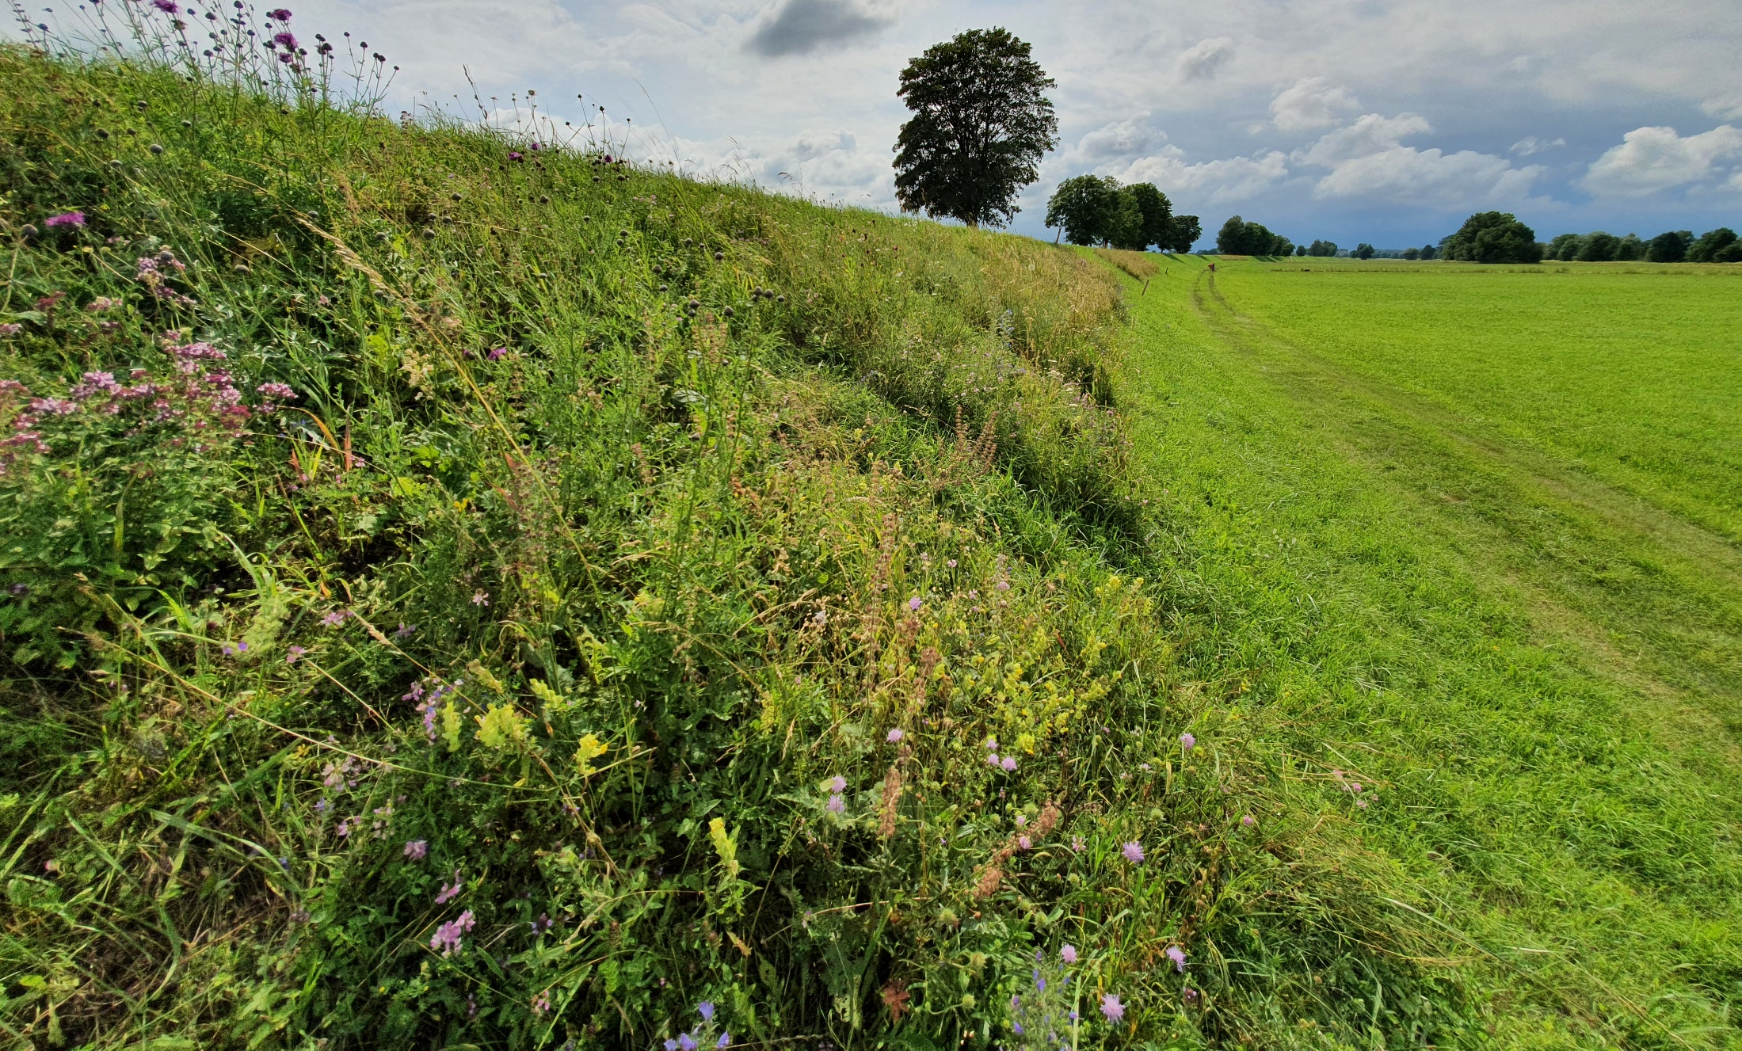
6 blocks
48 plots per block
North
South
2m
71 m
Treatments | Levels
Soil type | 6
Seed mix | 4
Exposition | 2
48 plots per block

