Slide 1

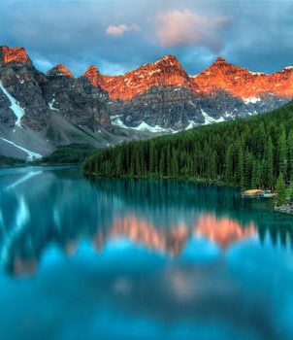
Your Alpin Sanctuary Awaits
A Digital Marketing Campaign for
Celestia Natura

Slide 2
Agenda
Product and USP
Target Audience and Pricing
Location, Promotion, and Brand Presence
Social Media Campaign

Slide 3
The Core of Celestia Natura
Core Offering: Luxurious wellness and rehabilitation services
Additional Features:
Exclusive access to a crystal-clear mountain lake
Diverse outdoor and indoor activities (e.g., meditation, physiotherapy)
Personalized dietary plans for every guest
USP: An exclusive sanctuary in the Tyrolean Alps – far away from distractions

Slide 4
Exclusivity for a Sophisticated Audience
Main Target Audience:
Affluent individuals, mostly aged 40+
Celebrities, athletes, and couples seeking privacy and relaxation
Pricing Strategy:
Premium pricing
Justified by world-class service and bespoke offerings

Slide 5
A Luxurious Retreat with Global Reach
Location:
Perched high in the Tyrolean Alps, surrounded by pristine nature
Promotion:
Partnerships with Golf clubs, yacht shows, and private aviation
Content marketing:
Themes on wellness, luxury, and lifestyle
Brand Presence:
Elegant website with virtual tours and a mobile app for personalized services

Slide 6
Who We Serve: Exclusive High-End Audiences
Primary Target Group:
Affluent, middle-aged adults (40–65 years)
Profile: Executives, entrepreneurs, retirees with high disposable income
Motivations: Stress-free environments for rejuvenation and connection with nature
Behavior: Follows luxury lifestyle content and books through exclusive platforms
Secondary Target Group:
Elite professional athletes (25–40 years)
Profile: High earners or sponsor-supported
Motivations: Access to world-class physiotherapy and tailored health programs
Behavior: Relies on professional networks or agents to find facilities

Slide 7
A Snapshot of Our Ideal Guest - Sophia van der Meer
Demographics:
Age: 45 | Profession: Global law firm partner | Income: €320,000/year
Location: Amsterdam, Netherlands | Marital Status: Married, no children
Lifestyle & Psychographics:
Enjoys: Yoga, hiking, fine dining, and curated wellness experiences
Values: Privacy, exclusivity, and seamless service
Pain Points & Goals:
Pain Points: Work-related stress, limited options for high-end retreats
Goals: Recharge mentally and physically, reconnect with nature, and experience bespoke wellness programs

Slide 8
Awareness Phase | Interest Phase | Decision Phase | Loyalty Phase
Attract attention to the exclusive luxury holiday home | Generate interest and engagement with the brand | Encourage bookings for potential customers | Ensure guests return and recommend the resort
Social media ads | Interactive Posts | Limited Time Offers | Tailored Post-Stay Communication
SEA (Google Ads, etc.) | E-Mail Marketing | Testimonials and Reviews | VIP Loyalty Program
Influencer Marketing | Personalized Newsletters | Remarketing Campaigns | Guest stories on Social Media
Content Marketing | Virtual Tour Videos | Streamlined Booking Experience | Exclusive early Access for previous guests

Slide 9
Social Media Advertising Overview
Objective: Leverage targeted advertising across key social media platforms to reach high-net-worth individuals globally
Platforms Highlighted: Facebook and Instagram
Ad Styles:
Story Ads: Immersive and visually appealing short-form ads showcasing Celestia Natura's serene mountain setting and luxurious amenities
Feed Ads: Eye-catching, professionally designed posts tailored for both Facebook and Instagram feeds, with actionable CTAs like 'Jetzt Buchen' and 'Angebot Einholen.’
Key Features:
Exclusive messaging emphasizing the unique wellness experiences
Stunning visuals that convey tranquility, luxury, and exclusivity
Engaging CTAs driving bookings and inquiries

Slide 10
Targeted Messaging and Audience Engagement
Ad Messaging Focus:
Relaxation and Wellness
'Discover Peace, Elevate Wellness' and 'Rejuvenate in the Heart of Untouched Nature’
Exclusivity:
Highlight private lakeside access, tailored dining, and expert wellness programs.
Urgency: Use of limited availability messaging, encouraging immediate bookings
Engagement Strategies:
Emotional appeal through idyllic imagery and personalized wellness promises
Strategic placement in profiles and feeds where target demographics engage Emphasis on driving actions through direct links and swipe-up features

Slide 11
Influencer Marketing
Objective:
Leverage influencer partnerships to elevate the resort’s image and expand its reach among high-net-worth individuals
Selected Influencers:
Manuel Feller: Austrian ski racer with a strong connection to wellness and resilience.
Wim Wenders: Filmmaker whose projects showcase stunning natural settings.
Nils Henkel: Michelin-starred chef aligning with the resort’s sustainable, high-end ethos.
Why It Works:
Enhances prestige by associating with renowned figures.
Aligns with the resort’s values of exclusivity, wellness, and sustainability.
Targets affluent, engaged audiences through influencer platforms.
Proposed Collaborations:
Social media campaigns and exclusive events
Content creation showcasing the resort’s breathtaking setting and premium services.

Slide 12
E-Mail Marketing
"Relive the magic of your stay with exclusive perks crafted for our loyal guests."
Exclusive Perks:
Private Chauffeur Service
Private Butler Service
Gourmet Dinner Under the Stars
Helicopter Tour of the Alps
Why Return?
Unparalleled luxury, breathtaking views, and personalized experiences.
Call to Action:
Reserve your return and let us elevate your next visit.
“We can’t wait to welcome you back to your home away from home!”

Slide 13
Strategic Keyword Research
Objective:
Attract organic traffic by targeting high-value keywords that highlight the resort’s USPs.
Focus Areas:
Wellness, nature, and exclusivity through topics like Experts in Wellness and The Calming Effect of Nature
SEO Highlights:
Custom URLs, optimized titles, engaging meta descriptions, and structured headings ensure maximum visibility.
Impact:
Positions the resort as a leader in luxury wellness while driving meaningful engagement and bookings.

Slide 14
Example Blog Details
Topic | Experts in Wellness | Outdoor Activities in Nature | Wellness for Mind and Body
Priority Keyword | Experts in Wellness | Outdoor Activities in Nature | Wellness for Mind and Body
URL | /highly-qualified-specialists | /outdoor-wellness | /wellness-body-mind
Title | Why Highly Qualified Specialists Are the Key to Your Wellbeing | Transform Your Health Through the Power of Outdoor Adventures | Discover Top Activities to Strengthen the Connection Between Body and Mind
Meta Description | Explore why highly qualified specialists in wellness and health are essential for personalized care, stress relief, and holistic well-being at luxury resorts. | Explore outdoor activities like hiking, meditation, and biking to enrich your wellness journey and rejuvenate body and mind. | Explore yoga, mindfulness, and tailored activities to balance body and mind, reduce stress, and improve mental clarity.
H1 | Why Wellness Professionals Matter | How Outdoor Activities Enrich Wellness | The Best Activities for Body and Mind
Sub-Headlines | - H2: The Role of Experts in Luxury Wellness- H3: Personalized Care for Stress Relief and Relaxation- H2: Specialists in Physiotherapy and Mental Health | - H2: The Benefits of Nature-Based Activities- H3: Guided Hikes for Body and Mind- H3: Mountain Biking and Meditation | - H2: How Yoga Improves Physical and Mental Wellness- H2: Mindfulness for Stress Relief

Slide 15
SEO Technical Requirements Overview
Objective:
Enhance website visibility and user experience through technical SEO improvements.
Key Focus Areas:
XML Sitemap
Page Speed
Internal Linking
Hreflang Tags
Mobile-Friendly Design

Slide 16
Core Success Criteria
XML Sitemap:
Validate with tools like Google Search Console and Screaming Frog.
Improve search engine listings with a well-structured sitemap.
Page Speed Optimization:
First Input Delay < 100 ms.
Time to Load < 3 seconds.
Google Lighthouse Performance Score ≥ 90.
Internal Linking:
Descriptive and intuitive anchor text.
Key pages are linked for easy navigation.
Reduced bounce rates and better user engagement.

Slide 17
Enhancing User Experience
Hreflang Tags:
Ensure correct language targeting for international audiences.
Prevent duplicate content issues.
Verify implementation with Hreflang Testing Tools.
Mobile-Friendly Design:
Pass Google’s Mobile-Friendly Test.
Seamless navigation and responsive elements for touch devices.
Manual and tool-based testing for performance.
Secure Website (HTTPS):
Encrypt user data with HTTPS.
Eliminate “Not Secure” warnings.
Use tools like SSL Checker to validate security.

Slide 18
Website Goals and Conversion Objectives
Primary Aim:
Attract potential customers, provide essential resort information, and convert visitors into leads or bookings.
Conversion Types:
Macro Conversions:
Directly contribute to revenue
Micro Conversions:
Smaller actions leading toward macro goals

Slide 19
Macro Conversions
Online Booking Completion
Goal:
Encourage visitors to book through the website.
KPIs:
Booking Form Submission Rate: Measures completed bookings.
Booking Revenue Generated: Tracks revenue from online bookings.
Newsletter Subscription
Goal:
Build an email subscriber base for lead nurturing.
KPIs:
Subscription Rate: Tracks engagement and sign-ups.
Email Open Rate: Evaluates content relevance and subscriber quality.

Slide 20
Micro Conversions
Blog Engagement
Goal:
Educate and inspire visitors through blog content.
KPIs:
Time Spent on Blog Pages: Reflects engagement with content.
Blog CTA Click-Through Rate: Measures effectiveness of calls-to-action.
Newsletter Subscription
Goal:
Allow visitors to visualize their stay with a virtual tour.
KPIs:
Virtual Tour Click Rate: Tracks interest in the feature.
Completion Rate of Virtual Tour: Indicates immersive and engaging experiences.

Slide 21
Google Data Studio Dashboard Concept
Objective: Provide an intuitive and interactive dashboard to monitor website performance and marketing outcomes.
Pages Overview:
Management Summary: High-level KPIs such as revenue, bookings, and occupancy.
Bookings & Revenue: Detailed breakdown by room type and booking trends.
Acquisition & Channel Traffic: Insights into traffic sources and trends.
Behavior of Users: Funnel and engagement metrics to optimize user experience.
Google Ads Metrics: Performance analysis of ad campaigns and keywords.
Key Features:
Interactive filters for customized views (e.g., time range, traffic source, device type).
Visualizations like scorecards, pie charts, bar charts, and funnels for easy interpretation.
Real-time data updates for timely decision-making.
Impact: Enables data-driven decisions, optimizes marketing efforts, and enhances website performance.

Slide 22
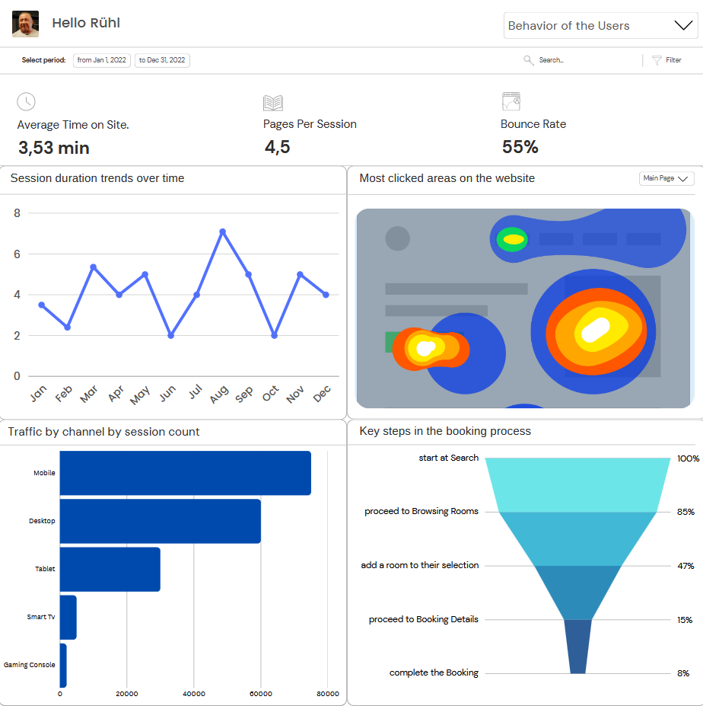
Google Data Studio Dashboard example

Slide 23
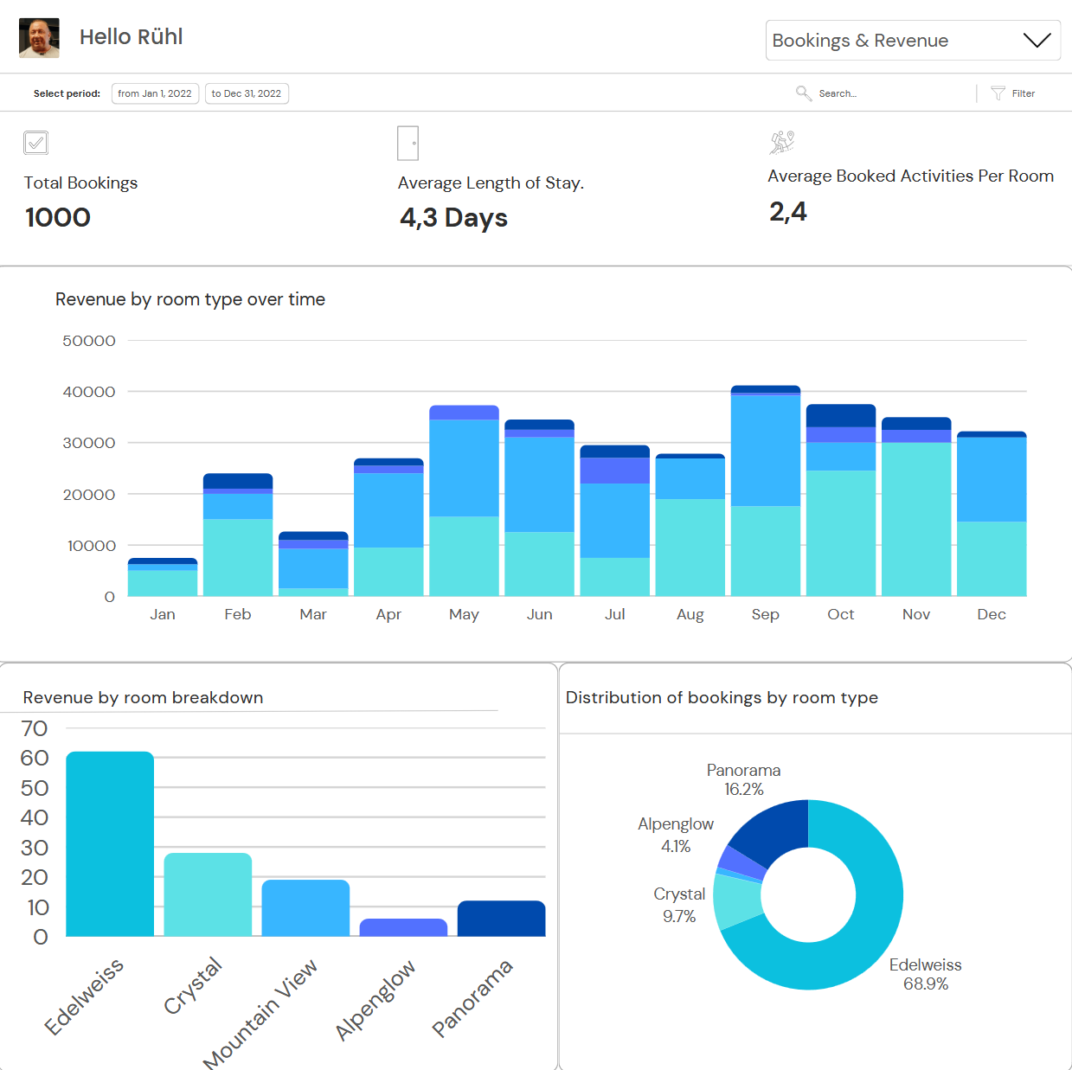
Google Data Studio Dashboard example

Slide 24
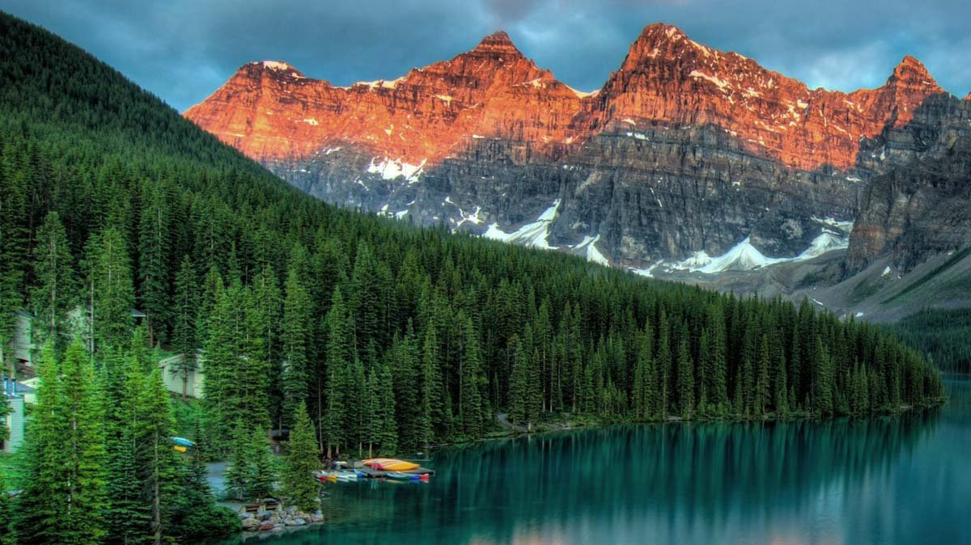
Your Alpin Sanctuary Awaits You

