Slide 1
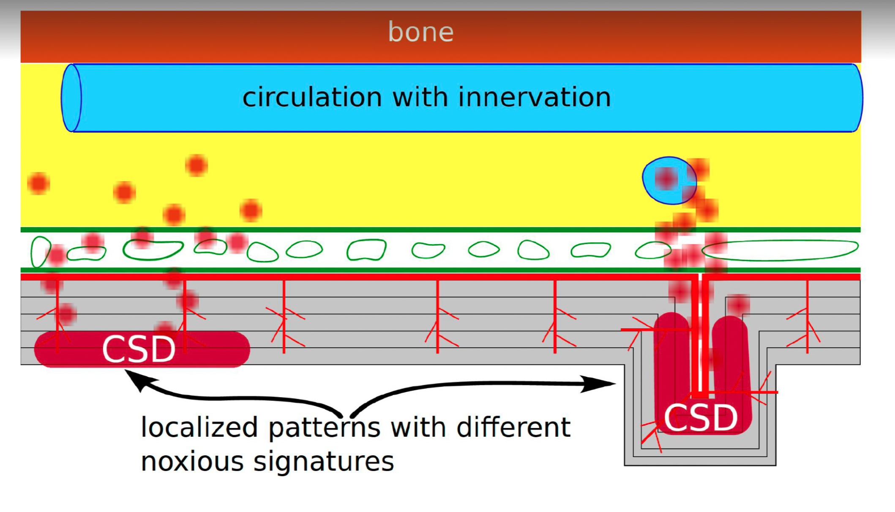
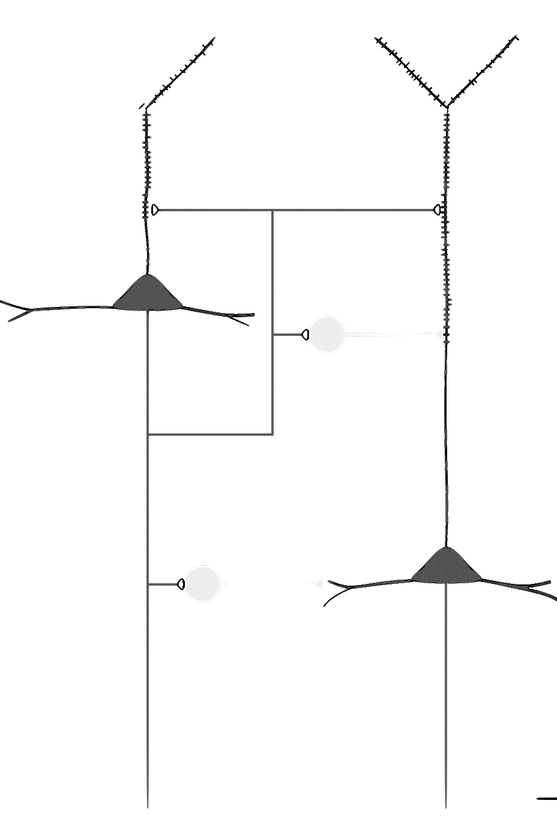
Target: Improve neurovascular coupling
Root cause: Hyperexcitable cortex

