Slide 1
OS-Level Python 3 Scripting
Useful Modules, Tips and Tricks
Markus Krause

Slide 2
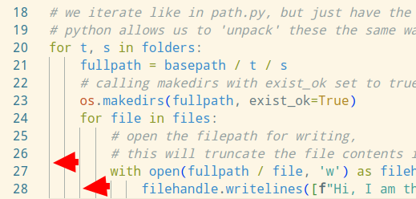
Python 3 - basics of basics
- Python uses indentation for functional blocks, there is no semicolons needed
- gold standard is 4 spaces - DO NOT USE TABS - DO NOT MIX WHITESPACE TYPES (!!!)
- editor with ‘falling’ indentation lines helps
- official documentation: https://docs.python.org/3/
- the ‘common oldest denominator’ if you wish to support almost all systems is Python 3.6, versions below that were early when Python 2 still dominated and were never widely adopted

Slide 3
“Shebang” shell line - how to call python correctly
- several options, none is truly 100% portable
- python3 should be requested directly, as some distros still have python 2.7 as default, so just using python is a slippery slope
- most likely the best variants:
#!/usr/bin/env python3
#!/bin/env python3
- also often seen:
#!/bin/python3
#!/usr/bin/python3
- do not code new stuff in python 2, it’s dead, deprecated and unsupported (and less nice)
- alternative: omit the shebang completely and call script via ‘python yourscript.py’ - not always the best option but guarantees you use the interpreter of your choice

Slide 4
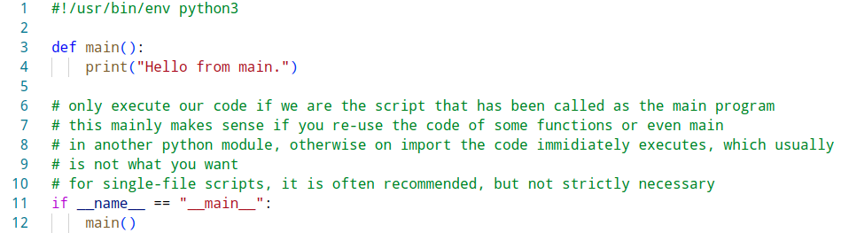

a word on if __name__ == “__main__”
- especially in python that mimics a script to be executed directly, you will find the infamous
if __name__ == “__main__”: construct
- this is to mark the execution entry point if the script is called as the top level by the interpreter
- purpose is to avoid unintended code execution when importing from your python file
- usually not a concern for single-file helper scripts
- if you are doing something more complex that consists of multiple files and imports: use it!
name_main.py

Slide 5
basic arithmetics and types
- integers are auto-sized in Python by the runtime, do not expect automatic overflows, they are signed
- + (add), - (sub), * (mult), % (modulo), ** (power of) function as expected
- Division is special:
- / is floating point division and will return a float even if the result fits in an integer
- / also is ‘overloaded’ in some contexts for other functions (see pathlib sections)
- // is flooring division, it always rounds DOWN, resulting type is int, or float min. one operand was float
- + (add) has also many other uses when not used on integers, e.g.:
- you can concatenate lists
- you can concatenate strings
- for very powerful matrix, vector, analytical math and data science, there is numpy, scipy and pandas, but these are normally not used in OS-level scripting and come with huge dependencies

Slide 6
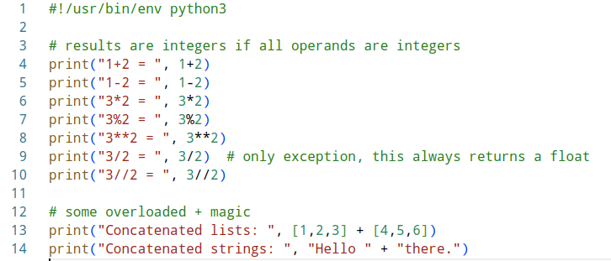
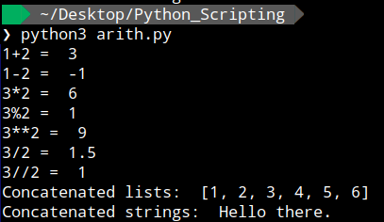
basic arithmetics and types
arith.py and its output

Slide 7
strings
- python strings can be delimited using “ ” or ‘ ‘, which is useful for nesting if you need these within the string
- f” “ marks a format string, where within { } variables an expressions can directly be inserted, this makes for very readable templating
- the older .format or C-style %-formatting syntax is also still available
- consult the official docs for formatting options, there is a lot available (pre-/after comma digits, hex, bin, filling with zeroes and much more) https://docs.python.org/3/library/string.html#format-examples
- there are loads of useful helper functions like split, join, endswith, startswith, find etc.
- if you want to check if a substring is within a given string, you can just use the ‘in’ operator
- for more complex pattern matching there are the fnmatch and regex modules, these go beyond the scope here, check their docs and the excellent howto:
- https://docs.python.org/3/library/fnmatch.html?highlight=fnmatch#module-fnmatch
- https://docs.python.org/3/howto/regex.html

Slide 8
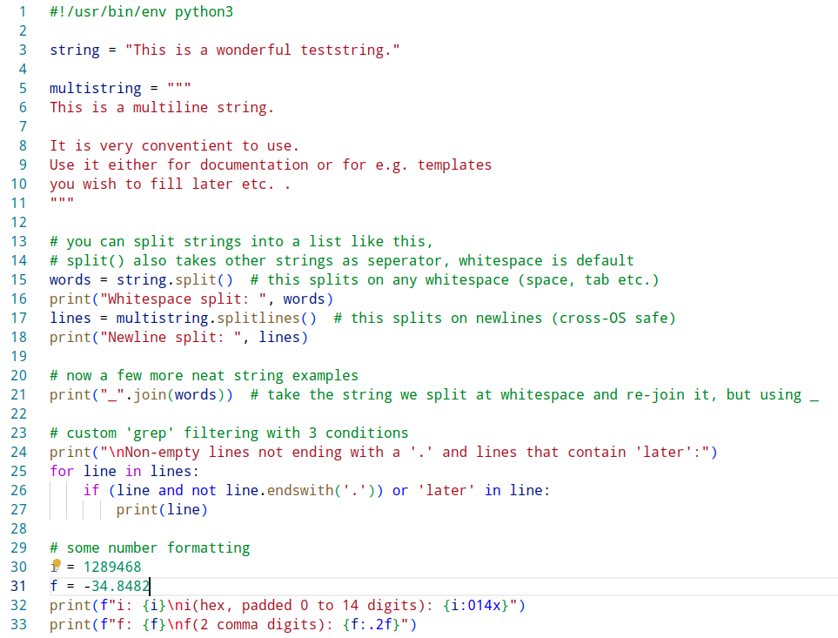
strings
strings.py

Slide 9
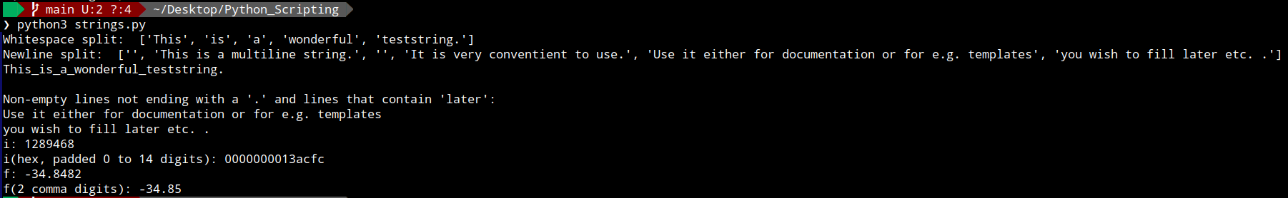
strings
Example output of strings.py:

Slide 10
collections
- pythons collections are one of the most powerful features of the language
- beware: the normal dictionary (aka HashMap in other languages) guarantees retention of insertion order in CPython in 3.6 and it is an actual language feature in 3.7, but if you rely on it, using OrderedDict explicitly might be a good idea
- next to lists, which can grow and shrink, there is also the fixed tuple, which mostly behaves like a list, but cannot be modified after creation (uses () instead of [] around it)
- another useful one is the ‘set’, which is unordered, unchangeable, and does not allow duplicate values
- there are also more fancvy containers like ‘deque’ (double-ended queue)
- dict, list, tuple and set are standard features and available without any import, others can be retrieved using the standard module import ‘collections’
- check the official docs for all the awesome features: https://docs.python.org/3/library/collections.html
- beware variables containing a collection are POINTERS, so an assignment will not copy the underlying collection unless explicitly requested using .copy()

Slide 11
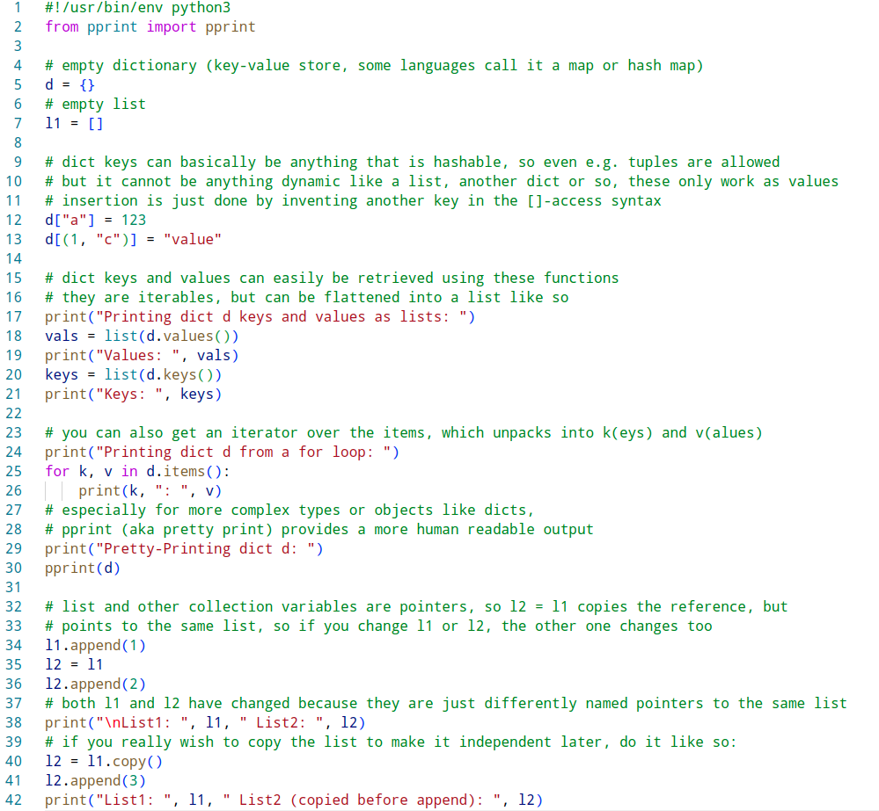
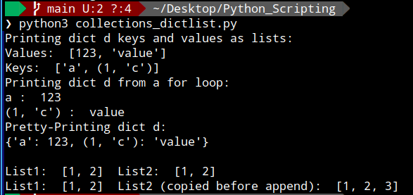
collections - dict and lists
collections_dictlist.py and its output:

Slide 12
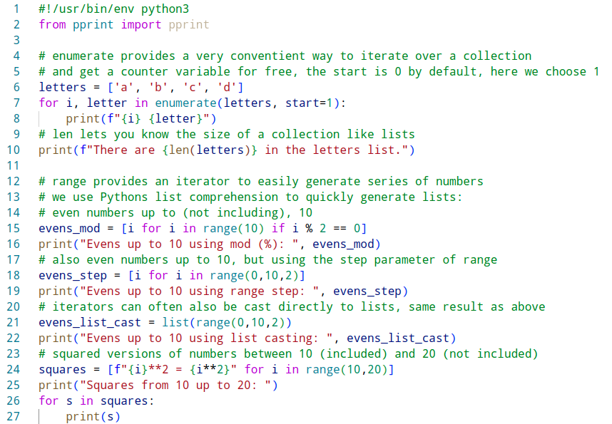
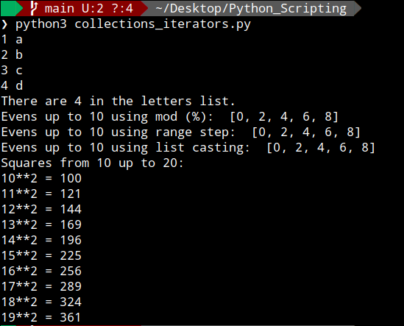
collections - iterators
collections_iterators.py and its output:

Slide 13
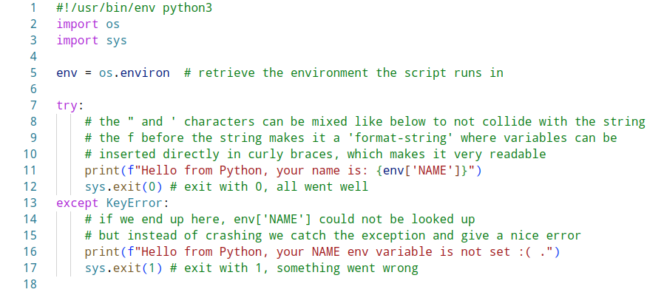
sys/os-module - exit codes and environment
sys_os.py

Slide 14
pathlib-module - os path handling
- pathlib is a cross-platform way of handling paths, and preferred in most cases over the old os.path
- automatically handles path delimiters the right way (“/” or “\”)
- by now in Python 3, Path classes are accepted basically by almost all system functions that also take simple strings as path inputs
- provides an overloaded / operator to easily attach further directories in the form of strings
- provides loads of useful check-functions like exists(), is_absolute()
- with iterdir() it is easy to iterate over all files in a directory
- with chmod() you can set permissions on a path
- loads more functionality, see the spec: https://docs.python.org/3/library/pathlib.html#pathlib.Path

Slide 15
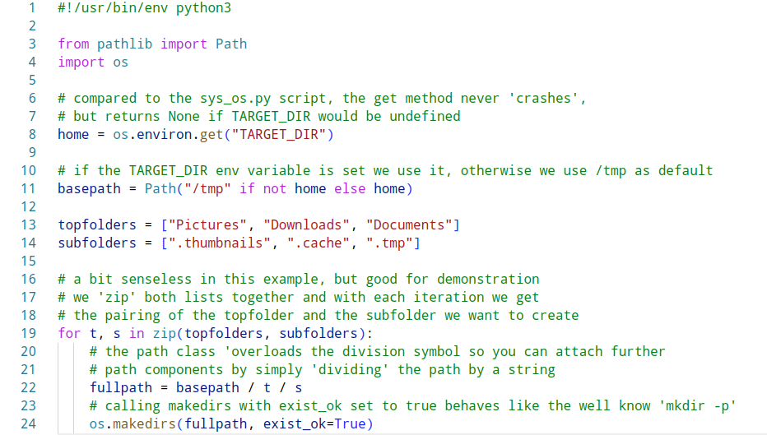
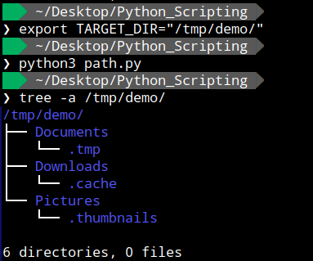
pathlib-module - os path handling
path.py script and its output:

Slide 16
file handling
- file handling in python comes with many very useful convenience functions
- file handles are usually aquired using the ‘with’ context manager and the ‘open’ function
- most common open modes are (for more see spec): ‘w’ for write, ‘r’ for read, ‘a’ for append
- the context manager ensures after the block is done, the file handle is properly closed and if stuff goes wrong, you get a meaningful stack trace from the program
- file handling goes well together with the previously mentioned pathlib module

Slide 17
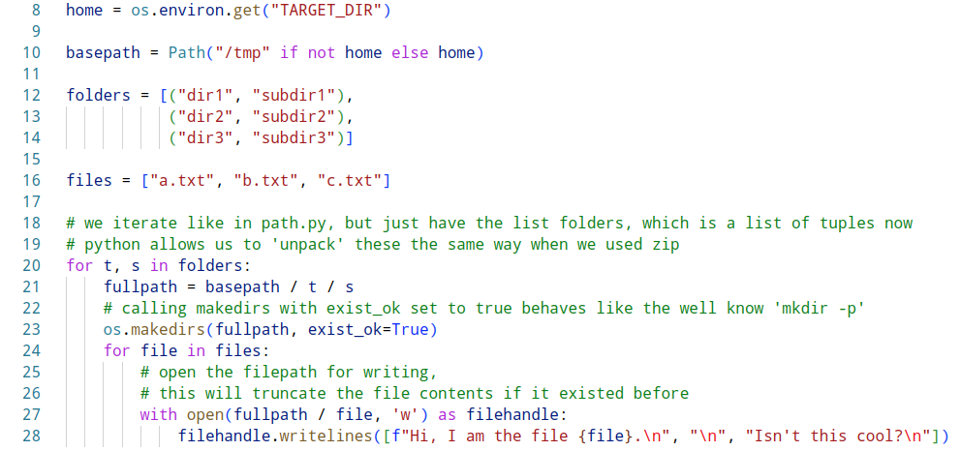
file handling
files.py

Slide 18
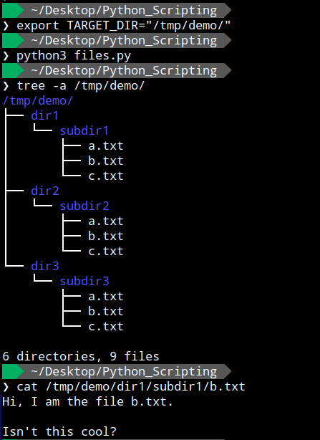
file handling
Example result of the files.py script:

Slide 19
user input
- except using env variables, there is several options to input things into the program either using e.g. command line arguments, config files or interactive input
- interactive textual input on the CLI is aquired using the ‘input’ function
- we can also get fancier and build a command-line UI using e.g. pydialog (not part of the standard library, must be installed via os-package or pip), docs are here: https://pythondialog.sourceforge.io/doc/widgets.html
- python offers easy input for all kinds of standard config and data formats including but not limited to: JSON, INI, TOML, YAML, CSV, XLS(X) (some of them require extra packages which must be installed to work)
- to build a proper command line tool with flags and positional arguments or subcommands, using the module argparse is strongly recommended

Slide 20
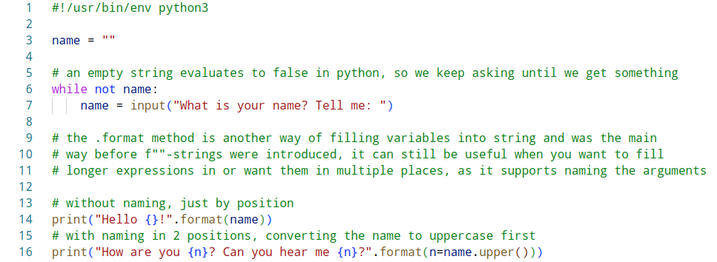
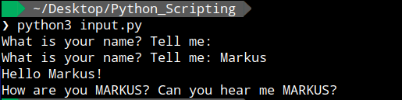
user input - input function
input.py

Slide 21
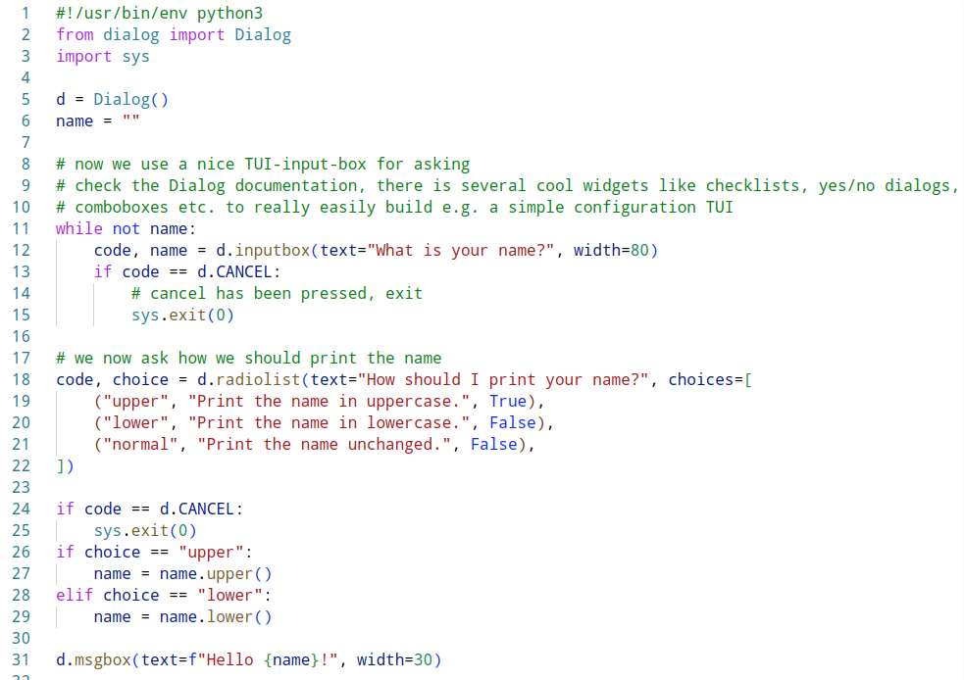
user input - pydialog
dialog_input.py

Slide 22
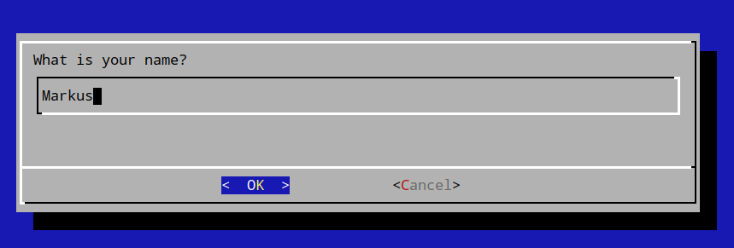
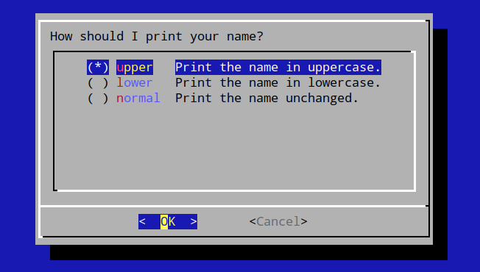
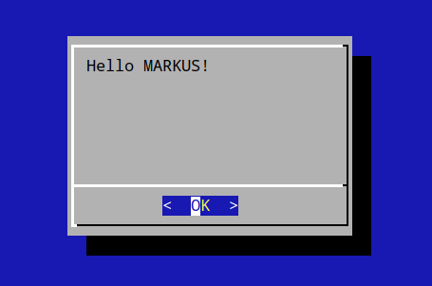
user input - pydialog
Example output for dialog_input.py

Slide 23
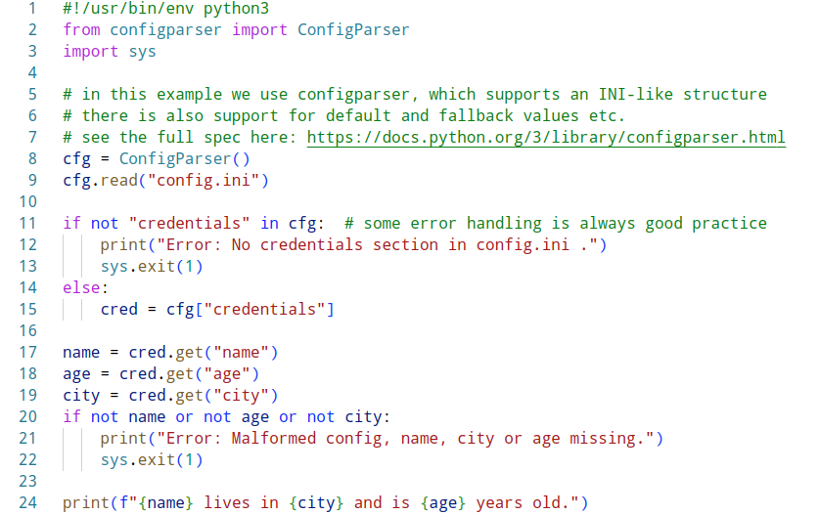


user input - configparser ini file
config.ini
Example output:
config_input.py

Slide 24
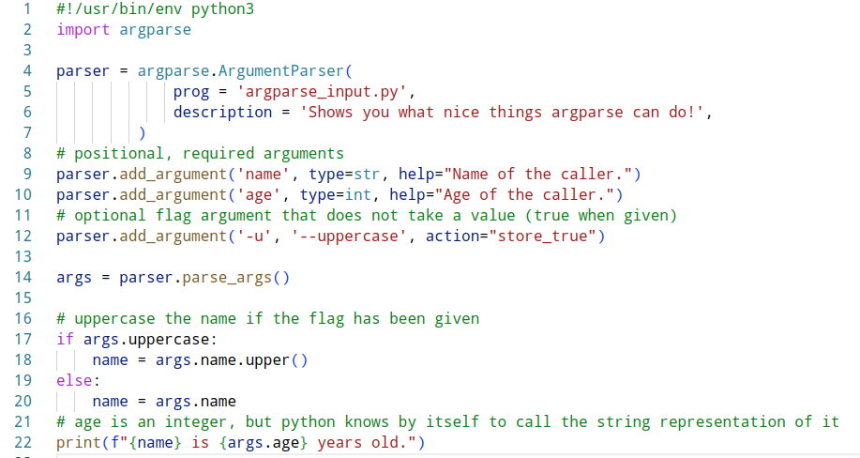
user input - argparse CLI interface
argparse_input.py

Slide 25
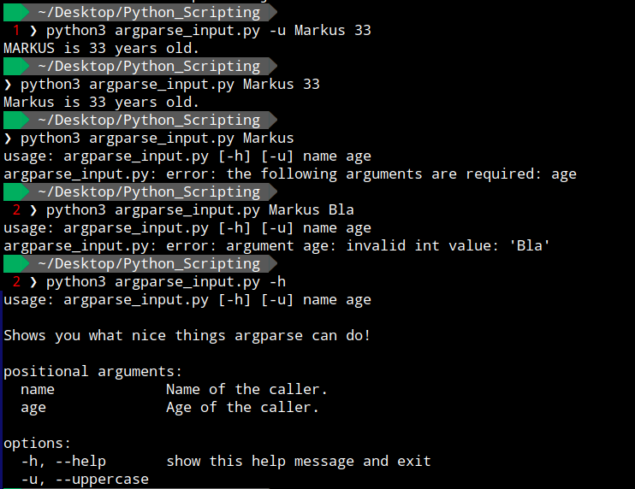
user input - argparse CLI interface
Example output for argparse_input.py
- checks type and presence of args
- auto-provides help

Slide 26
subprocess-module - running programs
- subprocess is part of the python standard lib and the main way to run programs from your script
- provides a clean interface to get STDOUT, STDERR, exit codes, create pipes
- large amount of parameters to control execution, e.g.:
- cwd to set the current working directory the process runs in
- env to pass a possibly manipulated environment
- stdout=PIPE, stderr=PIPE or capture_output=True (for both) to capture program outputs
- shell to request execution inside a shell context (avoid if not explicitly needed, because security)
- input parameter to construct pipes by sending in the output of a previous command
- documentation at: https://docs.python.org/3/library/subprocess.html

Slide 27
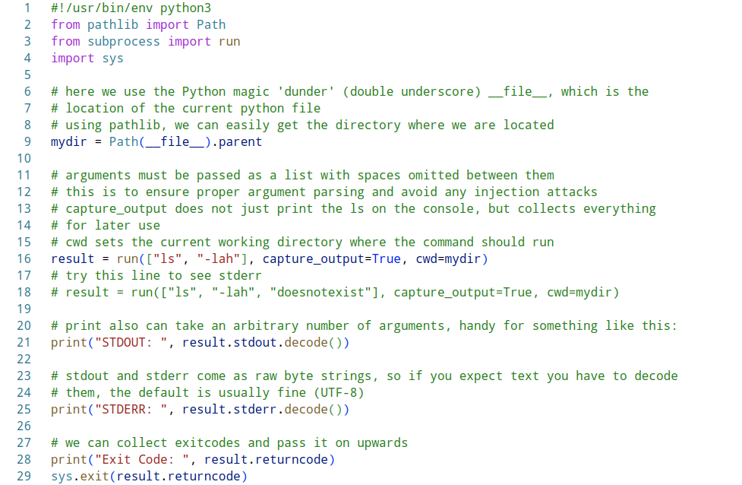
subprocess-module - running programs
subprocesses.py

Slide 28
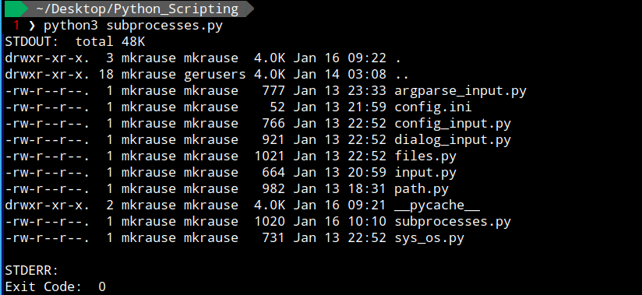
subprocess-module - running programs
Example result of the subprocesses.py script:

Slide 29
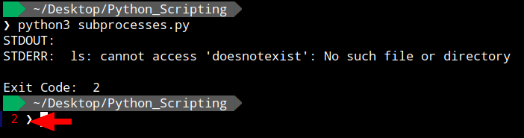
subprocess-module - running programs
When using the other call that results in an error, we can see the STDERR and Exit code
Example result of the subprocesses.py script with STDERR:

Slide 30
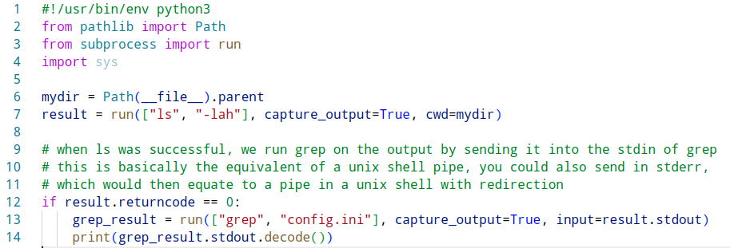

subprocess-module - constructing pipes
Use the input parameter to construct a pipe into another program call
subprocesses_pipe.py
Example output:

Slide 31
closing remarks
- use the official python docs and an editor with proper formatting and completion, we only scratched the surface here, all the collections, modules and types have loads more nice functionality that makes the python standardlib one of the best out there
- if you use leading edge stuff like the new switch-case statement in 3.10, make sure the systems you are targeting can support that (as said, in IT anything conforming to 3.6 or 3.8 for newer ones is a good call right now)
- educate yourself on Python environment tools like conda, pipenv, poetry etc., these can give you reproducible environments where you can test your stuff against a fixed version and set of dependencies
- don’t be ashamed to google the ‘pythonic’ way. usually for certain things there is a recommended and sleek way to do it, which the community happily communicates.
- especially for scripting and IT purposes, stick to standard CPython and keep your dependencies in check, this will keep your stuff portable and easily deployable

Slide 32
THANK YOU
You can find all the files of the tutorial and this presentation on GitHub:
https://github.com/markusdd/python_scripting_tutorial

