Slide 1
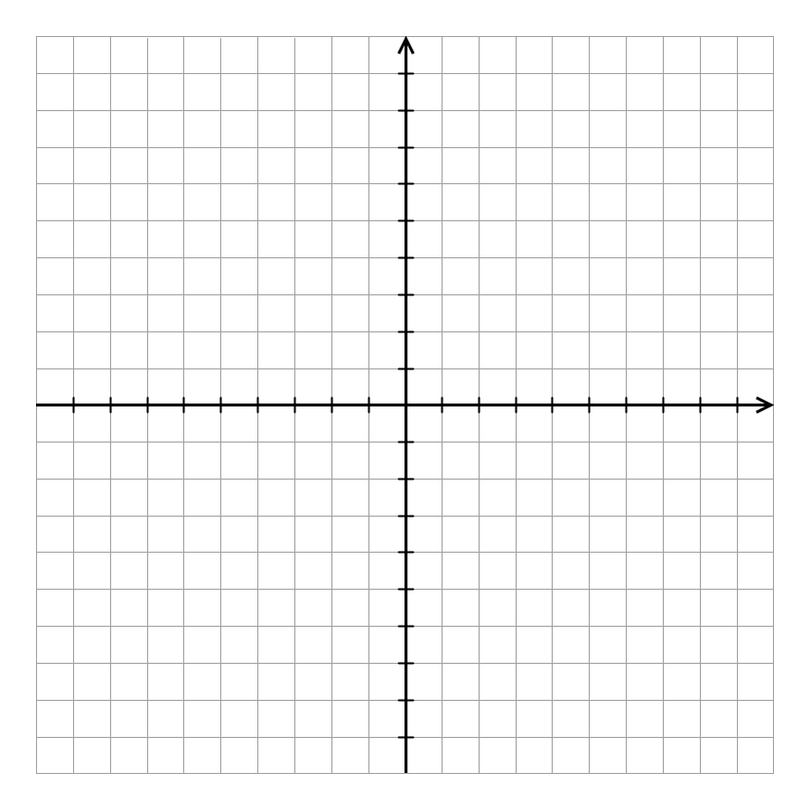
x₂
8
6
p₃
4
p₄
p₂
A₁
A₀
2
A₂
p
A₄
p₀
A₃
-8
-6
-4
-2
2
p₁
4
6
8
x₁
-2
-4
-6
-8

Slide 2
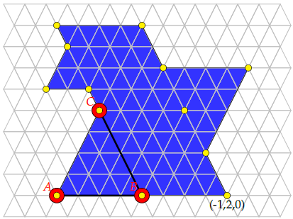
(0,-1,2)
(-1,0,2)
(0,-.75,1.75)
(-1,0.5,1.5)
(-2,1.5,1.5)
(0.5,-0.75,1.25)
(0,-0.25,1.25)
(-1,1,1)
(0,0,1)
(-1,1.5,0.5)
(1,0,0)
(0,1,0)

