Slide 1
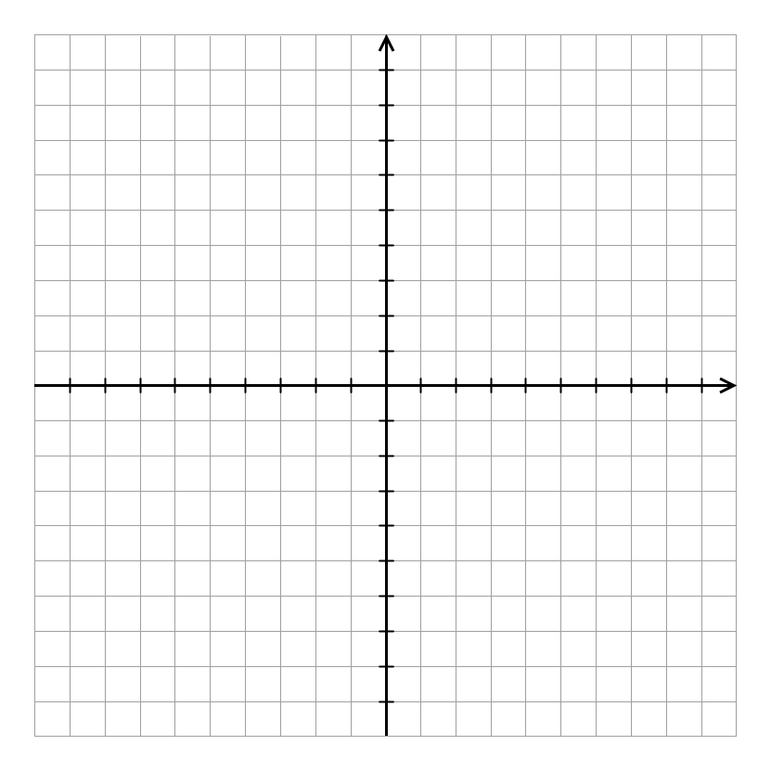
x₂
8
6
p₃
4
p₄
p₂
2
p
p₀
-8
-6
-4
-2
2
p₁
4
6
8
x₁
-2
-4
-6
-8

Slide 2
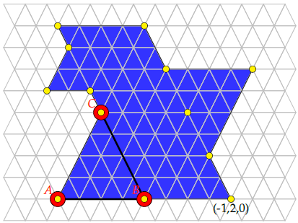
(0,1,2)
(-1,2,2)
(0,1,1.75)
(-1,2,1.5)
(-2,3,1.5)
(0.5,-0.5,1.25)
(0,1,1.25)
(-1,2,1)
(-1,2,0.5)

