Slide 1


Multi-armed (binomial) bandits
Prof. Dr. Markus Löcher
Notes:
In probability theory, the multi-armed bandit problem (sometimes called the K- or N-armed bandit problem) is a problem in which a fixed limited set of resources must be allocated between competing (alternative) choices in a way that maximizes their expected gain, when each choice's properties are only partially known at the time of allocation, and may become better understood as time passes or by allocating resources to the choice.^{[3][4]} This is a classic reinforcement learning problem that exemplifies the exploration-exploitation tradeoff dilemma. The name comes from imagining a gambler at a row of slot machines (sometimes known as "one-armed bandits"), who has to decide which machines to play, how many times to play each machine and in which order to play them, and whether to continue with the current machine or try a different machine.

Slide 2
Outline
Blitz review of classical testing
Tradeoff in power and sample size
Testing two proportions
Loss Functions in testing
Beta-Binomial Test (Bayes)
Main ideas of Sequential Testing
Bandits
Adaptive Allocation
Regret Minimization
Over Promising ?
2

Slide 3
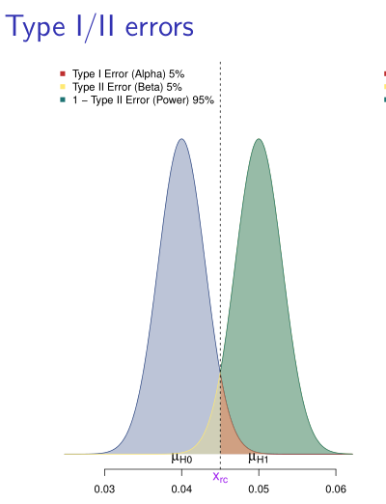
Null-hypothesis significance testing (NHST)
Sample size depends on α, power and effect size, e.g. n=168 for
One-sample tests reject the Null with no regard to the alternative
No way to account for streaming data
https://tinyurl.com/u4zudgv
3

Slide 4
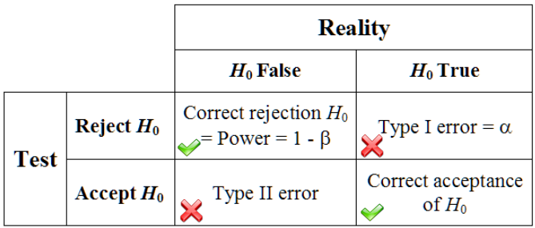
Hypothesis Testing
Hypothesis Testing
A type I error is the incorrect rejection of a true null hypothesis.
false positive (α)
test incorrectly indicates disease
medical treatment appears to cure a disease
A type II error is the failure to reject a false null hypothesis.
false negative (β)
blood test failing to detect the disease
clinical trial of a medical treatment failing to show effect
4
Notes:
Luckily our students have seen such an „asymmetry“ before, in the context of Bayes theorem and probability trees !

Slide 5
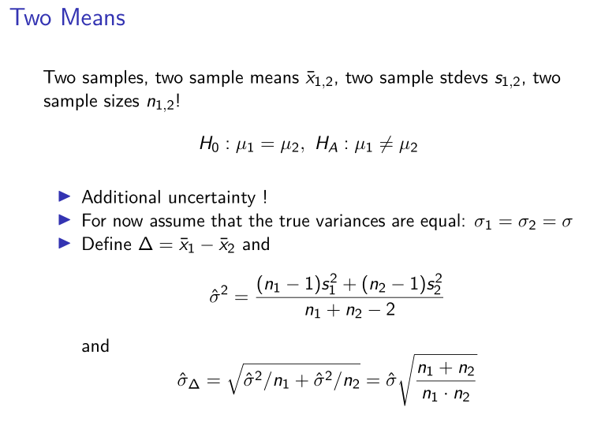
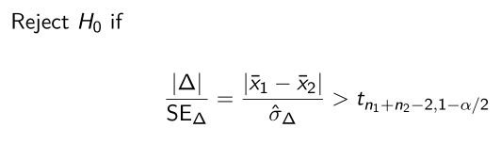
Two Sample Test
Testing two proportions
Power calculation demands 22K observations!
AB Testing
5
Notes:
Very similar to one-sample test

Slide 6
Testing two proportions
Normal approximation for reasonable n
How many samples would we need to differentiate p₁=0.04 from p₂=0.05 ?
Relevant for e.g. AB tests for click rates on Web pages
Following statements are tempting:
„The p-value is the probability that H₀ is true.“
„There is a 95% probability that page A is better than page B„
„There is a 95% probability that Δ lies in this in this interval“
6
Notes:
Power calculation demands 22K observations!
Awkward even when teaching about pvalues:
„What does a super low p-value of 0.0001“ mean ?

Slide 7
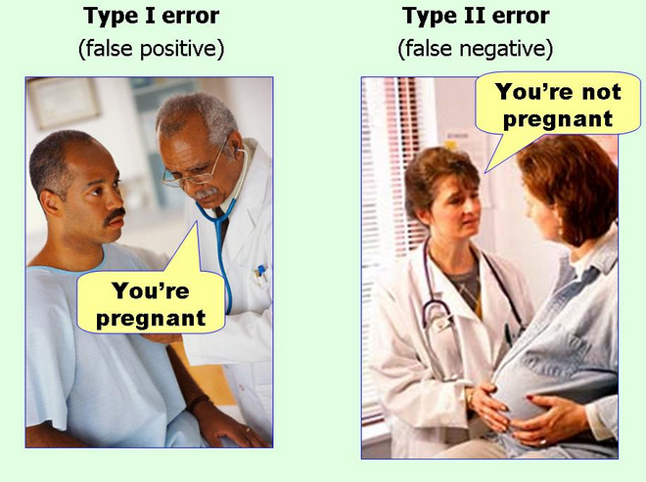
Loss Functions
NHST guarantees typeI/II error rates; how to translate those into „costs“ is up to the user.
Asymmetry: In most situations the costs will be drastically different for the two errors.
How would we „globally“ optimize over n, α, β ?
For click rates, a natural (symmetric) loss function would be the difference in expected clicks.
7
Notes:
Think medical context, car alarms, airport security, …
Compare to classification

Slide 8
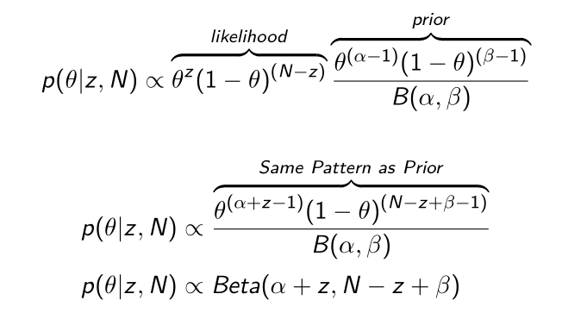
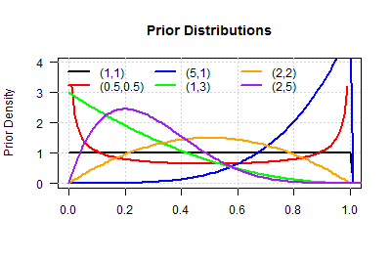
Beta Binomial
The Beta distribution is a conjugate distribution of the binomial distribution.
8

Slide 9
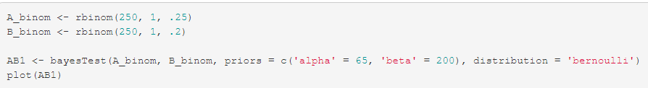
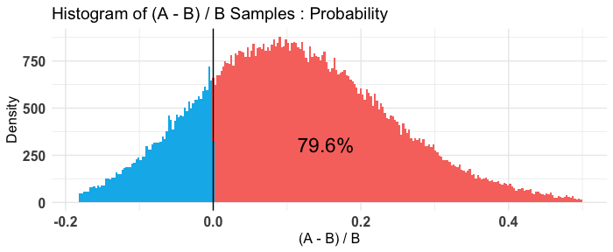
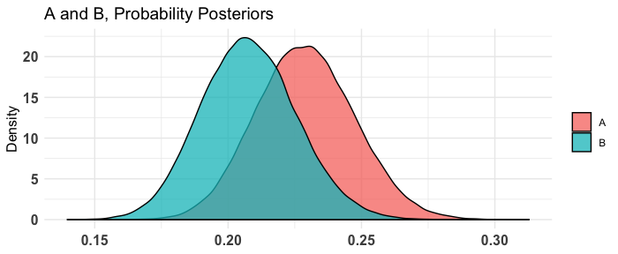
Bayes Testing
9
Notes:
As mentioned above, there are several reasons to prefer Bayesian methods for A/B testing (and other forms of statistical analysis!). First of all, interpretability is everything. Would you rather say “P(A > B) is 10%”, or “Assuming the null hypothesis that A and B are equal is true, the probability that we would see a result this extreme in A vs B is equal to 3%”? I think I know my answer. Furthermore, since we get a probability distribution over the parameters of the distributions of A and B, we can say something such as “There is a 74.2% chance that A’s λλ is between 3.7 and 5.9.” directly from the methods themselves.

Slide 10
Sequential Testing
In a traditional (frequentist) NHST setup, we need to decide on the smallest effect size that we want to detect prior to running the experiment and commit to it !
Dilemma: what if true effect size was larger:
Ideally, we would like to „peek“ every so often and stop the test early in case sufficient evidence against a zero effect has emerged
10
Notes:
The ensuing dilemma is obvious: while we might be willing to spend the ressources necessary if the signal-to-noise ratio is so low that we need large sample sizes; at the same time, we naturally would like to be able to stop the experiment early in case sufficient evidence against a zero effect has emerged.
For example, if the true effect size was twice as high as our expectation/safeguard, we could have gotten away with n=

Slide 11
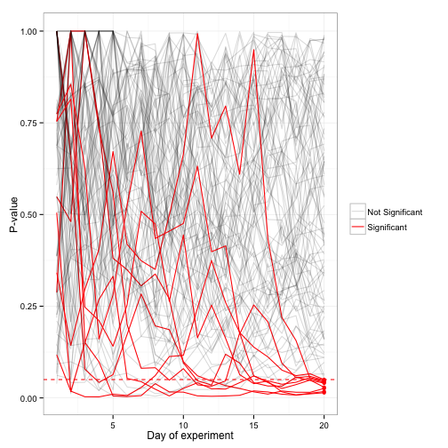
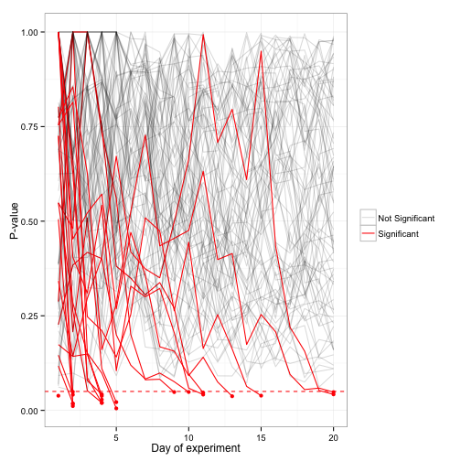
Optional Stopping
11
Notes:
Unfortunately, this leads to a common pitfall in performing A/B testing, which is the habit of looking at a test while it’s running, then stopping the test as soon as the p-value reaches a particular threshold- say, .05. This seems reasonable, but in doing so, you’re making the p-value no longer trustworthy, and making it substantially more likely you’ll implement features that offer no improvement.

Slide 12
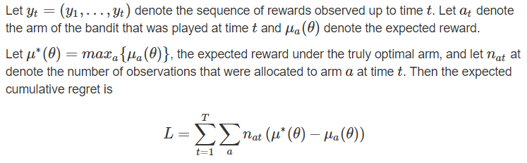
Regret
Optional stopping attempts to minimize „loss“ (sample size) during the testing phase (equal allocation)!
An even greedier strategy would be to adjust the fraction of samples in favor of the more promising „arms“: hoping to minimize regret
12
Notes:
Our simulation studies focus on regret, the cumulative expected lost reward, relative to playing the optimal arm from the beginning of the experiment.

Slide 13
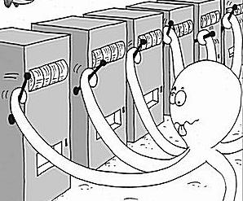
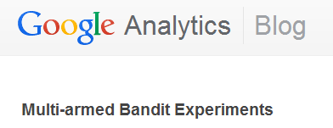
From static to streaming data
Trade-off between acquiring new information (exploration) and capitalizing on the information available so far (exploitation).
Sequential Decision Making
Adaptive Trials
Web site optimization, A/B testing
Decisions are typically made much faster.
Too good to be true ?
13
Notes:
Let us explain it in website optimization context. Suppose you have two versions of a landing page (say a control and a variation). In normal A/B testing, you will split your traffic equally between these two versions, so both get 50% traffic.

Slide 14
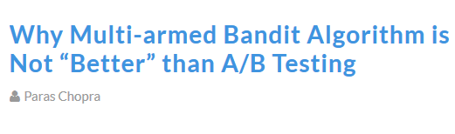
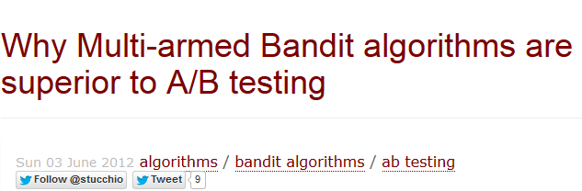
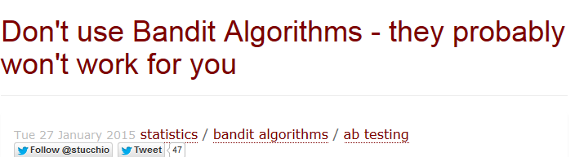
Multiarmed Bandits
Not without controversy
Many implementations
1. UCB algorithms
2. Play-the-winner 3. ɛ-greedy strategies
4. Thompson Sampling
14
Notes:
Let us explain it in website optimization context. Suppose you have two versions of a landing page (say a control and a variation). In normal A/B testing, you will split your traffic equally between these two versions, so both get 50% traffic.

Slide 15
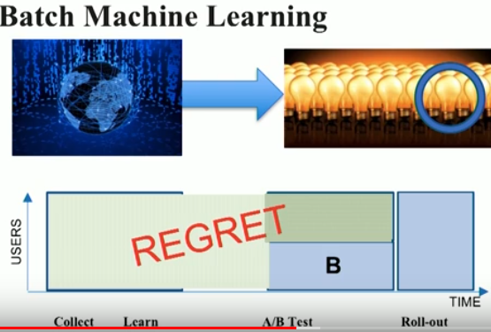
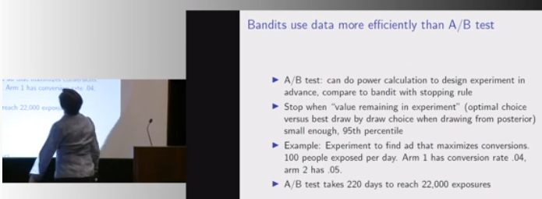
Prominent Advocates
Tony Jebara, Head of Netflix Machine Learning
Prof. Susan Athey, Stanford University
15

Slide 16
Background
The math behind the multi-armed bandit problem is so hard that approximate heuristic solutions are used in practice. The mathematical difficulties are neatly summarized in a famous quote by Peter Whittle (Whittle, 1979):
Thompson Sampling combines many of the best features of these heuristics.
[The bandit problem] was formulated during the [second world] war, and efforts to solve it so sapped the energies and minds of Allied analysts that the suggestion was made that the problem be dropped over Germany, as the ultimate instrument of intellectual sabotage.
16

Slide 17
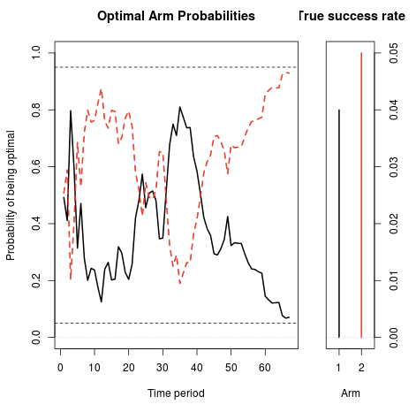
Binomial Bandit, two arms
Imagine true conversion rates of 4% and 5%
Power calculation demands 22K observations (~220 days)
Readjust traffic every day depending on the posterior probability of one arm being better than the other.
Average savings of 175 days!
17

Slide 18
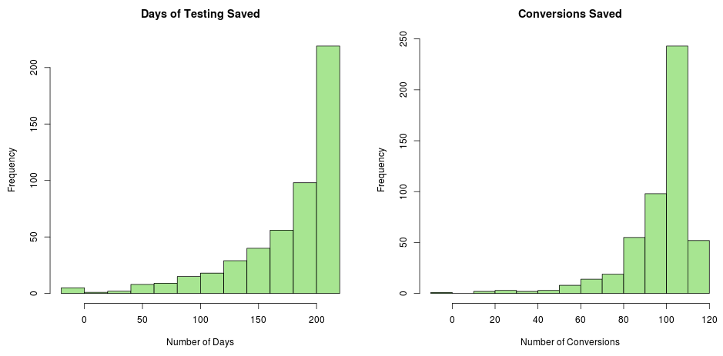
Stopping Criteria
Value remaining: ends the experiment when there’s at least a 95% probability that the value remaining in the experiment is less than 1% of the champion’s conversion rate.
Thompson sampling assigns visits to arms in proportion to the probability that each arm is optimal.
18

Slide 19
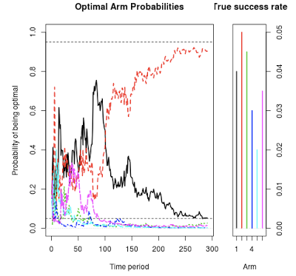
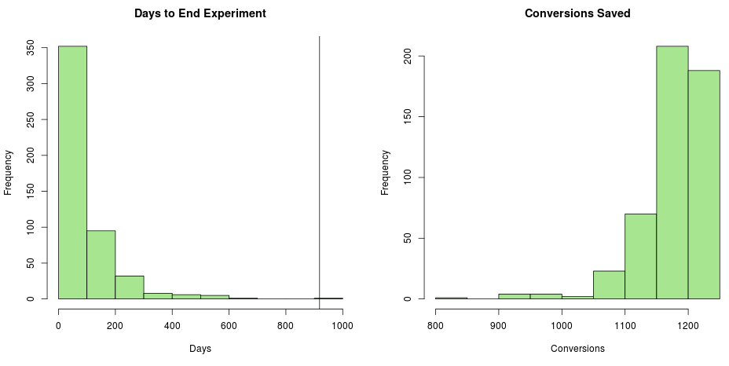
Multiple Arms
We need 15,307 observations in each arm of the experiment: total of 91,842 observations.
At 100 visits per day the experiment would have to run for 919 days
19
Notes:
The average experiment duration is 88 days (vs. 919 days for the classical experiment), and the average number of saved conversions is 1,173.

Slide 20
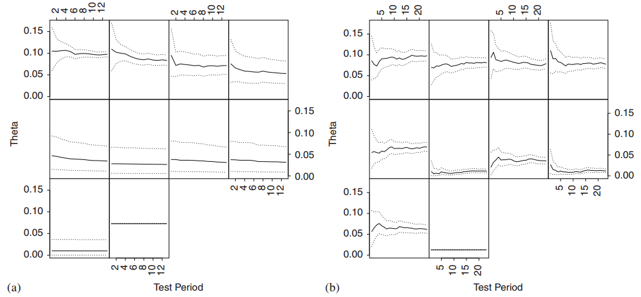
Posterior Distributions
Evolution of the posterior distribution under (a) randomized probability matching and (b) equal allocation
20
Notes:
Evolution of the posterior distribution (means and upper and lower 95% credibility bounds) of under (a) randomized probability matching and (b) equal allocation. Each panel corresponds to an arm. Arms are sorted according to optimality probability when the experiment ends.
Notice how the 95% credibility interval for the optimal arm (in the upper left plot of each panel) is smaller in panel (a) than in panel (b), despite the fact that the experiment in panel (b) ran longer. Likewise, notice that the 95% credible intervals for the sub-optimal arms are much wider under probability matching than under equal allocation.

Slide 21
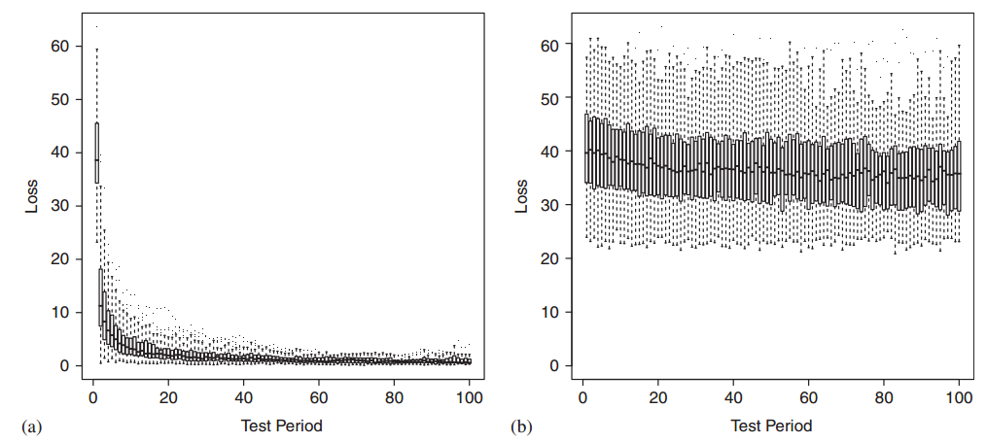
Regret Optimized
Regret: the cumulative expected lost reward, relative to playing the optimal arm from the beginning of the experiment
Expected regret per time period under (a) randomized probability matching and (b) equal allocation
21
Notes:
The simulation study consisted of 100 experiments, each with k=10 ‘true’ values of independently generated from the U(0,1/10 ) distribution. The first such value was assumed to be the current configuration and was assigned 10 6 prior observations, so that it was effectively a known
‘champion’ with the remaining nine arms being new ‘challengers’.
In this study, each update contains a Poisson(1000) number of observations allocated to the different
arms based on one of several allocation schemes. I ran each experiment until either the maximal
w at exceeded a threshold of 0.95, or else 100 time periods had elapsed. I consider both batch and real-time updates.

Slide 22
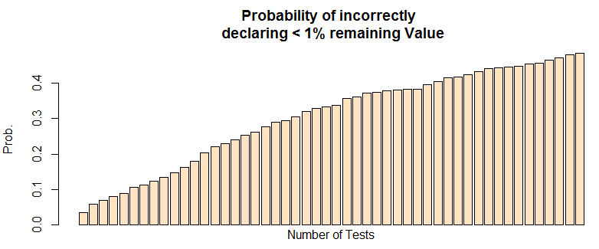
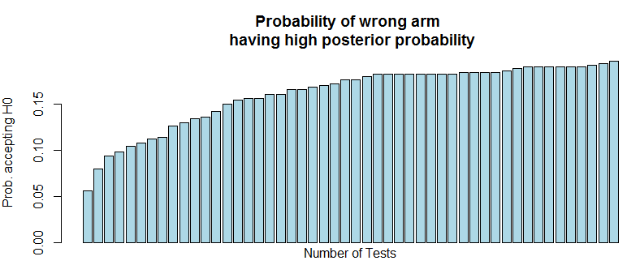
Multiple Testing
Stopping rule based on the value-remaining distribution is overly optimistic.
The true rate of falsely declaring the wrong arm to be the winner is substantially higher than the set level would suggest.
Experiment: pA = 0.2, pB = 0.2 · 1.04, test up to 50 times each time 20 coin tosses
22

Slide 23
Outlook
Simulate your own hypothesis: bandit package in R
The claim of “Bayesian testing is unaffected by early stopping” is simply too strong.
Focus on the expected loss assigns zero cost to type-I errors if rewards are equal.
Concerned about the choice of priors. More informative prior mitigates the effect of a stopping rule, but also comes with risk to your power and robustness if your guess is wrong
Google: “Beginning August 7, 2019, you won't be able to create or start Content Experiments (CX)”
23
Notes:
Optimize doesn't currently offer multi-armed bandit dynamic weight adjustment!

Slide 24
References
Erica CY, Sprenger AM, Thomas RP, Dougherty MR (2014) When decision heuristics and science collide. Psychonomic bulletin & review 21(2):268–282.
Lotze T, Loecher M (2014) bandit: Functions for simple A/B split test and multi-armed bandit analysis. URL https://CRAN.R-project.org/package=bandit
Robinson D (2015) Is bayesian a/b testing immune to peeking? not exactly. http://varianceexplained.org/r/bayesian-ab-testing/, accessed: 2017-05-30.
Rouder JN (2014) Optional stopping: No problem for bayesians. Psychonomic Bulletin & Review 21(2):301–308.
Sanborn AN, Hills TT (2014) The frequentist implications of optional stopping on bayesian hypothesis tests.Psychonomic bulletin & review 21(2):283–300.
Loecher, Markus. "Are Multi-Armed Bandits Susceptible to Peeking?." Zagreb International Review of Economics & Business 21.1 (2018): 95-104.
Scott SL (2010) A modern bayesian look at the multi-armed bandit. Applied Stochastic Models in Business and Industry 26(6):639–658.
Scott SL (2012) Google analytics help page. URL https://support.google.com/analytics/answer/2844870?hl=en.
Thompson WR (1933) On the likelihood that one unknown probability exceeds another in view of the evidence of two samples. Biometrika 25(3/4):285–294.
24

