Slide 1
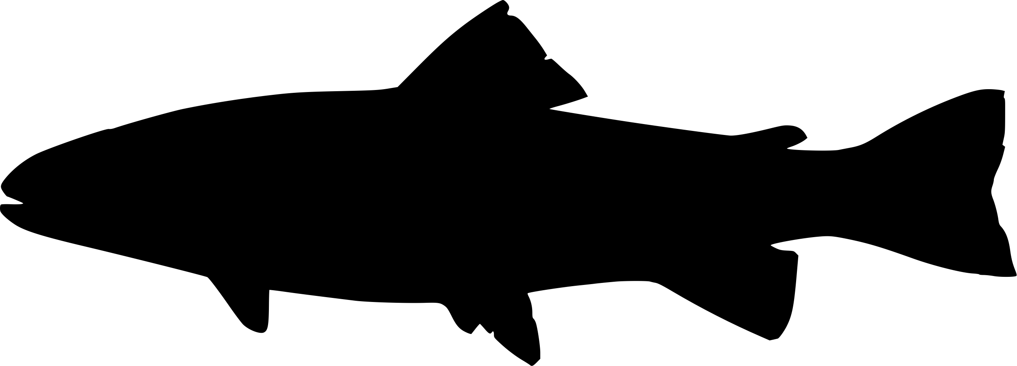
A) Outside of DPS
B) Within DPS
Other tributary
Mainstem, downstream
Mainstem, upstream
Mainstem, downstream
Mainstem, upstream
Other tributary
Natal tributary
C) Within DPS – upstream of natal tributary
Legend
Figure 2. Structure of the multistate model, showing the variable parameterization in three common situations: (a) a fish that has not yet entered its DPS; (b) a fish that has entered the boundaries of its DPS; (c) a fish that is within its DPS, but has overshot its natal tributary. Asterisks in the figure legend indicate parameters that are origin-specific for movements within DPS boundaries, but shared across origins for movements outside of DPS boundaries. The effects of winter spill days and spill volume are shared across all origins, and the effect of year is only origin-specific. The effect of temperature is season-specific, with different parameters estimated for the effect of temperature in the winter/spring vs. summer/fall.
Intercept*
Temperature*
Winter spill days
Spill volume
Year
Mainstem, downstream
Mainstem, upstream
Natal tributary
Other tributary

