Slide 1
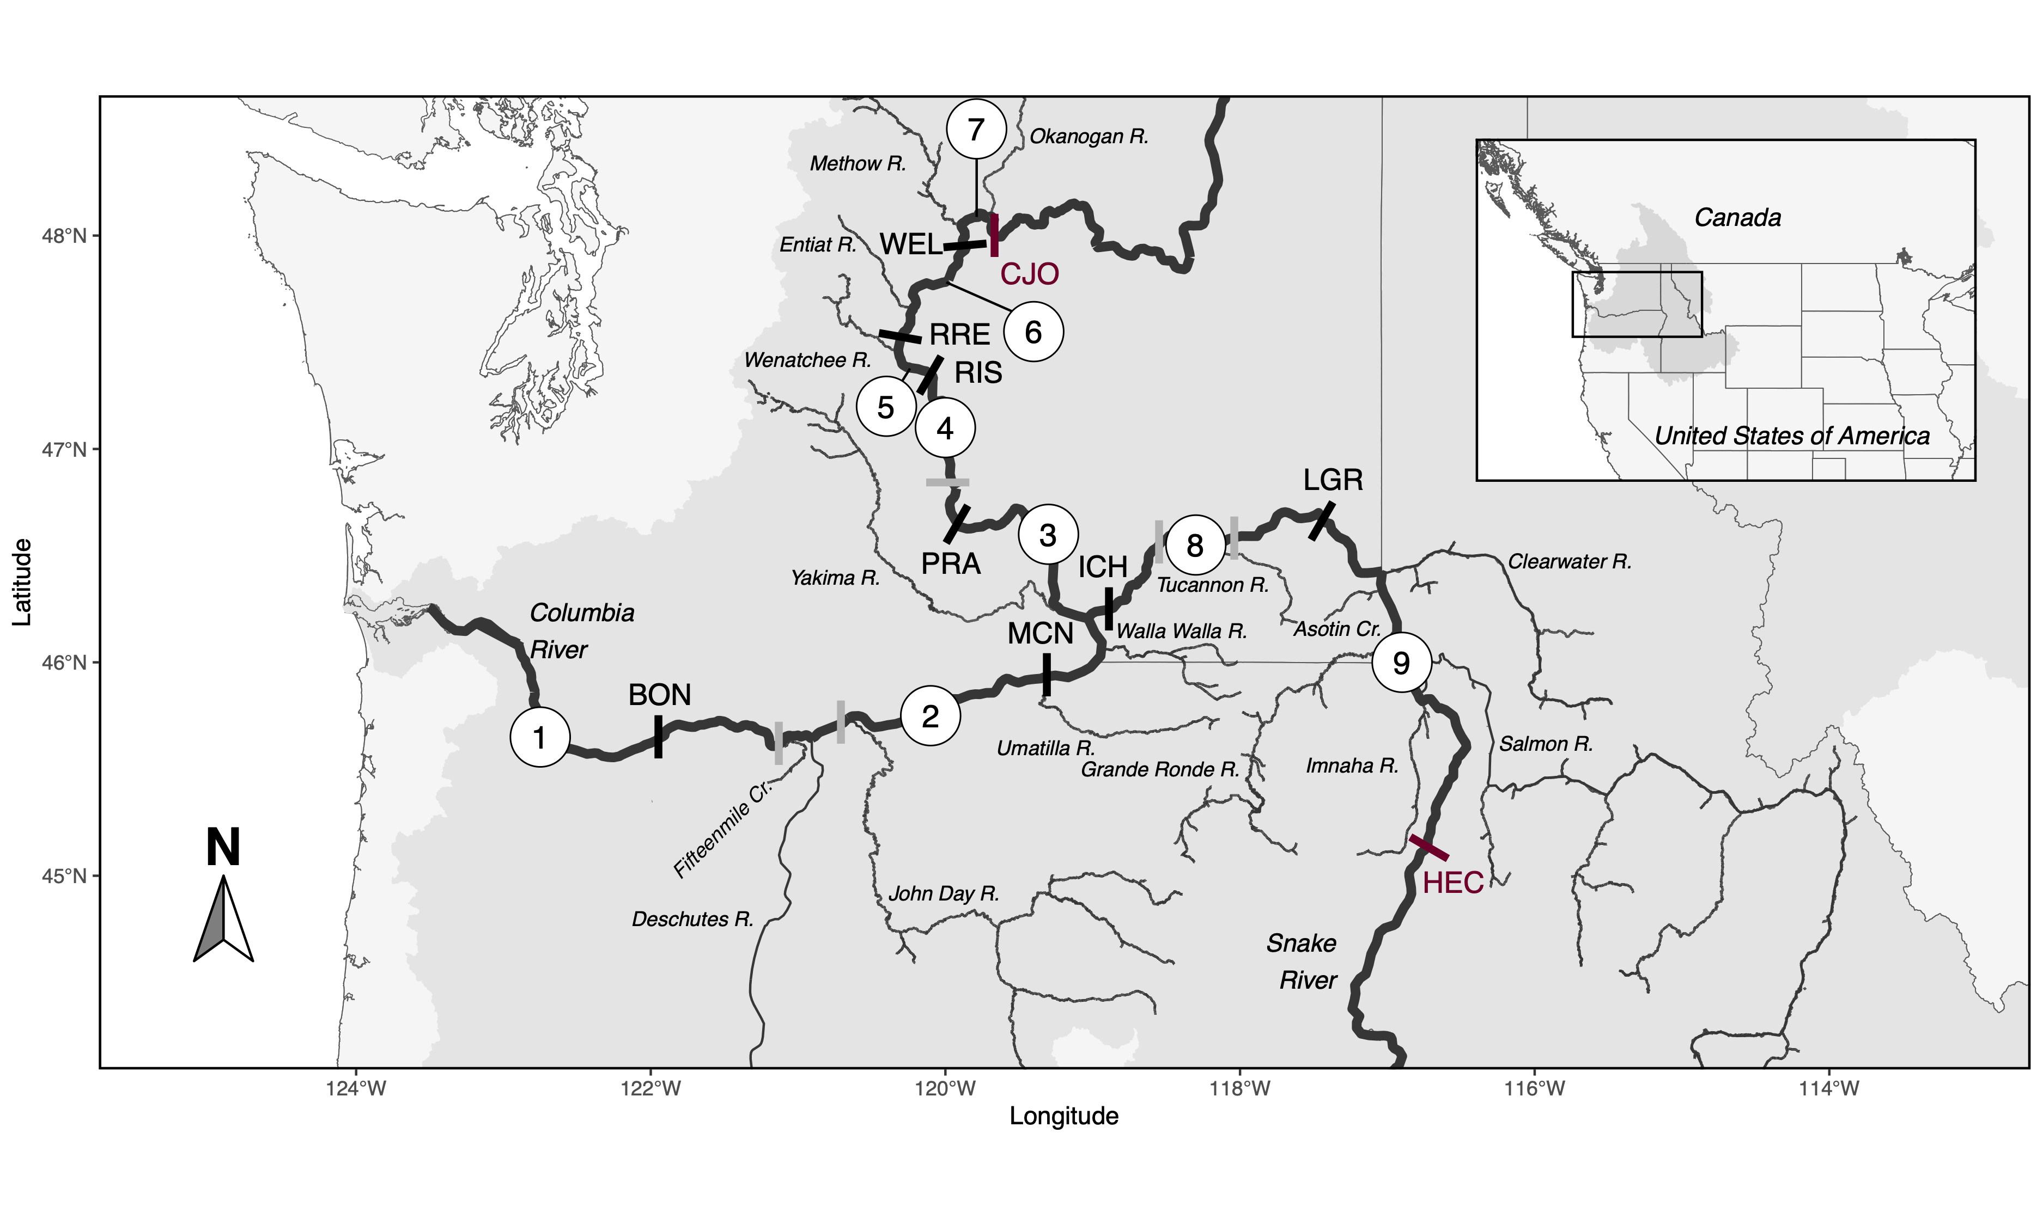
(A)
(B)
ENT
WEL
7
OTHER
7
WEN
6
RRE
MET
5
OKA
RIS
DES
JDR
YAK
4
PRA
1
BON
2
MCN
3
ICH
ASO
15M
UMA
8
LGR
CLE
OTHER
2
WAWA
9
TUC
SAL
IMN
GRRO

