Slide 1
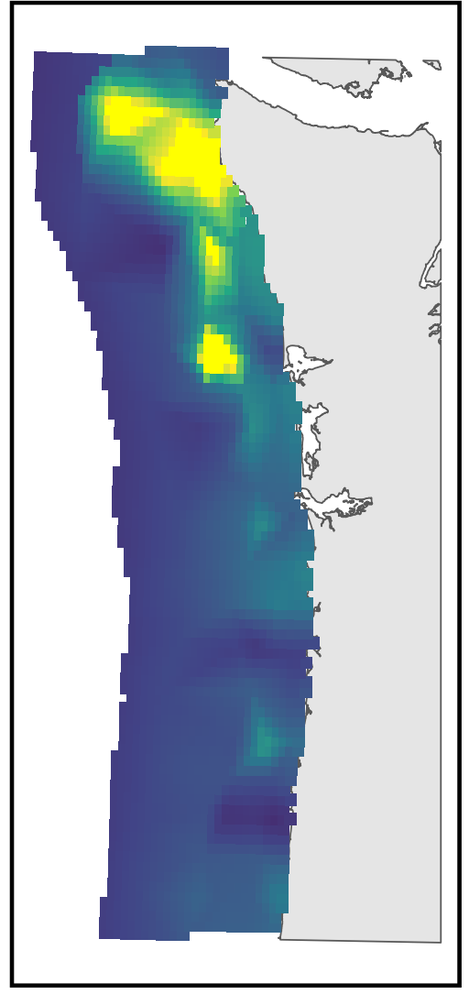
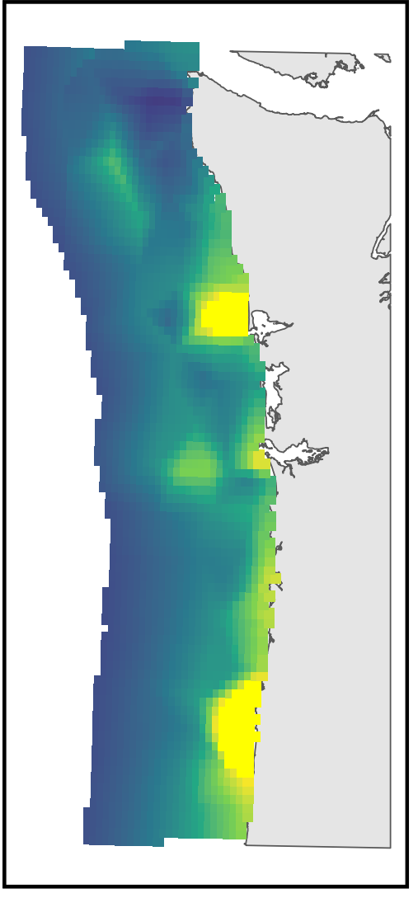
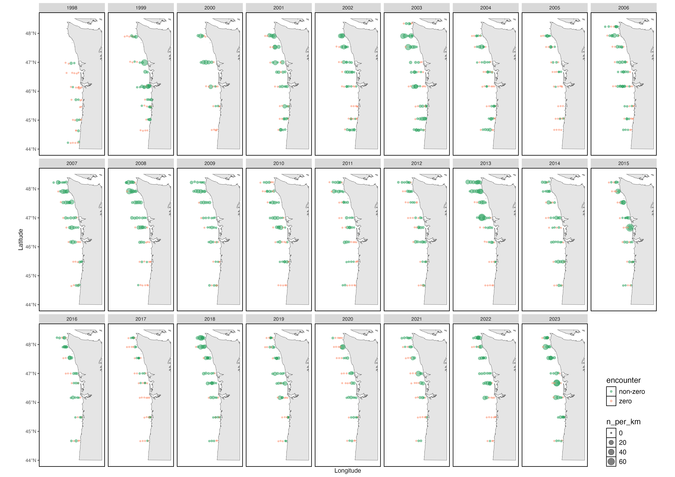
Survey data of multiple trophic levels of the pelagic NCC:
Modeled distributions for each taxon
Forage fishes (CCES/CPS survey)
Juvenile salmon (JSOES trawl)
Macrozooplankton and micronekton (PRS)
Small zooplankton (JSOES Bongo)
Phytoplankton (chl-a from remote sensing)
Calculate metrics of overlap; use to discuss foraging opportunity, predation risk, and competition risk, and see if any of those predict SAR or adult returns in a model that also includes various other potential predictors of marine survival

