Slide 1
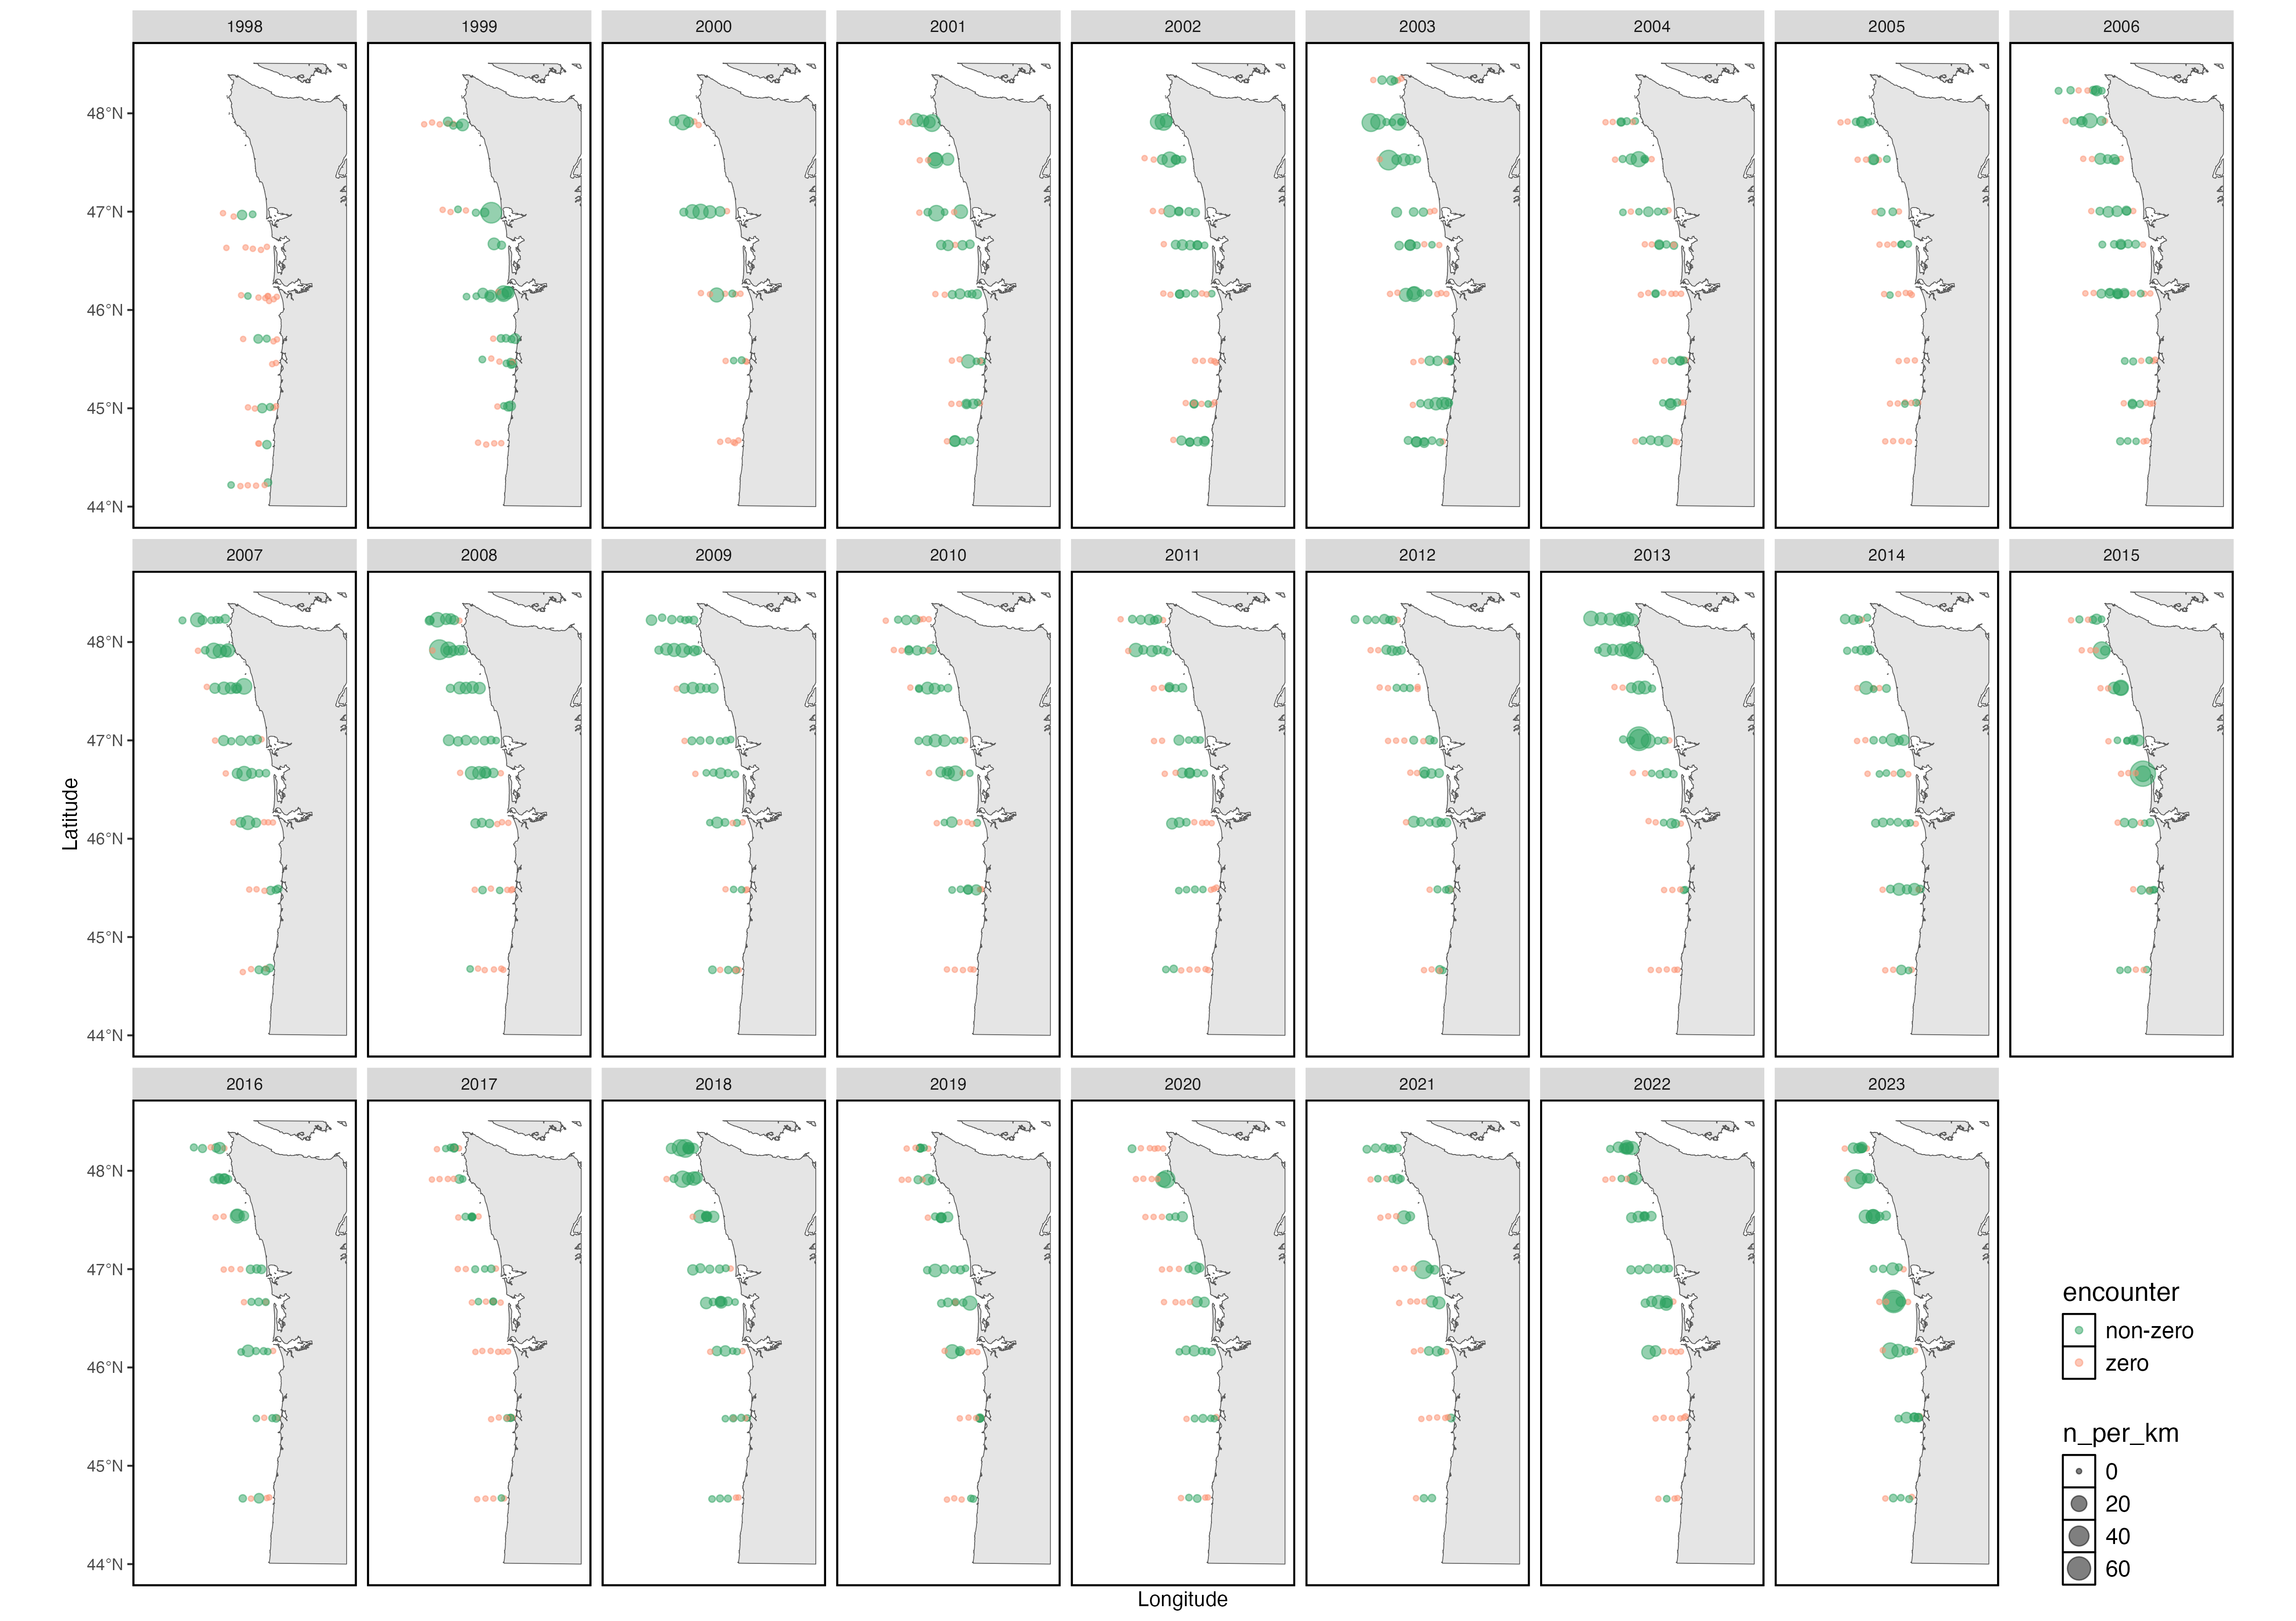
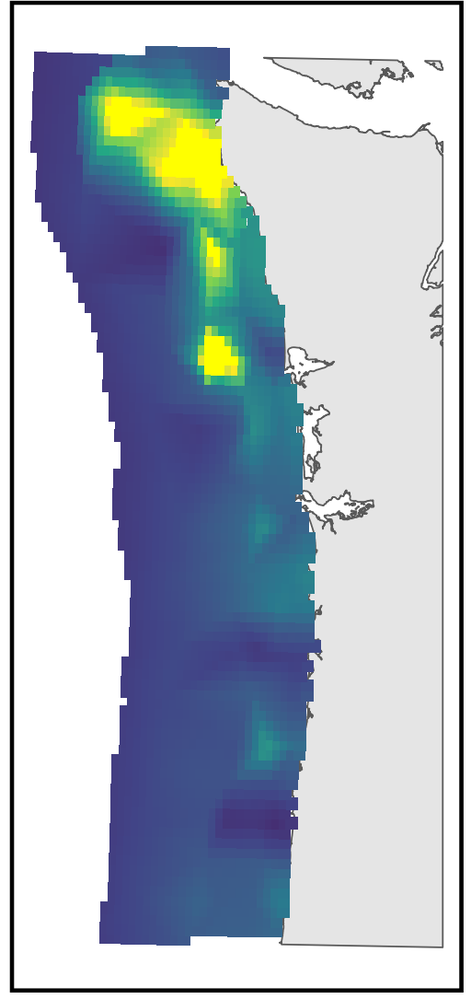
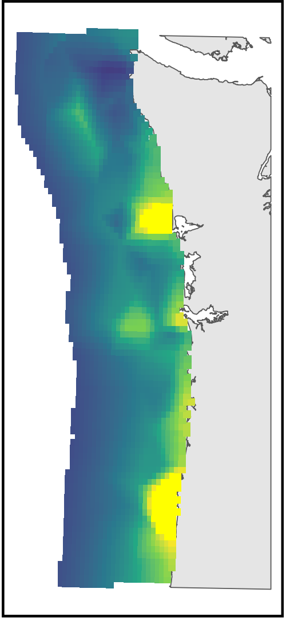
Survey data of multiple trophic levels of the pelagic NCC
Fit spatiotemporal models, using environmental covariates, to estimate the distribution of each taxon
Estimate spatiotemporal overlap between different taxa
Fit model to predict adult returns, using spatiotemporal overlap indices as predictor variables

