Slide 1

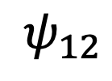
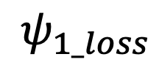
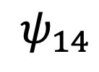
3
$$ψ_{13}$$
$$ψ_{12}$$
$$ψ_{14}$$
2
1
4
$$ψ_{1_loss}$$
Loss

