Slide 2
User controls
Fear of failure is minimized (undo of a function → “Back”-button)
User tries more (benefit of whole program)
User is faster because of short decision-times
Next steps are described by buttons
Notes:
The different controls in the GUI are very important for the usability. The user is in the position to act how he really wants and faulty inputs are no longer a problem, because the redo-function with the back-button. As a result the fear from the program by the user is minimized and the transaction-flow is visible. The next step is described by the button.

Slide 3
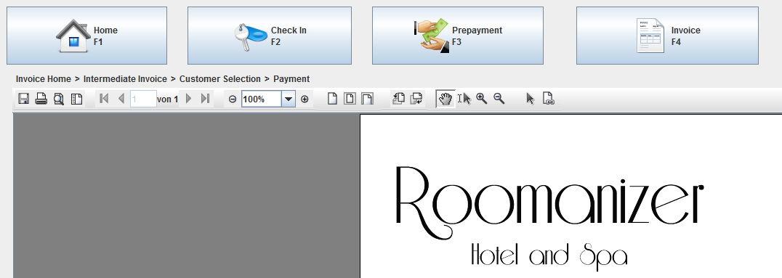
State bar
Overview
State bar shows the current position in the Use case
Notes:
Alternatively we use a state-bar, where the user gets an overview of the Use case.

Slide 4

Swing GUI
Platform independent
On all plattforms same look and feel
Extensible
inheritance
Customizable
Tables etc.

