Slide 1
Roomanizer
Hotel Software Project

Slide 2
Agenda
Team
Introduction
Demonstration of the program
Screencast
Customer Presentation Summary
Layer
Hibernate
Dynamic Mapper
State Pattern
Swing GUI
Integration external Software Modules
JSf & Ajax (web-reservation)
Project Management
Outlook
Summary
End

Slide 3
Team
Stefan Dunst
Christian Lins
Johannes Schwendinger
Markus Mohanty
Tobis Meusburger
Hubert Rall
Notes:
Aufzählen, Hauptaufgaben

Slide 4
Requirements
book /change /confirm / cancel a reservation
occupancy Preview
automated accounting
Presentation of different reports and statistics
room allocation
Check In / Out
Notes:
Here is a short description of the user requirements
the final version of the program allows the user to book, change, confirm and cancel a reservation.
It also allows u to see the occupancy of the rooms, an automated accounting, a presentation of differen reports and statistics, a room allocation and a Check in and out.

Slide 5
Introduction
expandability
modules
Notes:
Projektvorstellung: um was geht es?
Requirements, Pflichtenheft, was wurde gemacht, was kann der Kunde aktuell machen (erweiterbar/module)
Demo inhaltsverzeichnis ?!?!?!???
5

Slide 6
Demo
Notes:
Programm ausführen – vorstellen → Konzept (Hubert R.) Mitglieder: ….
Short cuts
… sonstige Vorteile
Mehrwert für Kunde
Besonderes an unserem Programm
6

Slide 7
Weather
Dynamically loaded every 15 minutes
Checks IP for locating city
4 days forecast
Detailed actual day forecast
Notes:
Here you can see the weather function. It is refreshed every 15 minutes, which makes it possible to detect spontaneous weather changes. We can also detect the current position of the user and download appropriate weather information for the next four days, by using his IP address.

Slide 8
Main Menue
Navigation system of the program
Allows to access most important functions
Always available
Provided by shortcut and a matching picture
Notes:
This weather screen is available by using the Main Menu. It is used as the Navigation system of the program, and allows you to directly the main functions of the system. Since it is always displayed on top of the screen, it is always available and can be used from anywhere. Every button is provided with a shortcut and a matching picture, which helps the user to find the right menu-point quicker and to switch menu-points without using the mouse.

Slide 9
Notes:
I just push the F4 button and we switch to the invoice - start - screen. Here you can choose the invoice u want to work with. If you have chosen your invoice, you can split and cancel the invoice. In this screen, you see all the invoice items, which belong to the selected habitations. Now it is possible to select single items or change the amount of items which should be paid, so you can split your invoice items and create different invoices. If you reduce the amount of the items, the other items won’t disappear. They just remain as open positions for the current habitation. So, as you can see, you can split the invoice just as you want. There are no restrictions, if a guest for example only wants to pay for a single drink, he can do it. This function is important when a guest wants to pay some items before he checks out or when there are different guests, who want to pay for their own services.
In addition, it is possible to cancel single invoice items, if you got the necessary permissions to do so. When you press the cancel button, a pop-up appears, in which you can specify the amount of items that shall be cancelled.
Now, when you are finished with the selection you can go back to see the intermediate invoice by pressing the “intermediate invoice” button.

Slide 10
Notes:
If you finished splitting and cancel your invoices, you have to enter the invoice address. Here you can select a customer from the database with the customer suggestions. In this window you are supposed to choose a customer. Since it searching for exact names would be tedious, we have implemented a fuzzy search, which allows the customers to be searched by their approximate name. This is quite important, considering that it saves a lot of time when guests do not have to spell the names of their customers.
If you finished splitting and cancel your invoices, you have to enter the invoice address. Here you can select a customer from the database with the customer suggestions. In this window you are supposed to choose a customer. Since it searching for exact names would be tedious, we have implemented a fuzzy search, which allows the customers to be searched by their approximate name. This is quite important, considering that it saves a lot of time when guests do not have to spell the names of their customers.

Slide 11
Pdf
No other program needed to display the invoices
Able to print out the PDFs
Save the invoice somewhere else than on the hard disk
Notes:
When you have done this, it is possible to show the user a created invoice as PDF. The PDF feature does not need another program to display the invoices. In addition it is possible to print out the PDFs and to save the invoice somewhere else than on the hard disk.

Slide 12
Screencast
Notes:
Invoice (alle beteiligt, abwechslungsreich)
12

Slide 13
Customer Presentation Summary
Notes:
Most important points

Slide 14
Technical Overview
Organisation
Layer
Hibernate
Dynamic Mapper
State Pattern
Swing GUI
Integration external Software Modules
JSf &Ajax (web-reservation)
Notes:
14

Slide 15


Technical Overview
Git
development environment
Notes:
Here a short technical Overview
As version management we used the online server from github because it was reachable from everywhere. (and because of the sweet cat as logo)
As development the java environment, because all of us had most experience with this language and it is robust.
15

Slide 16
Unified Process
Initialisierung 27.02 - 26.03
Timebox 1 27.04 - 30.04
Timebox 2 01.05 - 28.05
Timebox 3 28.05 - 15.06
Notes:
Here you can see our Unified Process which started with the
Initialization phase from the 27 of February to the 26 of march, in which we created the UseCases, looked for some Personas and developed a few Scenarios.
In Timebox one from the 27 of April to the 30 of April we started to design our UseCase with a paperprotoype, followd by the implementation and by testing.
The second Timebox from the 01. of May to the 28 of may was focused on the Integration of other implemented usecases and the implementation of a second one
The last Timebox from 28 of May to the 15 of June consisted of the implantation of an reservation which you can perform online.

Slide 17
Layer
Built after model-view-controller concept
Clear allocation of tasks
Clearly arranged
Access protection
Single layers can easily be exchanged/extended
Notes:
Auf elle Ebenen eingehen (eigene Folien mit drei, vier Punkten, was passiert)
Zuvor Überblick verschaffen – einzelne Schichten

Slide 18
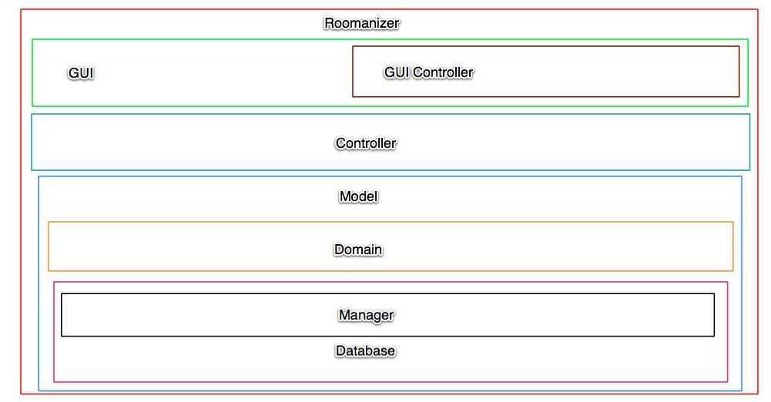
Layer
Notes:
New image needed. Controller in gui needs to be seen. Domain and database new… detailed pictures for each slide.

Slide 19
Layer
View
GUI
Controller
Coordination
Domainspecific cycle
Model
Domainobjects
External mapping layer
Translation DB-objects ↔ Domainobjects

Slide 20
Layer
External mapping layer
Classes with annotations for Hibernate
Contain no logical functionality
Contains manager-classes for communication to database:
For saving objects
To retrieve objects

Slide 21
Layer
Model
Contains classes for logical processing
All classes are implemented to a interface
Contain static methods:
To retrieve a object of a class, via a manager

Slide 22
Layer
View
Contains all classes the GUI uses
Also containing interfaces to hand over information to the model layer and the other way round
...

Slide 23
Layer
Controller
For each use-case one controller
Each controller implements the state-pattern
Notes:
Eventually statepattern-example

Slide 24

- an overview
Framework for object-related database mapping
Work on objects instead of database
Updates come regularly
Huge community
Open source →
no licence needed
can be altered
Notes:
Due to several recommondations and our own recherche we decided to use the hibernate framework for the database connection.
Hibernate is an open source mapping framework for java, that maps database tables to java classes, so that it‘s possible to work on regular java classes instead of requesting the database for every type of data.
Hibernate is the most used javamapping framework, so there is a broad community that can be helpful when there are problems using it.
Other reasons fo rour decisions where that there is no license needed and that there are regularly updates and bugfixes.

Slide 25
Advantages
Materializing and dematerializing
Caching of database-objects
Map inheritance and composition
HQL or criteria queries
Database independent queries
Define which joined tables should be mapped
Notes:
Hibernate manages the complete materialization and dematerialization process. This means, it returns objects when you execute a database query and in the other way it saves full objects into the database.
It also internally caches the database objects, which speeds the database action up.
One very special point is that hibernate is even able to map inherited objects out from relational databases, what was very helpful for our work.
Last but not least, there are two special ways to execute database queries with hibernate.
HQL (Hibernate Query Language) is similar to standard SQL, but is database independent and offers the feature to specify which joined tables should be mapped.
The criteria class has the same advantages, but a cirteria query is created by using different methods, which add other functionalities to the query (Joins and restrictions)
Its even possible to use native SQL Strings, but they have the disadvantage, that they do not work when you have inheritanced objects in your query.

Slide 26
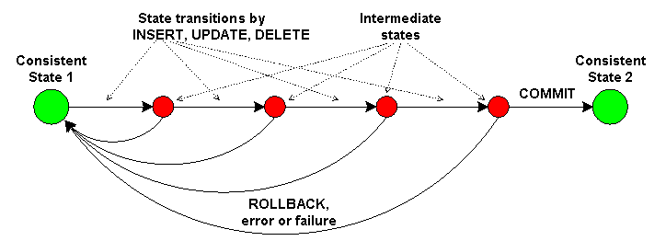
Transactions
Hibernate supports transactions
Units of work with one transaction
Restores old data on error → Persistent data
Notes:
One of our requiremnts for the database conection was, that it has to support transactions.
When we for example want to save a reservation there are different objects to save.
When an error occurs we have to restore the old data, if not there would be inconsistent data in the database what leads to several problems.
When we save something, we start an transaction and we confirm it if everything was okay, if not we make a rollback, what means we restore the old data.

Slide 27
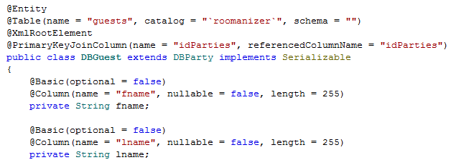
Mapping done by Annotations
Able to describe full configuration
Faster than xml-mapping
Notes:
Hibernate needs information about its classes, so that it can map the different database entries to the objects properties.
There are two different ways to give this information to hibernate. By XML files or with annotations.
We‘ve decided us to use annotations, because they are recommended by the hibernate community, because the interpreting of annotations is faster than the parsing of xml files.
On the code part you can see how a class is mapped to a table (show part) and how the variables are mapped to the columns (show) and configured as specified in the database.

Slide 28
Dynamic Mapper
Domain Layer
Mapper
Persistence Layer
Notes:
An important and interesting part in our Software is the Dynamic Mapper.
To split the Hibernate objects from our domain logic we decided to use different classes for these layers.
The only problem was to map betwenn these two layers, because we would have to write one maper for each class and adjust it with every modification we do.
So we decided to write one special mapper for all classes, our Dynamic Mapper.

Slide 29
Benefits
Independence from “Persistence Layer”
No Annotations in domain classes
Could be replaced
Uses “Reflection”
One mapper for all classes
One mapper instead of > 30
Also for new classes
Notes:
With our mapper, we are able to sepparate the Persistance Layer in which the Hibernate annotated objects are.
So we do not have to use these classes, where we could accedentially change the annotations, what would cause errors and the persistence Layer could easily be replaced, because our domain logic does not know it.
The mapper uses reflection to get the class name and the methods of the object that should be mapped.
So now we are able to map all our classes with one mapper instead of 30 or more. Even when we change the database we only have to write the new classes, the mapper can do the rest.

Slide 30
Pitfalls and requirements
Naming convention for class and method names
Console tool to check conventions
No lazy-fetching possible
Mapping circle: → Stack Overflow
Invoice Item
Invoice
Notes:
Of course our mapper cannot gues what it should map, so we introduced some name conventions in our prgramm.
Hibernate classes start with the prequel DB, the rest of the name is the same. Also the getter and setter Method on both sides need to be named the same.
To check for errors we created a small test programm, that checks the conventions.
Because we assign all values to our new objects, lazy fetching is impossible. All values are requested and so they have to be read from the database. This is no big problem because so, we read the data once and hibernate caches it. AT the beginn of a process the programm needs a bit more time, but after that it gets faster than otherwise.
The biggest problem in the development was that some of our objects refer themselves in both ways. So when we map an Invoice, it has to map the InvoiceItems and then it maps the Invoice agian.

Slide 31
Development
First version depth limited
Same mapping several times
Not all mappings are done
Current version
Saving mapped objects in Hash Map
About 300 times faster
All mappings are done
Notes:
Our first workaround was to depth limit the mapping process. So the object got mapped several times, but it stoped after some iterations.
This solution was slow and not all data was mapped to the domain layer.
In further development we have rewriten the mapper and now we save the already mapped objects in a HashMap.
If an already mapped object now has to be mapped, we just use the already saved object and so we do not run into an infinite loop.
Our performance tests have shown us, that this improvment speeded the mapping process by the factor 300 up and in addition we really map all connected object to our domain layer.

Slide 32
Functionality
Get the class name and search for equivalent
Customer ←→ DBCustomer
Save the new object
Find setter methods in new object
Search for the appendant getter in old object
setFirstName() → getFirstName()
Is model object?
Yes:
Use already saved object if possible
Map the object otherwise
No:
Invoke setter with result from getter
Notes:
Now i will give you a short introduction how the mapper works.
At first it reads the class name of the object that shall be mapped and searches for the new class name and creates an object based on that.
The new object gets saved in the HashMap. Then we search for setter methods in the new object and when we find one, we search for a suitable getter method in the old object.
If the return type is no object that has to be mapped we just use the setter method to set the returned value.
In the other case, we search if the returned object is already saved, if yes we just take the mapped object and set it in the new object.
If not, we map the new object – so the whole prcess starts from the beginning with the new object.

Slide 33
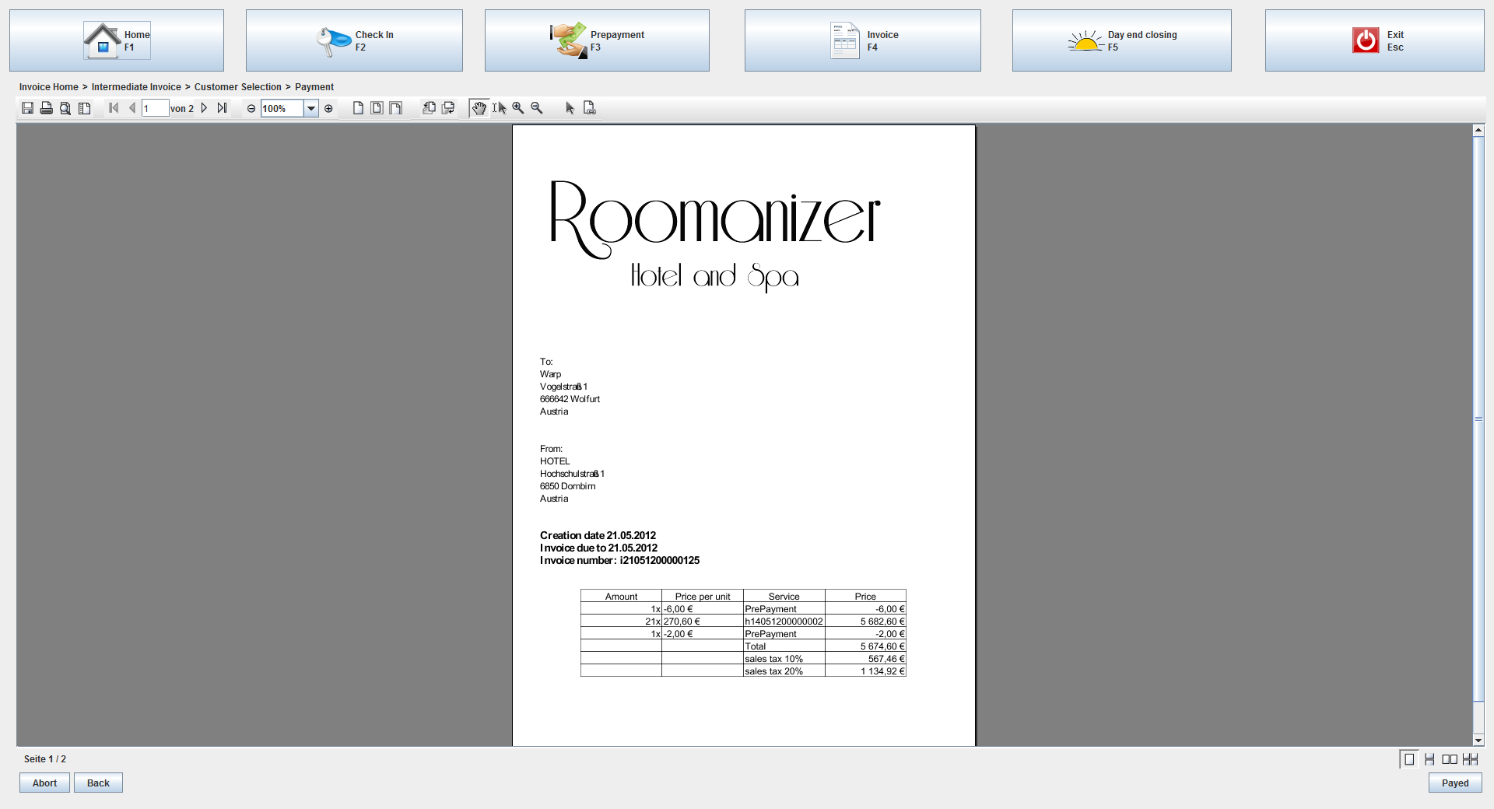
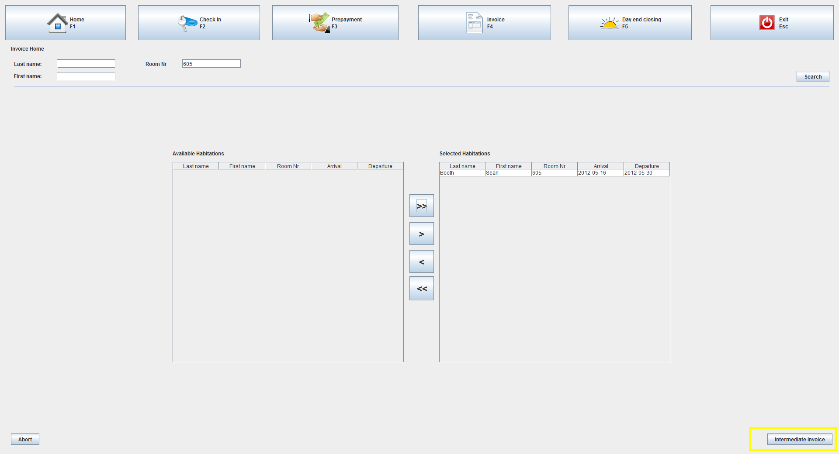
State Pattern
Used in use case controllers
Each step representing a state in the GUI
Always the same controller
Different implementations during runtime
Dynamically binding of state object
Notes:
Screens (Flip Chart, black board) – see sketch
Static problem with class change during runtime
Different controller classes (CreateInvoiceController in searchState,…
Nice polymorphic problem-solution, but….
We are using always the same controller from outside
Who would change the controller state? One more controller?
Switching the class of the object during runtime is not possible (in common Object Oriented programming languages)
Exception: Self (http://en.wikipedia.org/wiki/Self_(programming_language))
Solution: State Pattern

Slide 34
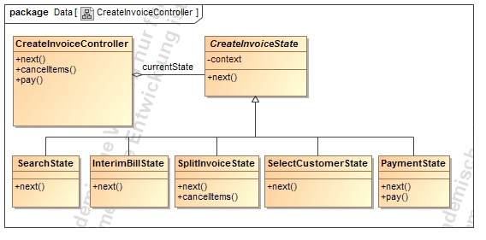
State Pattern - Structure
Abstract State
Methods throw
IllegalStateException
Context
Concrete States
Example: payment only works in the PaymentState
Notes:
Our team made the decission to use the state pattern in our use case controllers.
Example (Create Invoice Controller):
Model-structure with roles
Context: Controller – interface for gui
Abstract state: interface for different states to encapsulate them
Concrete state: implements the behaivour, which is connected to state of the context object
Conroller looks now like a object which changed his class!
For each step in the process, displayed as a single view in the user interface we created one state.
From the outside, we always use the same controller, but depending on the current state, differents actions are performed or an exception is thrown in the case, that this operation is not accessible in the current state.
In example: the next method is implemented in every state, but depending on the state, the next state is another one.
Other functions, like for instance the pay function, are only implemented in one state.
Another advantage of of the state pattern is the easy way to create new states. You can just insert a new class and link it depending on the called functions together with the ither states.

Slide 35
State Pattern - Advantages
Structuring the controller by state
easy, readable and maintainable code
State classification would be possible
Transitions are explicit
Consitence because of atomic states
Notes:
Structure:
the strucutre by state prevents long switch-case statements in the operations
Classification is possible, because super and sub classes in the states are supported
Transitions explicity: the state is an external class; so – from the perspective of the context – the state-transition is atomic

Slide 36

Swing GUI
Platform independent
On all plattforms same look and feel
Extensible
Inheritance of JComponent
Customizable
Components are parameterisable
Notes:
Introduction: THE Java GUI Framework
Platform independent (comparisson AWT)
Os native implementation with awt → in swing own rendering
Extensible: creating own components (for example the split and storno screen, if we use it on other posisitions → reusability)
- able to use the whole power of Jcomponents (Swing) like fire events, bound properties, java beans, many methods (which can be overwritten)
Customizable: standard set of elements, such as a border, inset, decorations, and other properties are available to customize tables, panels or buttons
Project:
Requirement → easy to integrate other guis, IF THEY USE THE SAME!

Slide 37
Integration
Implementation of interfaces not possible
Adapter classes inherit direct from domain objects from other team
Every adapter implements a generic adapter interface
Notes:
Bezug auf Adapter-Pattern (Einleitung)
Schwierigkeiten – wie haben wir es gelöst!

Slide 38
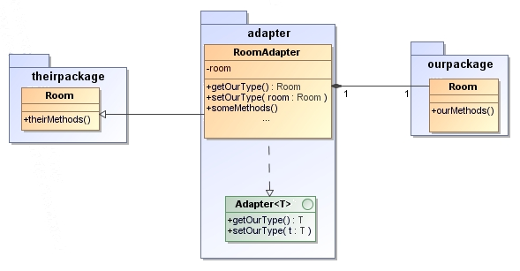
Integration
Notes:
The integration of the other program parts by implementation of interfaces was not possible, because no interfaces were available. To avoid the problem, our adapter classes inherit direct from the domain objects from the other team. Also every adapter implements a generic adapter interface, to set and read its type. This enables dynamic programming, there every of our adapters support this interface and so they can be read and created by other classes.

Slide 39
Integration of the GUI-Components
Different toolkits (Swing and SWT)
External Screen for „Prepayment“
Own implementation of „Day end closing“
Notes:
The SWT-GUI from Team F was not easy to integrate into our Swing-GUI, because they are 2 different toolkits. Fortunately the user interfaces from Team F was not extensive, so we replaced the SWT Message Box with a Swing counterpart.
The payment on account booking was implemented by the Accommodation -Panel from Team F, due to a conflict with the SWT-Panel integration into a Swing application.
Java don’t allow multiple inheritance. This prevents us to inherit from other adapters. So we override the methods from the superclass of the adapted class.
Prepayment (own console) because of incompatibility (ok from vollbrecht)
Day end closing only one message-box

Slide 40
JSF & Ajax
Event handling
makes it easy to write code that is invoked when particular events occur.
Managed beans
Easiest property binding
Notes:
JSF makes it easy to designate Java code that is invoked when forms are submitted. The code can respond to particular buttons, changes in particular values, certain user selections, and so on.
In JSP, you can use property="*" with jsp:setProperty to automatically populate a bean based on request parameters. JSF extends this capability and adds in several utilities, all of which serve to greatly simplify request param processing.

Slide 41
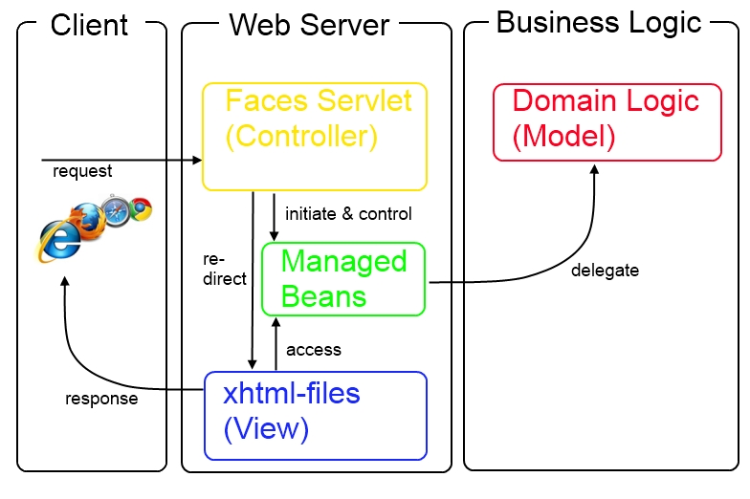
JSF - Architecture
Notes:
Model 2 archtitecture

Slide 42
JSF & Ajax
Integrated Ajax support
Use Ajax without explicit JavaScript Programming with simple Tags
Ajax knows about the server-side business logic
Form field conversion and validation
Built-in value checking and converting
Notes:
You can use jQuery, Dojo, or Ext-JS with servlets and JSP. However, JSF lets you use Ajax without explicit JavaScript programming and with very simple tags. Also, the Ajax calls know about the server-side business logic.
JSF has built-in capabilities for checking that form values are in the required format and for converting from strings to various other data types. If values are missing or in an improper format, the form can be automatically redisplayed with error messages and with the previously entered values maintained.

Slide 43
JSF & Ajax
Custom GUI controls
provides a set of APIs and associated custom tags to create HTML
Page templating
page templating system allows building pages that share layout or content
Consistent approach
encourages use of MVC
Notes:
JSF provides a set of APIs and associated custom tags to create HTML forms that have complex interfaces
Although JSP has jsp:include for reuse of content, JSF has a full-fledged page templating system that lets you build pages that share layout or content
JSF encourages consistent use of MVC throughout your application

Slide 44
Übergang??? Tech. Summary

Slide 45
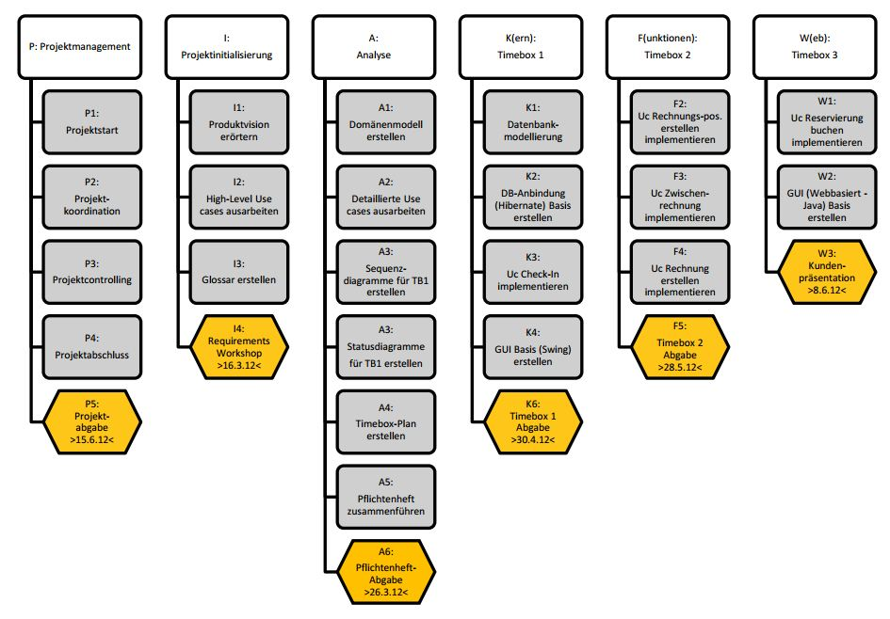
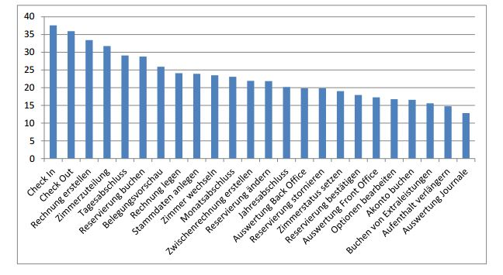
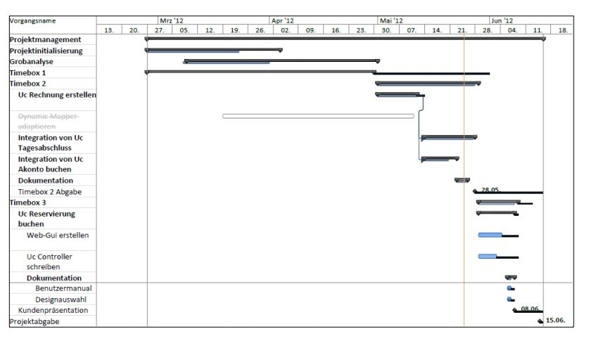
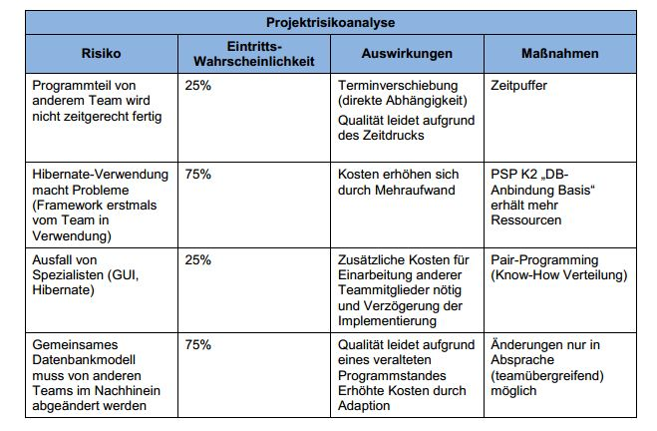
Project management
Kick-off Meeting
PSP
Gantt-Chart
Bottom-Up
Weekly report
Project risks
Closely working together
Notes:
Project Trend
Zeitplan, …
Developement, trend, improvements?
45

Slide 46
Outlook
Replacing/Upgrading of certain components easy thanks to layers
Integration into social media (for example book from Facebook)
Various options to extend website
Reviews
Vouchers
Notes:
What would be done? Was würde Sinn machen – weitere Schritte im Projekt (Integration vor Ort, Testlauf,…)
SW weiterentwicklung: neue Module hinzufügen (Basis steht)
46

Slide 47
Summary Technical Presentation
We hope this presentation was successful in explaining the various design decisions our team made, and why we made them
Notes:
47

Slide 48
Thank you
Notes:
HABIDERE

