Slide 1
Database

Slide 2
Database
Relational database System
Not object oriented!
Widely spread
Regularly updated
Huge community
Open source

Slide 3
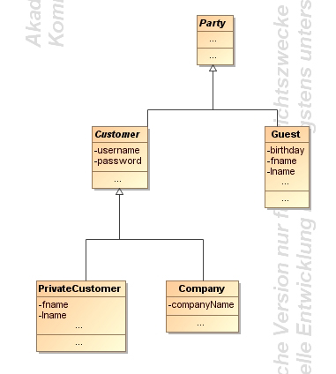
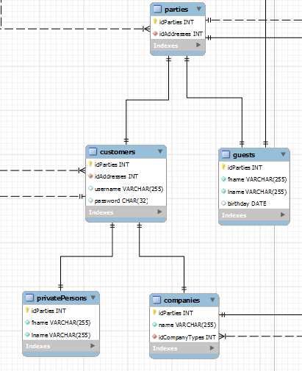
Object orientation
Inheritence simulated:
Parent-table holds basic information
Child-table holds additional information
Primary key matching
Advantages:
No NULL values
No redundant information
Disadvantages:
Many joins needed

