Slide 1

Roomanizer
Hotel Software Project
Notes:
May I call your attention to our project called Roomanizer, for which our team worked for the last 3 month.
Roomanizer is software which supports the stuff from a hotel in doing their work.

Slide 2
Requirements
book /change /confirm / cancel a reservation
occupancy Preview
automated accounting
Presentation of different reports and statistics
room allocation
Check In / Out
Notes:
Here is a short description of the user requirements. We had to develop a program which let the employee book, change, confirm and cancel a reservation,
to see the occupancy of the rooms,
The possibility for an automated accounting,
a presentation of differen reports and statistics,
a room allocation
and a Check in and out.

Slide 3
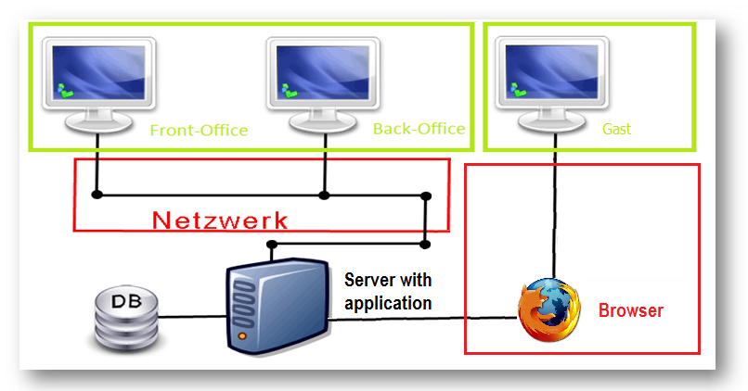
Operation
Notes:
To match the requirements we created a software consisting of moduls. This allows to implement new modules and so to expand the software.
On this sheet you can see how the software works yet. In the lower area of the graphic you can see the database which contains all informations. This database is saved on the server, on which the application works. With the red squares you can see, that it is possible to access the program by the local-Network or by using an Internetbrowser. With help of the Internetbrowser guests can log on from home. After that they have access and can reserve a room for a time period. Employees can use the program in the local network. So it work from the back and the front office. The program is expandable, this allows to add the kitchen for example

Slide 4
Unified Process
Initialisation 27.02 - 26.03
Timebox 1 27.04 - 30.04
Timebox 2 01.05 - 28.05
Timebox 3 28.05 - 15.06
Notes:
For building this here you can see our Unified Process which started with the
Initialization phase from the 27 of February to the 26 of march, in which we created the UseCases, looked for some Personas and developed a few Scenarios.
In Timebox one from the 27 of April to the 30 of April we started to design our UseCase with a paperprotoype, followed by the implementation and testing.
The second Timebox from the 01. of May to the 28 of may was focused on the Integration of another implemented usecase and to implement a usecase for another team.
The last Timebox from 28 of May to the 15 of June consisted of the implantation of an reservation which you can perform online.

Slide 5
Agenda
Demonstration
Layers
Hibernate
Dynamic Mapper
State Pattern
Swing GUI
Integration external Software Modules
JSf &Ajax (web-reservation)
Project Trend
Outlook
Summary
End
Notes:
In this presentation you will see first an short demonstration of the software.
After this you will see our layers and their functions.
Then you will hear something about our choice to use the hibernate framework.
Moreover you get explained the heart of our layer model, the dynamic mapper.
Next we will explain how we used the state pattern. We continue then in explaining, how we integrated external software modules.
In the end you will hear something about Jsf and Ajax from our web reservation.

Slide 6

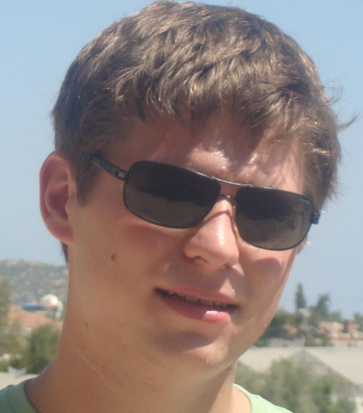
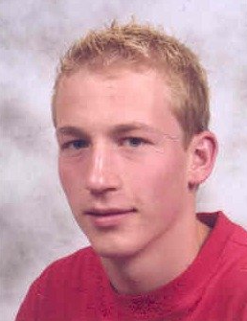
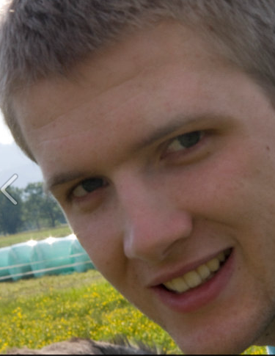
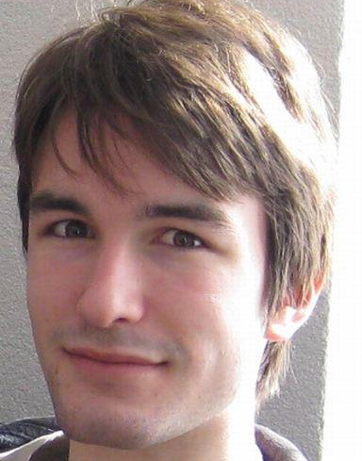
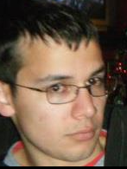
Team
Stefan Dunst
Christian Lins
Johannes Schwendinger
Markus Mohanty
Tobis Meusburger
Hubert Rall
Notes:
Now present our Team members.
I start with Stefan Dunst the leader of our project. Stefans main task was to create the database model and the domain model. Also as our Team leader he had to split and distribute the work.
He will explain the mapper and say something about hibernate
Next we have Christan Lins he created a schedule for the project management and the domain layer. Also he designed our Paper protoype Designs. He say why we chose the swt framework
Then we have here Johannes Schwendinger who wrote our Glossary for the project documentation. He also designed our Gui and developed our mapper classes. He tell you something about the integration and the adapter pattern.
Here we have Markus Mohanty our Hibernate specialist. He is the creator of the database and the Pdf Generator. Moreover he developed the Weather feature which i will show you later. He presentate the layers modell
Next we have Tobias Meusburger who created the Junit-Tests, directed our Reviews and created the Screencasts with our records. He expund a bit about the project management in our team and the Summary
And Finlay me, Hubert Rall, who advanced the domain layer, created the interfaces and wrote the user manual. I do the introduction and the prouct view

Slide 7


Technical Overview
Git
development environment
Notes:
Here a short technical Overview
As version management we used the online server from github because it was reachable from everywhere. AND BECAUSE OF THE SWEET CAT!!!
As development the java envionhment, because all of us had most experience with this language and it is robust.

