Slide 1
Layer
Markus Mohanty

Slide 2
Layer
Built after model-view-controller concept
Clear allocation of tasks
Clearly arranged
Access protection
Single layers can easily be exchanged/extended
Notes:
Auf elle Ebenen eingehen (eigene Folien mit drei, vier Punkten, was passiert)
Zuvor Überblick verschaffen – einzelne Schichten

Slide 3
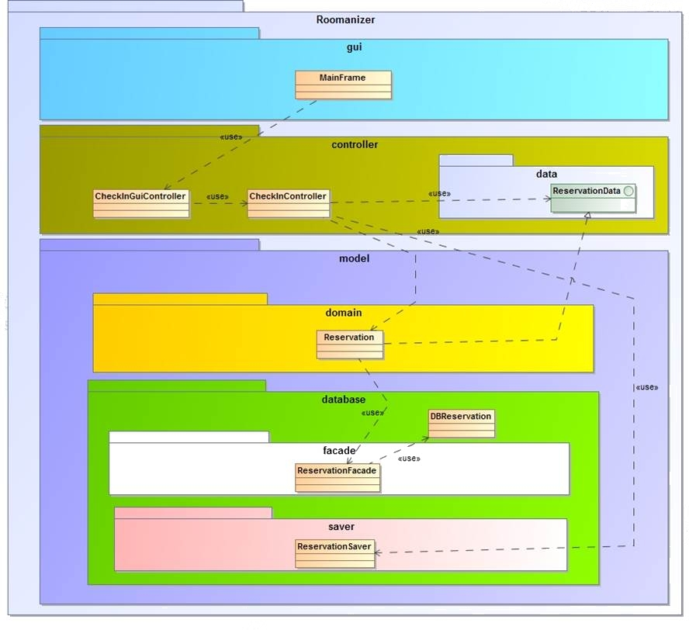
Layer
Notes:
New image needed. Controller in gui needs to be seen. Domain and database new… detailed pictures for each slide.

Slide 4
Layer
View
GUI
Controller
Coordination
Domainspecific cycle
Model
Domainobjects
External mapping layer
Translation DB-objects ↔ Domainobjects

Slide 5
Layer
External mapping layer
Classes with annotations for Hibernate
Contain no logical functionality
Contains manager-classes for communication to database:
For saving objects
To retrieve objects

Slide 6
Layer
Model
Contains classes for logical processing
All classes are implemented to a interface
Contain static methods:
To retrieve a object of a class, via a manager

Slide 7
Layer
View
Contains all classes the GUI uses
Also containing interfaces to hand over information to the model layer and the other way round
...

Slide 8
Layer
Controller
For each use-case one controller
Each controller implements the state-pattern
Notes:
Eventually statepattern-example

