Slide 1
Roomanizer
Hotel Software Project
Notes:
Page numbers…
Flipchart oder Ähnliches

Slide 2
Agenda
Layer
Hibernate
Dynamic Mapper
State Pattern
Swing GUI
Integration external Software Modules
JSf &Ajax (web-reservation)
Project Trend
Outlook
Summary
End

Slide 3
Team
Stefan Dunst
Christian Lins
Johannes Schwendinger
Markus Mohanty
Tobis Meusburger
Hubert Rall
Notes:
Aufzählen, Hauptaufgaben

Slide 4
Introduction
Notes:
Projektvorstellung: um was geht es?
Requirements, Pflichtenheft, was wurde gemacht, was kann der Kunde aktuell machen (erweiterbar/module)

Slide 5
Demo
Notes:
Programm ausführen – vorstellen → Konzept (Hubert R.) Mitglieder: ….
Short cuts
… sonstige Vorteile
Mehrwert für Kunde
Besonderes an unserem Programm

Slide 6
Screencast
Notes:
Invoice (alle beteiligt, abwechslungsreich)

Slide 7
Technical Overview
Notes:
Rahmenbedingungen: Versionsverwaltung (git), Entwicklungsumgebung, Unified Prozess (Timeboxen, …)

Slide 8
Layer
Built after model-view-controller concept
Clear allocation of tasks
Clearly arranged
Access protection
Single layers can easily be exchanged/extended
Notes:
Auf elle Ebenen eingehen (eigene Folien mit drei, vier Punkten, was passiert)
Zuvor Überblick verschaffen – einzelne Schichten

Slide 9
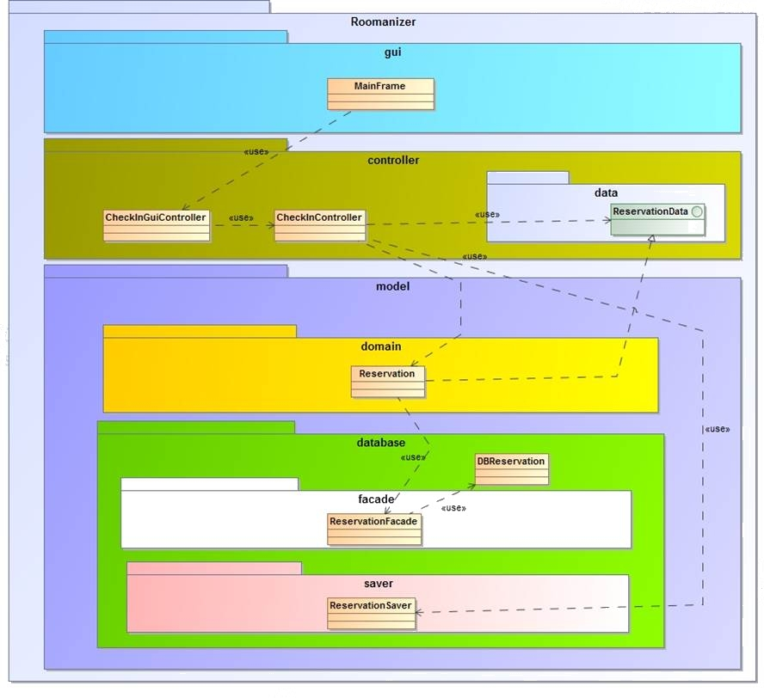
Layer

Slide 10
Layer
View
GUI
Controller
Coordination
Domainspecific cycle
Model
Domainobjects
External mapping layer
Translation DB-objects ↔ Domainobjects

Slide 11
Advantages
Independence of Hibernate
Easily replaced/extended

Slide 12

Hibernate and its Transactions

Slide 13
Hibernate - an overview
Framework for object-related database mapping
Open source →
no licence needed
can be altered
updates come regularly

Slide 14
Mapping done by Annotations
Annotations are able to describe all configurations of a database-table
Faster than xml-mapping
Notes:
Codeausschnitt zur Auflockerung

Slide 15
Advantages of Hibernate
Materializing and Dematerializing is done by Hibernate internally
Caching of database-objects done internally
Able to map inheritance
HQL or criteria queries
Notes:
HQL or criteria queries → Vorteile (Design Doku)

Slide 16
Hibernate and database-transactions
Hibernate is able to do transactions
Advantages:
Units of work for persistent data
Hibernate-transaction able to rollback
Keeps database persistent

Slide 17
Dynamic Mapper
Persistence Layer
Mapper
Database Layer
Notes:
Schaut unübersichtlich aus! Eventuell nur ein Pfeil anstatt den vielen.

Slide 18
Dynamic Mapper
Benefits:
Independent from Database Layer
One Mapper for all classes.
Uses Reflection

Slide 19
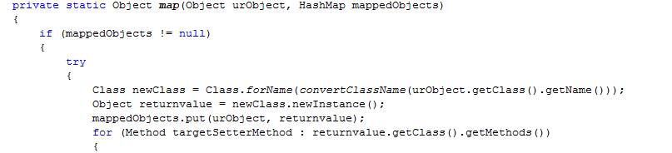
Dynamic Mapper
Pitfalls & Requirements
Naming convention for class and method names
Mapping circle, if an object from us holds another.

Slide 20
State Pattern
Used in use case controllers
One state per step
Always the same controller
Different implementations
next() goes on to the next state
Easy creation of new states
Notes:
Eigenes Diagramm erstellen?
Our team made the decission to use the state pattern in our use case controllers.
For each step in the process, displayed as a single view in the user interface we created one state.
From the outside, we always use the same controller, but depending on the current state, differents actions are performed or an exception is thrown in the case, that this operation is not accessible in the current state.
In example: the next method is implemented in every state, but depending on the state, the next state is another one.
Other functions, like for instance the pay function, are only implemented in one state.
Another advantage of of the state pattern is the easy way to create new states. You can just insert a new class and link it depending on the called functions together with the ither states.

Slide 21
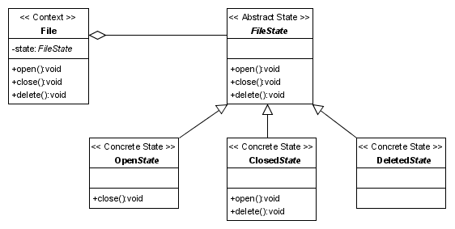
State Pattern
Notes:
Eigenes Diagramm erstellen?
Our team made the decission to use the state pattern in our use case controllers.
For each step in the process, displayed as a single view in the user interface we created one state.
From the outside, we always use the same controller, but depending on the current state, differents actions are performed or an exception is thrown in the case, that this operation is not accessible in the current state.
In example: the next method is implemented in every state, but depending on the state, the next state is another one.
Other functions, like for instance the pay function, are only implemented in one state.
Another advantage of of the state pattern is the easy way to create new states. You can just insert a new class and link it depending on the called functions together with the ither states.

Slide 22
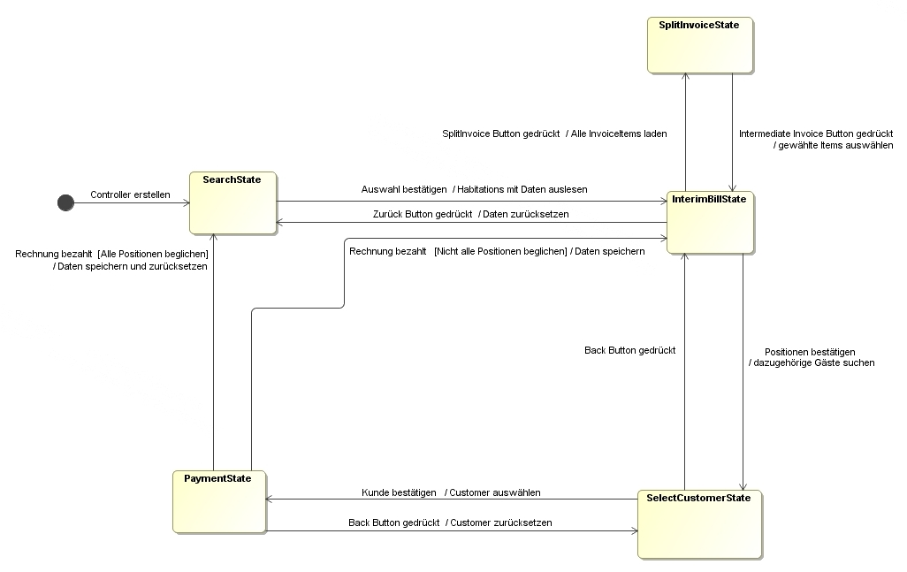
Example: create invoice
Notes:
Diagramm übersetzen? Notwendig? Nur states, dafür größer?
The creation of invoices needs four or five steps, depending on the need of splitting the invoice.
Each step provides different functionalities and when you want to go on, the next() method saves the changed data and initializes the next step.
When the invoice gets paid, the next state depends on wheter all items are paid or not. If there are „open“ items, the next step is the intermediate invoice state, in the other case we go back to the search state, where the different Accommodation s can be searched and selected.
The state pattern helps us to guarantee that we are not able to call methods, which shouldn‘t be accessible in different cases and also manages the process of the use case.

Slide 23

Swing GUI
Platform independent
On all plattforms same look and feel
Extensible
Inheritance of JComponent
Customizable
Components are parameterisable
Notes:
Introduction: THE Java GUI Framework
Platform independent (comparisson AWT)
Os native implementation with awt → in swing own rendering
Extensible: creating own components (for example the split and storno screen, if we use it on other posisitions → reusability)
- able to use the whole power of Jcomponents (Swing) like fire events, bound properties, java beans, many methods (which can be overwritten)
Customizable: standard set of elements, such as a border, inset, decorations, and other properties are available to customize tables, panels or buttons
Project:
Requirement → easy to integrate other guis, IF THEY USE THE SAME!

Slide 24
Integration
Implementation of interfaces not possible
Adapter classes inherit direct from domain objects from other team
Every adapter implements a generic adapter interface
Notes:
Bezug auf Adapter-Pattern (Einleitung)
Schwierigkeiten – wie haben wir es gelöst!

Slide 25
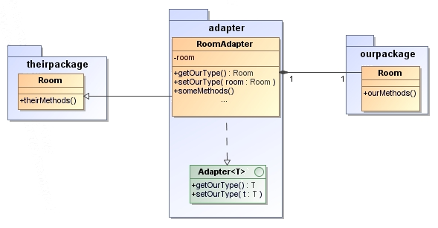
Integration
Notes:
The integration of the other program parts by implementation of interfaces was not possible, because no interfaces were available. To avoid the problem, our adapter classes inherit direct from the domain objects from the other team. Also every adapter implements a generic adapter interface, to set and read its type. This enables dynamic programming, there every of our adapters support this interface and so they can be read and created by other classes.

Slide 26
Integration of the GUI-Components
Different toolkits (Swing and SWT)
External Screen for „Prepayment“
Own implementation of „Day end closing“
Notes:
The SWT-GUI from Team F was not easy to integrate into our Swing-GUI, because they are 2 different toolkits. Fortunately the user interfaces from Team F was not extensive, so we replaced the SWT Message Box with a Swing counterpart.
The payment on account booking was implemented by the Accommodation -Panel from Team F, due to a conflict with the SWT-Panel integration into a Swing application.
Java don’t allow multiple inheritance. This prevents us to inherit from other adapters. So we override the methods from the superclass of the adapted class.
Prepayment (own console) because of incompatibility (ok from vollbrecht)
Day end closing only one message-box

Slide 27
Why JSF?
Event handling
JSF makes it easy to designate Java code that is invoked when forms are submitted. The code can respond to particular buttons, changes in particular values, certain user selections, and so on.
Managed beans
In JSP, you can use property="*" with jsp:setProperty to automatically populate a bean based on request parameters. JSF extends this capability and adds in several utilities, all of which serve to greatly simplify request param processing.
Notes:
Warum jsf, vorteile für uns, für Auftraggeber
Vorteile Formular
Probleme und Lösungen
Ajax:
Validierung?
This codesample shows how easy it is to use ajax with jsf. Only the <f:ajax tag is needed

Slide 28
Why JSF?
Integrated Ajax support
You can use jQuery, Dojo, or Ext-JS with servlets and JSP. However, JSF lets you use Ajax without explicit JavaScript programming and with very simple tags. Also, the Ajax calls know about the server-side business logic.
Form field conversion and validation
JSF has built-in capabilities for checking that form values are in the required format and for converting from strings to various other data types. If values are missing or in an improper format, the form can be automatically redisplayed with error messages and with the previously entered values maintained.

Slide 29
Why JSF?
Custom GUI controls
JSF provides a set of APIs and associated custom tags to create HTML forms that have complex interfaces
Page templating
Although JSP has jsp:include for reuse of content, JSF has a full-fledged page templating system that lets you build pages that share layout or content
Consistent approach
JSF encourages consistent use of MVC throughout your application.

Slide 30
Project management
Notes:
Project Trend
Zeitplan, …
Developement, trend, improvements?

Slide 31
Outlook
Notes:
What would be done? Was würde Sinn machen – weitere Schritte im Projekt (Integration vor Ort, Testlauf,…)
SW weiterentwicklung: neue Module hinzufügen (Basis steht)

Slide 32
Summary

Slide 33
Thank you
Notes:
HABIDERE

