Slide 1

- an overview
Framework for object-related database mapping
Work on objects instead of database
Updates come regularly
Huge community
Open source →
no licence needed
can be altered
Notes:
Due to several recommondations and our own recherche we decided to use the hibernate framework for the database connection.
Hibernate is an open source mapping framework for java, that maps database tables to java classes, so that it‘s possible to work on regular java classes instead of requesting the database for every type of data.
Hibernate is the most used javamapping framework, so there is a broad community that can be helpful when there are problems using it.
Other reasons fo rour decisions where that there is no license needed and that there are regularly updates and bugfixes.

Slide 2
Advantages
Materializing and dematerializing
Caching of database-objects
Map inheritance and composition
HQL or criteria queries
Database independent queries
Define which joined tables should be mapped
Notes:
Hibernate manages the complete materialization and dematerialization process. This means, it returns objects when you execute a database query and in the other way it saves full objects into the database.
It also internally caches the database objects, which speeds the database action up.
One very special point is that hibernate is even able to map inherited objects out from relational databases, what was very helpful for our work.
Last but not least, there are two special ways to execute database queries with hibernate.
HQL (Hibernate Query Language) is similar to standard SQL, but is database independent and offers the feature to specify which joined tables should be mapped.
The criteria class has the same advantages, but a cirteria query is created by using different methods, which add other functionalities to the query (Joins and restrictions)
Its even possible to use native SQL Strings, but they have the disadvantage, that they do not work when you have inheritanced objects in your query.

Slide 3
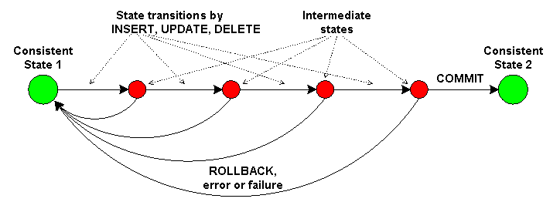
Transactions
Hibernate supports transactions
Units of work with one transaction
Restores old data on error → Persistent data
Notes:
One of our requiremnts for the database conection was, that it has to support transactions.
When we for example want to save a reservation there are different objects to save.
When an error occurs we have to restore the old data, if not there would be inconsistent data in the database what leads to several problems.
When we save something, we start an transaction and we confirm it if everything was okay, if not we make a rollback, what means we restore the old data.

Slide 4
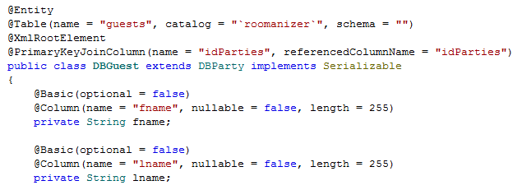
Mapping done by Annotations
Able to describe full configuration
Faster than xml-mapping
Notes:
Hibernate needs information about its classes, so that it can map the different database entries to the objects properties.
There are two different ways to give this information to hibernate. By XML files or with annotations.
We‘ve decided us to use annotations, because they are recommended by the hibernate community, because the interpreting of annotations is faster than the parsing of xml files.
On the code part you can see how a class is mapped to a table (show part) and how the variables are mapped to the columns (show) and configured as specified in the database.

Slide 5
Dynamic Mapper
Domain Layer
Mapper
Persistence Layer
Notes:
An important and interesting part in our Software is the Dynamic Mapper.
To split the Hibernate objects from our domain logic we decided to use different classes for these layers.
The only problem was to map betwenn these two layers, because we would have to write one maper for each class and adjust it with every modification we do.
So we decided to write one special mapper for all classes, our Dynamic Mapper.

Slide 6
Benefits
Independence from “Persistence Layer”
No Annotations in domain classes
Could be replaced
Uses “Reflection”
One mapper for all classes
One mapper instead of > 30
Also for new classes
Notes:
With our mapper, we are able to sepparate the Persistance Layer in which the Hibernate annotated objects are.
So we do not have to use these classes, where we could accedentially change the annotations, what would cause errors and the persistence Layer could easily be replaced, because our domain logic does not know it.
The mapper uses reflection to get the class name and the methods of the object that should be mapped.
So now we are able to map all our classes with one mapper instead of 30 or more. Even when we change the database we only have to write the new classes, the mapper can do the rest.

Slide 7
Pitfalls and requirements
Naming convention for class and method names
Console tool to check conventions
No lazy-fetching possible
Mapping circle: → Stack Overflow
Invoice Item
Invoice
Notes:
Of course our mapper cannot gues what it should map, so we introduced some name conventions in our prgramm.
Hibernate classes start with the prequel DB, the rest of the name is the same. Also the getter and setter Method on both sides need to be named the same.
To check for errors we created a small test programm, that checks the conventions.
Because we assign all values to our new objects, lazy fetching is impossible. All values are requested and so they have to be read from the database. This is no big problem because so, we read the data once and hibernate caches it. AT the beginn of a process the programm needs a bit more time, but after that it gets faster than otherwise.
The biggest problem in the development was that some of our objects refer themselves in both ways. So when we map an Invoice, it has to map the InvoiceItems and then it maps the Invoice agian.

Slide 8
Development
First version depth limited
Same mapping several times
Not all mappings are done
Current version
Saving mapped objects in Hash Map
About 300 times faster
All mappings are done
Notes:
Our first workaround was to depth limit the mapping process. So the object got mapped several times, but it stoped after some iterations.
This solution was slow and not all data was mapped to the domain layer.
In further development we have rewriten the mapper and now we save the already mapped objects in a HashMap.
If an already mapped object now has to be mapped, we just use the already saved object and so we do not run into an infinite loop.
Our performance tests have shown us, that this improvment speeded the mapping process by the factor 300 up and in addition we really map all connected object to our domain layer.

Slide 9
Functionality
Get the class name and search for equivalent
Customer ←→ DBCustomer
Save the new object
Find setter methods in new object
Search for the appendant getter in old object
setFirstName() → getFirstName()
Is model object?
Yes:
Use already saved object if possible
Map the object otherwise
No:
Invoke setter with result from getter
Notes:
Now i will give you a short introduction how the mapper works.
At first it reads the class name of the object that shall be mapped and searches for the new class name and creates an object based on that.
The new object gets saved in the HashMap. Then we search for setter methods in the new object and when we find one, we search for a suitable getter method in the old object.
If the return type is no object that has to be mapped we just use the setter method to set the returned value.
In the other case, we search if the returned object is already saved, if yes we just take the mapped object and set it in the new object.
If not, we map the new object – so the whole prcess starts from the beginning with the new object.

