Slide 1
State Pattern
Used in use case controllers
Each step representing a state in the GUI
Always the same controller
Different implementations during runtime
Dynamically binding of state object
Notes:
Screens (Flip Chart, black board) – see sketch
Static problem with class change during runtime
Different controller classes (CreateInvoiceController in searchState,…
Nice polymorphic problem-solution, but….
We are using always the same controller from outside
Who would change the controller state? One more controller?
Switching the class of the object during runtime is not possible (in common Object Oriented programming languages)
Exception: Self (http://en.wikipedia.org/wiki/Self_(programming_language))
Solution: State Pattern

Slide 2
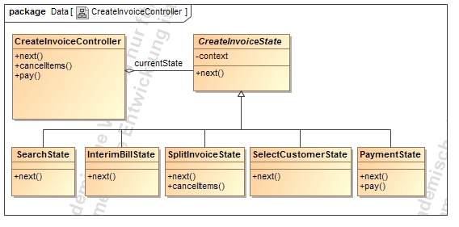
State Pattern - Structure
Abstract State
Methods throw
IllegalStateException
Context
Concrete States
Example: payment only works in the PaymentState
Notes:
Our team made the decission to use the state pattern in our use case controllers.
Example (Create Invoice Controller):
Model-structure with roles
Context: Controller – interface for gui
Abstract state: interface for different states to encapsulate them
Concrete state: implements the behaivour, which is connected to state of the context object
Conroller looks now like a object which changed his class!
For each step in the process, displayed as a single view in the user interface we created one state.
From the outside, we always use the same controller, but depending on the current state, differents actions are performed or an exception is thrown in the case, that this operation is not accessible in the current state.
In example: the next method is implemented in every state, but depending on the state, the next state is another one.
Other functions, like for instance the pay function, are only implemented in one state.
Another advantage of of the state pattern is the easy way to create new states. You can just insert a new class and link it depending on the called functions together with the ither states.

Slide 3
State Pattern - Advantages
Structuring the controller by state
easy, readable and maintainable code
State classification would be possible
Transitions are explicit
Consitence because of atomic states
Notes:
Structure:
the strucutre by state prevents long switch-case statements in the operations
Classification is possible, because super and sub classes in the states are supported
Transitions explicity: the state is an external class; so – from the perspective of the context – the state-transition is atomic

