Slide 1
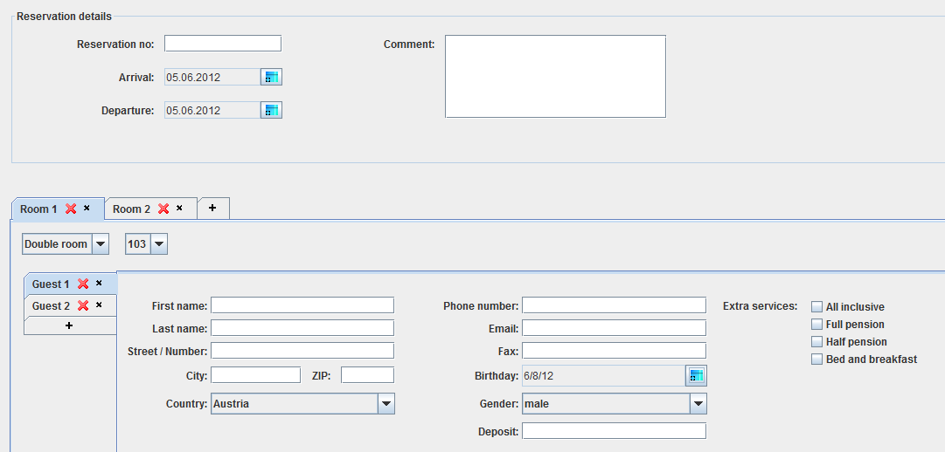
The check in screen.
Notes:
Here you can enter the data for the check-in. What at first glance seems a bit confusing on closer inspection is a well-thought-out solution.

Slide 2
The reservation details
Notes:
In the top of this screen the reservation details can be seen. It is possible to change the arrival and departure time if you want.

Slide 3
The room tabs
Notes:
Up here you can see all the rooms that have been reserved. Of course it is easy to add more or delete some.

Slide 4
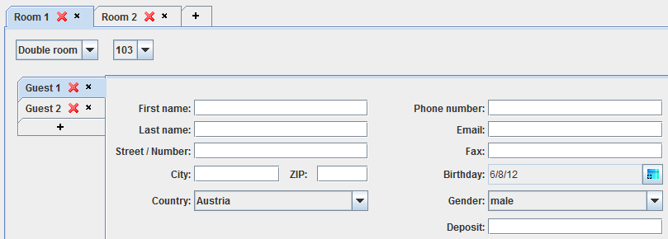
The guest tabs
Notes:
The same is possible with guests per room. If guests have been associated with reservations, it fills in the fields immediately.

Slide 5
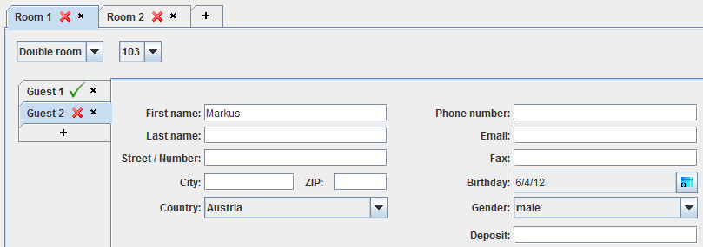
Guest 1 filled out fully
Notes:
If a form is fully filled the red x changes into a green tick as shown in this picture.

Slide 6
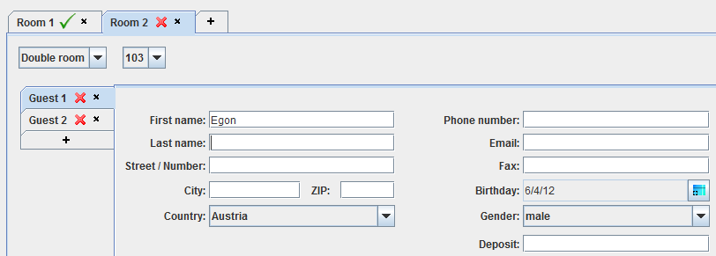
All guesttabs from room 1 are filled out fully
Notes:
The same happens with the room tab if all of its guestsfields are filled out correctly.

