Slide 1
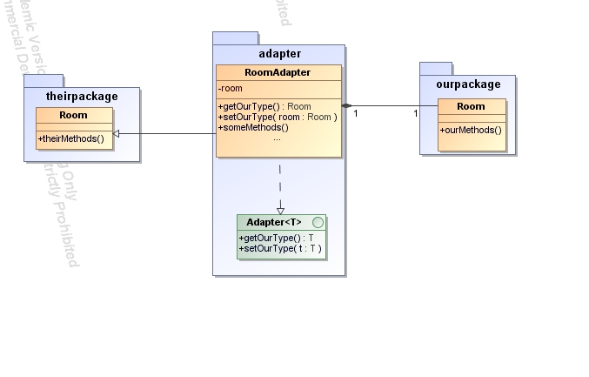
Adapter integration
The integration of the other program parts by implementation of interfaces was not possible, because we got no interfaces available. To avoid the problem, our adapter classes inherit direct from the domain objects from the other team. Also every adapter implements a generic adapter interface, to set and read its type. This enables dynamic programming, there every of our adapters support this interface and so they can get red and created by other classes.
Implementation of interfaces not possible
Adapter classes inherit direct from domain objects from other team
Every adapter implements a generic adapter interface

Slide 2
GUI integration
The SWT-GUI from Team F was not easy to integrate into our Swing-GUI, because they are 2 different toolkits. Fortunately the user interfaces from Team F was not extensive, so we replaced the SWT Message Box with a Swing counterpart.
The payment on account booking was implemented by the Habitation-Panel from Team F, due to a conflict with the SWT-Panel integration into a Swing application.
Java don’t allow multiple inheritance. This prevents us to inherit from other adapters. So we override the methods from the superclass of the adapted class.
Not easy to integrate – different toolkits
Not extensive interface could be replaced

