Slide 1
Roomanizer
Hotel Software Project

Slide 2
Agenda
Team
Introduction
Customer presentation
Technical presentation
Project Management
Outlook

Slide 3
Team
Stefan Dunst
Christian Lins
Johannes Schwendinger
Markus Mohanty
Tobias Meusburger
Hubert Rall
Notes:
Aufzählen, Hauptaufgaben

Slide 4
Introduction
Hotelsoftware „Roomanizer“
Focus on key processes
No accounting
No human resources management
No time and attendence recording
Notes:
Interne Abläufe
Kernfunktionen
Nicht Ziele zur Abgrenzung (keine Buchhaltung,…)

Slide 5
Requirements
Book /change /confirm / cancel a reservation
Occupancy preview
Automated day end closing
Presentation of different reports and statistics
Room allocation
Check In / Out
Notes:
Here is a short description of the user requirements
the final version of the program allows the user to book, change, confirm and cancel a reservation.
It also allows u to see the occupancy of the rooms, an automated accounting, a presentation of differen reports and statistics, a room allocation and a Check in and out.

Slide 6
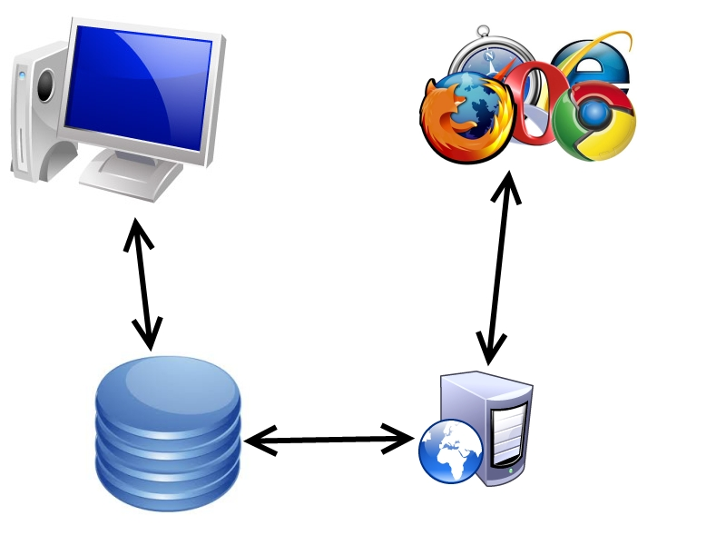
Architecture
Browser
Workstation
Database
Web server
Notes:
Wo liegt die Logik? Fat-, Thin-Client
Beispiele: Workstation → Rezeptionist, Browser → Kunde/Gast

Slide 7
Customer presenation
Demonstration of the program
Screencast
Summary

Slide 8
Demo
Notes:
Programm ausführen – vorstellen → Konzept (Hubert R.) Mitglieder: ….
Short cuts
… sonstige Vorteile
Mehrwert für Kunde
Besonderes an unserem Programm
8

Slide 9
Screencast
Notes:
Invoice (alle beteiligt, abwechslungsreich)
9

Slide 10
Summary
Usability
Shortcuts
Clear navigation bar
Supports flexible handling
Special functionality
Weather forecast
Built-in PDF viewer
Approx search
Notes:
Supports flexible handling: viel dynamisch in einem Schritt (Beispiel: Check-In→ Räume/Gäste dyn. ändern)
Approx search: …

Slide 11
Technical presentation
Layer model
Database
Hibernate
Dynamic Mapper
State Pattern
Swing GUI
Integration external Software Modules
JSF (web-reservation)
Notes:
11

Slide 12




Overview
Git
Java
Netbeans
MySQL
Unified Process
Notes:
Was verwenden wir? Auf Technologien kurz eingehen. Warum verwenden wir diese?
Genaueres später!
12

Slide 13

Unified Process
Inception
Kick off
Definition of Use cases
Elaboration
Requirements engineering
Construction
Timeboxes
Transition

Slide 14
Layer
Built after model-view-controller concept
Clear allocation of tasks
Clearly arranged
Access protection
Single layers can easily be exchanged/extended
Notes:
Auf elle Ebenen eingehen (eigene Folien mit drei, vier Punkten, was passiert)
Zuvor Überblick verschaffen – einzelne Schichten

Slide 15

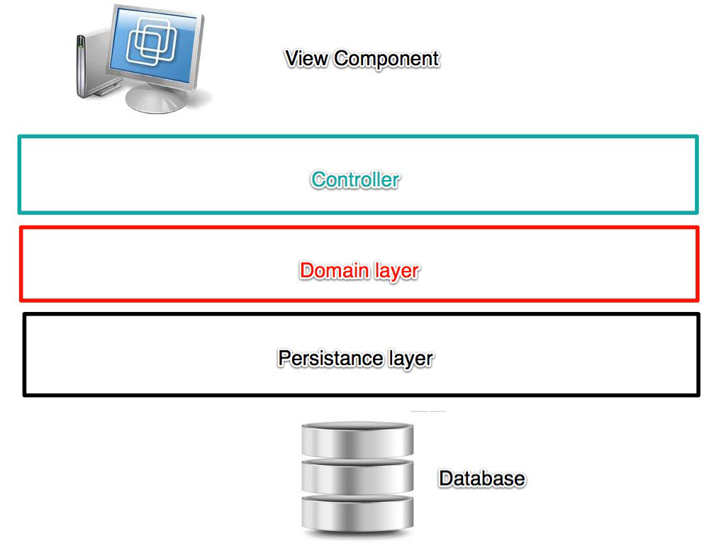
Layer
Notes:
New image needed. Controller in gui needs to be seen. Domain and database new… detailed pictures for each slide.

Slide 16
Layer
Persistence layer
Classes with annotations for Hibernate
Contain no logical functionality
Contains manager-classes for communication to database:
For saving objects
To retrieve objects

Slide 17
Layer
Model
Contains classes for logical processing
All classes are implemented to an interface
Contain static methods:
To retrieve a object of the class, via a manager

Slide 18
Layer
Controller
For each use-case one controller
Controllers implement the state-pattern
Notes:
Reference to Stefan

Slide 19
Layer
View
Contains all classes the GUI uses
Also containing interfaces to hand over information to the model layer and the other way round
Specific controller for GUI operations

Slide 20
Layer
Webarchitecture:
Able to replace SWING GUI with JSF
Complete logical processing still in layers below
Managed beans as GUI controller

Slide 21
Database
Relational database System
Not object oriented!
Widely spread
Regularly updated
Huge community
Open source

Slide 22
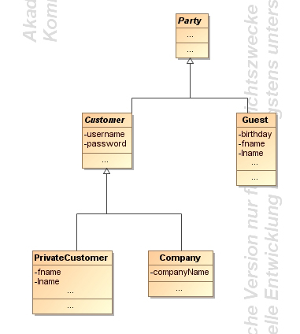
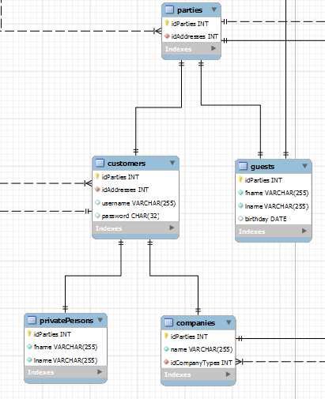
Object orientation
Inheritence simulated:
Parent-table holds basic information
Child-table holds additional information
Primary key matching
Advantages:
No NULL values
No redundant information
Disadvantages:
Many joins needed

Slide 23

Hibernate - an overview
Framework for object-related database mapping
Work on objects instead of database
Updates are distributed regularly
Huge community
Open source →
no licence needed
can be altered
Notes:
Due to several recommondations and our own recherche we decided to use the hibernate framework for the database connection.
Hibernate is an open source mapping framework for java, that maps database tables to java classes, so that it‘s possible to work on regular java classes instead of requesting the database for every type of data.
Hibernate is the most used javamapping framework, so there is a broad community that can be helpful when there are problems using it.
Other reasons fo rour decisions where that there is no license needed and that there are regularly updates and bugfixes.

Slide 24
Advantages
Materializing and dematerializing
Caching of database-objects
Map inheritance and composition
HQL or criteria queries
Database independent queries
Define which joined tables should be mapped
Notes:
Hibernate manages the complete materialization and dematerialization process. This means, it returns objects when you execute a database query and in the other way it saves full objects into the database.
It also internally caches the database objects, which speeds the database action up.
One very special point is that hibernate is even able to map inherited objects out from relational databases, what was very helpful for our work.
Last but not least, there are two special ways to execute database queries with hibernate.
HQL (Hibernate Query Language) is similar to standard SQL, but is database independent and offers the feature to specify which joined tables should be mapped.
The criteria class has the same advantages, but a cirteria query is created by using different methods, which add other functionalities to the query (Joins and restrictions)
Its even possible to use native SQL Strings, but they have the disadvantage, that they do not work when you have inheritanced objects in your query.

Slide 25
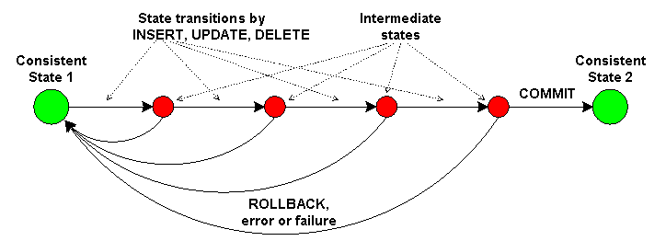
Transactions
Hibernate supports transactions
Units of work with one transaction
Restores old data on error → Persistent data
Notes:
One of our requiremnts for the database conection was, that it has to support transactions.
When we for example want to save a reservation there are different objects to save.
When an error occurs we have to restore the old data, if not there would be inconsistent data in the database what leads to several problems.
When we save something, we start an transaction and we confirm it if everything was okay, if not we make a rollback, what means we restore the old data.

Slide 26
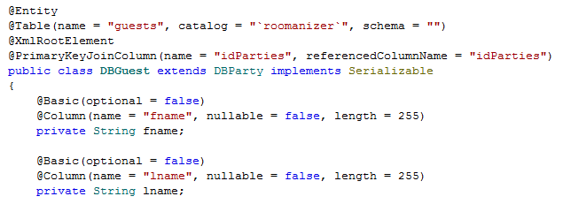
Mapping done by Annotations
Able to describe full configuration
Faster than xml-mapping
Notes:
Hibernate needs information about its classes, so that it can map the different database entries to the objects properties.
There are two different ways to give this information to hibernate. By XML files or with annotations.
We‘ve decided us to use annotations, because they are recommended by the hibernate community, because the interpreting of annotations is faster than the parsing of xml files.
On the code part you can see how a class is mapped to a table (show part) and how the variables are mapped to the columns (show) and configured as specified in the database.

Slide 27
Dynamic Mapper
Domain Layer
Mapper
Persistence Layer
Notes:
An important and interesting part in our Software is the Dynamic Mapper.
To split the Hibernate objects from our domain logic we decided to use different classes for these layers.
The only problem was to map betwenn these two layers, because we would have to write one maper for each class and adjust it with every modification we do.
So we decided to write one special mapper for all classes, our Dynamic Mapper.

Slide 28
Benefits
Independence from “Persistence Layer”
No Annotations in domain classes
Could be replaced
Uses “Reflection”
One mapper for all classes
One mapper instead of > 30
Also for new classes
Notes:
With our mapper, we are able to sepparate the Persistance Layer in which the Hibernate annotated objects are.
So we do not have to use these classes, where we could accedentially change the annotations, what would cause errors and the persistence Layer could easily be replaced, because our domain logic does not know it.
The mapper uses reflection to get the class name and the methods of the object that should be mapped.
So now we are able to map all our classes with one mapper instead of 30 or more. Even when we change the database we only have to write the new classes, the mapper can do the rest.

Slide 29
Pitfalls and requirements
Naming convention for class and method names
Console tool to check conventions
No lazy-fetching possible
Mapping circle: → Stack overflow
Invoice Item
Invoice
Notes:
Of course our mapper cannot gues what it should map, so we introduced some name conventions in our prgramm.
Hibernate classes start with the prequel DB, the rest of the name is the same. Also the getter and setter Method on both sides need to be named the same.
To check for errors we created a small test programm, that checks the conventions.
Because we assign all values to our new objects, lazy fetching is impossible. All values are requested and so they have to be read from the database. This is no big problem because so, we read the data once and hibernate caches it. AT the beginn of a process the programm needs a bit more time, but after that it gets faster than otherwise.
The biggest problem in the development was that some of our objects refer themselves in both ways. So when we map an Invoice, it has to map the InvoiceItems and then it maps the Invoice agian.

Slide 30
Development
First version depth limited
Same mapping several times
Not all mappings are done
Current version
Saving mapped objects in HashMap
About 300 times faster
All mappings are done
Notes:
Our first workaround was to depth limit the mapping process. So the object got mapped several times, but it stoped after some iterations.
This solution was slow and not all data was mapped to the domain layer.
In further development we have rewriten the mapper and now we save the already mapped objects in a HashMap.
If an already mapped object now has to be mapped, we just use the already saved object and so we do not run into an infinite loop.
Our performance tests have shown us, that this improvment speeded the mapping process by the factor 300 up and in addition we really map all connected object to our domain layer.

Slide 31
Functionality
Get the class name and search for equivalent
Customer ←→ DBCustomer
Save the new object
Find setter methods in new object
Search for the appendant getter in old object
setFirstName() → getFirstName()
Is model object?
Yes:
Use already saved object if possible
Map the object otherwise
No:
Invoke setter with result from getter
Notes:
Now i will give you a short introduction how the mapper works.
At first it reads the class name of the object that shall be mapped and searches for the new class name and creates an object based on that.
The new object gets saved in the HashMap. Then we search for setter methods in the new object and when we find one, we search for a suitable getter method in the old object.
If the return type is no object that has to be mapped we just use the setter method to set the returned value.
In the other case, we search if the returned object is already saved, if yes we just take the mapped object and set it in the new object.
If not, we map the new object – so the whole prcess starts from the beginning with the new object.

Slide 32
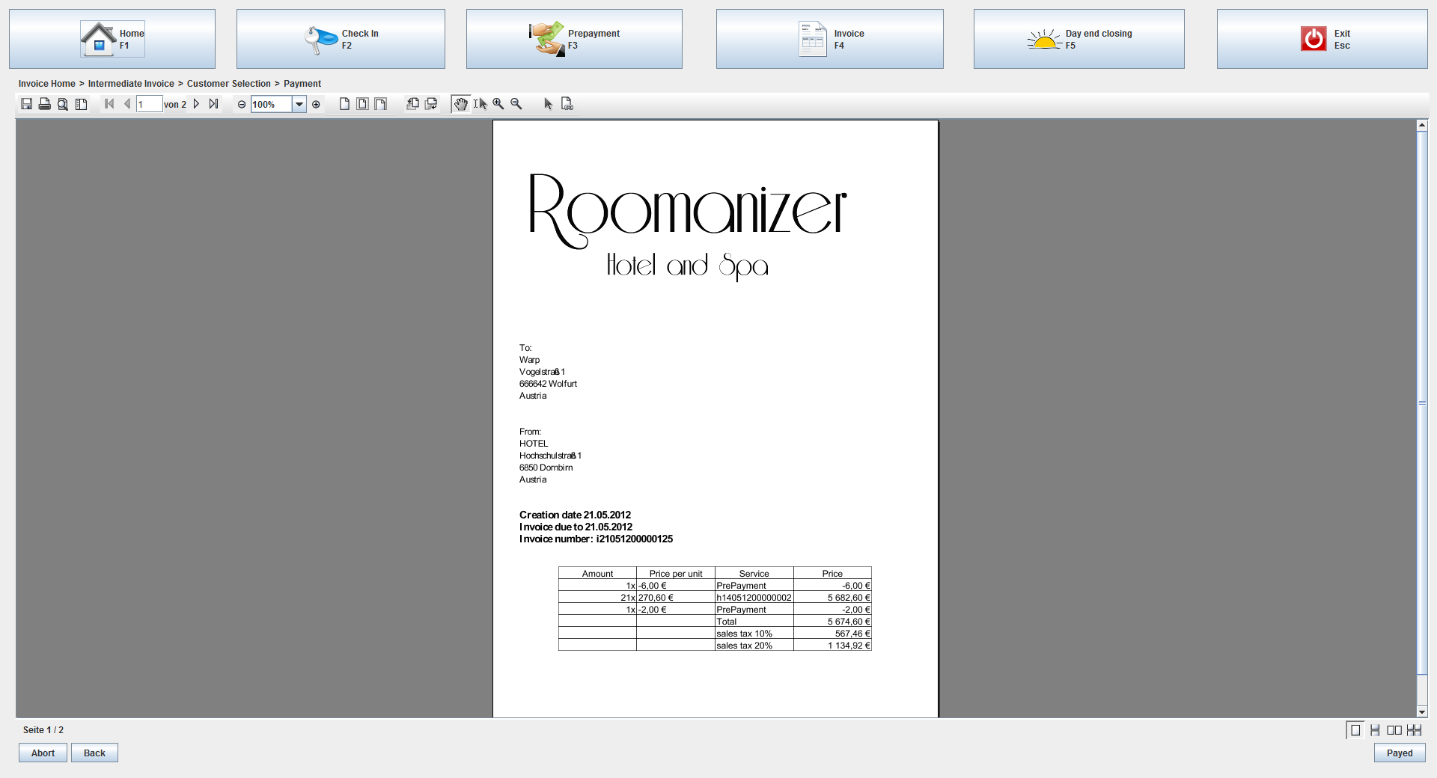
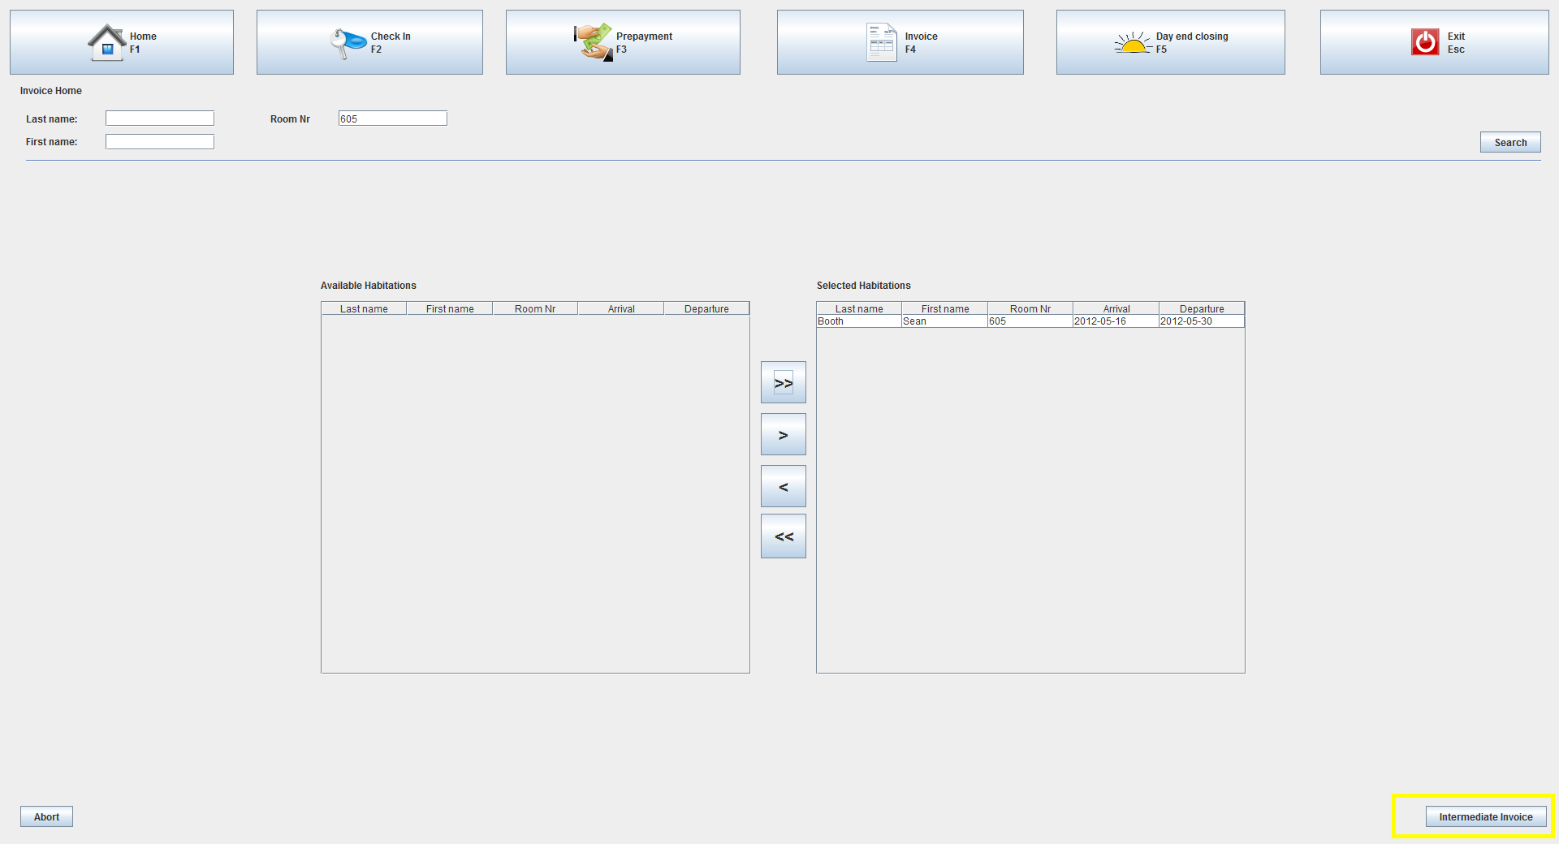
State Pattern
Used in use case controllers
Each step representing a state in the GUI
Always the same controller
Different implementations during runtime
Dynamically binding of state object

Slide 33
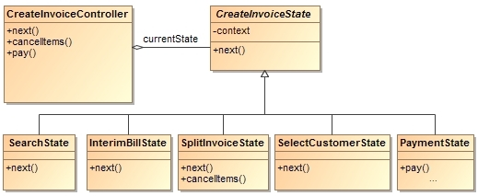
State Pattern - Structure
Abstract State
Methods throw
IllegalStateException
Context
Concrete States
Example: payment only works in the PaymentState

Slide 34
State Pattern - Advantages
Structuring the controller by state
easy, readable and maintainable code
State classification would be possible
Transitions are explicit
Consitence because of atomic states
Comfortable developement

Slide 35

Swing GUI
Platform independent
same look and feel on all platforms
Extensible
Inheritance of JComponent
Customizable
Components are parameterisable

Slide 36
Integration
No interfaces available for implementation
Adapter classes inherit directly from domain objects of team F
Every adapter implements a generic adapter interface
Notes:
Bezug auf Adapter-Pattern (Einleitung)
Schwierigkeiten – wie haben wir es gelöst!

Slide 37
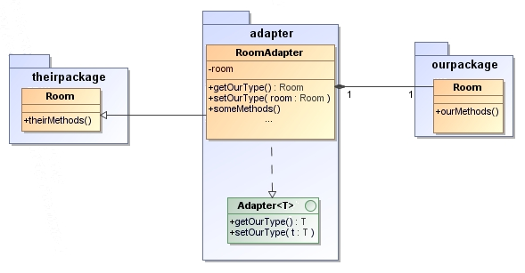
Integration
Notes:
The integration of the other program parts by implementation of interfaces was not possible, because no interfaces were available. To avoid the problem, our adapter classes inherit direct from the domain objects from the other team. Also every adapter implements a generic adapter interface, to set and read its type. This enables dynamic programming, there every of our adapters support this interface and so they can be read and created by other classes.

Slide 38
Integration of the GUI-Components
Different toolkits (Swing and SWT)
External window for „Prepayment“
Own messagebox for „Day end closing“
Notes:
The SWT-GUI from Team F was not easy to integrate into our Swing-GUI, because they are 2 different toolkits. Fortunately the user interfaces from Team F was not extensive, so we replaced the SWT Message Box with a Swing counterpart.
The payment on account booking was implemented by the Accommodation -Panel from Team F, due to a conflict with the SWT-Panel integration into a Swing application.
Java don’t allow multiple inheritance. This prevents us to inherit from other adapters. So we override the methods from the superclass of the adapted class.
Prepayment (own console) because of incompatibility (ok from vollbrecht)
Day end closing only one message-box

Slide 39
Java Server Faces (JSF)
Event handling
makes it easy to write code that is invoked when particular events occur
Managed beans
Automatic property binding

Slide 40


JSF
Integrated Ajax support
Use Ajax without explicit JavaScript Programming with simple Tags
Ajax knows about the server-side business logic
Form field conversion and validation
Built-in value checking and converting
Notes:
JSF has built-in capabilities for checking that form values are in the required format and for converting from strings to various other data types. If values are missing or in an improper format, the form can be automatically redisplayed with error messages and with the previously entered values maintained.

Slide 41
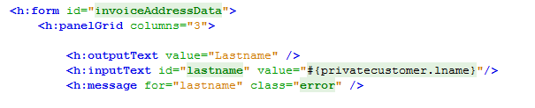
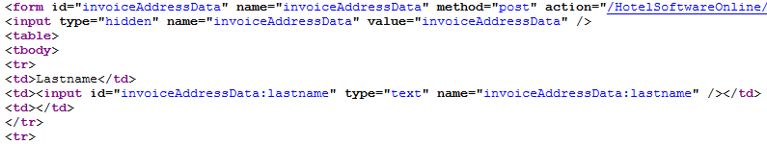
JSF
Custom GUI controls
provides a set of APIs and associated custom tags to create HTML
Page templating
page templating system allows building pages that share layout or content
Consistent approach
encourages use of MVC
Notes:
JSF provides a set of APIs and associated custom tags to create HTML forms that have complex interfaces
Although JSP has jsp:include for reuse of content, JSF has a full-fledged page templating system that lets you build pages that share layout or content
JSF encourages consistent use of MVC throughout your application

Slide 42
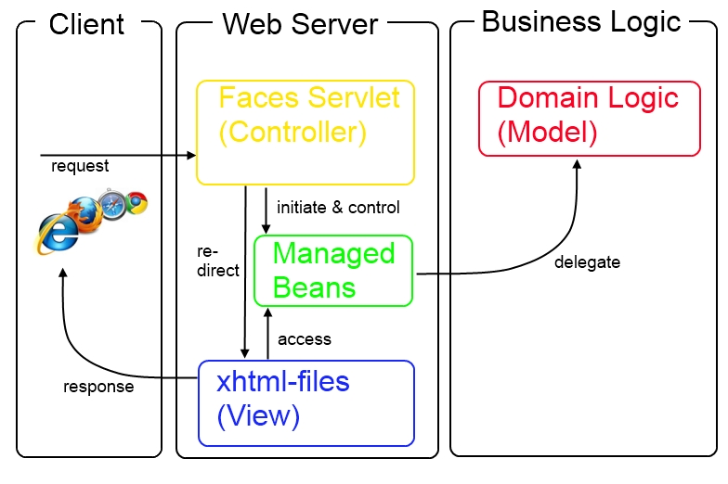
JSF - Architecture
Notes:
Model 2 archtitecture

Slide 43
Team
Introduction
Customer presentation
Technical presentation
Project Management
Outlook

Slide 44
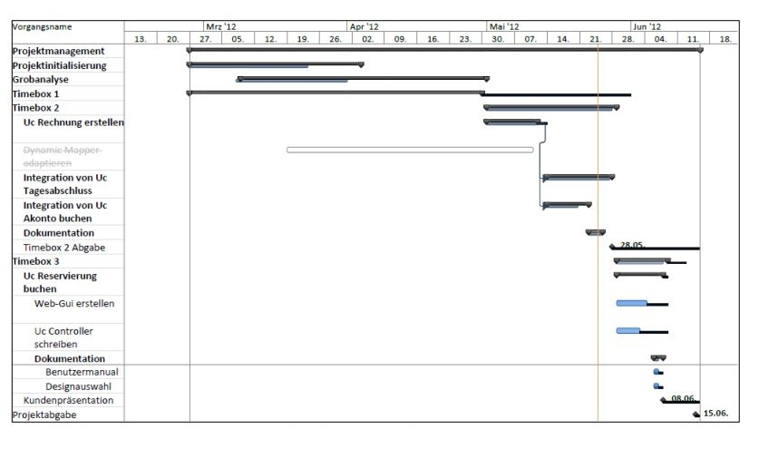
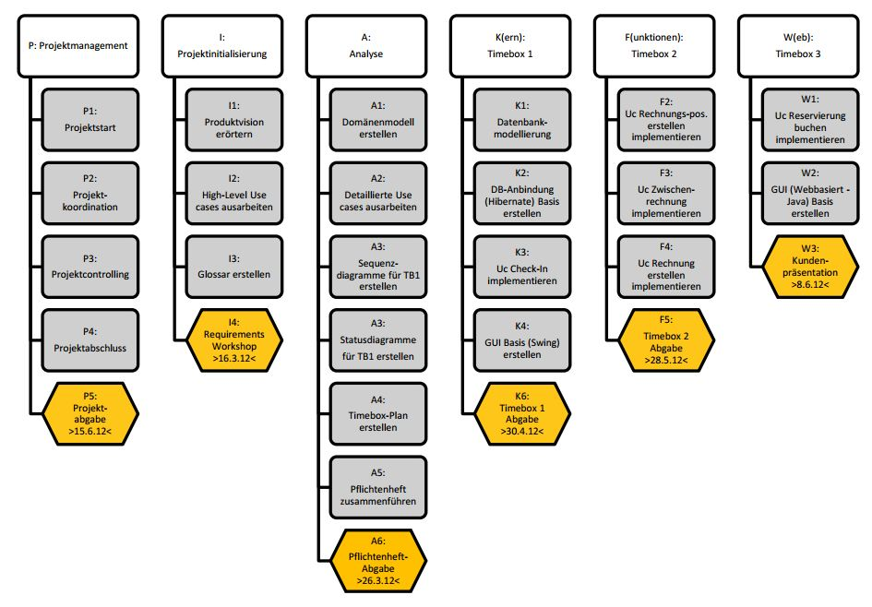
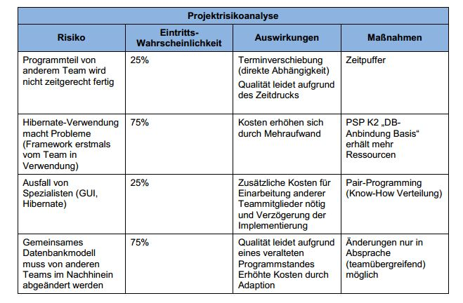
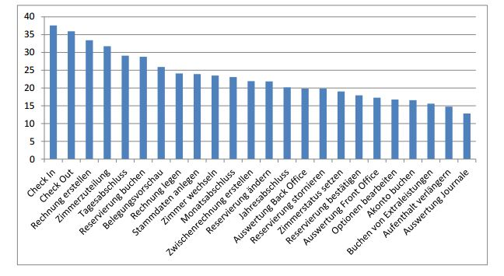
Project management
Kick-off Meeting
Work Breakdown Structure
Gantt-Chart
Bottom-Up
Weekly report
Project risks
Closely working together
Notes:
Project Trend
Zeitplan, …
Developement, trend, improvements?
44

Slide 45
Outlook
Replacing/Upgrading of certain components easy thanks to layers
Integration of remaining sections of the hotel
f.e. Kitchen
Integration of remaining use cases
f.e. annual statement
Integration into social media (for example book from Facebook)
Various options to extend website
Reviews
Vouchers
12.06.12
Roomanizer Presentation Team E
45
Notes:
45
What would be done? Was würde Sinn machen – weitere Schritte im Projekt (Integration vor Ort, Testlauf,…)
SW weiterentwicklung: neue Module hinzufügen (Basis steht)
45

Slide 46
Summary
Extensible
Layer model
Dynamic mapper
State pattern
Technologies
MySQL
Hibernate
PDF viewer
Java with Swing
Notes:
Technologien: weitverbreitet → support (mysql – oracle), hibernate (meist verwendet – abnahme mapping), pdf-viewer (ice-community like jboss), java (mulitplatform
Free („no“ costs)
46

Slide 47
Thank you
We hope this presentation was successful in explaining the various design decisions our team made, and why we made them
Questions ?
Notes:
HABIDERE

