Slide 1

Wheat Price Forecasting and MSP Credibility Analysis
An Evidence-Based Assessment Amidst Farmer Protests (2012–2024)

Slide 2
Context and Purpose of Analysis
Ongoing debate on legal guarantee of Minimum Support Price (MSP).
Farmer protests (2020–2025) intensified focus on MSP efficacy.
Study evaluates if MSP reflects market realities for wheat.
10-year price data used for time-series analysis and forecasting.

Slide 3
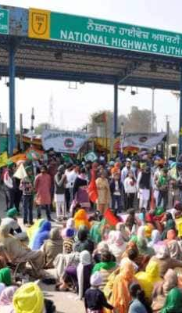
Farmer Suicides and Protest Impact
11,290 farming-related suicides in 2022 (6.6% of all suicides) – NCRB.
822 suicides in Marathwada, Maharashtra in 2024; only 303 compensations.
₹1,639 crore toll revenue loss in Punjab (2020–2024).
Over 80 train cancellations and severe transport blockades.

Slide 4
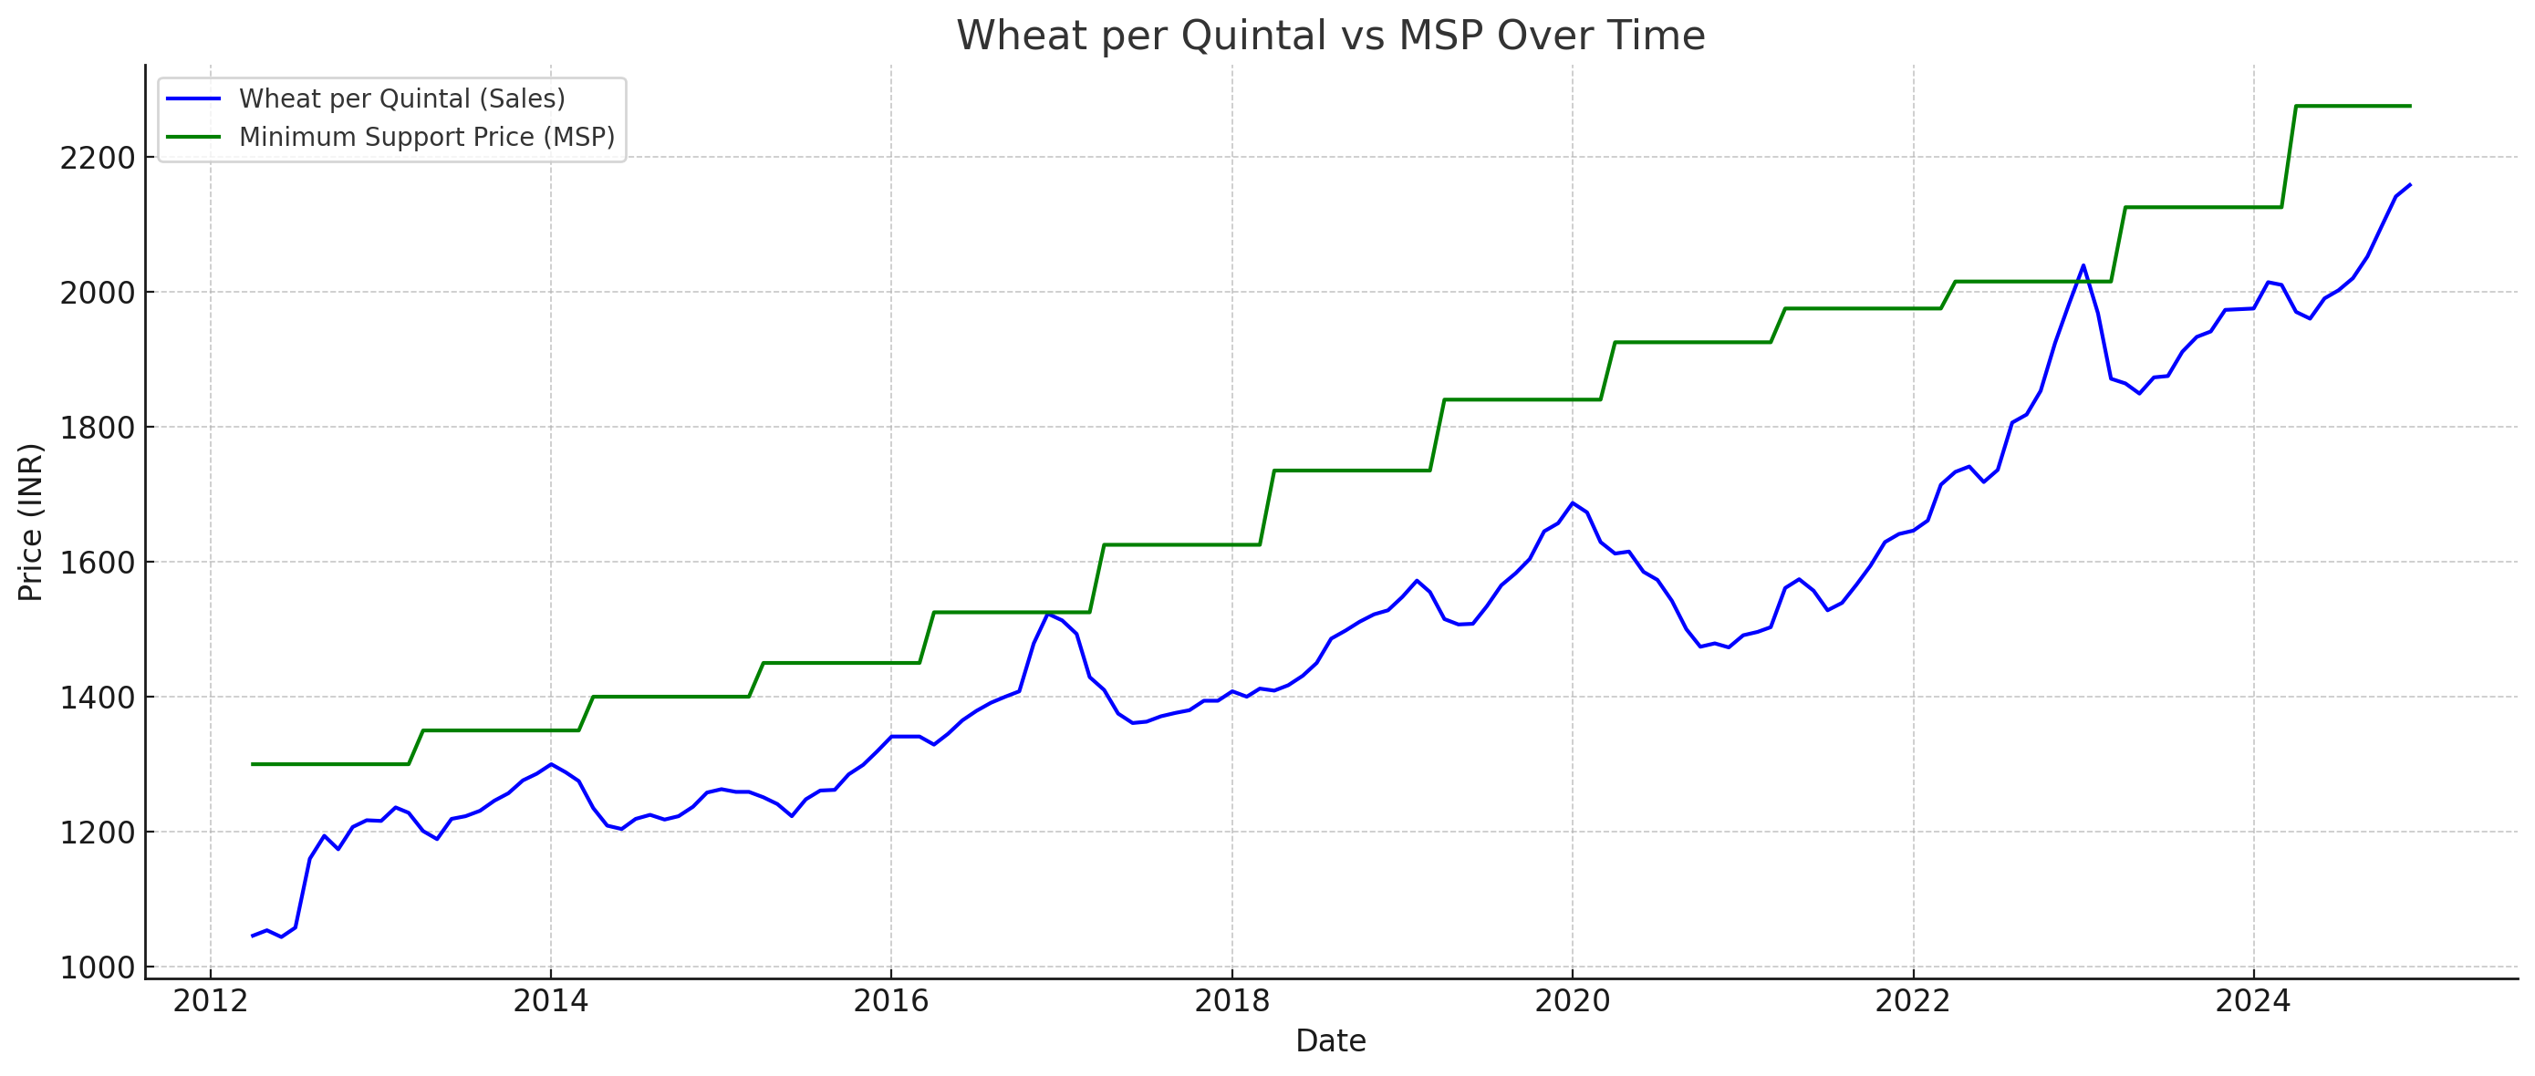

Slide 5
Data Overview
Monthly data from April 2012 to December 2024.
Variables: Market Price (Sales), MSP, Quarter, Time Index.
Crop analyzed: Wheat (1 of 20 MSP-listed crops).

Slide 6
Modeling Framework
Model 1: Linear Trend
Model 2: Trend + Seasonality (Quarter Dummies)
Model 3: Trend + Seasonality + Lag 1
Model 4: Trend + Seasonality + Lags 1–3
Model 5: ARIMA(2,1,0)(1,0,0)[12] with drift

Slide 7
Model Comparison Summary
Model Adj R² RMSE Notes
M1 0.897 187.43 High autocorrelation
M2 0.901 198.05 Overfitting risk
M3 0.835 109.33 Best forecasting model
M4 0.854 113.59 Slightly overfitted
ARIMA - 23.47 Stable, low-residuals

Slide 8
ARIMA Model Insights
Fitted model: ARIMA(2,1,0)(1,0,0)[12] with drift.
Parameters: AR1 = 0.4966, AR2 = -0.1718, SAR1 = 0.0151, Drift = 7.33.
Train RMSE = 23.47, MAPE = 1.12%.
Residuals are nearly white noise; minimal autocorrelation.
ARIMA captures temporal dependencies better than linear models.

Slide 9
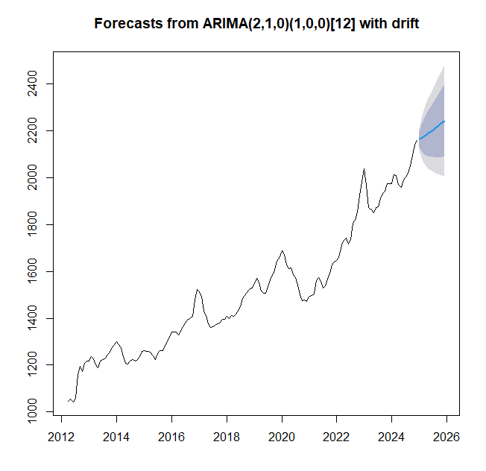

Slide 10
Conclusion and Policy Implication
MSP shows limited alignment with short-term market dynamics.
Seasonality and autocorrelation are critical to wheat pricing.
Lag models and ARIMA outperform linear methods in forecasting.
Data-driven support for farmer demand on MSP credibility.
Legal MSP guarantee could provide price stability and reduce distress.

