Slide 1


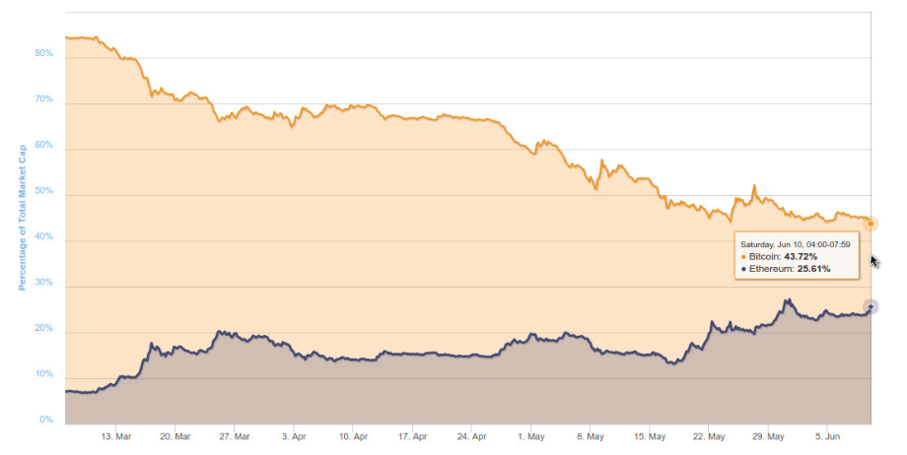
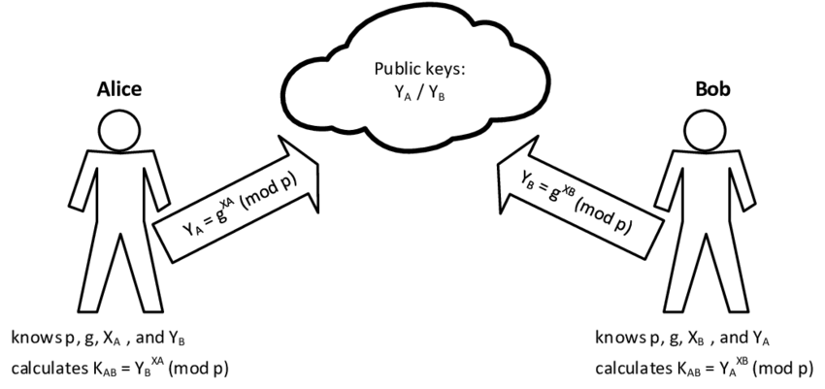
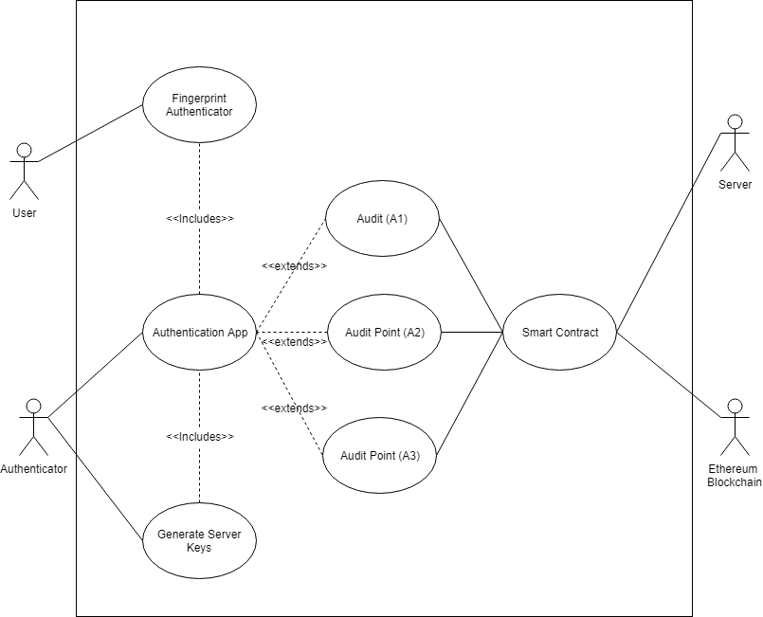
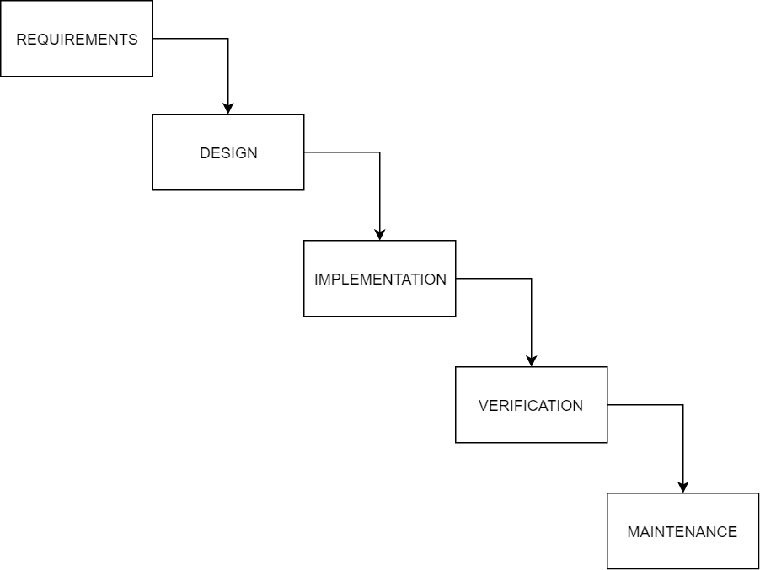
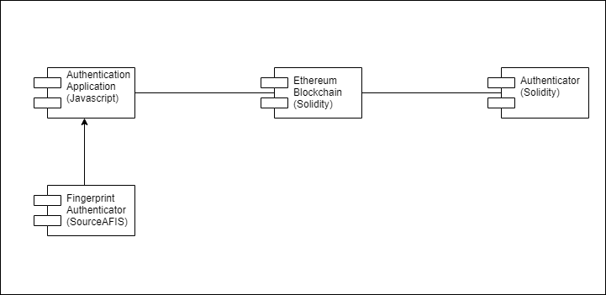
Ethenticate!
BUILDING AUTHENTICATION SYSTEMS USING BLOCKCHAIN TECHNOLOGIES
Introduction!: Since its initial paper in 2012, Ethereum, the public, Blockchain based distributed computing platform and operating system, has grown in both its ubiquity and the scope of its use. Here we present one such solution, using the Ethereum network as the backbone of an authentication service designed to scan, compare and confirm user’s fingerprints. The Ethereum blockchain’s immutability serving as a valuable guarantee of trust, ensuring that every fingerprint a user authenticates cannot be altered, modified, deleted or changed.
Why use the Blockchain to store Biometric data?: Blockchain technologies rely on private keys that are controlled solely by the user, it also has a number of features that make the storage of data safe, these include encryption keys, zero-knowledge data storage, and decentralized ledger
ETHEREUM MARKET SHARE INCREASE
Aim: If someone can gain access to a system illegitimately, it often means successive access to a system through illegitimate means is an inevitability. Reliable evidence of the vulnerable step in the authentication flow is paramount to harden the system. This requires an audit trail, along with real time notifications. I intend to propose a method through which Ethereum, through a smart contract, can serve as an authority’s mechanism to prove, beyond doubt, that an illegitimate but successful identification took place at the fingerprint scan stage. With Blockchains immutability serving as an excellent medium to store audit trails and reliable access notifications upon which one can act
Ethereums increasing market share is making it an increasingly popular choice for solutions developers
Diffie-Hellman Key Exchange
Our solution for sharing sensitive information is modelled on DHE, it allows the generation of a shared secret (which are keys) between two parties over an insecure channel. The process is then intermediated by the Ethereum Blockchain which stores information that is passed between “Alice” and “Bob”. Who, in this case, will be the authentication client and the authenticator.
Objectives:
Allows users to send random parameters for the protocol and the address of the relevant smart contract.
Secret keys that allow access to the smart contract which serve as the second factor for authentication.
Secret keys that allow access to the smart contract which serve as the second factor for authentication.
Secret keys that allow access to the smart contract which serve as the second factor for authentication.
To produce an audit point, defined as A1, that will serve as confirmation that the user can interact with the blockchain.
To produce a second audit point where the authenticator receives and decrypts the first message of the DHE and the nonce and publishes the component of the DHE and the decrypted nonce to show that it is possesses the public key.
Creating a shared secret, k = A^{b} = Bª.
To create a third audit point, A3 which is where receivers public key is encrypted for better privacy and forward-secrecy..
Methodology: I intend to use the waterfall development methodology. It’s a traditional software development method that consists of sequential phases in which specific goals are accomplished
Design: The design itself consisted of three key elements, the authentication client, the Ethereum Blockchain and the authenticator. All three would be used for both the exchange of keys as well as the sending and matching of fingerprints. This information would then be stored on both a local database and the Ethereum blockchain
Results: The software itself was effective in producing both public and private keys for our authentication client and our authenticator. We were also able to deploy our smart contract onto the Rinkeby Ethereum test network. I have shown below some examples of the keys that the software produced:
Conclusion: This project was highly effective in providing insight into complex topics relating to Ethereum, Blockchain technology as well as cryptography. The software has significant market potential and could be very attractive to service users who like added security provided by a decentralized network like Ethereum.
Recommendations: Perhaps the most pressing recommendation would be that of including a visual user interface into any future software product. This would reduce the learning curve for users who may have difficulty understanding long hexadecimal values.
Server Public Key: 2edd74b24551a99b3e96ceec943f5815
Server Private Key: 7f76a3a292bd847f64af8983021bff8f
Server Secret: c7613cf0175f0bdd4a21497c6ea0a2e3
Client Public Key: a4498511cd0a77095d422a57b12a595a
Client Fingerprint: 2eca195445e93c4c1096b5eefae23f63:beb64972062c7f0a235ff44a34f9a600700e8b552a3789499edb

