Slide 1
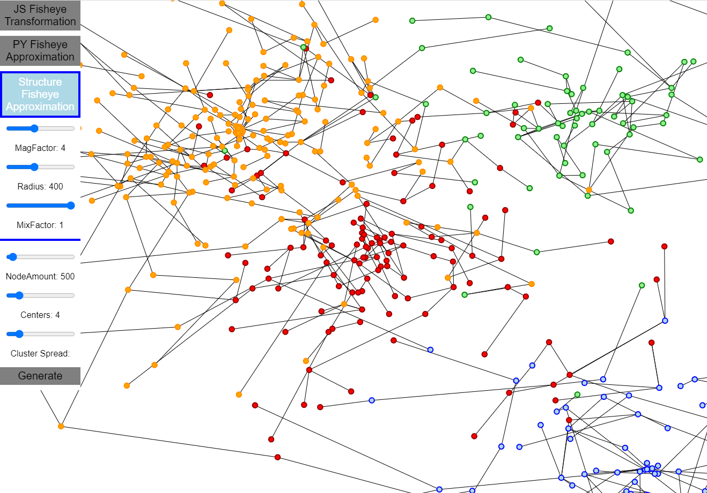
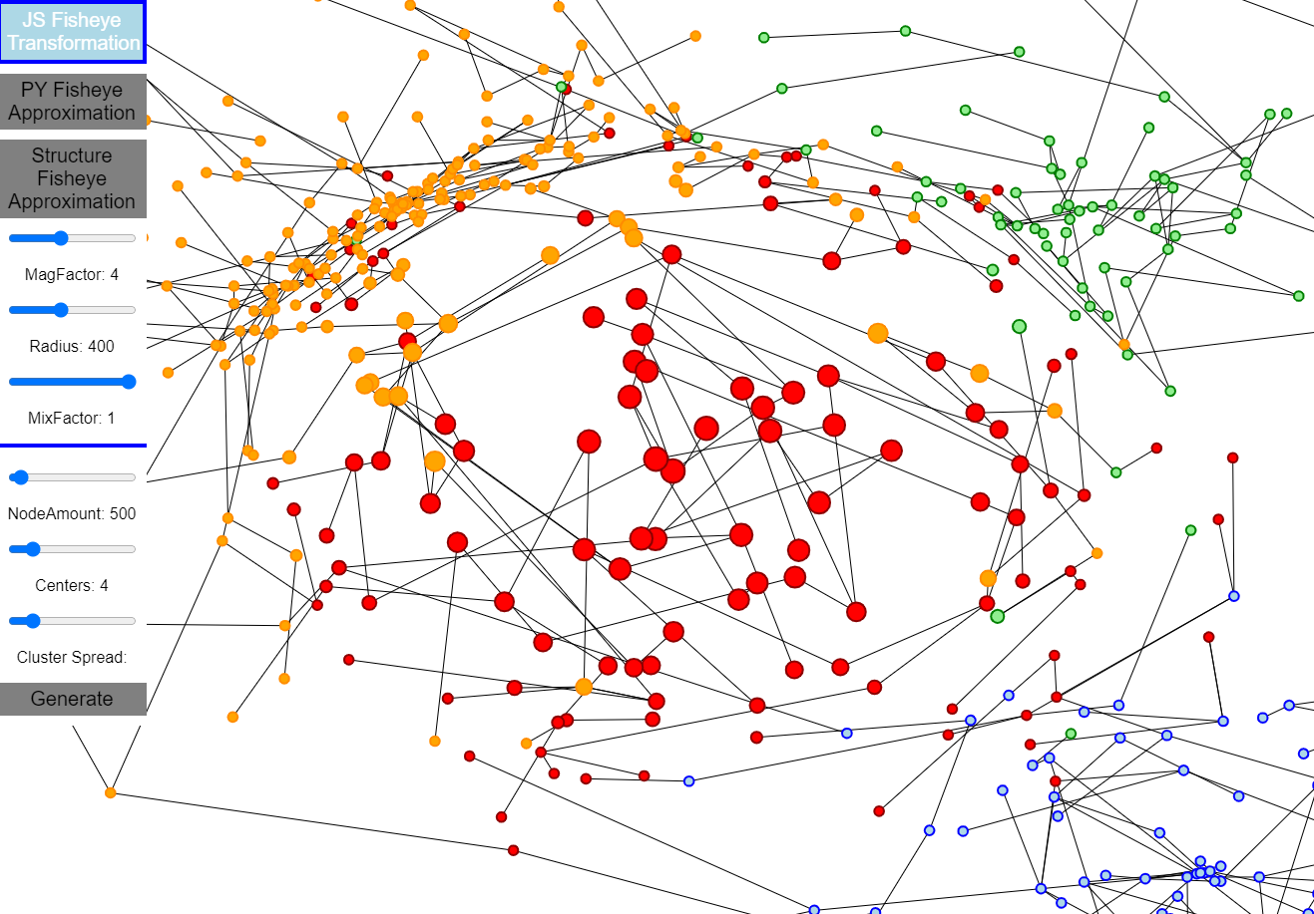
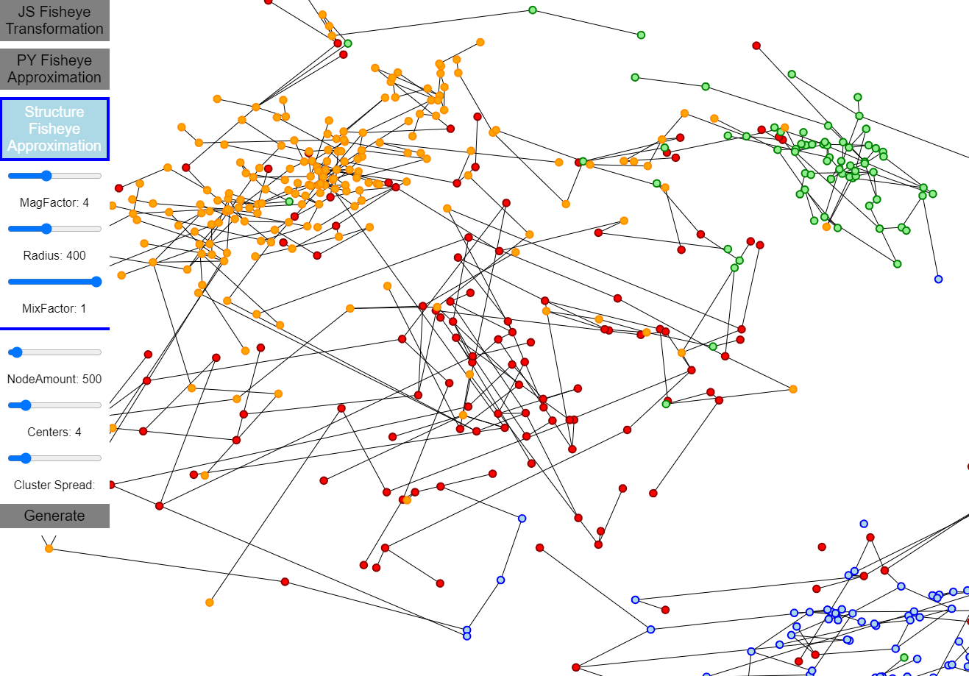
VU Visualisierung 2 (186.833) Structural Fisheye Approximation
Teaser image of your planned work
Markus Peitl / 01526724
Institute of Visual Computing & Human-Centered Technology, TU Wien, Austria

Slide 2
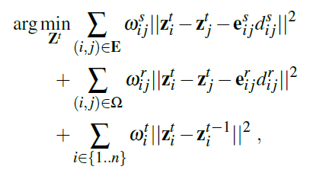
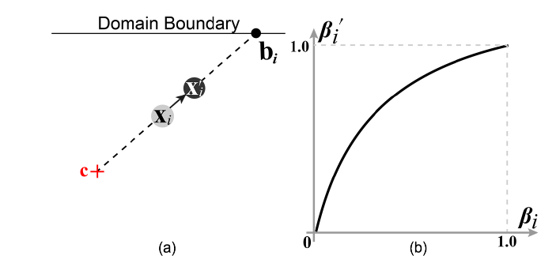
Paper Concept - Structure aware Fisheye View
Constraints:
structure preservation
readability
layout coherency
Graphical fisheye:
Nonlinear distortion of distance ratio
Notes:
Summarize the algorithms and concepts described in the paper
If space is available, put some representative image here
~ 1 minute

Slide 3



Concept
Structural Constraint:
Edge lengths of fisheye layout
Edge angles of original layout
Readability Constraints (focal area):
Overlapping nodes
Add virtual edge with edgelength
Edge crossings
Rotate against each other
Notes:
Describe what you plan to implement – you do not need to and often should not stick 100% to the algorithm described in the paper.
If you do not stick closely to the paper, describe what you omit and / or what you will implement additionally.
The design and implementation effort should be proportional to the lab ECTS! Take existing libraries and online examples into account when estimating your effort!
If you have any open questions, put them here!
~1 minute

Slide 4

Implementation – Python + Numpy
Inspiration of neural neworks
Loss for each edge calculated
-> Loss at each node calculated
Loss = vector(x,y) , size nodes
-> Gradient = vector(x,y)
newLoss < loss → switch direction
else keep direction
„Wiggle“ nodes to find local minima
Momentum for better results
Turns out → IT WORKS!

Slide 5
Architecture
JavaScript
Drawing
Viewing
Useriteraction
NodeJs (Relay)
Python + Numpy
Data manipulation
Gradient decent

Slide 6
Concept
Notes:
Describe what you plan to implement – you do not need to and often should not stick 100% to the algorithm described in the paper.
If you do not stick closely to the paper, describe what you omit and / or what you will implement additionally.
The design and implementation effort should be proportional to the lab ECTS! Take existing libraries and online examples into account when estimating your effort!
If you have any open questions, put them here!
~1 minute

Slide 7
Concept
Notes:
Describe what you plan to implement – you do not need to and often should not stick 100% to the algorithm described in the paper.
If you do not stick closely to the paper, describe what you omit and / or what you will implement additionally.
The design and implementation effort should be proportional to the lab ECTS! Take existing libraries and online examples into account when estimating your effort!
If you have any open questions, put them here!
~1 minute

Slide 8
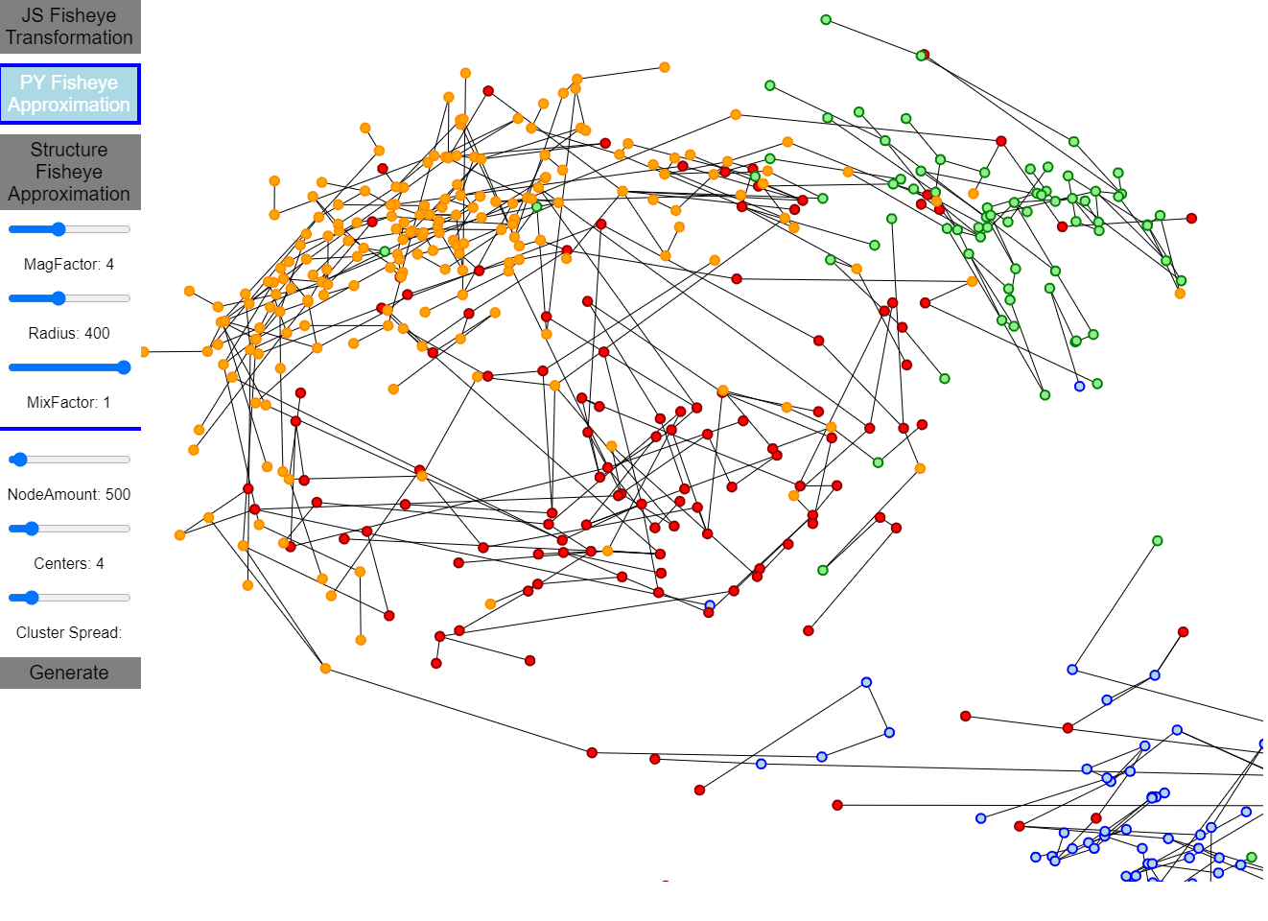
Concept
Notes:
Describe what you plan to implement – you do not need to and often should not stick 100% to the algorithm described in the paper.
If you do not stick closely to the paper, describe what you omit and / or what you will implement additionally.
The design and implementation effort should be proportional to the lab ECTS! Take existing libraries and online examples into account when estimating your effort!
If you have any open questions, put them here!
~1 minute

Slide 9
Concept
Notes:
Describe what you plan to implement – you do not need to and often should not stick 100% to the algorithm described in the paper.
If you do not stick closely to the paper, describe what you omit and / or what you will implement additionally.
The design and implementation effort should be proportional to the lab ECTS! Take existing libraries and online examples into account when estimating your effort!
If you have any open questions, put them here!
~1 minute

Slide 10
wang2019
Y. Wang and Y. Wang and H. Zhang and Y. Sun and C. Fu and M. Sedlmair and B. Chen and O. Deussen
Structure-aware Fisheye Views for Efficient Large Graph Exploration
IEEE Transactions on Visualization and Computer Graphics (vol. 25, pp. 566 - 575)
2019
Notes:
This is the last slide that remains visible until the next group comes up.
Nothing to say here.

