Slide 1

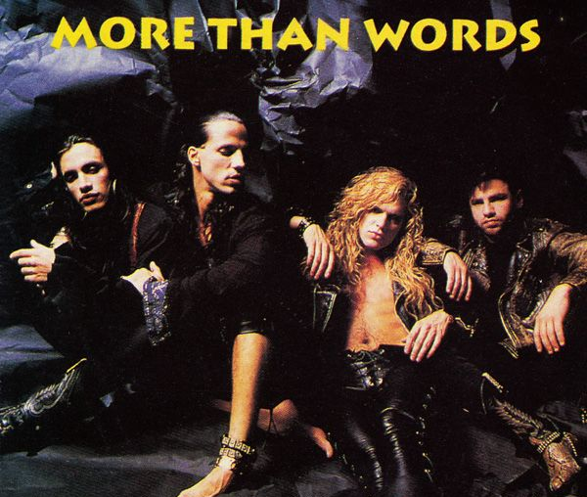
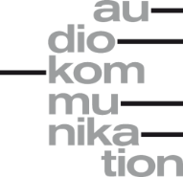
Genre-Discriminating Lyrical Patterns in Anglophone German Popular Music
Markus Radke
Research Colloquium, Audio Communication Group
Technische Universität Berlin, 23.04.2026
Notes:
Start Steffen

Slide 2
Lyrics encode popular music genre differences
Popular Music Genre
stylistic markers¹
socio-cultural conventions^{2,3}
Encoded in^{4,5,6}
Lyrics
Lyrics-Based
Music Genre Recognition^{7,8}

Slide 3
Prediction vs Explanation
Prediction
Performance
Pretrained LLMs
such as BERT¹, RoBERTa², DistilBERT³
intransparent word embeddings⁴
Deep Learning with
Attention Visualization^{5,6}
single-token interpretation
Interpretable Models/Features?
cultural insights⁷
robust and trustworthy deployment^{8,9}
Interpretability and Transparency

Slide 4
We Investigate Lyrical Style
Often emphasized interpretable formal structural features^{1,2,3,4}
textual statistics
rhymes
lexical descriptors

Slide 5
We Investigate Lyrical Style
Lyrical Style⁵
topics⁶
sentiments⁷
formulaic expressions⁸
multiword expressions^{9,10,} (common collocations, idioms)
single words^{4,5} (slang, spelling, lexical words)
vocalizations¹¹
Often emphasized interpretable formal structural features^{1,2,3,4}
textual statistics
rhymes
lexical descriptors

Slide 6
Research Questions
RQ1: Which lyrical style patterns (topics, sentiments, formulaic expressions) discriminate genres in Anglophone German popular music?
RQ2: To what extent do style-based interpretable ML models match a fine-tuned DistilBERT LLM baseline on lyrics-based music genre prediction?
RQ3: What can we learn about style-related lyrical genre differences from such interpretative models for popular music studies?

Slide 7
MEthods
Notes:
Ab hier übernimmt Markus

Slide 8
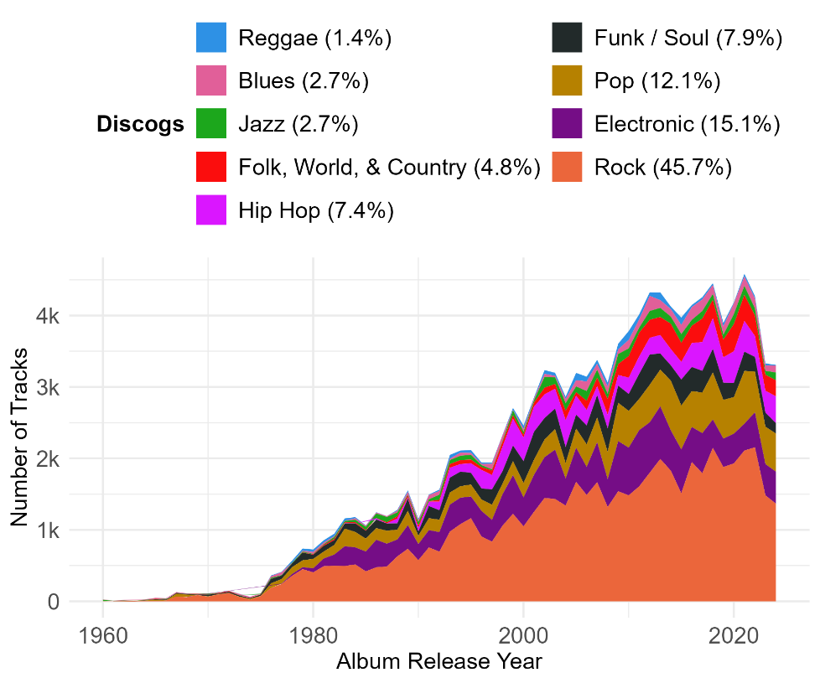
Corpus: Popular-Tracks-In-Germany Data Set (POPTRAG)
Webscraping and APIs
MediaControl Album- and Singlecharts (1977-2024) 215,702 tracks
Spotify-Recommendations for Germany (2024) 026,949 tracks
Spotify Daily 200 Charts (2017-2024) 0 8,801 tracks
Spotify Featured Playlists Germany (2024) 011,994 tracks
English lyrics from Genius and release genres from Discogs (51%):
Multilabel Discogs assignments (35% remaining) reduced to most specific single genre label
Music genres with at least 1% in remaining corpus
N = 126,042 tracks
9 music genres
Notes:
MediaControl GERMAN

Slide 9
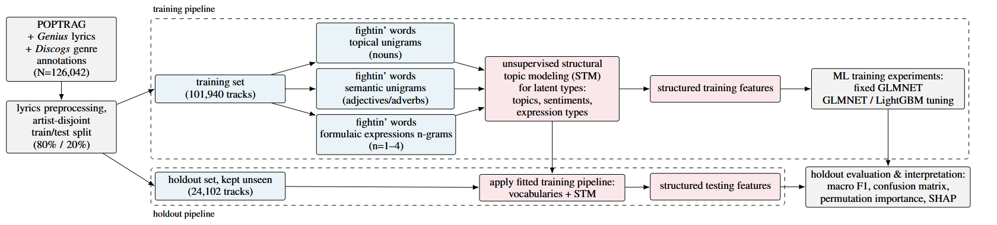
Lyrics Preprocessing and Split
Basic Cleaning
trim whitespaces
remove content in square brackets
unify “*” (e.g, “f*ck” -> “fuck”)
remove structure indicators (e.g., “chorus”)
fix missing apostrophes
For topics and sentiments only:
lemmatize and tag part of speech
reduce to nouns (topics) or adjectives and adverbs (sentiments)
min 3 characters, no stopwords
must be in English vocabulary whitelist (spaCy and nltk Python libraries)
Stratified artist-grouped¹ split in:
Training (80%) Holdout (20%)

Slide 10
RQ1: Stylistic Patterns – Fightin‘ n-grams Vocabularies
Extract n-grams
unigrams for topics and sentiments, n in [1,2,3,4] for expressions
discard stopword only n-grams, trivial article+noun and to+infinitive bigrams
min. 2 artist for n-grams
Fightin’ n-grams¹ (“Does an n-gram appear significantly more often in one genre than in all others?)
One vs. Rest LLR per genre + n-gram with prevalence prior
Benjamini False Discovery Rate² corrected one-sided test (FDR, α = 0.001)
For expressions:
top-down recursive phrase extraction, “glueing” significant
break non-significant multi-word phrases after final FDR
Count n-grams for Document-Term-Matrix (DTM)

Slide 11
RQ1: Stylistic Patterns – Latent Types
Aggregate DTM on
unique artist-genre combinations
reduce 101,940 docs to 7,713 docs
mitigate n-gram sparsity during model training (later overfitting)
Structural Topic Modeling (STM)¹
tune for k=[2, 3…, 20] topics with 50/50 train-validation split
choose optimal k using exclusivity, coherence, and holdout likelihood²
Interpret types based on top FREX n-grams³
Apply models on track-level data for features
Investigate per-genre type probabilities in training corpus

Slide 12
RQ2+3: Machine Learning Experiments and Interpretation
Discard redundant features before model training
remove topic, sentiment, and expression type with highest sum across artist-genre probabilities
Baselines
tuned DistilBERT on raw lyrics¹
TF-IDF²+ GLMNET³
weighted random
Models and Interpretation
Fixed-parameter GLMNET for individual and combined dimensions
Tuned GLMNET+LightGBM⁴ for best set
permutation importance⁵ and SHAP⁶ on holdout

Slide 13
RESULTS
Notes:
Ab hier übernimmt Markus

Slide 14
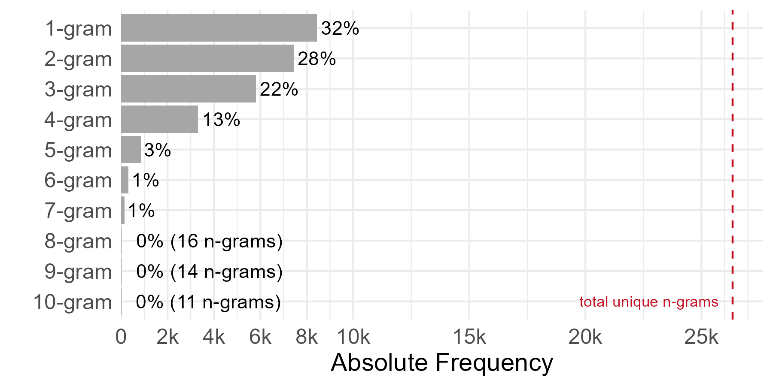
RQ1: Music Genre Discriminating Style - Vocabularies
n-gram type distribution for expressions
Dimension | Vocabulary Size
Topics | 3,827 unigrams
Sentiments | 857 unigrams
Expressions | 26,344 n-grams
Notes:
Why Musicbrainz:
many genres
Democartic voting

Slide 15
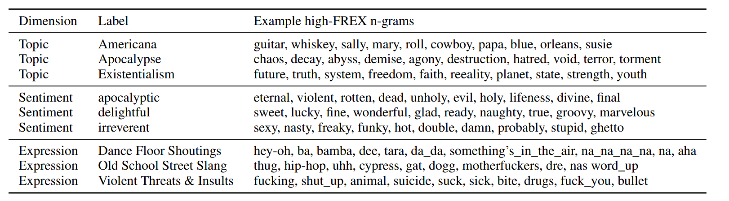
RQ1: Music Genre Discriminating Style – Latent Types
12 Topics, 8 Sentiments, 15 Expression Types
Example Latent Type Interpretations:
Notes:
Why Musicbrainz:
many genres
Democartic voting

Slide 16
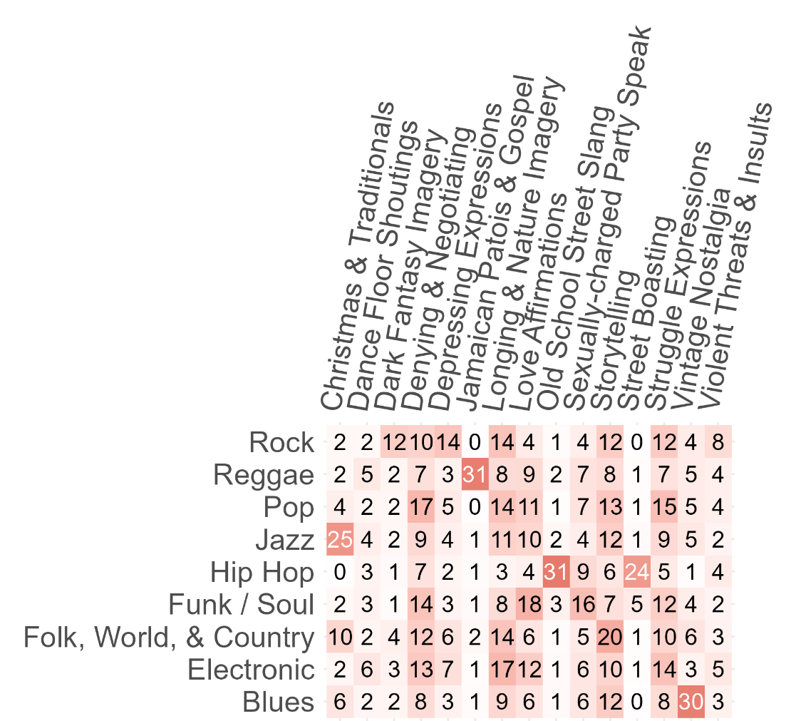
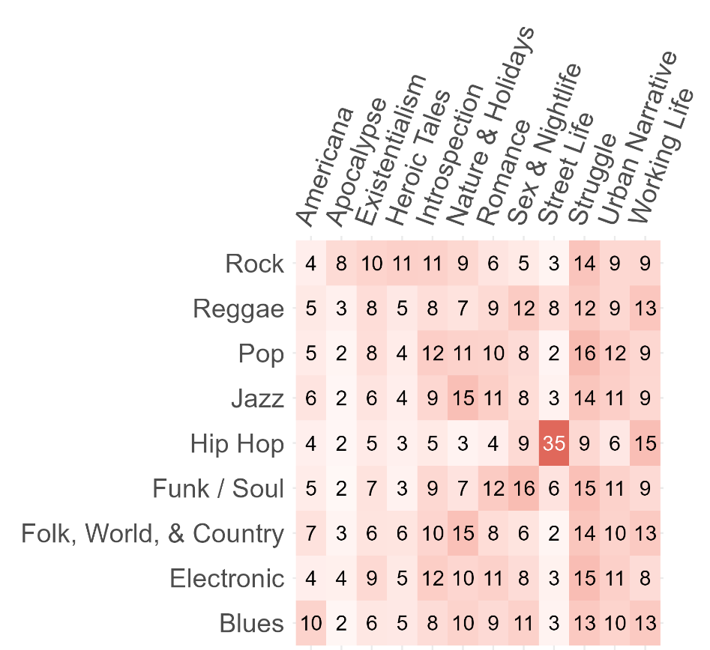
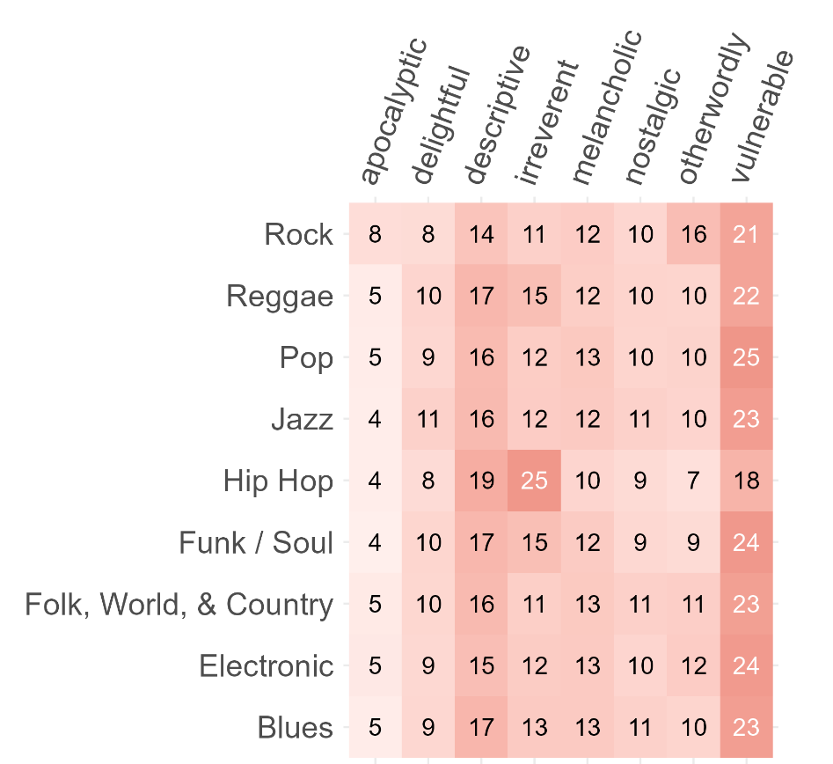
RQ1: Music Genre Discriminating Style – Latent Types Probability
Notes:
Why Musicbrainz:
many genres
Democartic voting

Slide 17
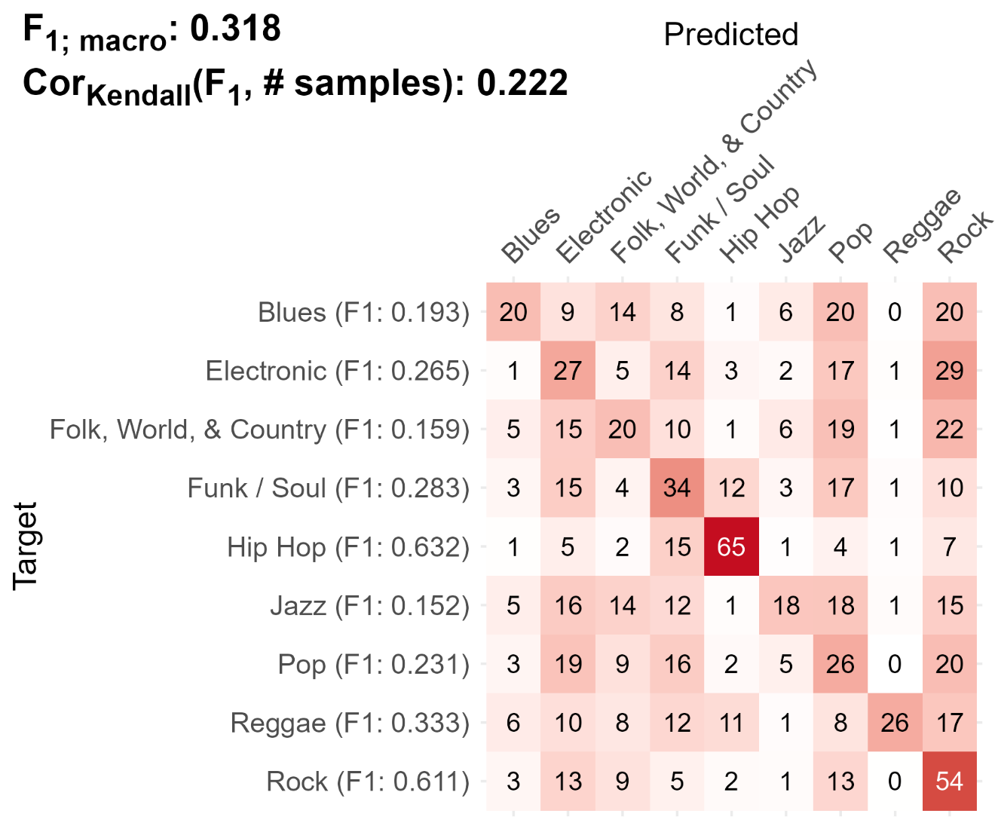
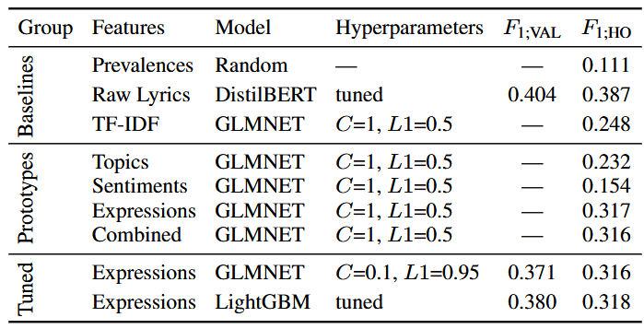
RQ2: Interpretable ML Performance
Confusion Matrix for tuned LightGBM
82,2% of DistilBERT LLM baseline
Notes:
Why Musicbrainz:
many genres
Democartic voting

Slide 18
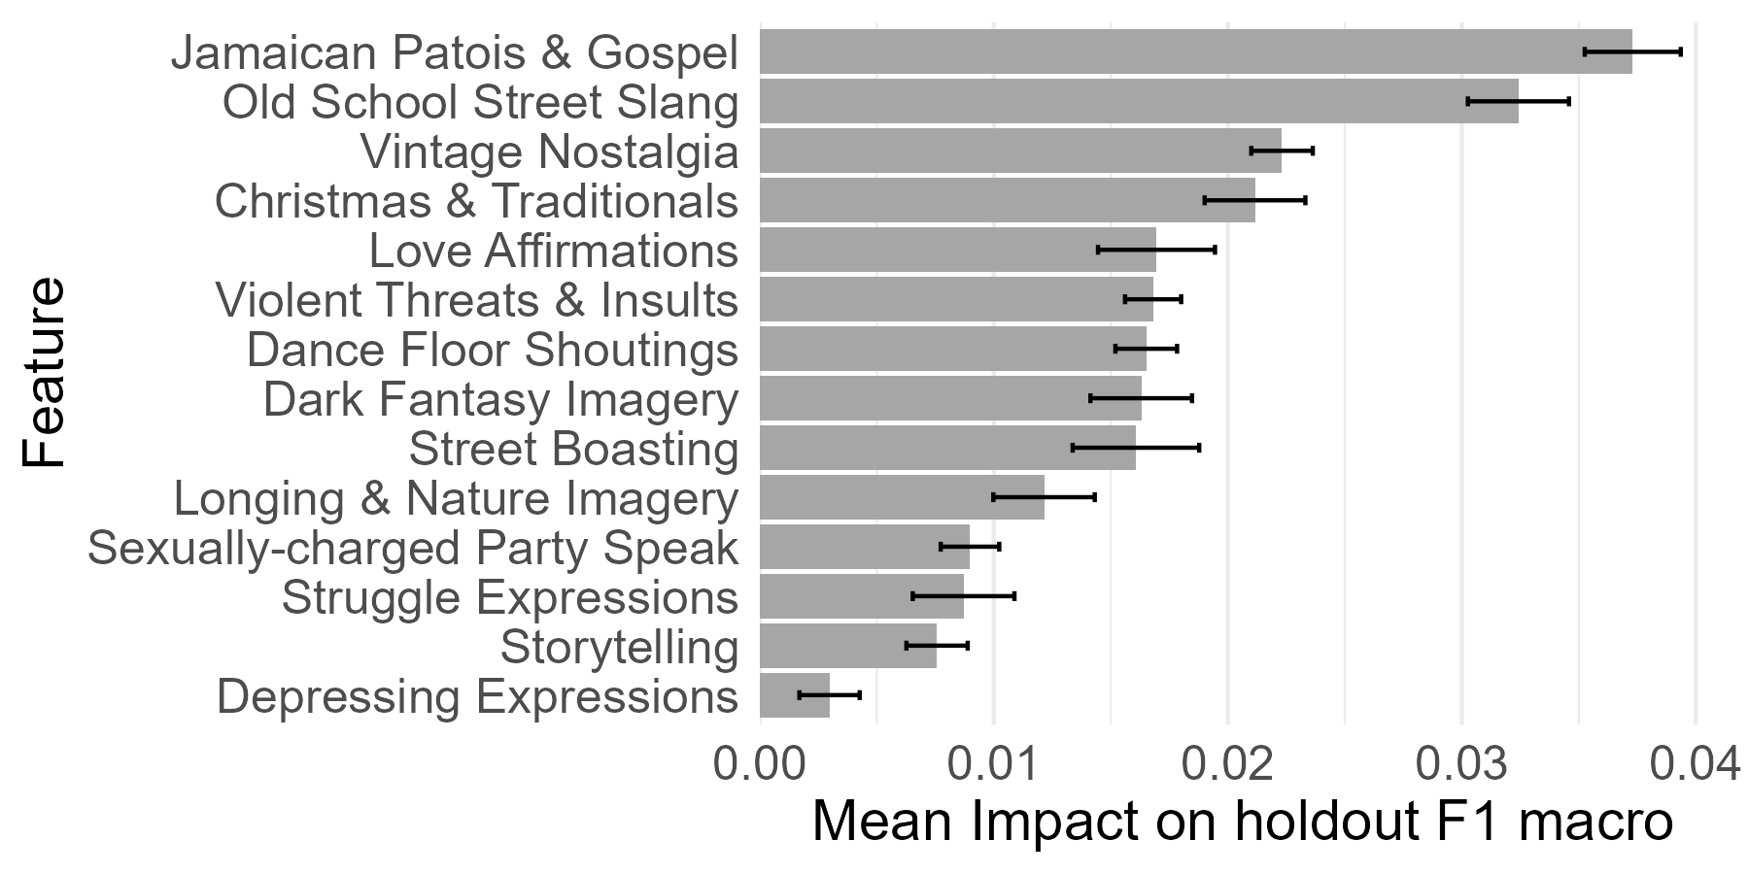
RQ3: Global Feature Importances
Notes:
Why Musicbrainz:
many genres
Democartic voting

Slide 19
DISCuSSIOn

Slide 20
Summary
RQ1: Which lyrical style patterns (topics, sentiments, formulaic expressions) discriminate genres in Anglophone German popular music?
Identified:
12 topics,
8 sentiments
15 types of formulaic expressions
RQ2: To what extent do style-based interpretable ML models match a fine-tuned DistilBERT LLM baseline on lyrics-based music genre prediction?
Interpretable models retain 82,2% of DistilBERT LLM baseline
RQ3: What can we learn about style-related lyrical genre differences from such interpretative models for popular music studies?
Formulaic expressions substantially more discriminative than topics, sentiment;
Some expression types to not generalize
Notes:
TODO:
Natürliche Validität der Ergebnisse (von Menschen gemacht)
Was ist ein State of the Art? Was für Felddaten?
Lyrics nur basal eingeflossen

Slide 21
Discussion
Show that Genre-specific phrasing more important for stylistic discrimination than topics and sentiments (RQ1+3)
Hip Hop and Rock most easily discriminated³ (RQ2+3)
Hich prevalence of negatively valenced topics, sentiment, formulaic expressions in the corpus^{1,2} (RQ1)
Principled division between predictive and explanatory models (RQ2+3); supports scholarly and practical applications^{4,5}

Slide 22
Limitations
Dicogs community’s perspective on fuzzy genre boundaries¹
Multilabel reduced to single label assignments for interpretability
Genres treated as temporarily stable² and single label categories
Future Research
Extend to other corpora, other languages and language agnostic models³
Integrate with other features (audio, release-context, and formal / structural lyrics) in interpretable models⁴

Slide 23
Next Steps for Thesis
Compare approach with German language lyrics and translation (DGPuK) and use COMGET genres
Integrate in automatic music genre classifier
Finish fixing and improving Spotivey donation tool (May)
Add gamified “Spotify wrapped"-style feature
Collect listening data from German adults aged 18–30 (June)

Slide 24
Thank you very much for listening! markus.radke@tu-berlin.de

