Slide 1

C# Patterns
Workshop
Rainer Stropek
software architects gmbh
Web
Mail
Twitter
http://www.timecockpit.com
rainer@timecockpit.com
@rstropek
Design Patterns for C#

Slide 2

Introduction
Rainer Stropek
Developer, Entrepreneur
Azure MVP, MS Regional Director
Trainer at IT-Visions
Contact
software architects gmbh rainer@timecockpit.com Twitter: @rstropek

Slide 3
Creational Patterns

Slide 4
Factory Pattern
Object for creating other objects
Use polymorphism for object creation
Code is not tied to specific classes or objects
Easier to refactor
Variants
Factory method pattern
Abstract factory pattern: Encapsulate group of individual factories with a common theme

Slide 5
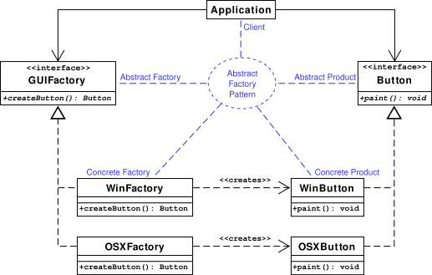
Abstract Factory
Image Source (Wikipedia)

Slide 6
Factory Pattern
.NET Examples
SqlClientFactory and DbProviderFactory
DbConnection.CreateCommand

Slide 7
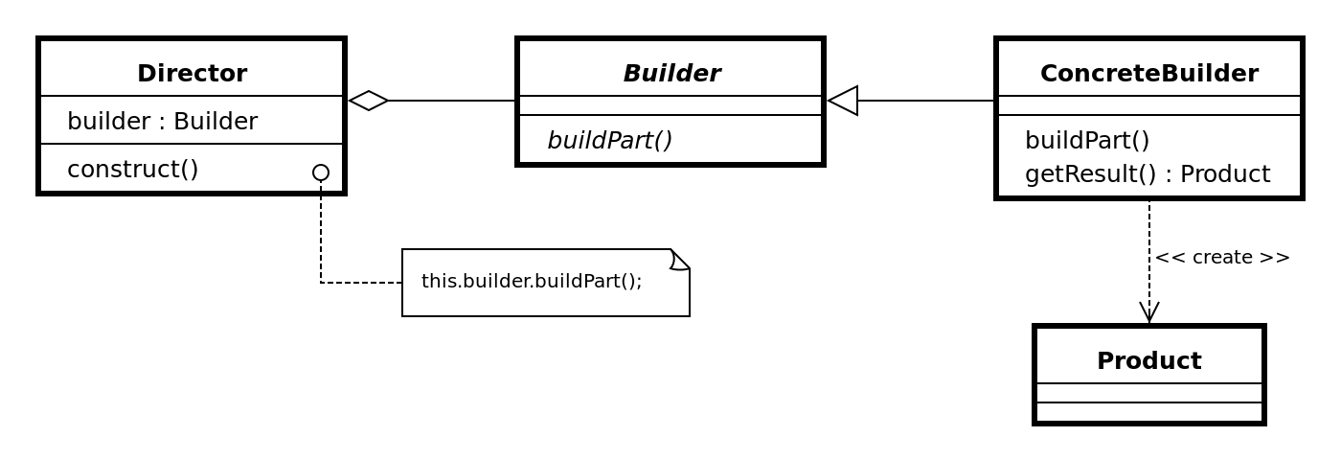
Builder Pattern
Used to create complex objects
Alternative: Large amount of constructors with many parameters
Used to create immutables from mutables
Initialize object step by step, return immutable constructed object
Image Source (Wikipedia)

Slide 8
Builder Pattern
.NET Examples
SqlConnectionStringBuilder
StringBuilder
Mutable → Immutable
ImmutableList<T>.Builder
Mutable → Immutable

Slide 9
Singleton Pattern
Restricts the instantiation of a class to one object
Use with care
Is the restriction really necessary?
Do you really need this global state?
.NET Example
Application.Current

Slide 10
Structural Patterns

Slide 11
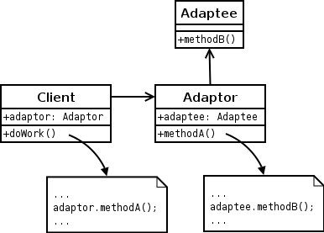
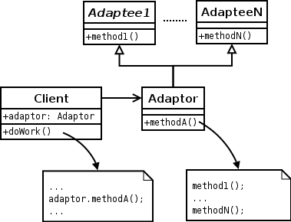
Adapter Pattern
Interface of existing class to be used as another interface
Work with existing classes without changing their code (e.g. add base class)
.NET examples
System.ArrayList.Adapter (source)
Object Adapter:
Class Adapter:
Image Source (Wikipedia)

Slide 12
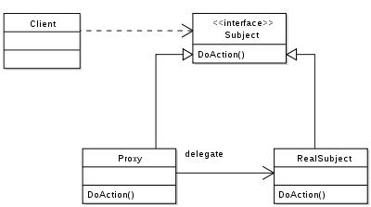
Proxy Pattern
Class functioning as an interface to something else
Examples: Remote proxies, virtual proxies, protection proxies
.NET examples
HttpClientHandler.Proxy (using a network protection proxy)
OData Service Proxy (remote proxy)
Image Source (Wikipedia)

Slide 13
Behavioral Patterns

Slide 14
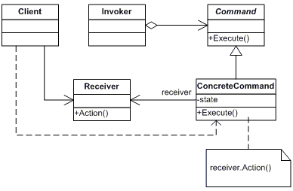
Command Pattern
Object encapsulates information needed to perform action
Often used with Lambda expressions
Example: DelegateCommand in Prism library
.NET examples
ICommand
IDbCommand
ProcessStartInfo
Image Source (Wikipedia)

Slide 15
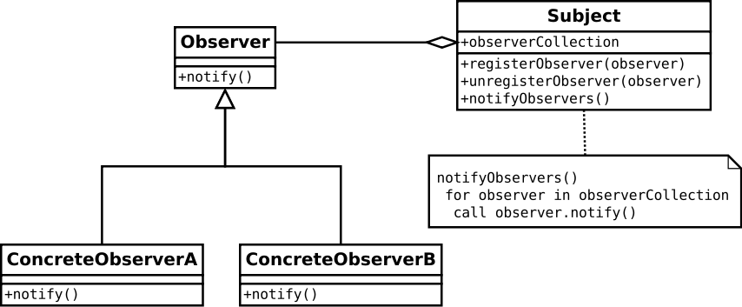
Observer Pattern
Object (“subject”) notifies dependents (“observers”) of state changes
.NET examples
IObservable<T>
IObserver<T>
DiagnosticListener
Image Source (Wikipedia)

Slide 16
.NET Example
public class Startup : IObserver<KeyValuePair<string, object>>
{
private readonly byte[] message = Encoding.UTF8.GetBytes("Hello World");
public void ConfigureServices(IServiceCollection services)
{
// Note how the Observable pattern is used in DiagnosticListener. It implements
// IObservable<T>, therefore we can subscribe to events.
var listener = new DiagnosticListener("Microsoft.AspNetCore");
listener.Subscribe(this);
services.AddSingleton<DiagnosticSource>(listener);
}
public void Configure(IApplicationBuilder app)
{
app.Map("/error", errorApp =>
// Throw exception for demo purposes
errorApp.Run(h => { throw new DivideByZeroException(); }));
app.Run(h => h.Response.Body.WriteAsync(message, 0, message.Length));
}
#region Implementation of IObserver<T>
public void OnCompleted() => Console.WriteLine("OnCompleted");
public void OnError(Exception error) { throw error; }
public void OnNext(KeyValuePair<string, object> value) =>
Console.WriteLine($"OnNext: {value.Key}");
#endregion
}
ASP.NET Core 1

Slide 17
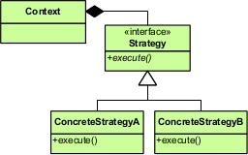
Strategy Pattern
Select algorithms behavior at runtime
.NET examples
List<T>.Sort(IComparer<T>)
Often used with Lambda expressions
List<T>.Sort(Comparison<T>)
Image Source (Wikipedia)

Slide 18
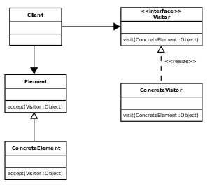
Visitor Pattern
Separate an algorithm from an object structure
Example: Add new operations to existing object structures
.NET examples
CSharpSyntaxWalker
CSharpSyntaxRewriter
Image Source (Wikipedia)

Slide 19
.NET Example
public class Program
{
public static void Main(string[] args)
{
var tree = CSharpSyntaxTree.ParseText(
@"class Test { public void DoSomething() =>
System.Console.WriteLine(""Hello World!""); }");
var v = new PrintMethodNamesVisitor();
v.Visit(tree.GetRoot());
var r = new MethodRenamingRewriter();
var newRoot = r.Visit(tree.GetRoot());
Console.WriteLine(newRoot.ToString());
v.Visit(newRoot);
}
}
public class PrintMethodNamesVisitor : CSharpSyntaxWalker
{
public override void VisitMethodDeclaration(MethodDeclarationSyntax node)
{
Console.WriteLine(node.Identifier.Value);
base.VisitMethodDeclaration(node);
}
}
Roslyn

Slide 20
.NET Example
public class MethodRenamingRewriter : CSharpSyntaxRewriter
{
public override SyntaxNode VisitMethodDeclaration(MethodDeclarationSyntax node)
{
if (node.Identifier.Value.ToString() == "DoSomething")
{
return node.ReplaceNode(node, SyntaxFactory.MethodDeclaration(
node.AttributeLists,
node.Modifiers,
node.ReturnType,
node.ExplicitInterfaceSpecifier,
SyntaxFactory.Identifier("DoSomethingElse"),
node.TypeParameterList,
node.ParameterList,
node.ConstraintClauses,
node.Body,
node.ExpressionBody));
}
return node;
}
}
Roslyn

Slide 21
Resources
Software Design Patterns on Wikipedia
.NET Design Patterns

Slide 22

Q&A
Workshop
Rainer Stropek
software architects gmbh
Web
Mail
Twitter
http://www.timecockpit.com
rainer@timecockpit.com
@rstropek
Thank you for attending!

