Slide 1

Multilingual Text Analytics for Healthcare

Slide 2
Agenda
Baseline approach
1
2
Our approach
Representation of text
3
4
Experiments
Future work
5

Slide 3



Baseline approach
NLP Task
(e.g. NER,
Summary)
Translate
Translate
Notes:
Advantages:
- Use of pretrained english model possible
Disadvantages of Translation:
Errors in translation
Translation is expensive
No end-to-end implementation

Slide 4

Our approach
Multilingual Embedding
NLP Task
Multilingual Embedding
Notes:
Instead of expensive translation we create independent multilingual embeddings
We use these embeddings to solve NLP Tasks like summarization or named entitity recognition
For this tasks we can use pretrained models on the multilingual embeddings
Usually, we get a text output from the NLP model, instead we aim to get a language indenpendent embedding which can be transformed to any language.

Slide 5
Our approach
Multilingual Embedding
NLP Task
Multilingual Embedding
LASER model
by Facebook
Notes:
We focused on only on the first part, to get language independent representations of the text
Therefore, we used a multilingual model by Facebook, which is trained on 93 languages, written in 23 different alphabets
There are other similar models available, for example from Google.
First of all, we wanted to figure out how these mutlilingual embeddings work

Slide 6
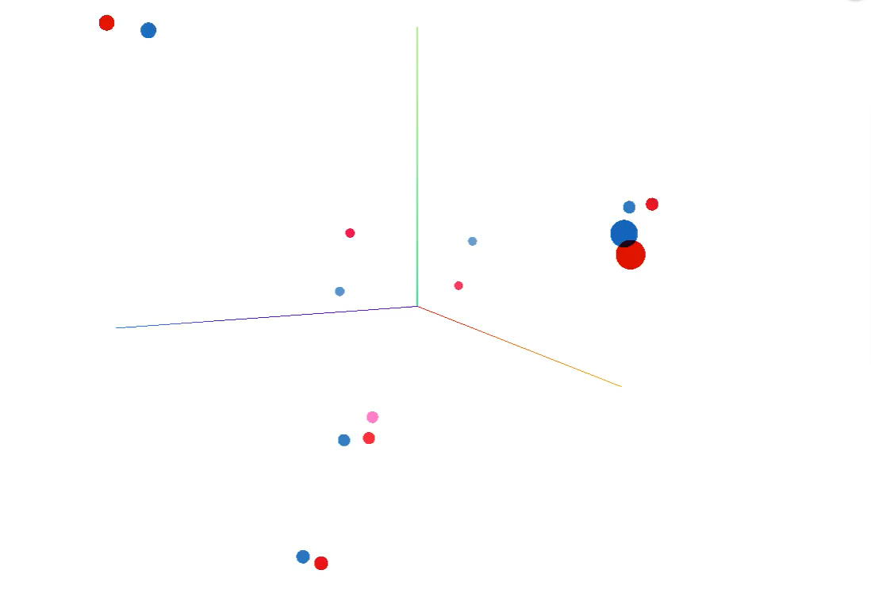
Universal representation of text

Slide 7
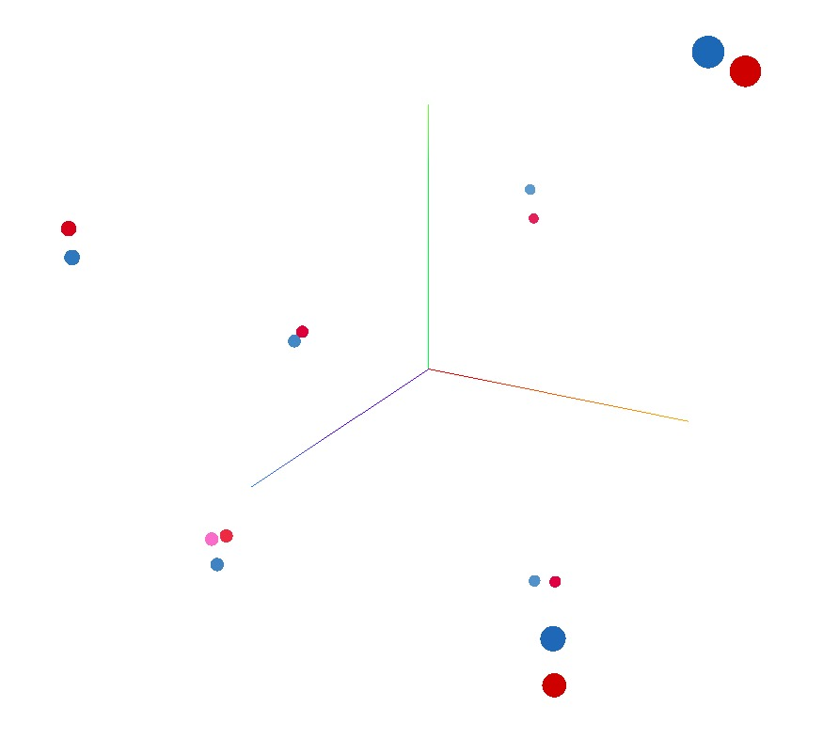
Universal representation of text
Helping patients and caregivers to understand medical information.
Unterstützung von Patienten und Pflegepersonal beim Verständnis medizinischer Informationen.
Помощь пациентам и ухаживающим за ними лицам в понимании медицинской информации

Slide 8
Universal representation of text
Магний - незаменимый минерал, обладающий мышечно-расслабляющими, слабительными и антиаритмическими свойствами, эффективен как кофактор многочисленных ферментов.
Magnesium is an essential mineral with muscle-relaxing, laxative and anti-arrhythmic properties, which is effective as a cofactor of numerous enzymes.

Slide 9
Our approach
Multilingual Embedding
NLP Task
Multilingual Embedding
Notes:
As a simple proof-of-concept we tested our approach on two simple classification tasks

Slide 10
Experiments
Classification Task
Sentiment anaylsis on movie data
Classify diagnoses to medical specialities
Approach
Use multilingual embeddings as input
Simple neural network for classification
Train on english descriptions
Test on german descriptions
Results
Accuracy on english movie data: 0.81 (n=1000), german movie data: 0.84 (n=50)
AUC on german english medical data: 0.82 (n=500) , german medical data: 0.82 (n=200)
Notes:
-

Slide 11
Future work
Multilingual Embedding
NLP Task
Multilingual Embedding

Slide 12
Question & discussion

