Slide 1

Multilingual Text Analytics for Healthcare

Slide 2
Agenda
Baseline approach
1
2
Our approach
Representation of text
3
4
Experiments
Future work
5

Slide 3



Baseline approach
NLP Task
(e.g. NER,
Summary)
Translate
Translate
Notes:
Advantages:
- Use of pretrained english model possible
Disadvantages of Translation:
Errors in translation
Translation is expensive
No end-to-end implementation

Slide 4

Our approach
Multilingual Embedding
NLP Task
Multilingual Embedding
Notes:
Instead of expensive translation we create independent multilingual embeddings
We use these embeddings to solve NLP Tasks like summarization or named entitity recognition

Slide 5
Our approach
Multilingual Embedding
NLP Task
Multilingual Embedding
LASER model
by Facebook
Notes:
- Laser trained on 93 languages, written in 23 different alphabets

Slide 6
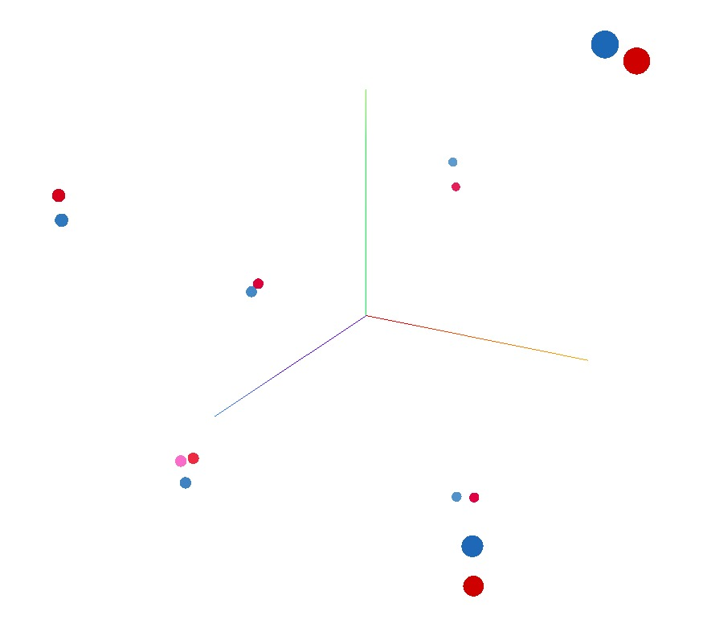
Universal representation of text

Slide 7
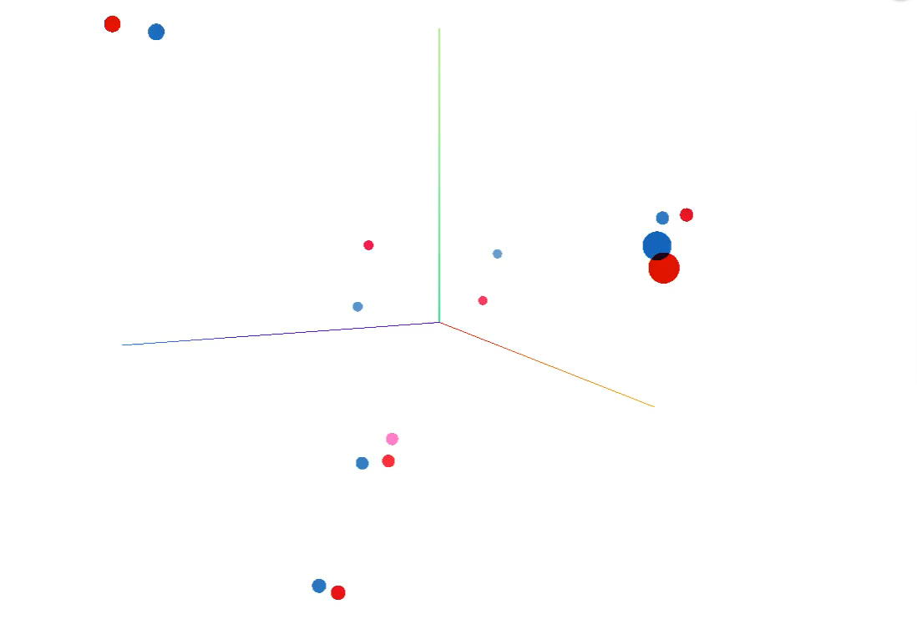
Universal representation of text

Slide 8
Experiments
Classification Task
Sentiment anaylsis on movie data
Classify diagnoses to medical specialities
Approach
Use multilingual embeddings as input
Simple neural network for classification
Train on english descriptions
Test on german descriptions
Results
accuracy on english movie data: 0.81 (n=1000), german movie data: 0.84 (n=50)
AUC on german english medical data: 0.82 (n=500) , german medical data: 0.82 (n=200)

Slide 9
Future work
Multilingual Embedding
NLP Task
Multilingual Embedding

Slide 10
Question & discussion

