Slide 1
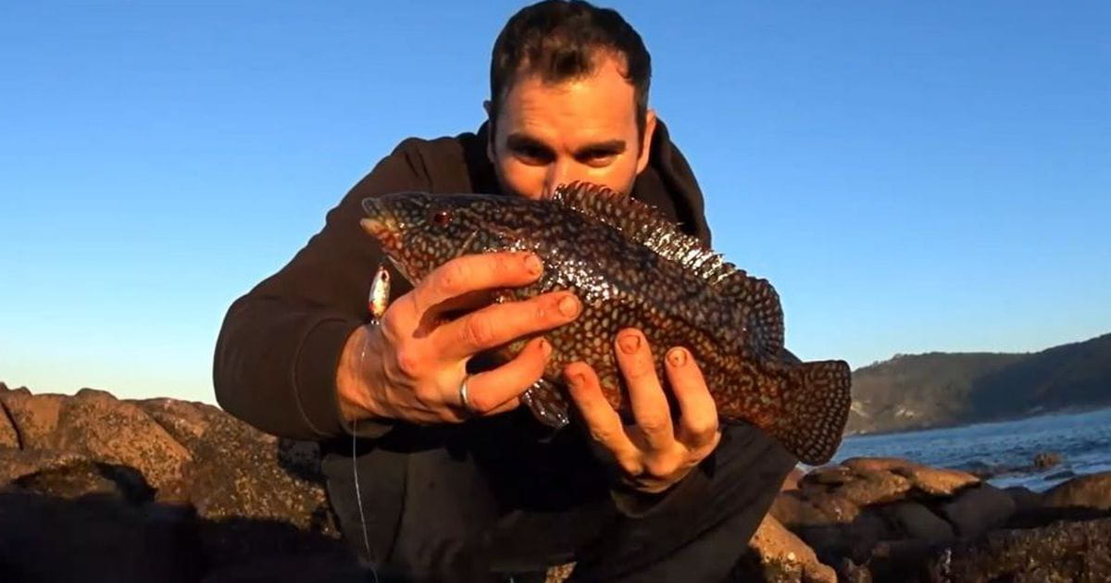
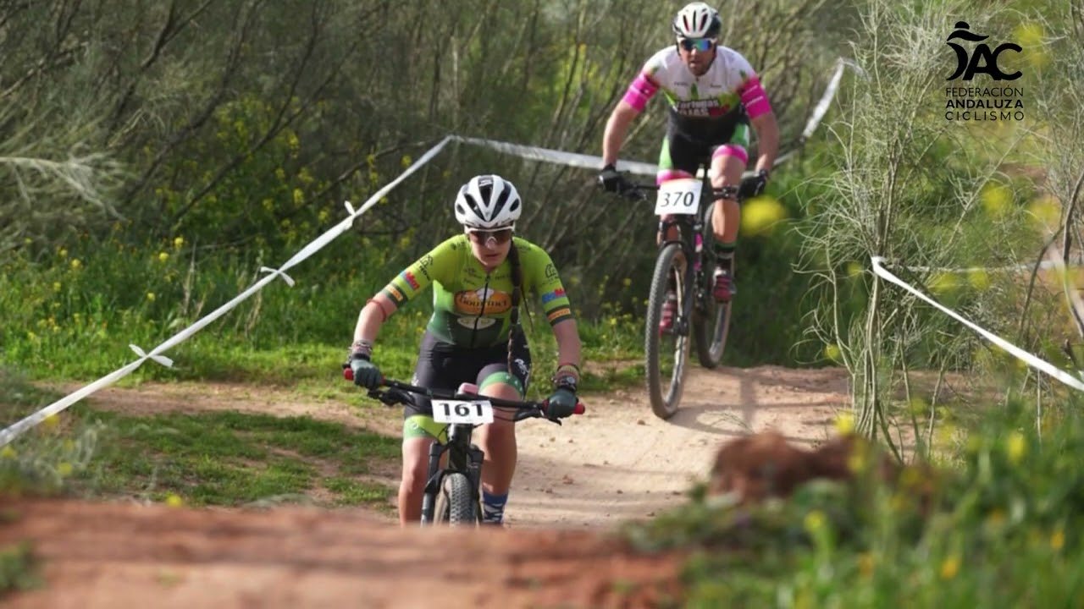
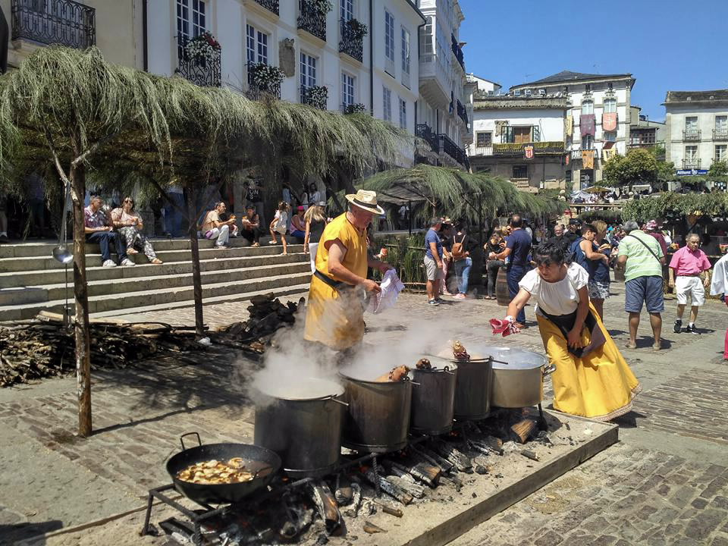
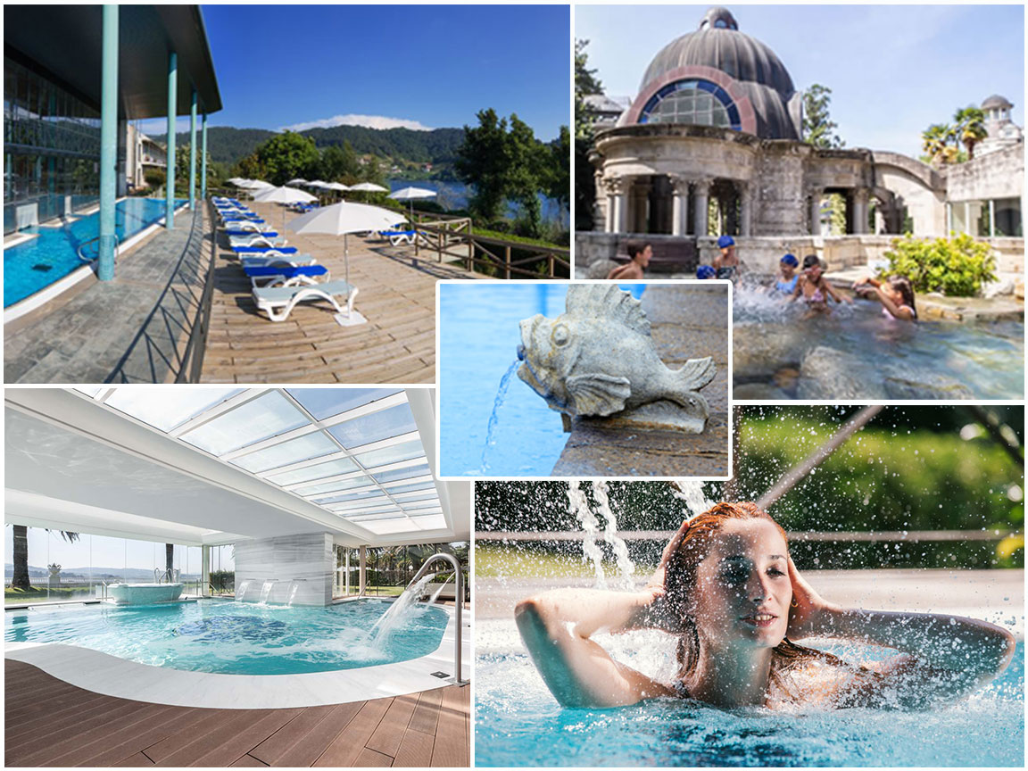
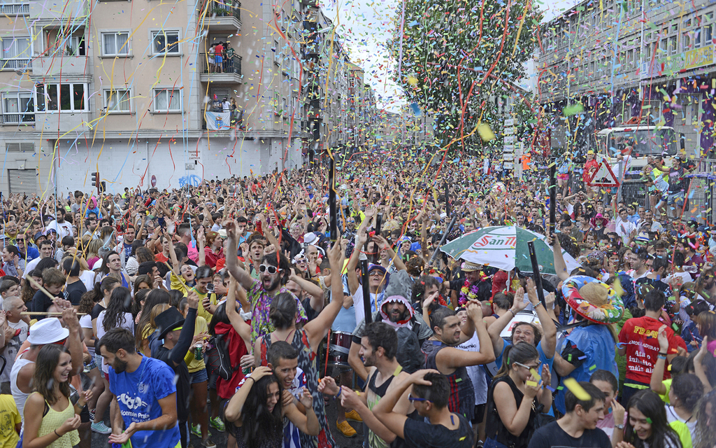
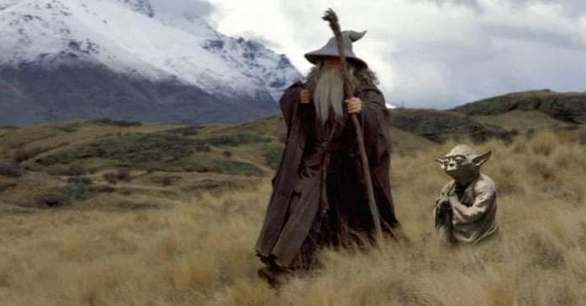
Galicia

Slide 2
Thank you oleole

Slide 3
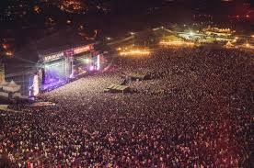
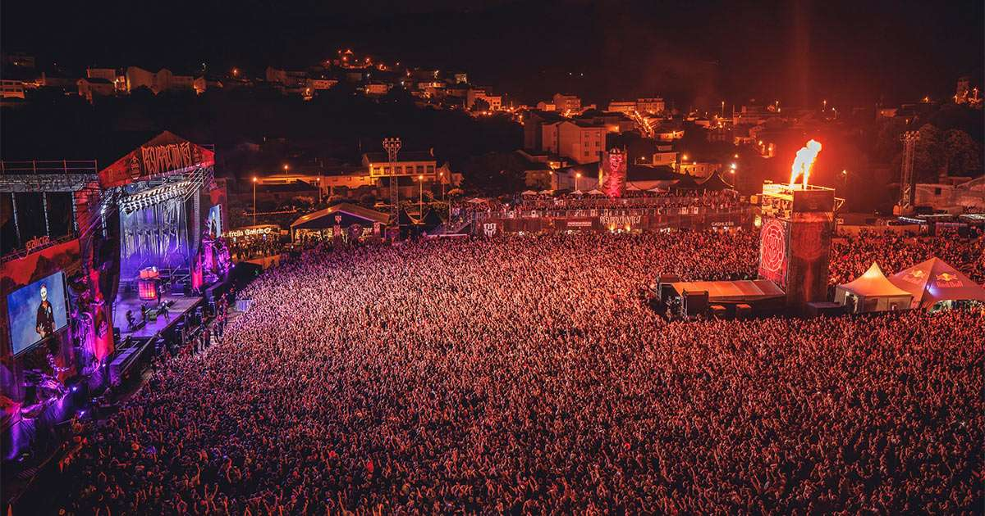
Festivals
Son do Camiño
Resurrection Fest

Slide 4
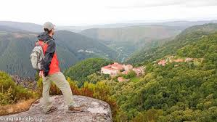
Hiking
Pedroso
Pena Trevinca
Ribeira sacra

Slide 5
Midnight party
Santiago’s historic center
Lugo’s historic center
Vilagarcía’s Water party
Much more...

Slide 6
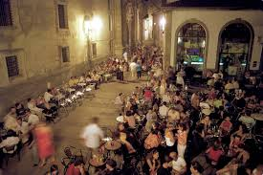
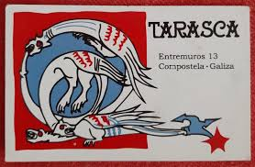
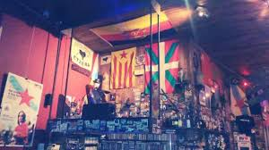

Slide 7
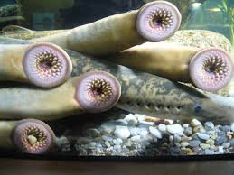
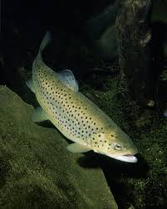
Hunt & Fishing
Port
‘Batea’
River

Slide 8
Spa
Cuntis
Mondariz
Ourense

Slide 9
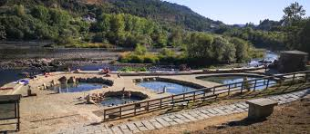
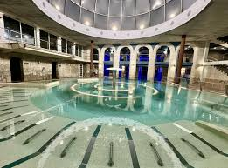
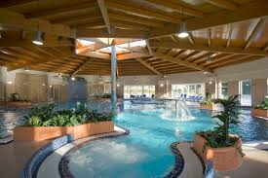

Slide 10
Diferent parties
Apostol
Saturdays in Padron
Medieval parties:
  Catoira
  Noia

Slide 11


