Slide 1
the Ubuntu community
ten million people
and growing
Notes:
Theme created by
Sakari Koivunen and Henrik Omma
Released under the LGPL license.

Slide 2
What is your name?

Slide 3
Me?
Mark Van den Borre
classical guitarist
volunteer
ubuntu-be.org
markvdb@ubuntu.com

Slide 4
No, I mean the project!

Slide 5
Ubuntu is...
like Apple Mac OS X
like Microsoft Windows
an operating system for your computer

Slide 6
Ubuntu is free
free to use: home, school, work
free to copy & distribute: web, burn
free to modify: Kurdish

Slide 7
Ubuntu is safe
immune to viruses
immune to spyware
builtin firewall

Slide 8
Batteries included!

Slide 9
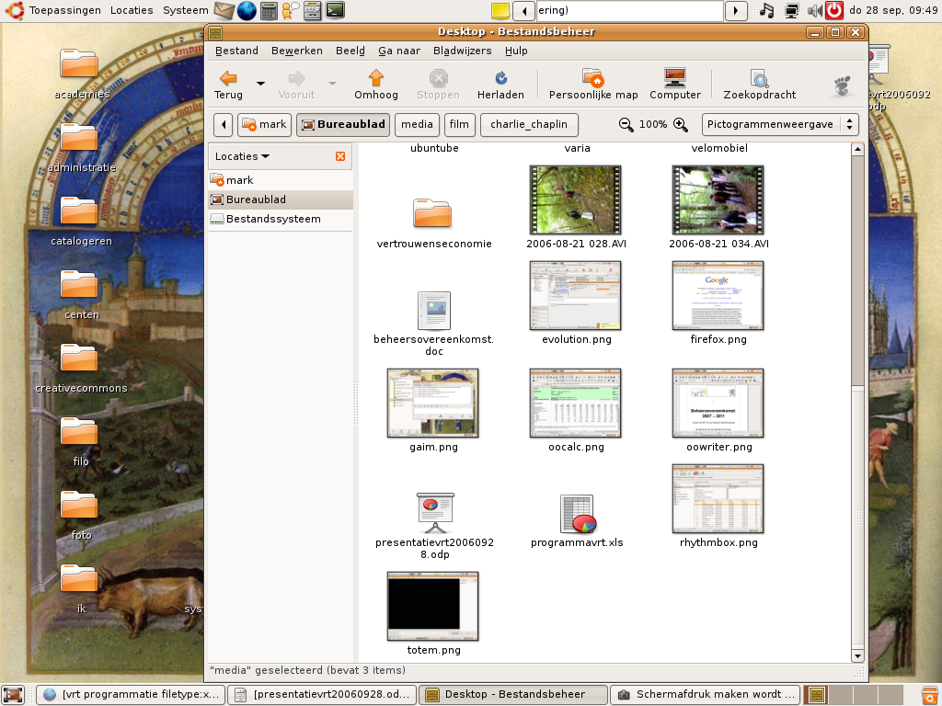
Batteries included

Slide 10
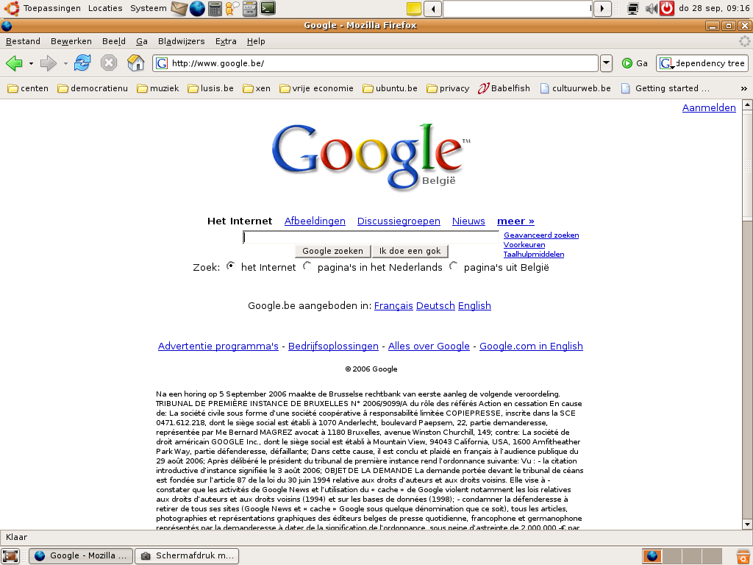
Batteries included?

Slide 11

Actually...

Slide 12
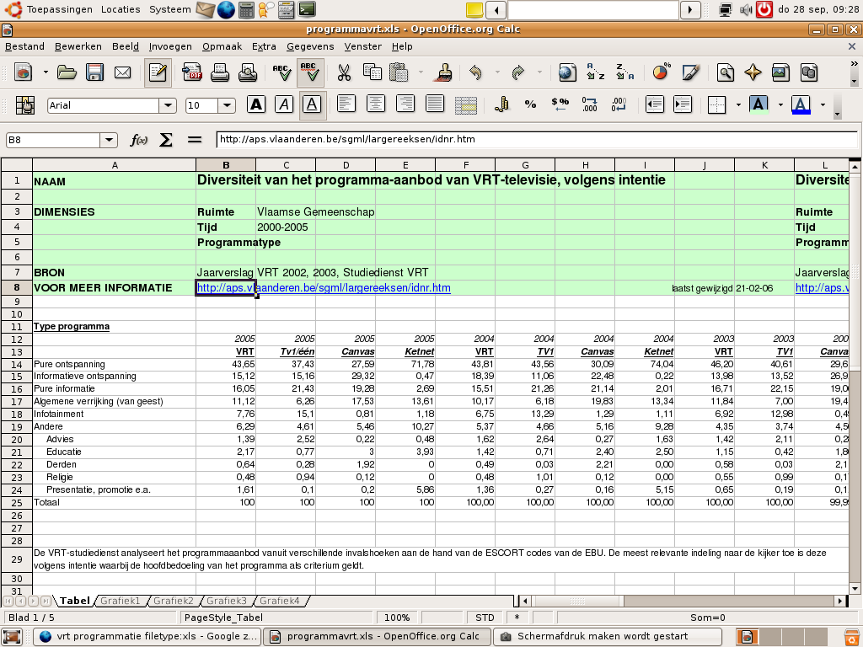
...it's...

Slide 13
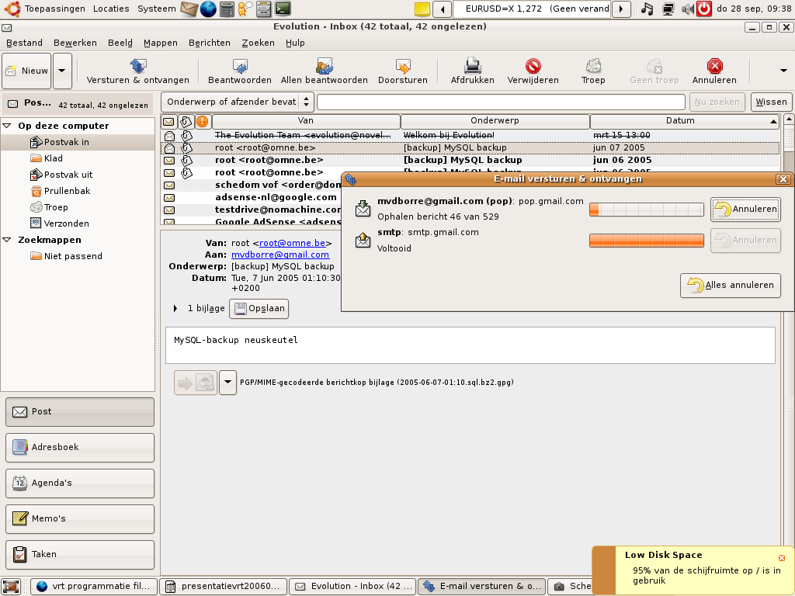
...more...

Slide 14
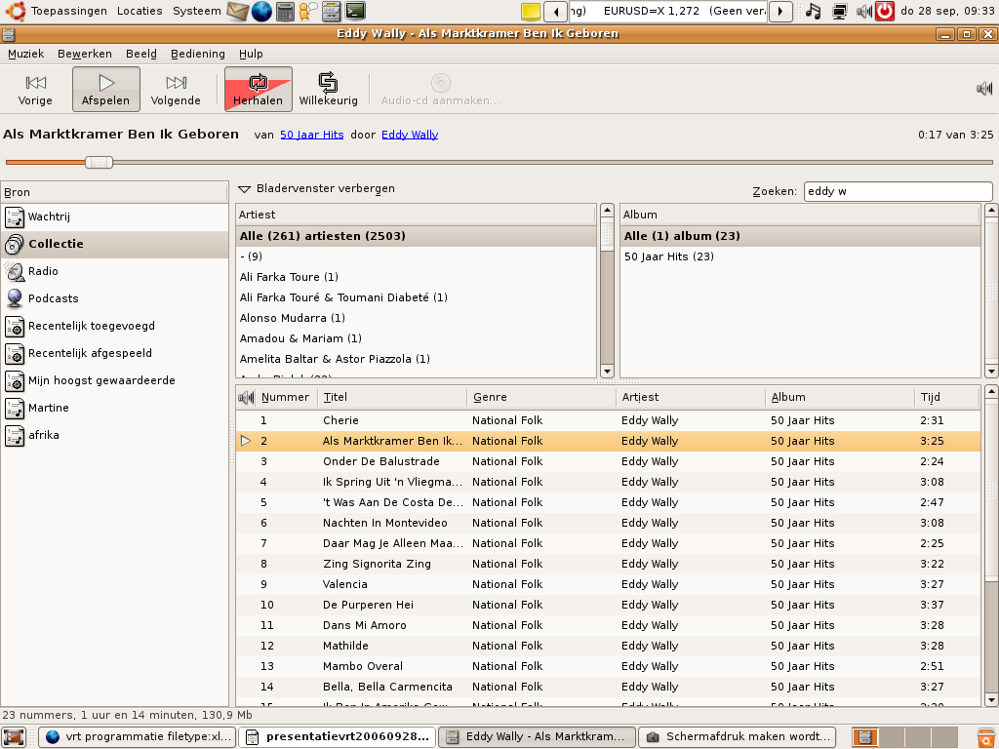
...like...

Slide 15
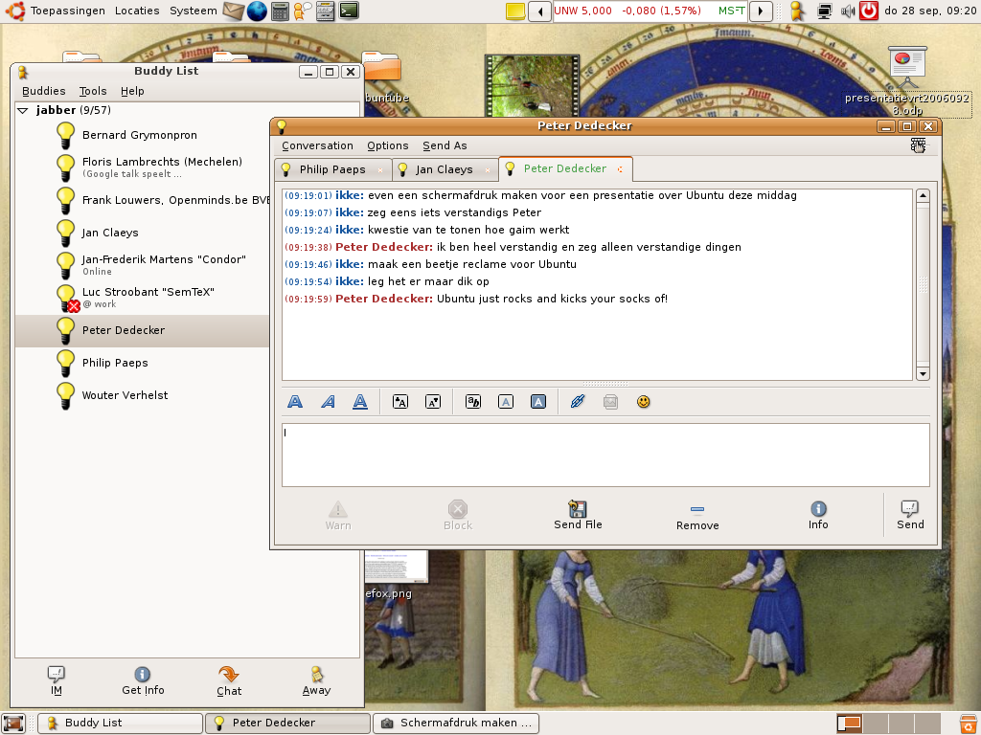
...solar power included!

Slide 16
What is your quest?

Slide 17
To find the holy grail
computer user freedom
native language
disabilities

Slide 18
What is your favorite color?

Slide 19
What is your favorite color?
Blue. Why?

Slide 20
What do you people do?

Slide 21
What do you people do?
develop
translate
assure quality
use & help use
promote

Slide 22
How do you people talk?

Slide 23
Virtual communication

Slide 24
Virtual communication...
email & mailing lists
launchpad.net
chat: irc & jabber
blogs & planets
forums
wiki
phone & phone conference

Slide 25
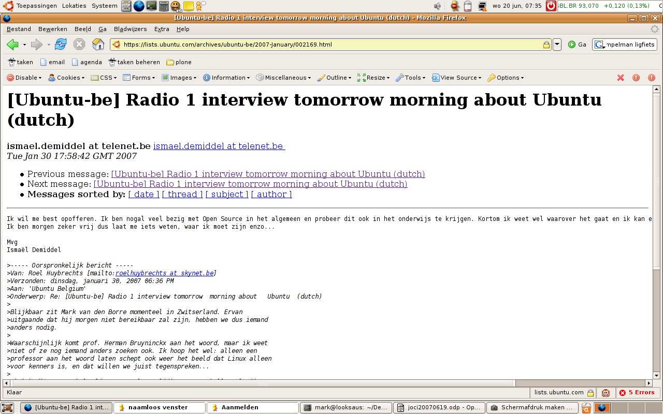
Mailing lists

Slide 26
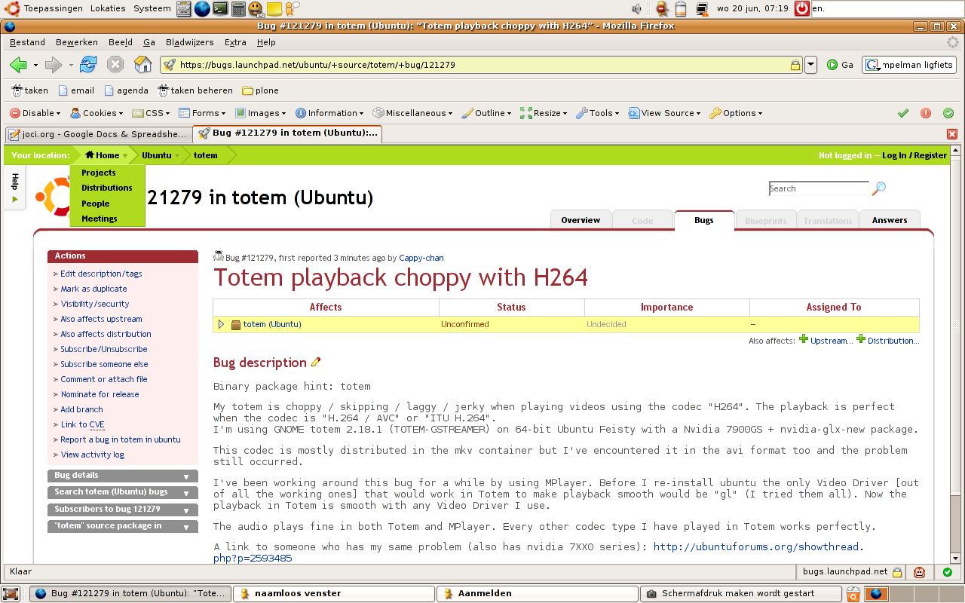
Launchpad.net: bugs

Slide 27
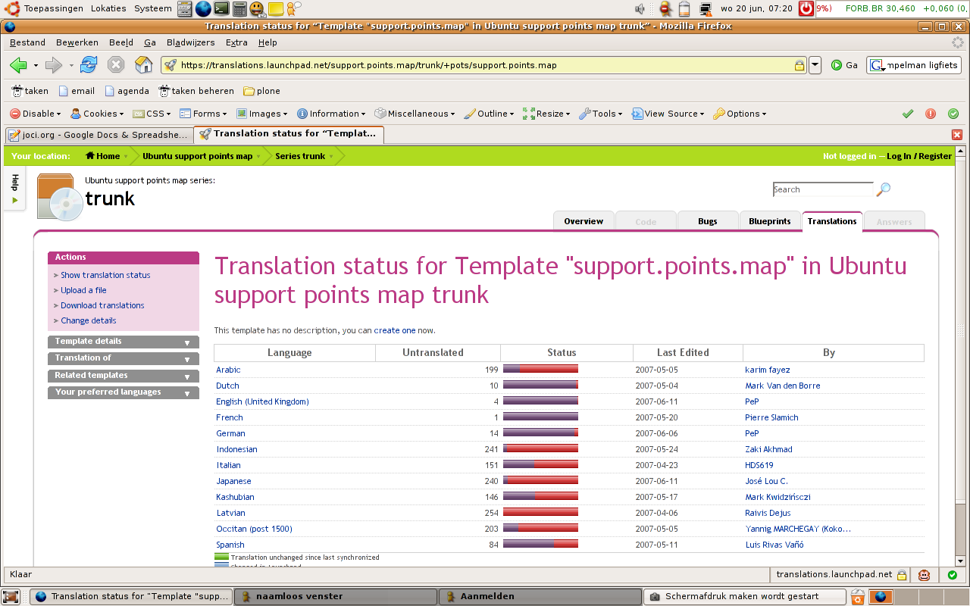
Launchpad.net: translations

Slide 28
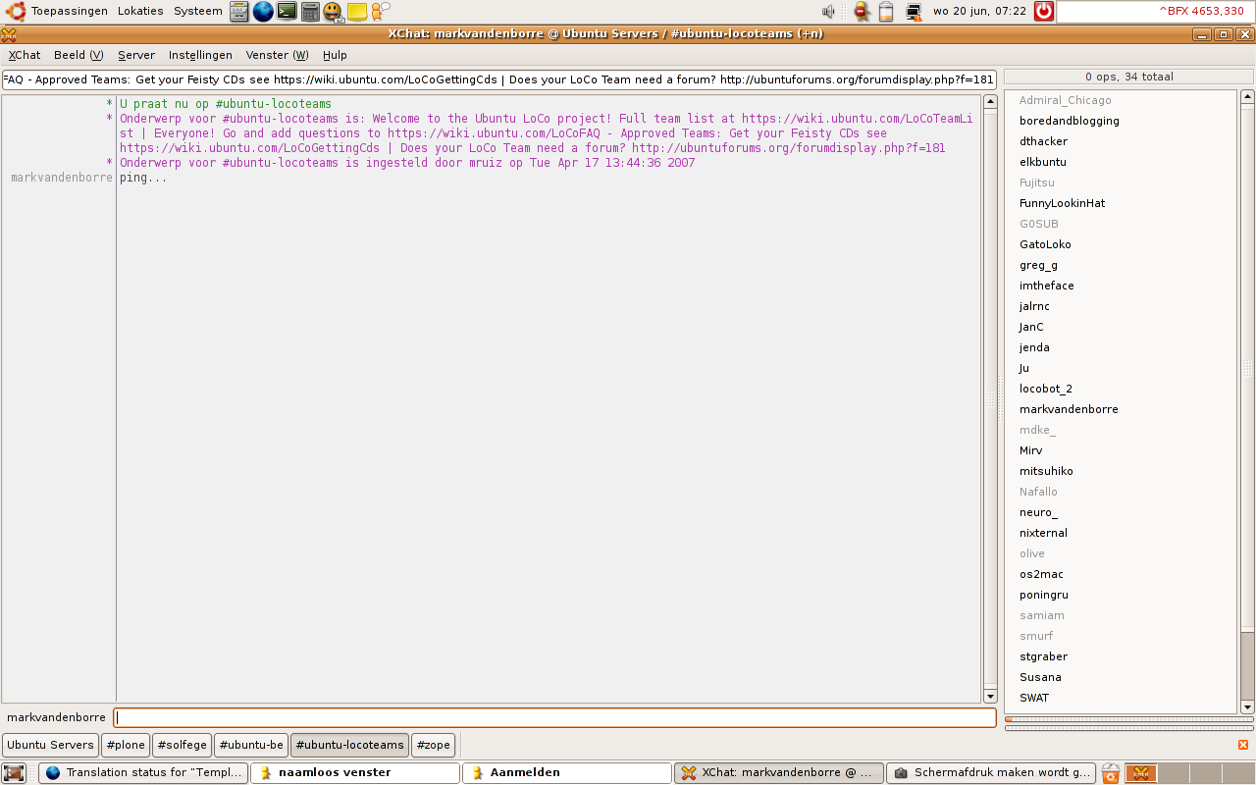
Group chat

Slide 29
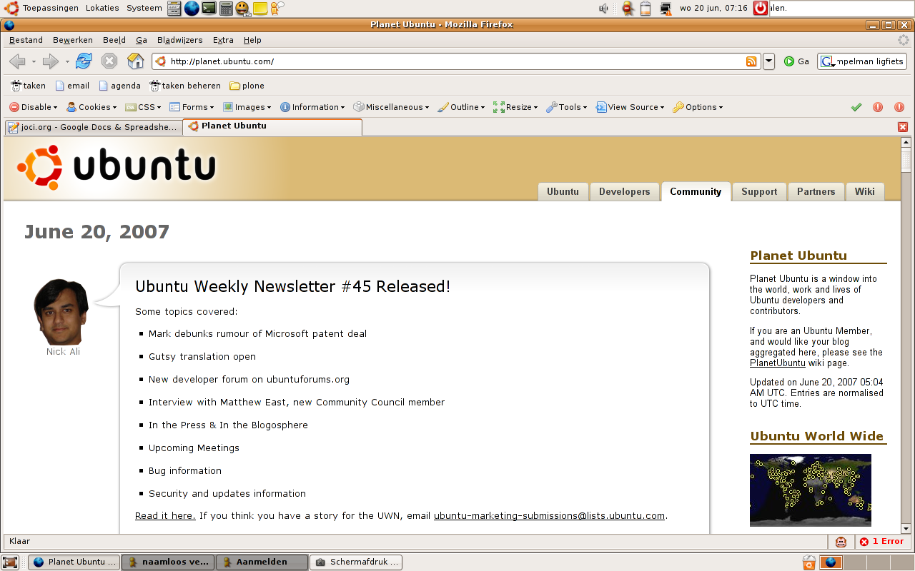
Blogs and planets

Slide 30
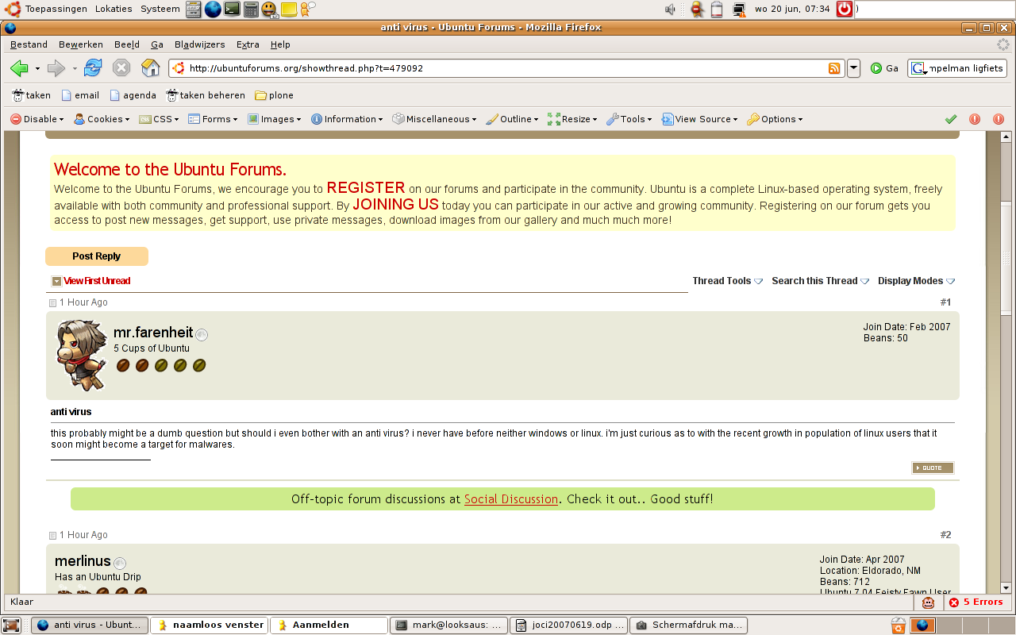
Ubuntu forums

Slide 31
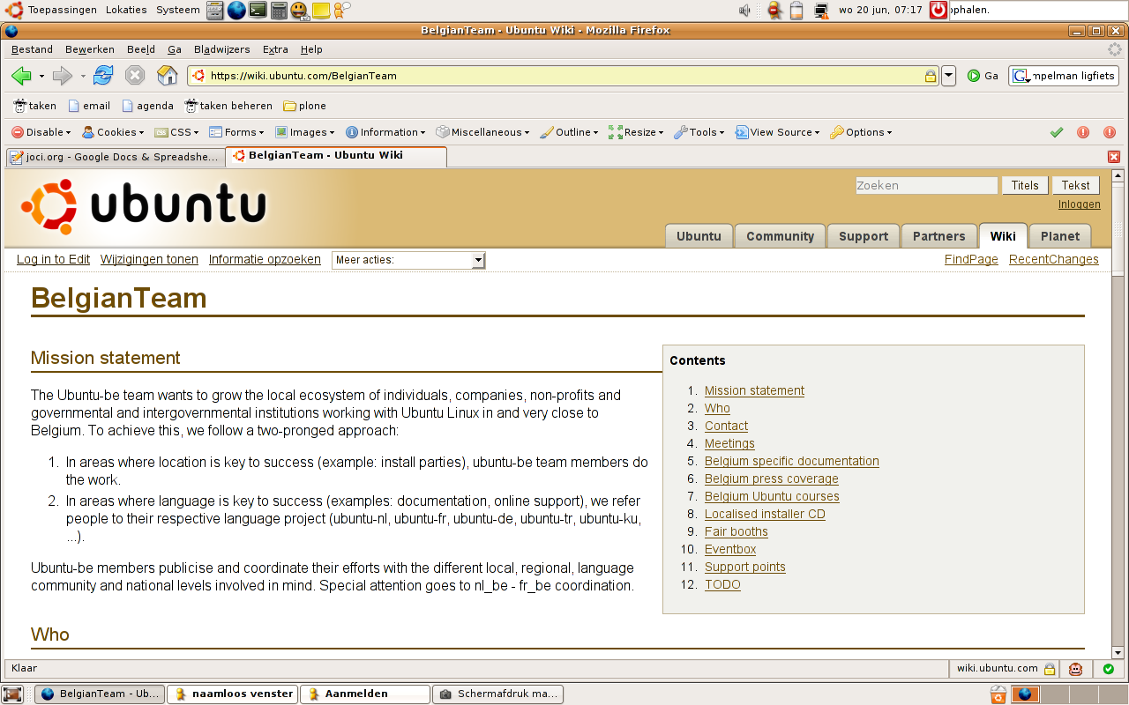
Ubuntu wiki

Slide 32
Can't replace physical meetings

Slide 33
Physical meetings
Ubuntu developer summit 2x/year
  2am conversation
free software conferences
  FOSDEM beer
install festivals
fairs
matching map

Slide 34
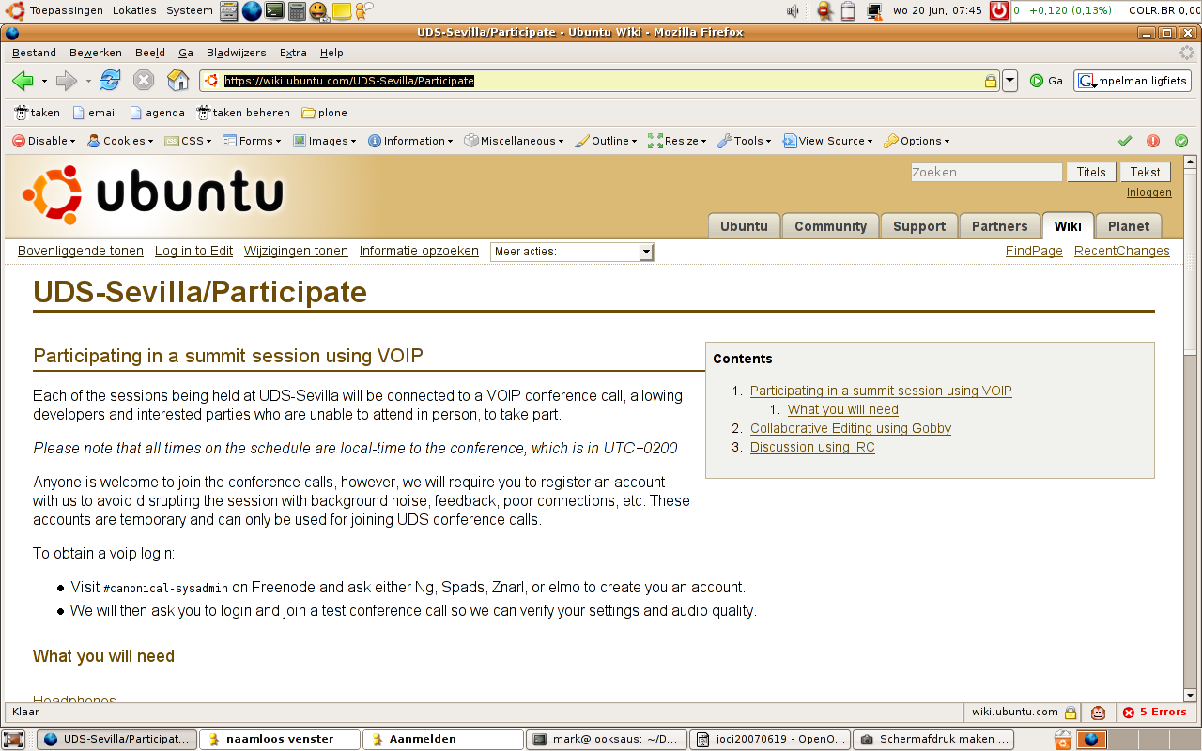
Ubuntu developer summit

Slide 35
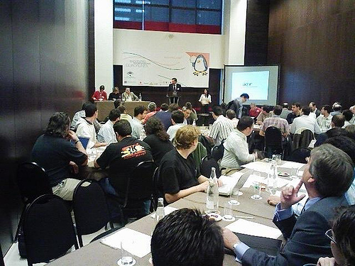
Ubuntu developer summit

Slide 36
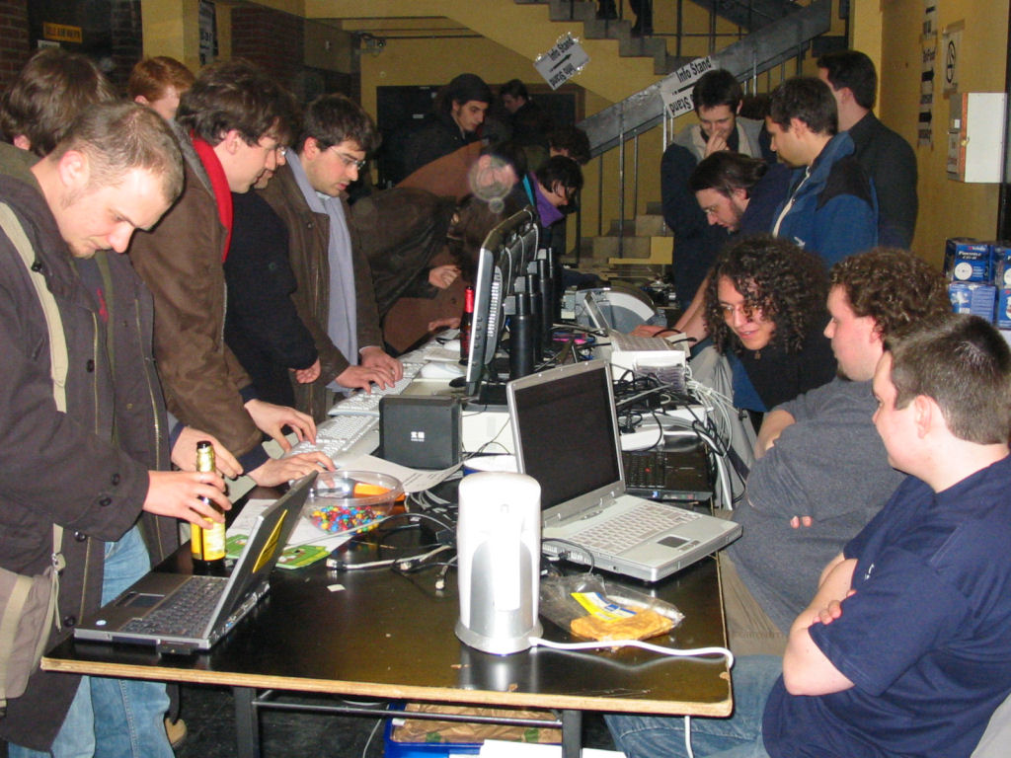
Free software conferences

Slide 37
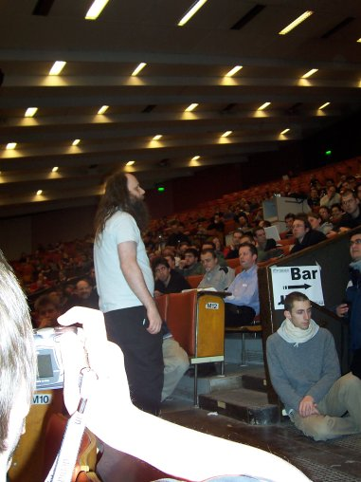
A bishop...

Slide 38
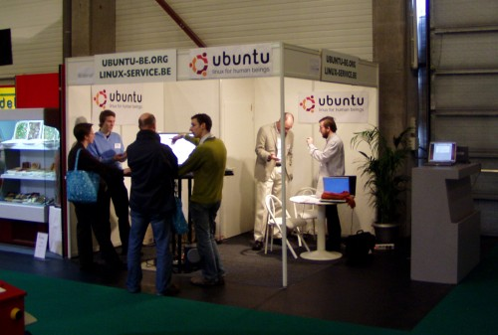
Fairs

Slide 39
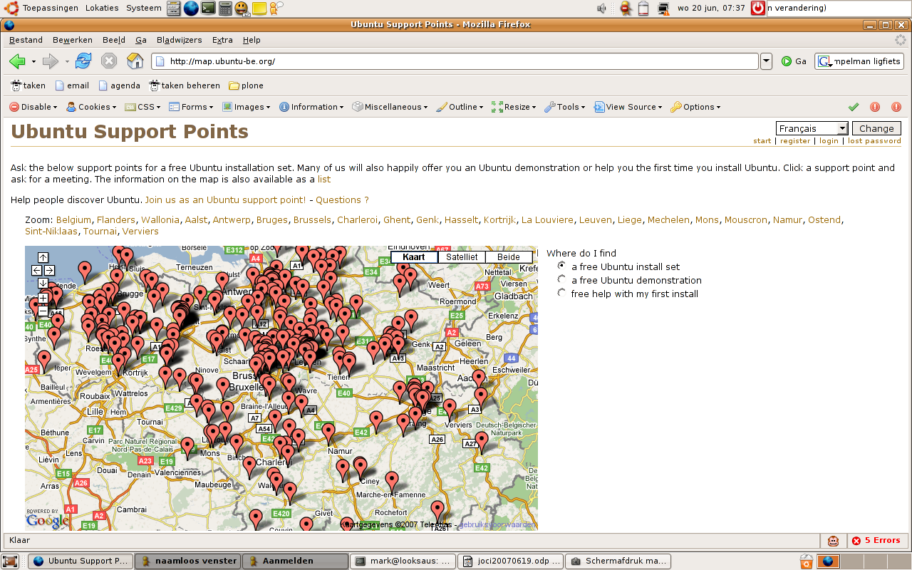
Matching map

Slide 40
A particular culture

Slide 41
People profile
intelligent
predominantly male
global
from pinko commie hippies
to global free market fundies
wealthy allies

Slide 42
Lots of open space
all this open space... just do it!

Slide 43
Trust
You fixed this problem that drove me nuts. I owe you a beer.
I trust you.

Slide 44
Informal, but make no mistake...
ruthless meritocracy at the core

Slide 45
Openness
Why keep this private? It's only accounting...

Slide 46
Questions
What is the air-speed velocity of an unladen swallow?
African or European?

