Slide 1

Real-Time PID Control Demo
Goals:
Implement a PID control loop in C++
Enable live parameter tuning from Python
Demonstrate timing determinism and jitter
Visualize steady-state and transient behavior
Outcome:
Working RT control loop
Live tuning + visualization
Measurable timing behavior

Slide 2
System Architecture
Components:
C++ RT Loop (PID + thermal plant)
Python PID Client (live tuning)
Python Visualizer (timing & response)
Communication:
File-backed shared memory (mmap)
CSV logs for timing and response
Design Rationale:
Simple, inspectable IPC
Clear separation of concerns

Slide 3
REAL time control loop
Loop Characteristics:
Fixed-rate loop at 50 Hz
lock_gettime(CLOCK_MONOTONIC)
nanosleep pacing
Per-Iteration Flow:
Read PID params
Compute PID
Update plant
Log timing & response
Metrics:
Period
Execution time
Jitter

Slide 4
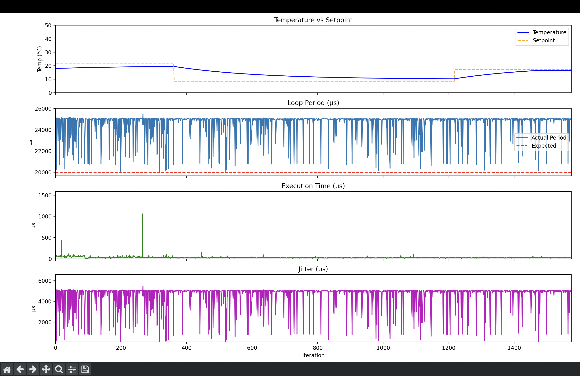
Demonstrating Determinism
Steady State:
Stable period
Low execution time variance
Runtime Interaction:
Live gain updates
Setpoint changes
No missed iterations
Visualization:
Temperature vs Setpoint
Period, Exec Time, Jitter

Slide 5
Limitations and takeaways
Caveats:
Soft real-time (macOS / POSIX)
Not a true RTOS
Simulated plant
What Translates:
Architecture
Timing instrumentation
Control structure
Key Takeaways:
Determinism is measurable
Safe runtime tuning
Scales to RT Linux / embedded

