Slide 1



River Database
Node Shapefile
Reach Shapefile
L2_HR_RiverTile
L2_HR_PIXC
L2_HR_PIXC_VecRiver

Slide 2
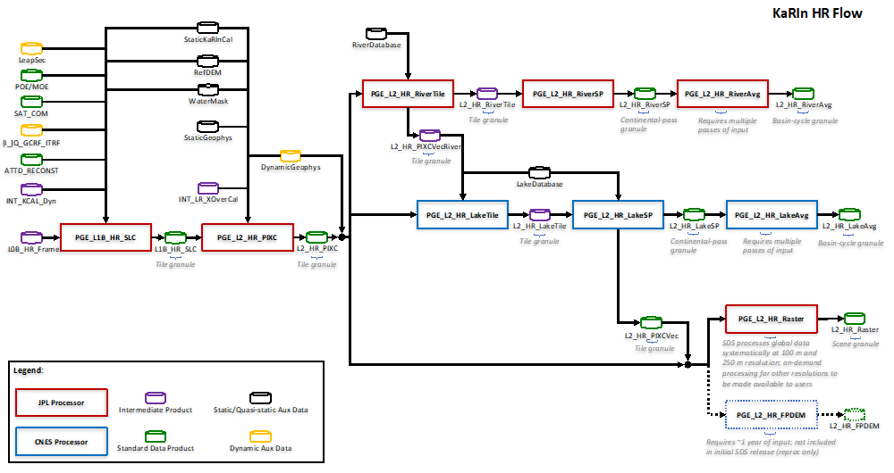

Slide 3
RIVERS
PIXEL CLOUD

