Slide 1
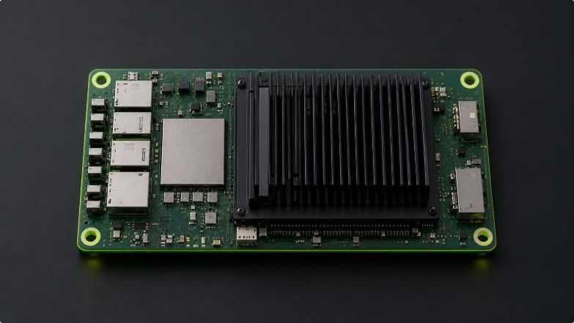
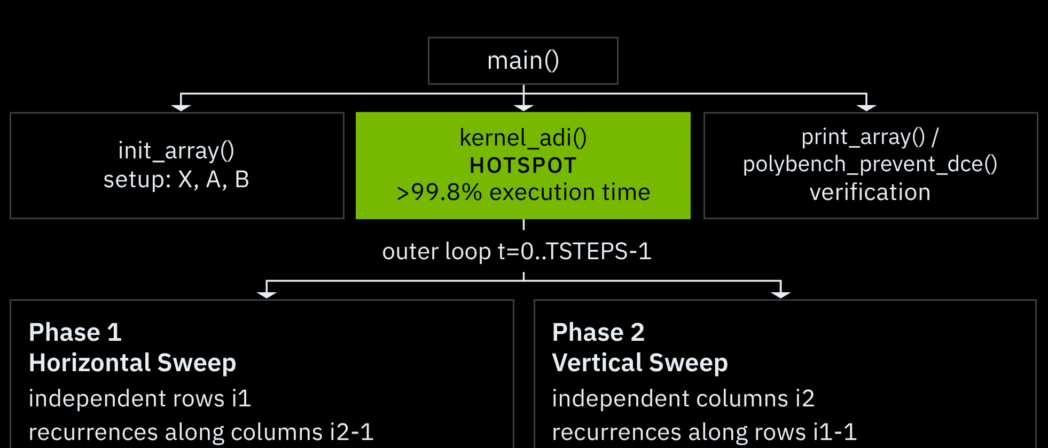
PROBLEM ANATOMY & PROFILING
ADI (Alternating-Direction Implicit) Stencil Solver
Analysis of the 2D parabolic PDE integration kernel from PolyBench/C · Author: Raffaele Cimino
KERNEL CALL HIERARCHY & PROFILE
PLATFORM SPECIFICATION
Target SoC: NVIDIA Jetson Nano
CPU: Quad-core ARM Cortex-A57 @ 1.43 GHz
Memory: 4 GB 64-bit LPDDR4 (25.6 GB/s), 2 MB shared L2
Toolchain: gcc -O2 -fopenmp -lm · 4 dedicated threads
Physical Goal: Solves 2D parabolic PDEs (heat diffusion, fluid dynamics) via alternating horizontal and vertical tridiagonal half-steps. main() coordinates dataset allocation, instrumentation and DCE.
Execution strictly bound to the 4 Cortex-A57 CPU cores.

Slide 2

ALGORITHMIC IMPLEMENTATION
Incremental Parallel Implementations: v1_rc, v2_rc, v3_rc
From persistent thread regions to loop fusion and dynamic tasking on 4 ARM Cortex-A57 cores
v1_rc
v2_rc
v3_rc
PERSISTENT THREAD REGION
ROW-WISE LOOP FUSION
TASKLOOP & LOOP INVERSION
Hoists #pragma omp parallel outside the timestep loop, removing fork-join runtime overhead.
Same parallization of v1_rc but in addition fuses forward sweep, normalization, and backward substitution into one parallel loop over i1.
Removes 2 global barriers (for loops) per timestep; active row data stays warm in each core's private 32 KB L1 data cache.
Applies #pragma omp taskloop num_tasks(4 * nthreads) for dynamic runtime task scheduling.
Inverts Phase 2 loop nest (i2 outermost) to pack column work into tasks, cutting down to 2 taskloop barriers per timestep.
Row and column sweeps partitioned using standard #pragma omp for with explicit global barriers between phases.

Slide 3
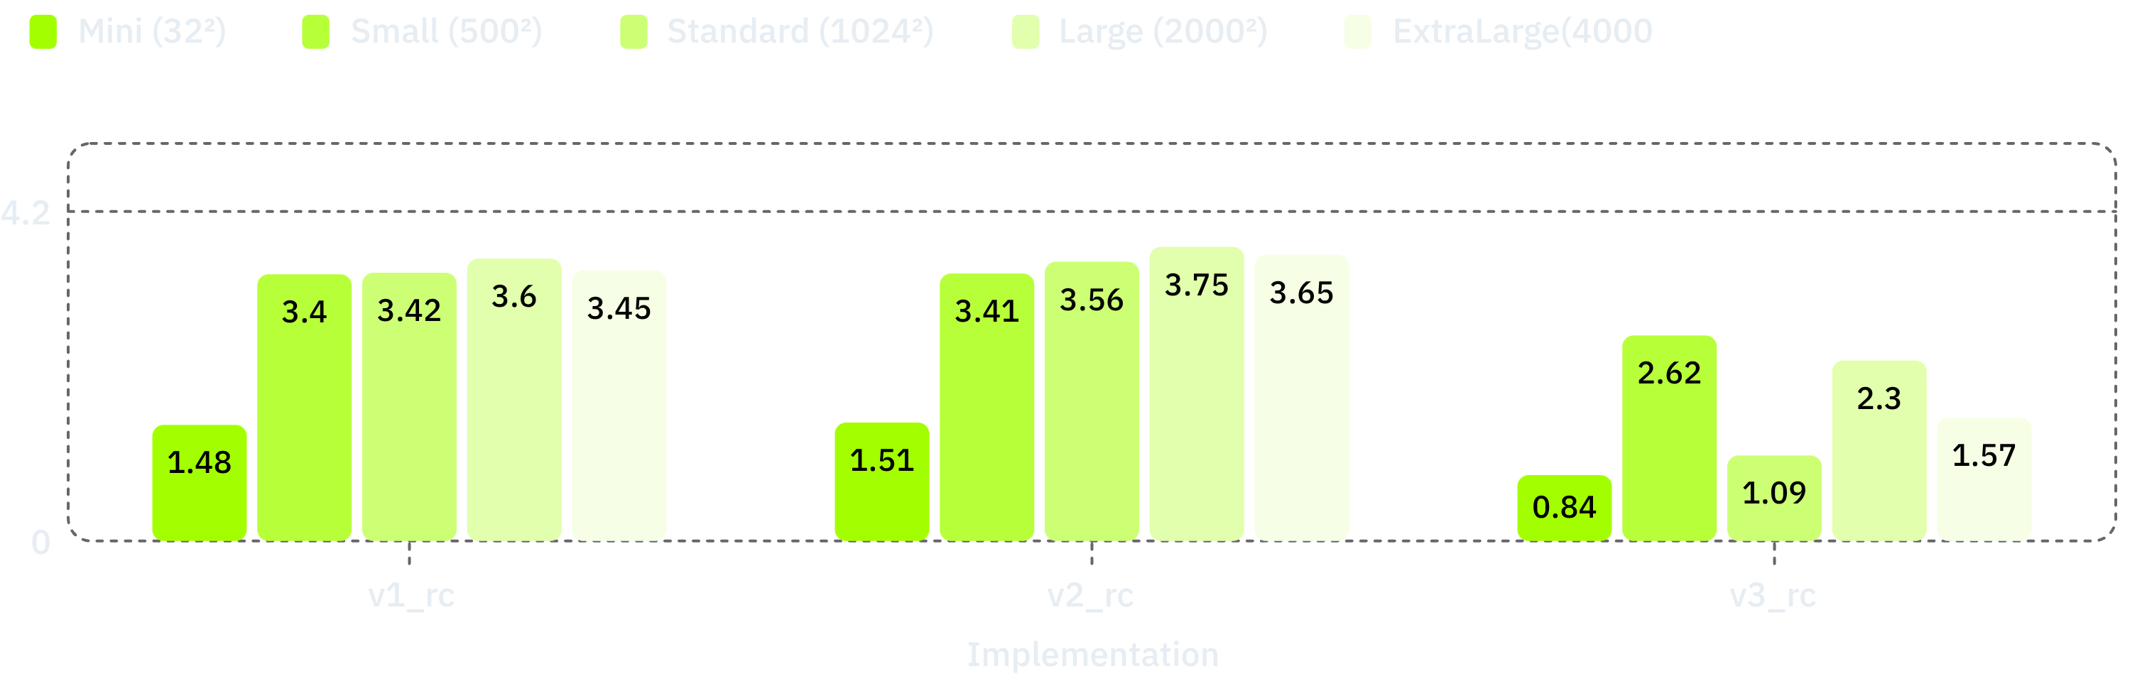
BENCHMARK ON NVIDIA JETSON NANO
Quantitative Scaling: v2_rc reaches 3.75x on Large dataset
PolyBench/C ADI benchmark suite on 4x ARM Cortex-A57 cores @ 1.43 GHz across 5 standard problem sizes
EXECUTION TIME (S) · LOWER IS BETTER
SPEEDUP Sp= Tseq/Tp & PARALLEL EFFICIENCY
Version | Mini (32²) | Small (500²) | Standard (1024²) | Large (2000²) | ExtraLarge (4000²)
Sequential | 0.000245 | 0.3125 | 6.5005 | 24.700 | 172.652
v1_rc (Persistent For) | 0.000166 | 0.0919 | 1.9020 | 6.8523 | 49.987
v2_rc (Loop Fusion) | 0.000162 | 0.0918 | 1.8258 | 6.5930 | 47.000
v3_rc (Taskloop) | 0.000291 | 0.1192 | 5.9531 | 10.7266 | 110.061
Version | Mini | Small | Standard | Large | ExtraLarge | Max E4
v1_rc | 1.48x | 3.40x | 3.42x | 3.60x | 3.45x | 90.1%
v2_rc | 1.51x | 3.41x | 3.56x | 3.75x | 3.65x | 93.7%
v3_rc | 0.84x (slowdown) | 2.62x | 1.09x | 2.30x | 1.57x | 65.5%
SEEDUP SCALING COMPARISON
v2_rc sustains near-linear scaling; v3_rc experiences severe degradation on Mini, Standard and ExtraLarge.

Slide 4


HPC TAKEAWAYS & HARDWARE PHYSICS
Why Loop Fusion (v2_rc) Crushed Taskloop (v3_rc)
Cache locality and SIMD vs. barrier elimination on an embedded SoC
V2_RC · 93.7% EFFICIENCY (respect to maximum of 4x)
V3_RC · COLLAPSE · 65.5% EFFICIENCY
Spatial locality: Unit-stride access along i2 uses every 64-byte cache line fetched from LPDDR4.
SIMD: GCC emits 128-bit ARM NEON SIMD instructions for independent column elements.
Barriers: Spin-lock barriers cost under 100 ns on 4 dedicated cores, about 5 ms total impact.
L2: From Standard up, the matrix footprint exceeds 24 MB and spills past the 2 MB L2 into LPDDR4.
Stride: Inverted Phase 2 jumps bytes (8 KB) per step, causing L1/L2 misses and TLB thrashing.
Task overhead: Task descriptors allocated every timestep add latency on a regular stencil.
AMDAHL VALIDATION
V2_RC · MAXIMUM SPEEDUP
3.97x
3.75x
·
v2_rc reaches 3.75x, 94.5% of the theoretical Amdahl ceiling.

