Slide 1

FINAL
DEFENSE

Slide 2

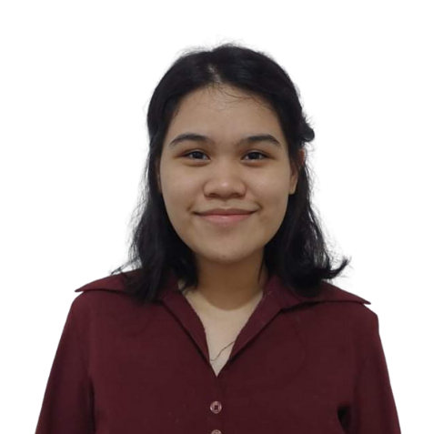
Researcher’s Profile
Andrea Jane L. Ermac
Blk. 1 Lot 34 Summerfield Residences Maybunga Pasig City
09227119596
andreajane.ermac@tup.edu.ph
Skills
Knowledgeable in some programming languages such as C, C++, Python
Knowledgeable in Web development (HTML, CSS)
Knowledgeable in Web designing (Figma, Wix)
Projects Done
Land Division using Last Diminisher Algorithm
Lead Programmer
Oct 2022 – Feb 2023
TEAMBA Programming Language
Assistant Programmer
Oct 2022 – Feb 2023
Implementation of Sex Education in Web-based Learning Application for Pre-teens (9-11 years old) in Barangay Maybunga
Data Scientist
Nov 2022 – July 2023

Slide 3
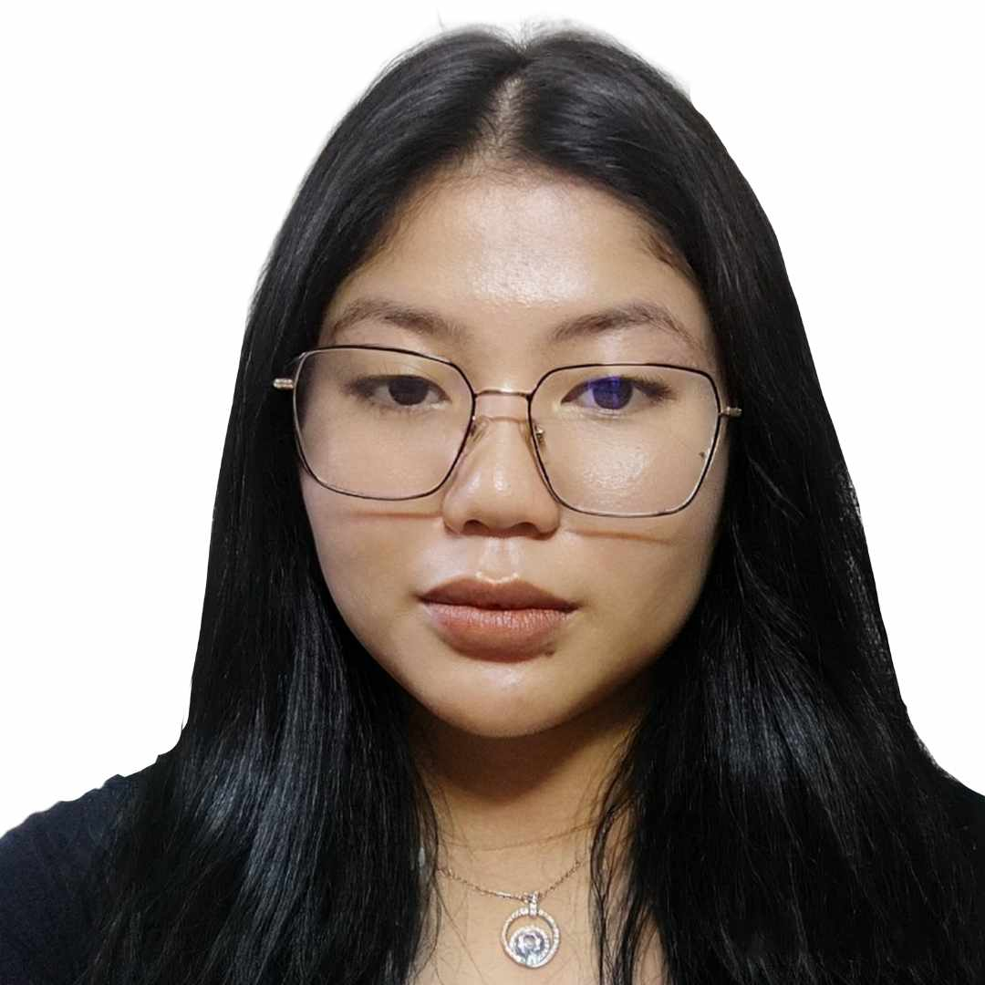
Researcher’s Profile
Julio, Natalie Kate L.
802 San Jose St. Manuyo Uno Las PInas City
09687454491
nataliekate.julio@tup.edu.ph
Skills
Knowledgeable in some programming languages such as C, C++, Python
Knowledgeable in Web development (HTML, CSS), Game Development ( Android Studio)
Knowledgeable in Web designing (Figma, Wix)
Projects Done
Web-Based Application that
Translates Basic FSL
Team Lead
Jan 2023 - July 2023
DrugProfiler: Mobile Application that Identifies a medicine, its use and side effect using CNN
Project Manager
Oct 2022 – Feb 2023
GayLingo Translator using Natural Language Processing
Project Manager
Oct 2022 - Feb 2023

Slide 4
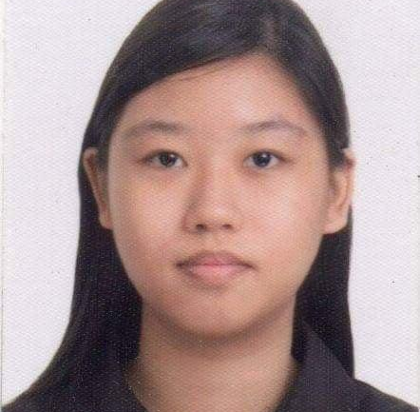
Researcher’s Profile
Randall Eira C. Lim
Unit 3A, 142 General Pio Valenzuela Street, Caloocan City
09258889024
randalleira.lim@tup.edu.ph
Skills
Knowledgeable in some programming languages, such as Assembly, C, C++, Python, and object-oriented programming
Knowledgeable in Web development (HTML, CSS)
Knowledgeable in Web designing (Figma, Wix)
Speaks English, Filipino, and Mandarin Chinese
Projects Done
Land Division using Last Diminisher Algorithm
Assistant Programmer
Oct 2022 – Feb 2023
TEAMBA Programming Language
Assistant Programmer
Oct 2022 – Feb 2023
Implementation of Sex Education in Web-based Learning Application for Pre-teens (9-11 years old) in Barangay Maybunga
Data Scientist
Nov 2022 – July 2023

Slide 5

Researcher’s Profile
Researcher’s Profile
Mark Cedrick B. Tacorda
Ph 7c Pkg 7 Blk 55 Lot 29 Brgy. 176 Bagong Silang, Caloocan City
09102998162
markcedrick.tacorda@tup.edu.ph
Skills
Knowledgeable in some programming languages such as C, C++, Python
Knowledgeable in Game Development (Godot, GDScript)
Knowledgeable in Machine Learning (Tensorflow, Keras)
Knowledgeable in UI designing (Figma)
Projects Done
Web-Based Application that Translates Basic FSL
Assistant Programmer
Jan 2023 - July 2023
DrugProfiler: Mobile Application that Identifies a medicine, its use and side effect using CNN
Lead Programmer
Oct 2022 – Feb 2023
Designing a Smart Campus Directory Application for the COS Building of TUP - Manila Using Ant Colony Optimization
Lead Programmer
Jan 2023 - July 2023

Slide 6

Smart Directory Map Locator with Navigation using A* Algorithm for the National Museums in Manila

Slide 7
Background of the Study
Causes
Problems
Effects
With two national museums and numerous galleries, the vastness and variety make it challenging for visitors and staff to navigate efficiently.
Existing tools like physical maps, satellite navigation, and online virtual tours are insufficient for indoor navigation, especially in large and intricate spaces like museums.
Lack sufficient interactive or accessible information points within the premises that provide detailed and real-time information about the exact locations of specific art pieces, sculptures, or galleries.
Difficulty in familiarizing with the museums’ layout and halls
Inefficient navigation tools, leading to confusion and time wastage
Lack of specific location information
Inconvenience for visitors
Reduced overall efficiency
Potential loss of engagement
Perceived Solution:
Smart Directory Map Locator with Navigation using A* Algorithm for the National Museums in Manila
Notes:
Causes:
Complexity of the National Museum Complex: With three national museums and numerous galleries, the vastness and variety make it challenging for visitors and staff to navigate efficiently.
Lack of Effective Navigation Tools: Existing tools like physical maps, satellite navigation, and online virtual tours are insufficient for indoor navigation, especially in large and intricate spaces like museums.
Inadequate Information Accessibility: Limited or Non-Interactive Information Points; The museums might lack sufficient interactive or accessible information points within the premises, such as digital kiosks or easy-to-use apps, that provide detailed and real-time information about the exact locations of specific art pieces, sculptures, or galleries.
Problems:
Difficulty in Orientation: New visitors, tourists, and even staff members struggle to familiarize themselves with the museums' layout and halls due to the extensive area.
Inefficient Navigation Tools: Current maps and navigation tools don't adequately support indoor navigation, leading to confusion and time wastage.
Lack of Specific Location Information: Visitors may face challenges in finding specific art pieces, sculptures, or galleries they wish to explore within the museums.
Effects:
Inconvenience for Visitors: Difficulty in navigating the complex leads to a less satisfying and potentially frustrating museum experience for visitors.
Reduced Efficiency: Wasted time and effort in trying to find specific locations or navigate through the museums can reduce overall efficiency, both for visitors and museum staff.
Potential Loss of Engagement: Visitors might miss out on exploring certain exhibits or galleries due to navigation difficulties, impacting their overall engagement with the museums.

Slide 8

Objectives of the Study
1.Design a smart navigation system with the following features:
User Log-in System
Shortest Path (Employ the A* pathfinding algorithm to find the shortest route from one place to another)
Average Distance and ETA
Filter for every floor
View Gallery (list of all artifacts, artworks, sculpture, etc. per museum)
Track Visitation Progress

Slide 9
Objectives of the Study
2) Create the map, where necessary information is provided. It includes:
Labels (e.g. Gallery V, Gallery VI, Exit, Restroom etc.)
Brief information about the galleries
Information about the art/sculpture/piece and artists
Establish a QR code to access the download link for the finished application.

Slide 10
Objectives of the Study
3) Develop the actual mobile application using developmental tools.
Godot 4 – Game Engine (for 2D map digitalization, Main UI development, and routes optimization)
Firebase ( for database)
Android Studio (for mobile application development)
4) Test and evaluate the system in terms of functional suitability and reliability.
5) Determine the level of acceptability of the developed prototype system using the ISO 25010 criteria such as functional suitability, performance efficiency, usability, reliability, and maintainability.

Slide 11
Scope and Limitations
The study will focus on developing a smart navigation system to help with navigation and guide users to their target destination with the correct route.
The system is exclusively centered around the National Museums of Manila (Fine Arts and Anthropology) and does not extend to the other branches or museums.
Users can access the application through the QR code provided at every entrance of the National Museums, granting them access to the app and its functionalities.
The navigation system’s functionality heavily relies on the A* algorithm for navigation and pathfinding, and alternative algorithms or navigation methods are not considered within its scope.
Tracks the progress of the user's visits (galleries/paintings/artifacts/sculptures already visited).
Mapping of the national museums is limited to the individual buildings within the museum and does not extend to other areas or locations.

Slide 12
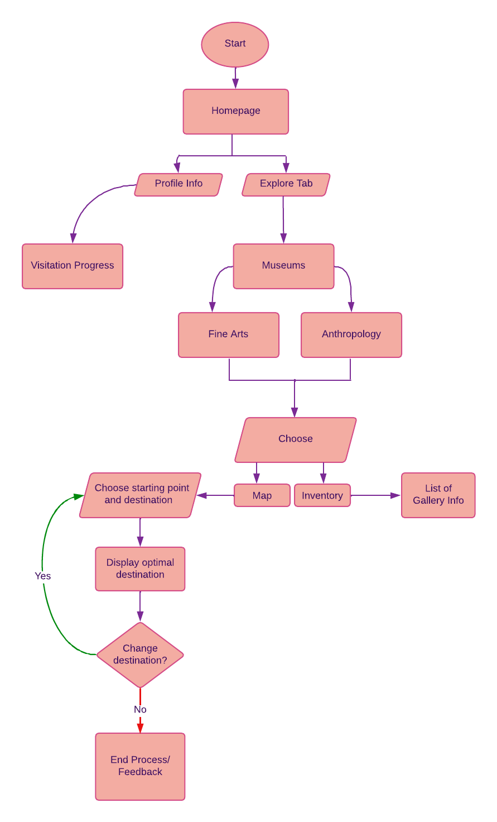
Project Design
Program Flowchart of System

Slide 13
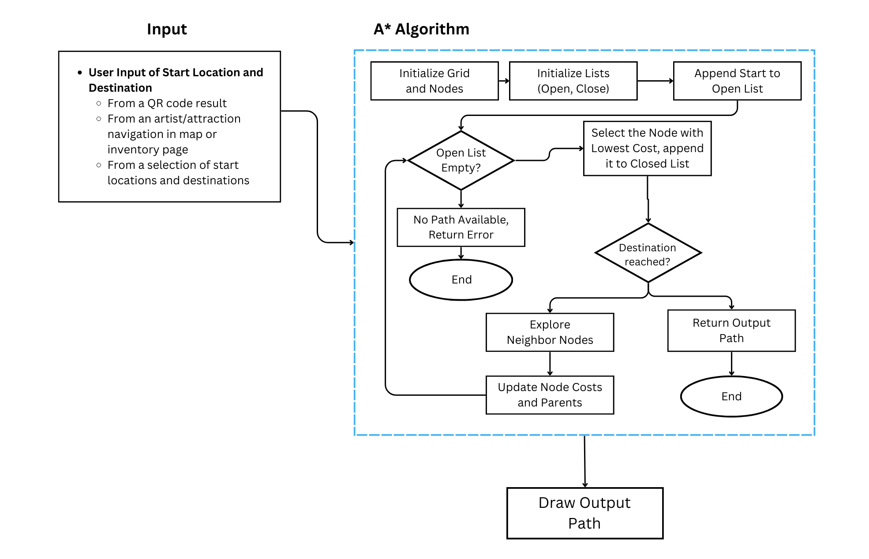
Project Design
Program Flowchart of Artificial Intelligence

Slide 14
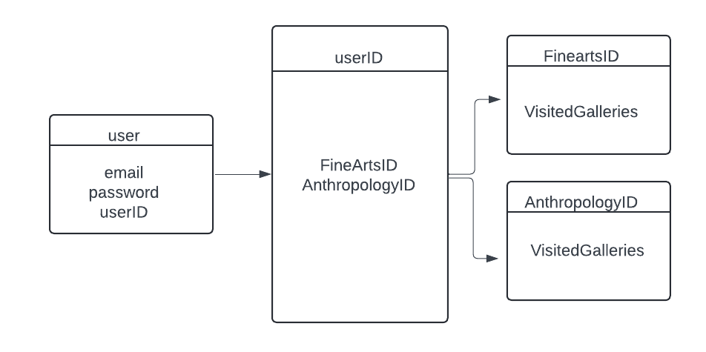
Project Design
Entity Relationship Diagram for Log-In and User Data

Slide 15
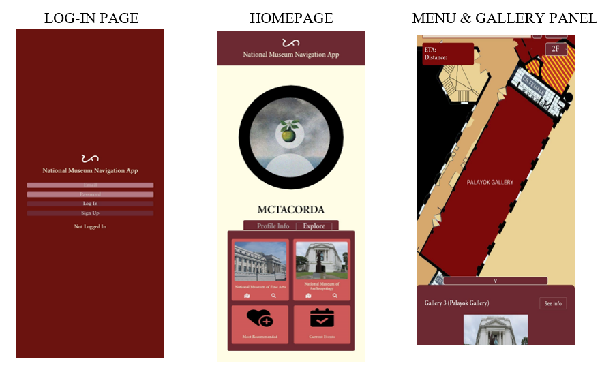
Project Design
Wireframing

Slide 16
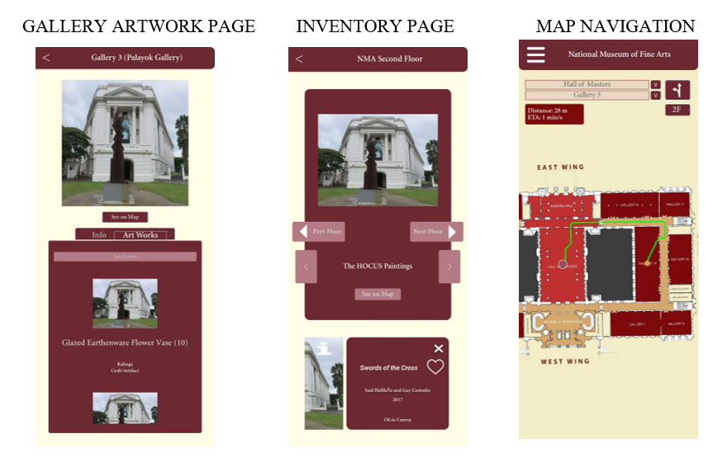
Project Design
Wireframing

Slide 17
DEMO
Wireframing

Slide 18
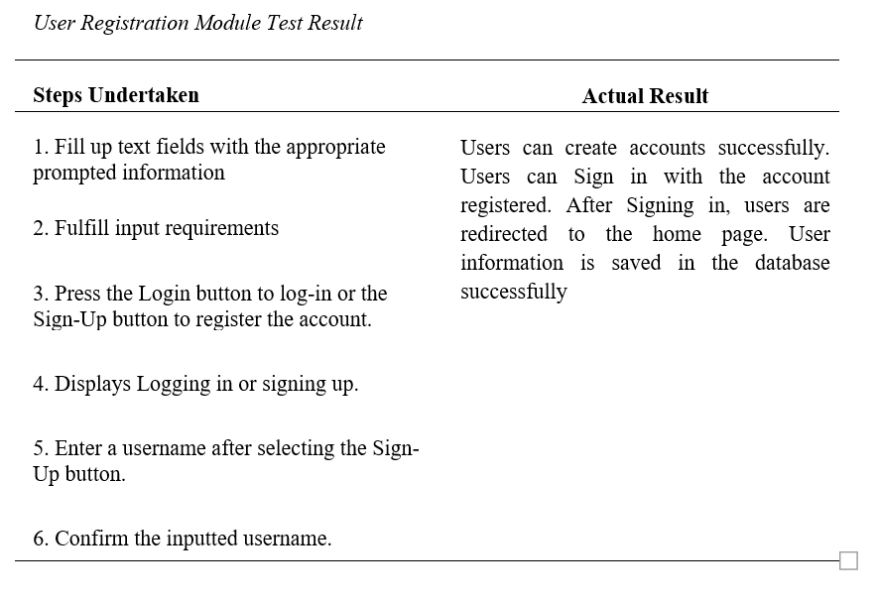
TEST RESULTS

Slide 19
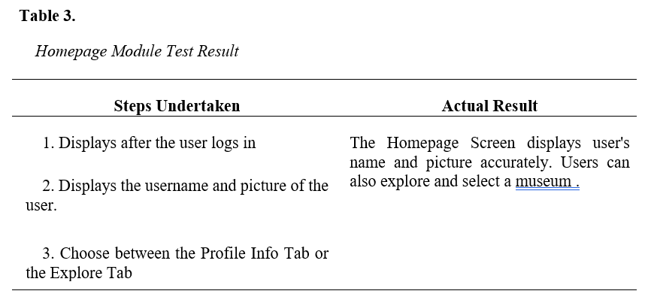
TEST RESULTS

Slide 20
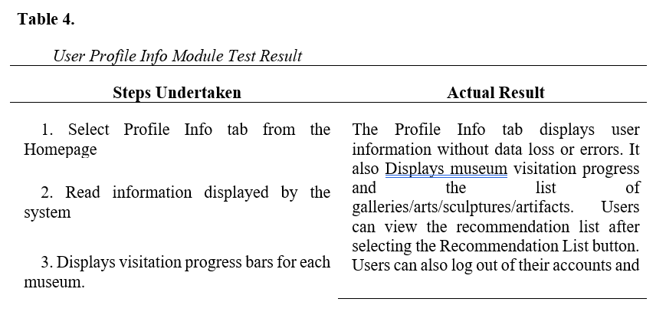
TEST RESULTS

Slide 21
TEST RESULTS

Slide 22
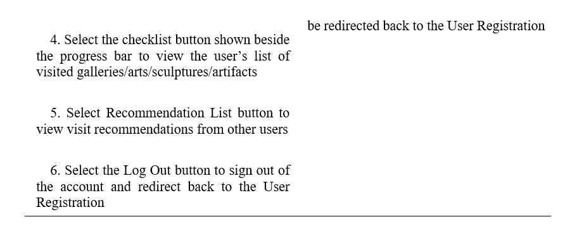
TEST RESULTS

Slide 23
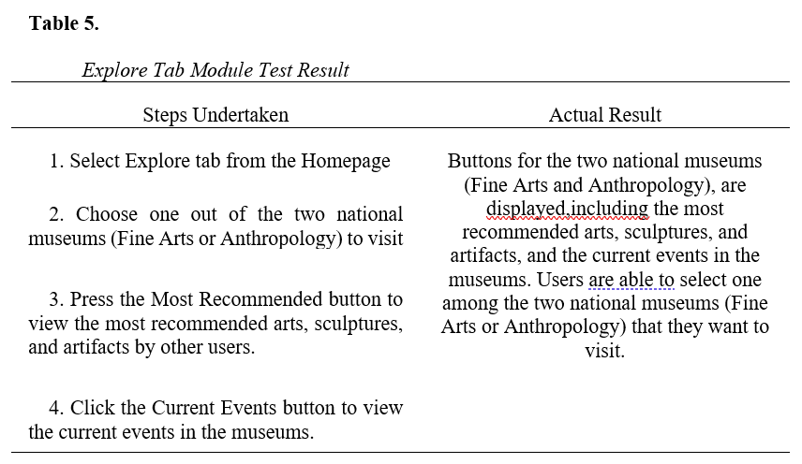
TEST RESULTS

Slide 24
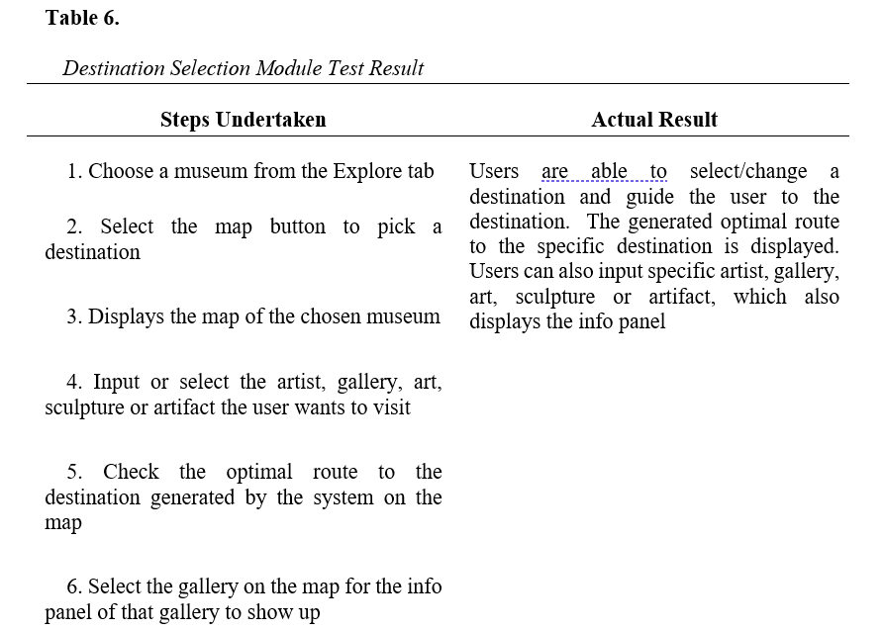
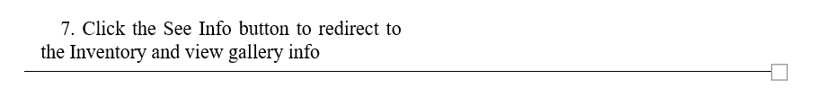
TEST RESULTS

Slide 25
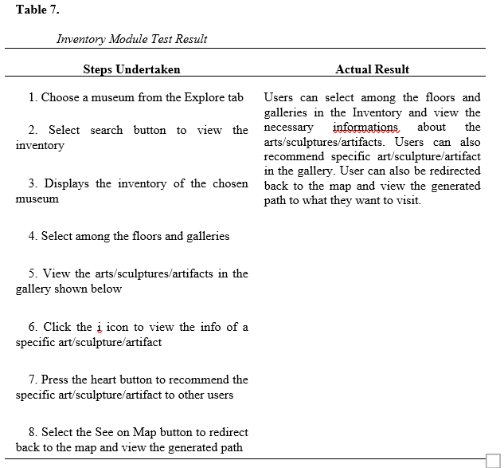
TEST RESULTS

Slide 26
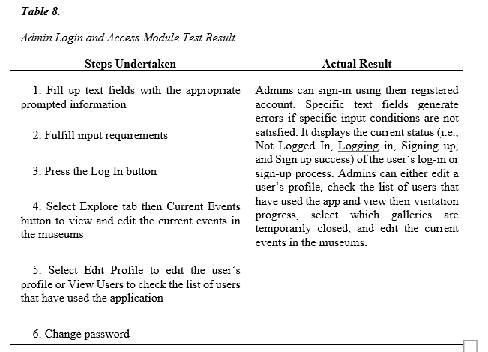
TEST RESULTS

Slide 27
CONCLUSION
“Smart Directory Map Locator with Navigation using A* Algorithm for the National Museums in Manila” is well-received and highly acceptable in terms of Functional Suitability, Performance Efficiency, Usability, Reliability, and Maintainability, following the ISO 25010 criteria.
The map completely provided the necessary information, including labels and legends per floor, brief information about the place, information about the art/sculpture/piece and artist, and the established QR code for download link access of the finished application.

Slide 28
