Slide 1
J8, Strategic Studies U.S. Special Operations Command
Optimizing SOF Military Construction (MILCON) Resources
MILCON Prioritization and Allocation Tool (MPAT)

Slide 2
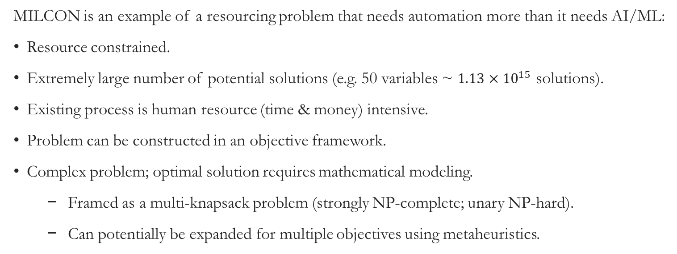
Our Data Problem
Military Construction (MILCON) Example
MILCON is an example of a resourcing problem that needs automation more than it needs AI/ML:
Resource constrained.
Extremely large number of potential solutions (e.g. 50 variables ~ $1.13×{10}^{15}$ solutions).
Existing process is human resource (time & money) intensive.
Problem can be constructed in an objective framework.
Complex problem; optimal solution requires mathematical modeling.
Framed as a multi-knapsack problem (strongly NP-complete; unary NP-hard).
Can potentially be expanded for multiple objectives using metaheuristics.

Slide 3

MILCON Mathematical Method: Integer Programming
In the most basic format, the MILCON example is a multi-knapsack problem.
Which combination of projects provide the most value within our fiscal year budget constraints?
MILCON Projects
Value = Y
NET = FY23
FY21
suitcase
FY22
suitcase
FY23
suitcase
FY24
suitcase
FY25
suitcase

Slide 4
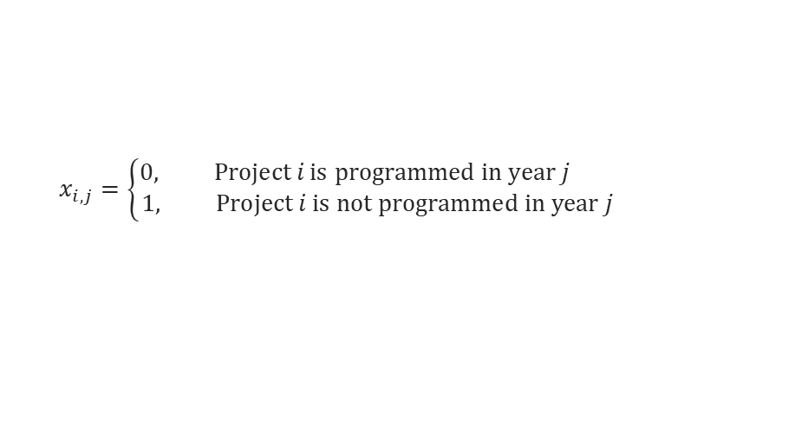

MILCON Optimization Integer Programming Variables
Key Variables
$i=\text{Project} \text{number} \left\{1, 2, ⋯, n\right\}$.
$$j=\text{Fiscal} \text{Year} \left\{18, 19, ⋯, 24\right\}$$
$$x_{i,j}=\left\{\begin{aligned}0, \text{Project} i \text{is} \text{programmed} \text{in} \text{year} j \\ &1, \text{Project} i \text{is} \text{not} \text{programmed} \text{in} \text{year} j\end{aligned}\right.$$
$$u_{i}=\text{POM} \text{sponsor} \text{of} \text{project} i\text{.}$$
$$c_{i}=\text{Cost} \text{of} \text{project} i \text{per} \text{year}\text{.}$$
$v_{i,j}=\text{V}\text{a}\text{lue} \text{of} \text{project} i \text{in} \text{year} \text{j}$.
${CBPL}_{i}=Capabilities$Based Program List score for project.
$$r_{i,p}=\text{Rank} \text{assigned} \text{to} \text{project} i \text{by} \text{POM} \text{sponsor}\text{ (}p\text{).}$$
$$w_{r}=\text{Weight} \text{applied} \text{to} \text{Rank} \text{Score} \text{in} \text{the} \text{value} \text{function}\text{.}$$
$$w_{c}=\text{Weight} \text{applied} \text{to} \text{CPBL} \text{Score} \text{in} \text{the} \text{value} \text{function}\text{.}$$
$${MF}_{i}=\text{Must} \text{fund} \text{Fiscal} \text{Year} \text{project} i \text{must} \text{be} \text{funded}\text{.}$$
$${NET}_{i}=\text{No} \text{earlier} \text{Fiscal} \text{Year} \text{that} \text{project} i \text{can} \text{be} \text{funded}\text{.}$$
Each cost has an associated lead or lag time.
$${PDS}_{i}=Prospectus development study cost of project i.$$
$${PND1}_{i}=First planning and design cost of project i.$$
$${PND2}_{i}=Second planning and design cost of project i.$$
$${CEQOM}_{i}=Collateral equipment operations and maintenance cost of project i.$$
${CEQPROC}_{i}=Collateral equipment procurement cost of project i$.
${C4IOM}_{i}=Command, control, communications, computing and information (C4I) cost of project i$.
$${C4IPROC}_{i}=C4I procurement cost of project i.$$

Slide 5
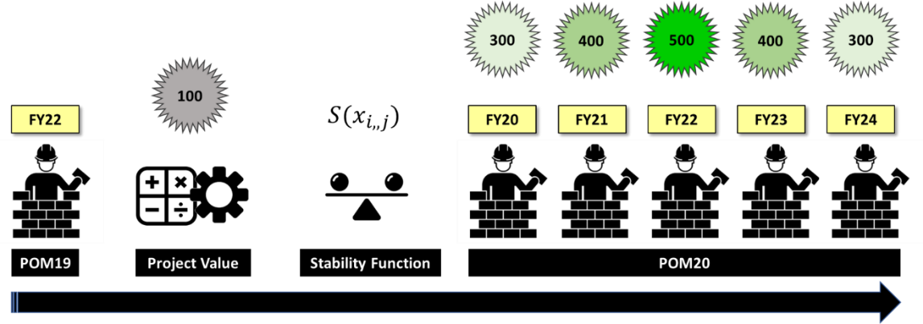


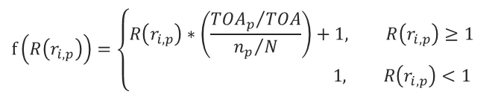
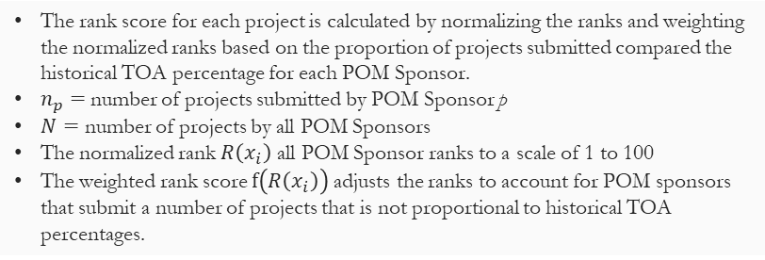
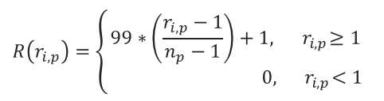
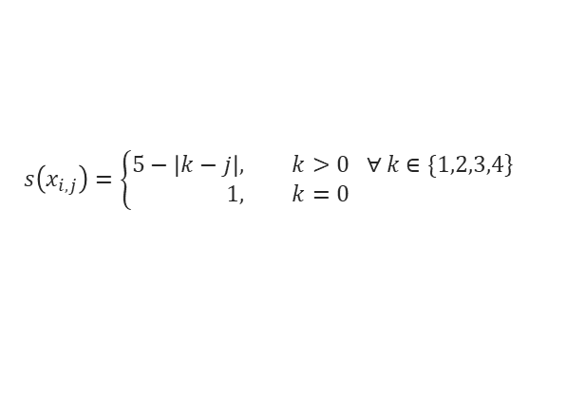
MILCON Optimization Integer Programming Value Score
How are value scores calculated?
$$v_{i,j}=s\left(x_{i,j}\right)∗\left[w_{c}\left(f\left({CBPL}_{i}\right)\right)+w_{r}\left(f\left(R\left(r_{i,p}\right)\right)\right)\right]$$
Stability Function
$$s\left(x_{i,j}\right)=\left\{\begin{aligned}\left.5−\left|k−j\right|, \&k>0 ∀ k∈\{1,2,3,4\right\} \\ 1, &k=0\end{aligned}\right.$$
The stability function accounts for the relationship between the current program and the previous program. This function provides a reward for minimizing the number of year-to-year project shifts between POM cycles.
Regardless of when a project was programmed in the previous POM, it has a higher likelihood of being included in the current solution, and it is more likely to be programmed in the same FY as in the previous POM.
Example: If a project was programmed for FY22 in POM19, it will receive and increase to its entire value based on its location in POM20.
Rank Score (Normalized and Weighted by TOA)
The rank score for each project is calculated by normalizing the ranks and weighting the normalized ranks based on the proportion of projects submitted compared the historical TOA percentage for each POM Sponsor.
$n_{p}=$ number of projects submitted by POM Sponsor p
$N=$ number of projects by all POM Sponsors
The normalized rank $R\left(x_{i}\right)$ all POM Sponsor ranks to a scale of 1 to 100
The weighted rank score $f\left(R\left(x_{i}\right)\right)$ adjusts the ranks to account for POM sponsors that submit a number of projects that is not proportional to historical TOA percentages.
$$R\left(r_{i,p}\right)=\left\{\begin{aligned}99∗\left(\frac{r_{i,p}−1}{n_{p}−1}\right)+1,{ r}_{i,p}≥1 \\ 0,{ r}_{i,p}<1\end{aligned}\right.$$
$$f\left(R\left(r_{i,p}\right)\right)=\left\{\begin{aligned}R\left(r_{i,p}\right)∗\left(\frac{{{TOA}_{p}}/{TOA}}{{n_{p}}/N}\right)+1, R\left(r_{i,p}\right)≥1 \\ 1, R\left(r_{i,p}\right)<1\end{aligned}\right.$$
CBPL Score (Normalized)
The CBPL score for each project is calculated by normalizing the CBPL values on a scale of 0 to 100 using the maximum and minimum CBPL values.
$$f\left({CBPL}_{i}\right)=100∗\left(\frac{{CBPL}_{i}^{−1}−min\left({CBPL}^{−1}\right)}{max\left({CBPL}^{−1}\right)−min\left({CBPL}^{−1}\right)}\right)$$

Slide 6

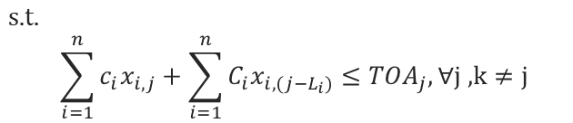

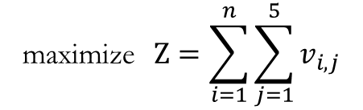




MILCON Optimization Integer Programming Objective & Constraints
Multi-Knapsack Problem: Strongly NP-Complete
Objective Function
Value function
$$\text{maximize}{Ζ=\sum_{i=1}^{n}{\sum_{j=1}^{5}{v_{i,j}}}}$$
$$v_{i,j}=s\left(x_{i,j}\right)∗\left[w_{c}\left(f\left({CBPL}_{i}\right)\right)+w_{r}\left(f\left(R\left(r_{i,p}\right)\right)\right)\right]$$
Constraints
$C_{i}∋ \left\{{PDS}_{i},{PND}_{i},{CEQ}_{i},{C4I}_{i},… \right\}$ $L_{i}∋ \left\{l_{PDS, i},l_{PND,i},l_{CEQ,i},… \right\}$
$$\text{s}\text{.}\text{t}\text{. }$$
$$\sum_{i=1}^{n}{c_{i}x_{i,j}+\sum_{i=1}^{n}{{C_{i}x}_{i,(j−L_{i})}}≤{TOA}_{j}, ∀\text{j}\text{ ,}\text{k}≠j}$$
Budget Constraints The sum of the costs for all projects programmed in each FY cannot exceed the TOA for that FY.
Must Fund Constraints A project cannot be programmed prior to the must fund FY (if a must fund FY exists).*
$$x_{i,{MF}_{i}}=1;$$
$$x_{i,j }=0, ∀ j<{NET}_{i};$$
No Earlier Than Constraint A project cannot programmed prior to its NET FY.
$$\sum_{j=1}^{5}{x_{i,j}≤1;}$$
Limiting Constraints A project cannot programmed in more than one FY.
$$\sum_{j=1}^{5}{x_{i,j}≥BR;}$$
Business Rule Constraint A project programmed in prior POM must be included in the current solution. (Removed for POM21)
Whole Projects Constraint A project cannot be partially programmed.
$$x_{i,j}=binary$$
* Component #1 priorities were assigned as Must Fund in the Desired FY for POM21.

Slide 7
MILCON Optimization Integer Programming Input Data
The model requires one input file of requested MILCON projects.
Project | POM Sponsor | Cost | CBPL Score | Rank Score | NET | Must Fund | Previous POM | PDS Lead | PDS Cost | PND Lead | PND Cost | CEQ Lag | CEQ Cost | C4I Lag | C4I Cost
Project 1 | USASOC | $108,000 | 192.44 | 54 | FY21 |  | 0 | -3 | 125 | -1 | $4,320 | 2 | $795 | 2 | $135
Project 2 | NSW | $100,000 | 192.44 | 0 |  | FY22 | 20 | -3 | 125 | -1 | $4,000 | 2 | $,4800 | 2 | $368
Project 3 | HQ | $97,000 | 108.28 | 50 |  | FY21 | 0 | 0 | 125 | -1 | $3,880 | 2 | $0 | 2 | $398
Project 4 | MARSOC | $80,000 | 192.44 | 44 | FY22 |  | 0 | -3 | 125 | -1 | $3,200 | 2 | $9,000 | 2 | 900
Project 223 | NSW | $77,000 | 104.86 | 373 |  |  | 23 | -3 | 125 | -1 | $3,080 | 2 | $4,786 | 1 | $1,436
Project 224 | AFSOC | $75,000 | 136.73 | 373 |  |  | 20 | -3 | 125 | -1 | $3,000 | 2 | $1,870 | 2 | $368
The input data is used to construct a integer program in matrix format.
For POM20, there were 1,170 decision variables for an analysis of 234 projects.
Ax
≤
b
941 × 1,170
941 × 1

Slide 8

MILCON Optimization Integer Programming R Shiny
MPAT is uses R programming and is hosted with an R Shiny Server for a internet browser user interface.

Slide 9
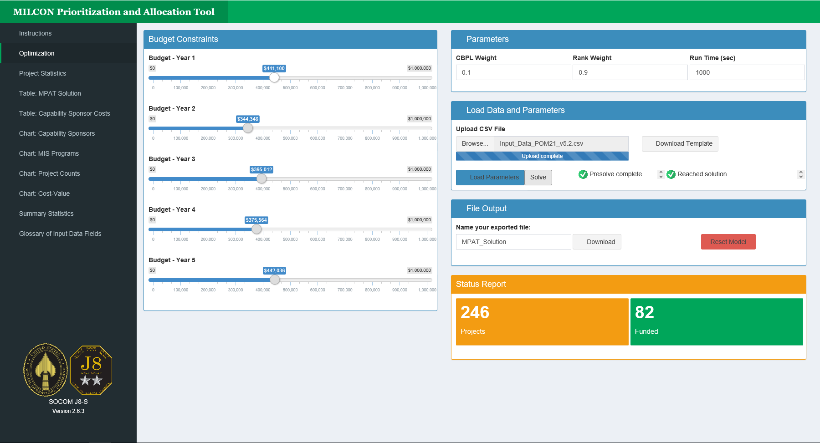
MILCON Optimization Integer Programming R Shiny
Users import data, adjust parameters, and solve the integer programming model to produce an optimal solution.

Slide 10
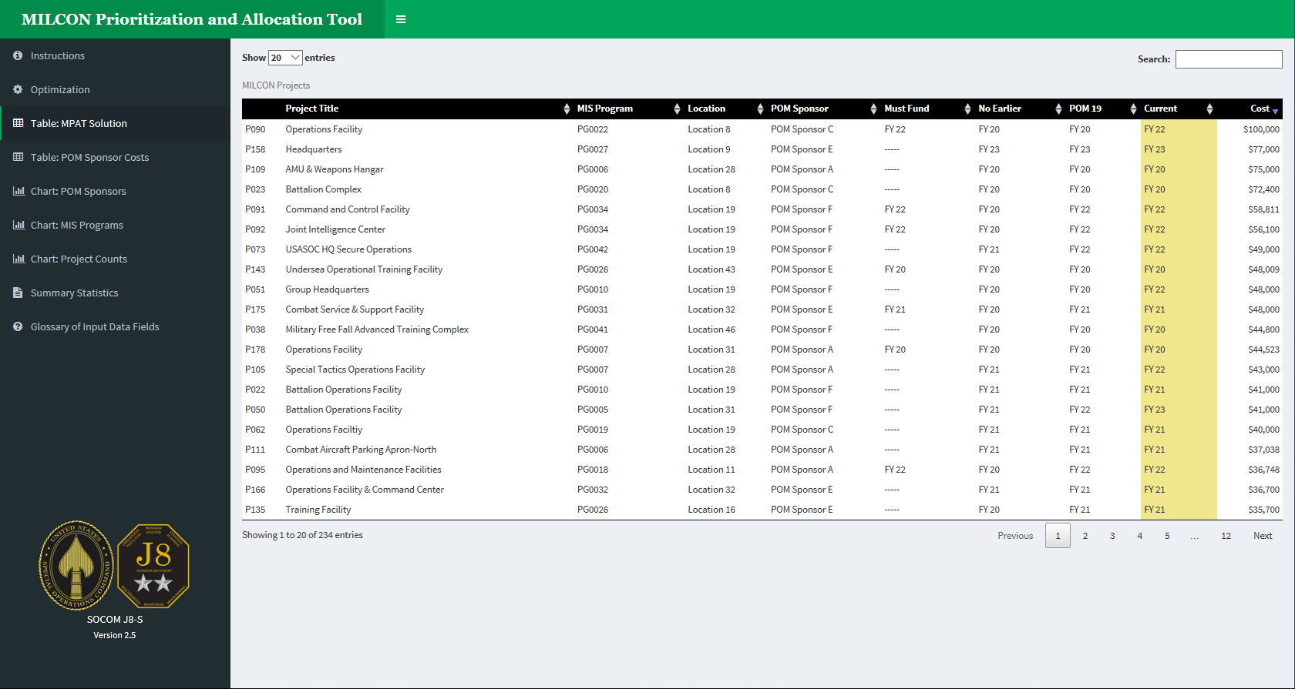
MILCON Optimization Integer Programming R Shiny
The solution table displays the recommended funding year for each project. The example below is sorted by cost.

Slide 11
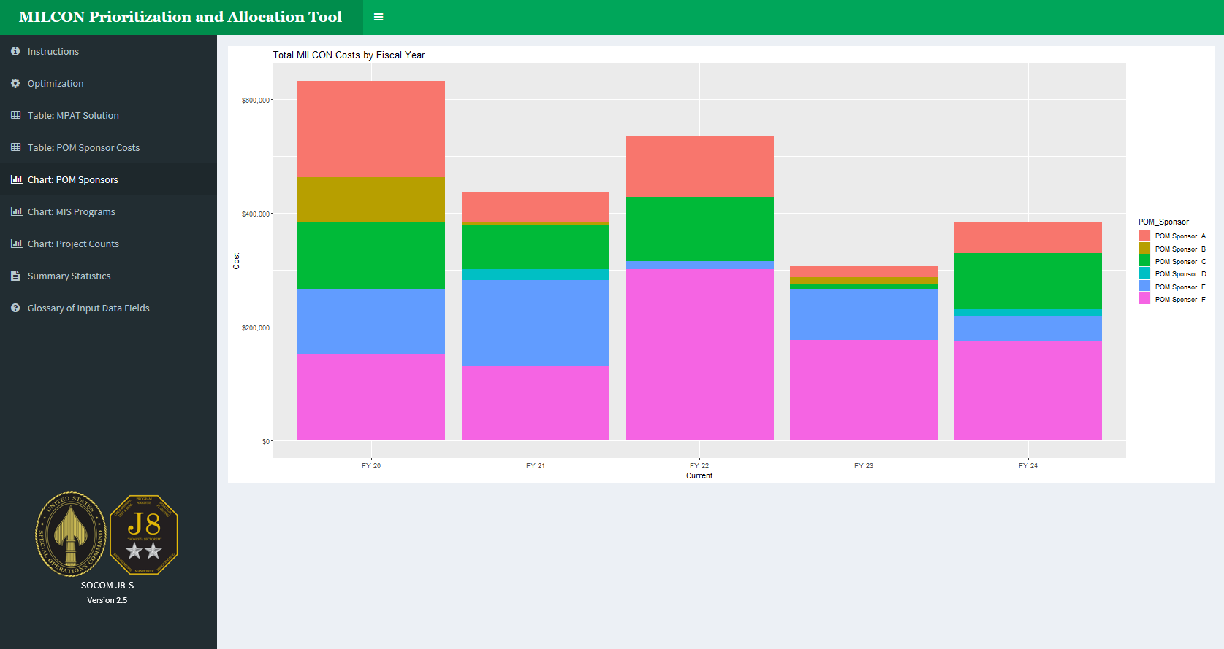
MILCON Optimization Integer Programming R Shiny

Slide 12
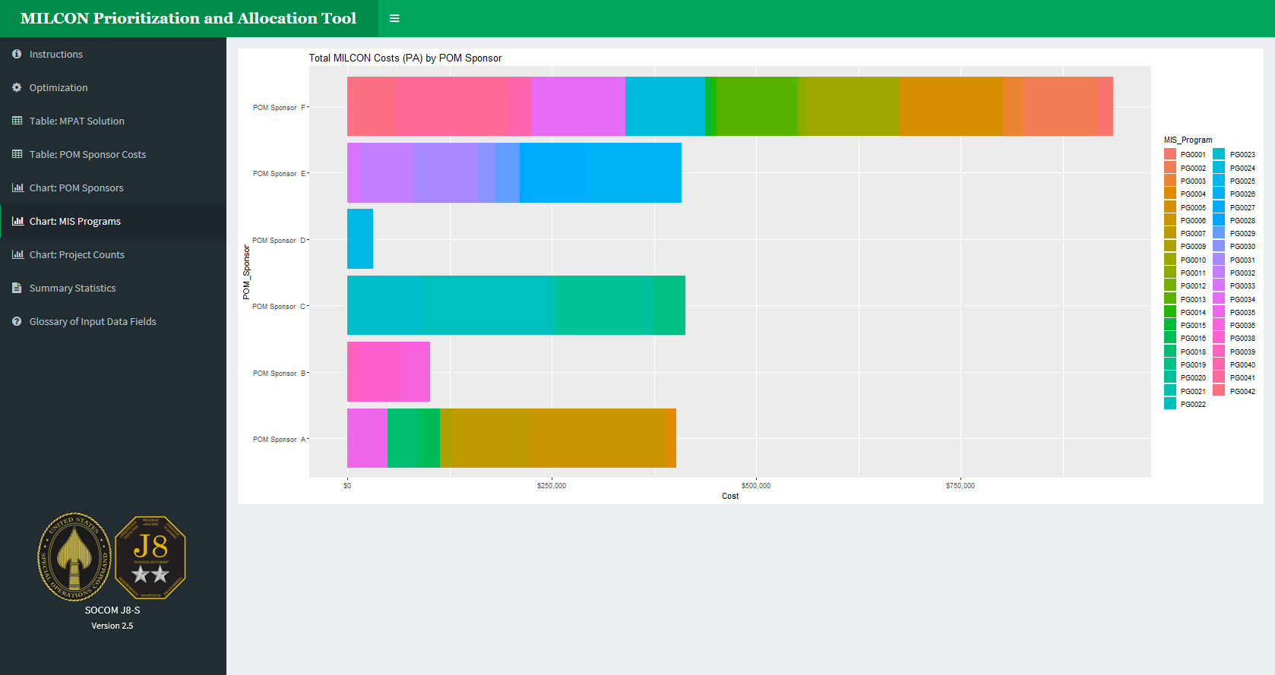
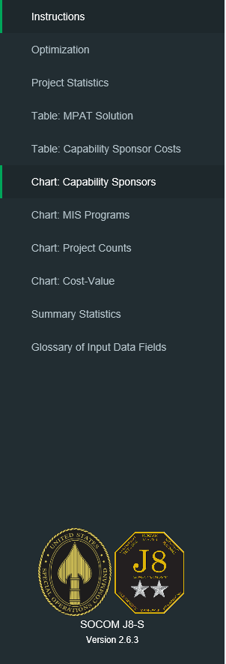
MILCON Optimization Integer Programming R Shiny

Slide 13
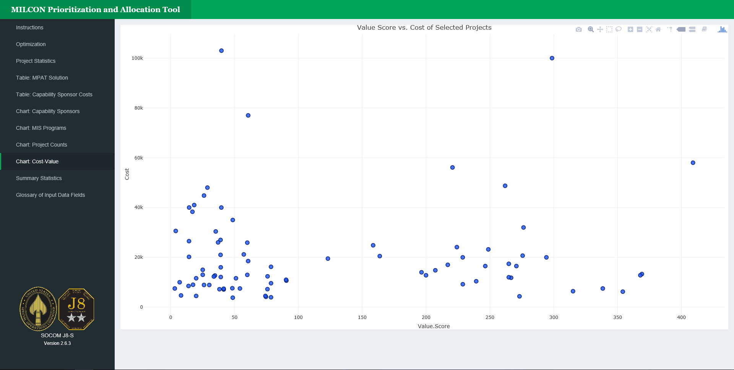
MILCON Optimization Integer Programming R Shiny

Slide 14
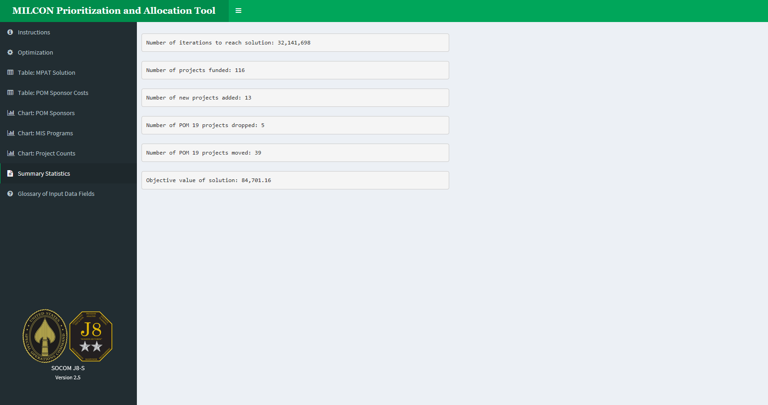
MILCON Optimization Integer Programming R Shiny
We can add any type of visualization that is helpful to analyze the output.

Slide 15
Backup

Slide 16
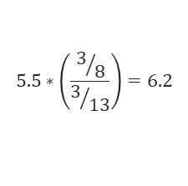
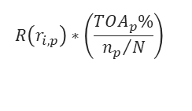
MILCON Optimization Integer Programming Value Score
How do we make a composite ranking of mutually exclusive ranks?
Sponsor A ranks 3 projects
Sponsor B ranks 10 projects
Step 1:
Put rakings on the same scale.
Step 2
Merge to a combined indexed list.
Step 3
Scale based on TOA proportions.
A
B
A
B
AB
AB
1 to n Rank
1
1
1
1
1
0.6
1
2
2
5.5
2
1
Assume
TOA_{A} % for A is 3/8
TOA_{B} % for B is 5/8
1.2
2
2
2.5
3
3
3
10
3
3
3.4
4
4
4
4
3.7
5
5
5
5
4.9
6
6
6
5.5
6.2
7
7
7
6
Example
6.2
8
8
8
7
$$R\left(r_{i,p}\right)∗\left(\frac{{TOA}_{p}\%}{{n_{p}}/N}\right)$$
7.4
9
9
9
10
8
8.9
10
10
$$5.5∗\left(\frac{3/8}{3/{13}}\right)=6.2$$
9.8
11
9
Number of projects (N) = 13
Number of A projects (n_{A}) = 3
Number of B projects (n_{B}) = 10
10
11.1
12
10
12.3
13

