Slide 1
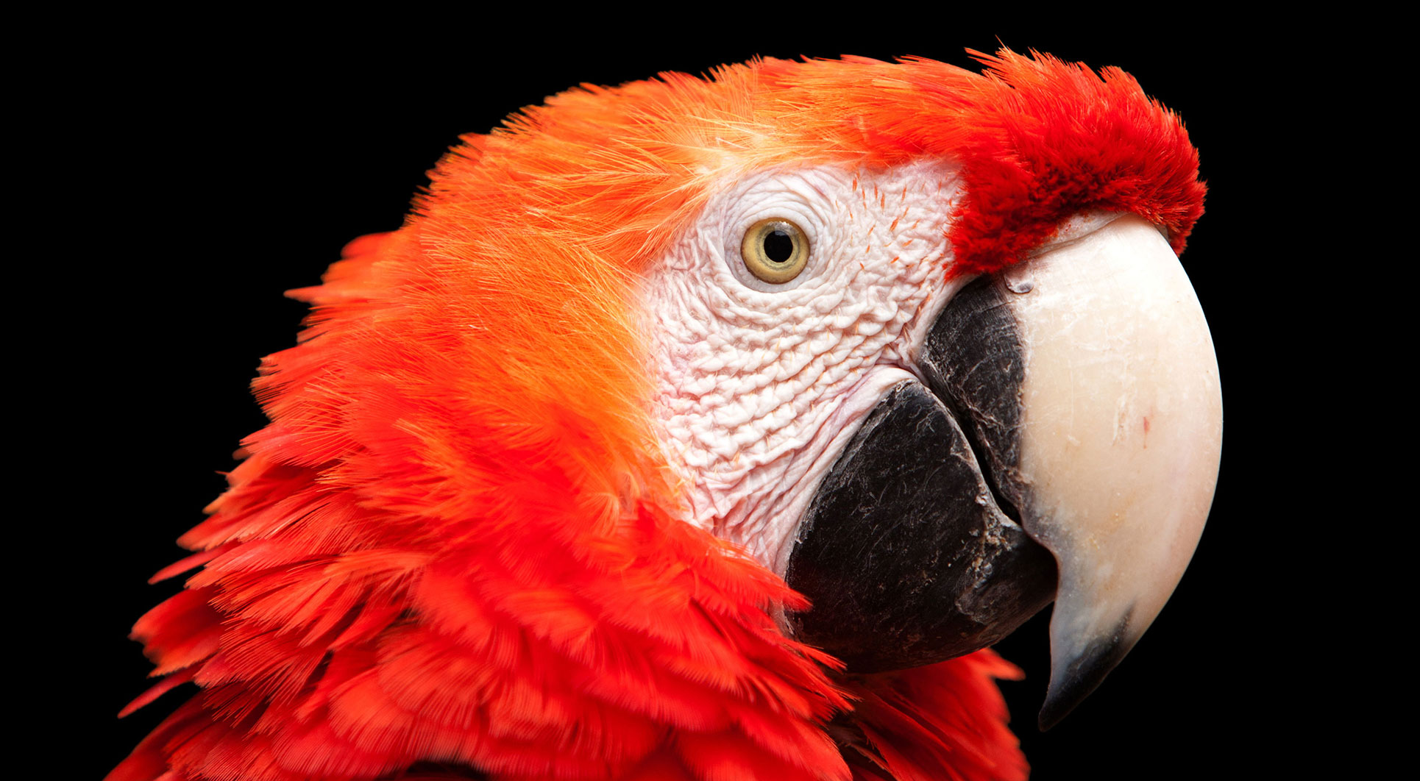
视频5：循环语句
《探索Python的魔法世界》
小牛叔出品

Slide 2
视频5：循环初步
3.1 开启重复的魔法之门 – 循环
3.2 随机抽出10个勇士
3.3 打印出金字塔形状

Slide 3
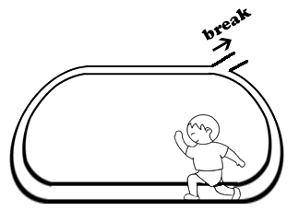
1、循环
while <条件>:
语句

Slide 4

2、循环抽取勇士
抽1名
合格不
合格：申请减1
够10个
结束
不合格

Slide 5
3、金字塔
0 |  |  |  |  |  |  |  |  |  | * |  |  |  |  |  |  |  |  |  |  | 1 | 9
1 |  |  |  |  |  |  |  |  | * | * | * |  |  |  |  |  |  |  |  |  | 3 | 8
2 |  |  |  |  |  |  |  | * | * | * | * | * |  |  |  |  |  |  |  |  | 5 | 7
3 |  |  |  |  |  |  | * | * | * | * | * | * | * |  |  |  |  |  |  |  | 7 | 6
4 |  |  |  |  |  | * | * | * | * | * | * | * | * | * |  |  |  |  |  |  | 9 | 5
5 |  |  |  |  | * | * | * | * | * | * | * | * | * | * | * |  |  |  |  |  | 11 | 4
6 |  |  |  | * | * | * | * | * | * | * | * | * | * | * | * | * |  |  |  |  | 13 | 3
7 |  |  | * | * | * | * | * | * | * | * | * | * | * | * | * | * | * |  |  |  | 15 | 2
8 |  | * | * | * | * | * | * | * | * | * | * | * | * | * | * | * | * | * |  |  | 17 | 1
9 | * | * | * | * | * | * | * | * | * | * | * | * | * | * | * | * | * | * | * |  | 19 | 0

