Slide 1
The Natural Disasters Disast-board
Jason Chody
Ryan Henkel
Marla Blanco

Slide 2

Introduction-WHY?
Climate change and natural disasters profoundly impact our global society and environment
Natural disasters like fires, floods, hurricanes, droughts, etc, are events that can result in devastating consequences, including property damage, environmental degradation, and even loss of life
By evaluating the data correlating to the trends of these global events, we can mitigate and prepare to reduce overall impact. Hopefully reducing vulnerabilities and making strides to create a safer and more resilient world
This Photo by Unknown Author is licensed under CC BY

Slide 3
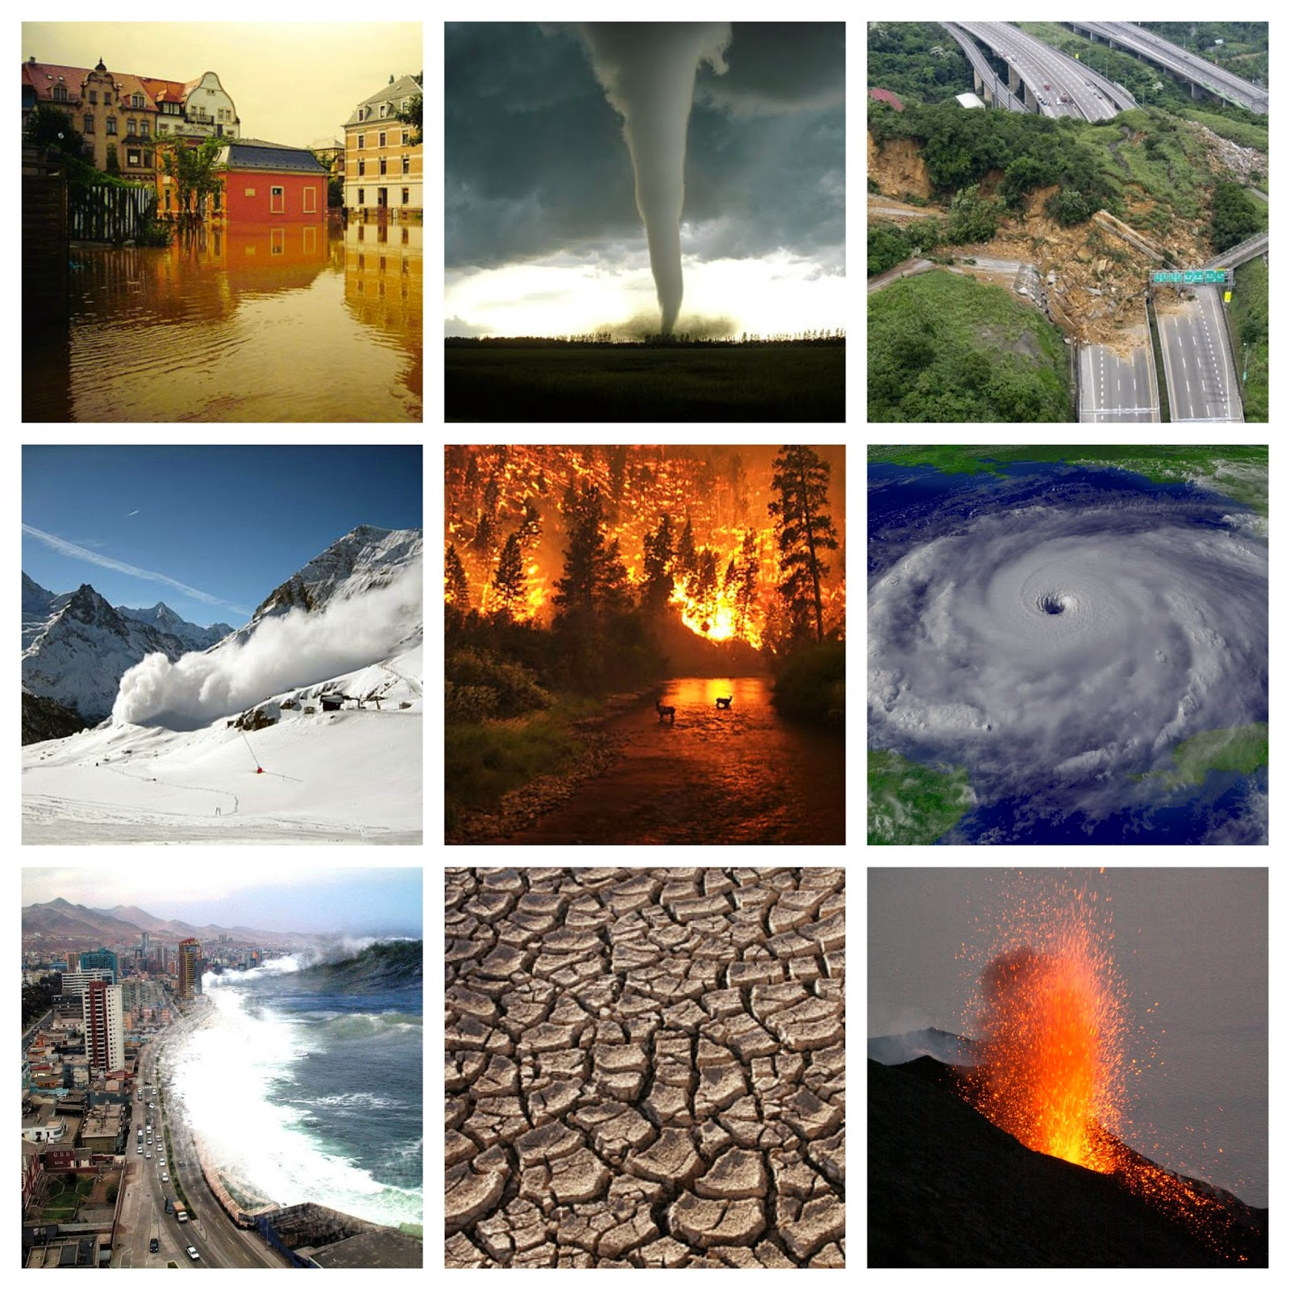
Our Take
Our group chose to gather data on FEMA National Disaster Declarations, globally declared disasters and global surface temperature anomalies
We predicted a positive correlation between the increasing surface temperature anomalies and overall frequency/severity of natural disasters
This Photo by Unknown Author is licensed under CC BY-SA-NC

Slide 4
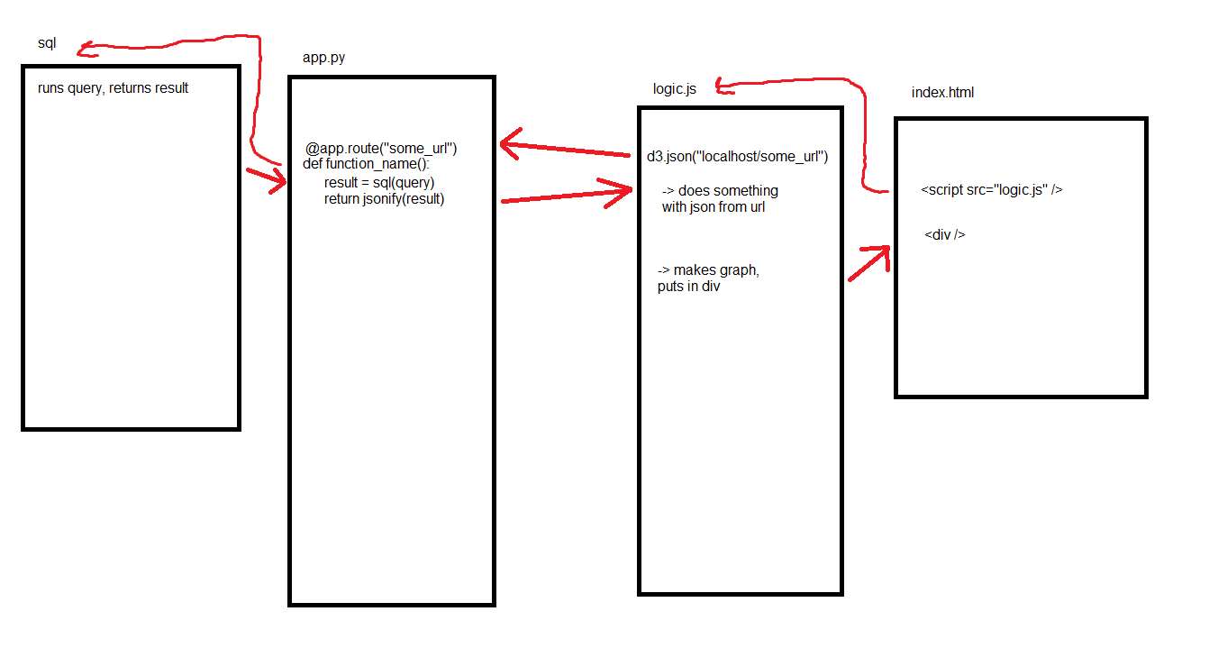
Dashboard Background

Slide 5
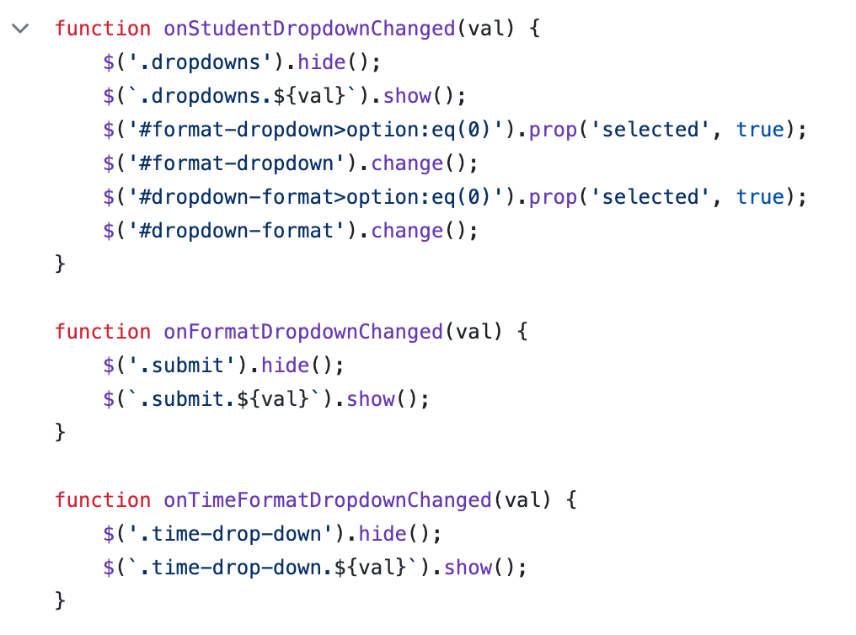
Methods-jQuery over d3.js
More specialized
More intuitive
1/3 the size
With the use of Plotly and Leaflet instead of d3 for our visualizations, jQuery becomes the superior choice
Notes:
1. because jQuery is only for general dom manipulation, it's faster. we were making a web app, and so we went with a library for creating web apps 2. narrower library scope means smaller size of the library - ~160 kilobytes isn't much, but you're not always going to be building for people with good internet connections 3. i didn't see the point of d3 making d3.json() return a Promise? $.getJSON(url, function) sticks d3's "then" function directly into the url request - not only does this make more sense, but it also allows you to see this functionality directly on the same page in the jquery documentation, instead of having to be pointed to another web page for the "then" documentation

Slide 6
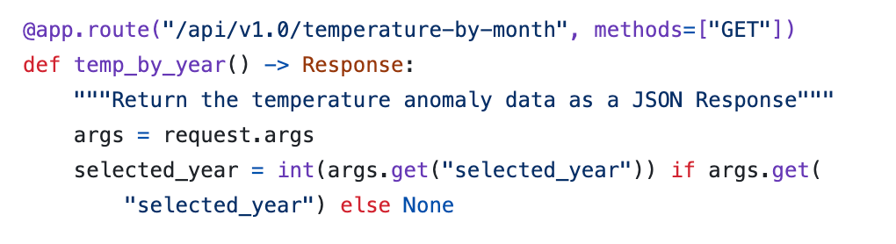
Methods-HTML GET over FLASK HTML
More flexibility
Fewer unique endpoints
Less to update
Fewer breaking changes on updates
Notes:
1. you can specify parameters as you want, in any order, by name. 2. you can use one endpoint for more different types of queries, based on whether or not a parameter exists in the url 3. adding or removing functionality to a specific query type means just changing a few lines of code, instead of: the endpoint, the function header, the code, possibly creating a new function... 4. end-users (people using the api from their javascript) probably won't have to change their code to get the same results when the api is updated

Slide 7
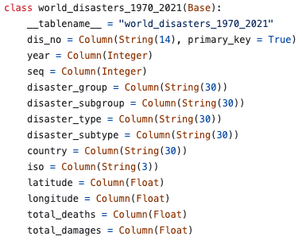
Methods-Explicitly-defined ORM Classes
Speed
Our datasets, our database, our knowledge
Modularity and readability
Notes:
1. the database needs to be opened, read from, and closed each time a query is made. using reflection for this would be needlessly slow, having to analyze the database every call, because... (of point 2) 2. we're not retrieving unknown tables from an unknown database. we made the database, we made the tables, we know exactly what it looks like. a few minutes now saves us time on every api call later 3. because we defined the tables directly, we're able to use them to build queries while the table is closed. we can build those queries and then use a single helper function (run_sql_command) to handle the actual database manipulation

Slide 8
Dashboard Demonstration

Slide 9
Conclusions
Global temperature anomalies are increasing over the years
Most natural disasters are not increasing in frequency
Hurricanes, fires, and severe storms ARE increasing in frequency
Death toll is decreasing
Notes:
-Natural disasters that are increasing, are spreading to new areas, causing more widespread harm, not just localized harm
-DEATH TOLL DECREASE: most likely due to preparedness but we don’t have that data to be certain

