Slide 1
Temperature/Humidity/Soil Moisture Sensor
First Prototype
By: Marla Ebeid
Omar Helmy
Shireen Afify

Slide 2



Idea Recap
IoT oriented
Our goal is to measure the temperature and humidity in the corridors of the department as well as the Soil moisture level in the plants and display them on the department’s screens.

Slide 3
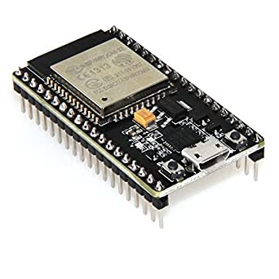
Hardware Components (Updated)
ESP-WROOM-32
DS18B20 Sunfounder Temperature Sensor
DHT11 Sunfounder Humiture Sensor
Soil Moisture Sensor AB054
Jumper Wires
10K Resistors
Power Supply (USB to Laptop)
Breadboard
I2C Lcm1602 Screen

Slide 4

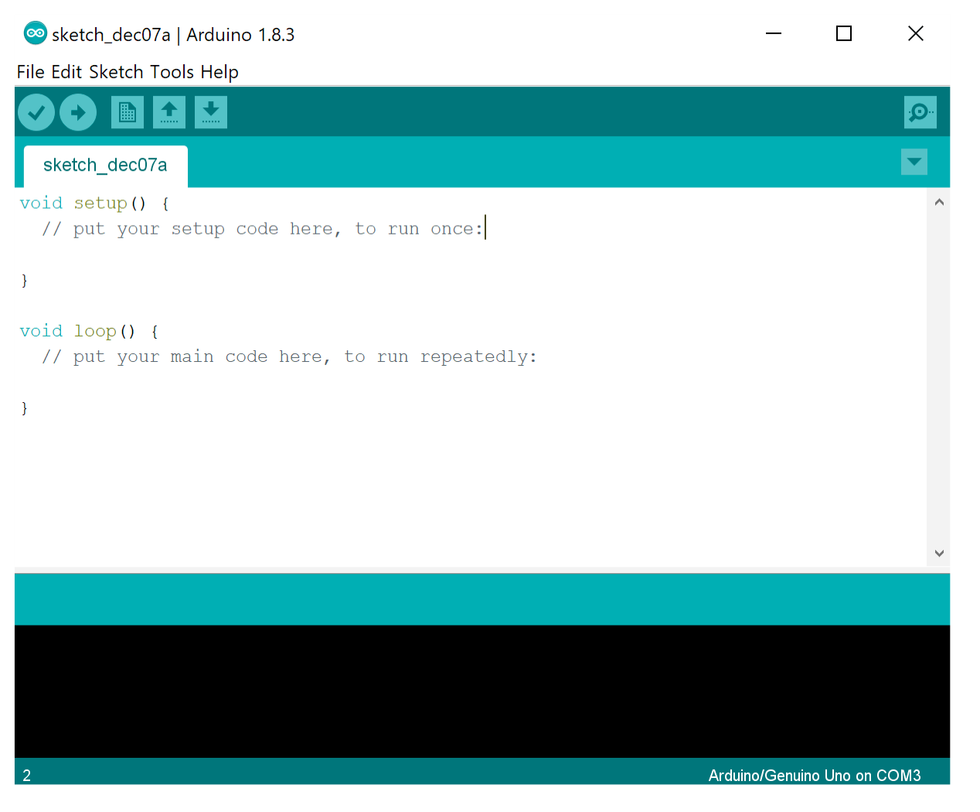
Software Components (Updated)
Arduino IDE
Libraries for Temperature Sensor
DallasTemperature
Libraries for Humidity Sensor
DHT
Adafruit Sensor
Libraries for LCD Screen
One Wire
LiquidCrystal_I2C

Slide 5
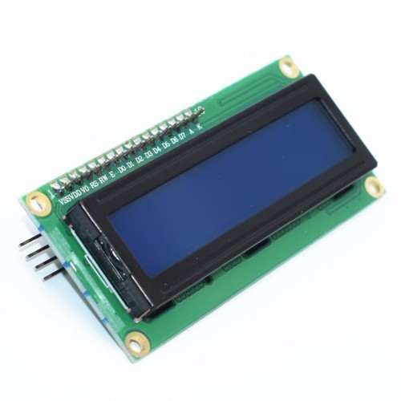
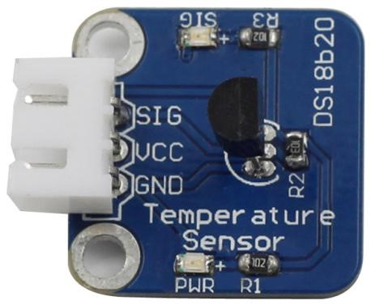
Temperature Sensor Connections
DS18B20 | ESP32
GND | GND
VCC | VCC
SIG | 10K resistor in parallel with D4
LCD | ESP32
GND | GND
VCC | VCC
SDA | D21 (GPIO 21)
SCL | D22 (GPIO 22)

Slide 6
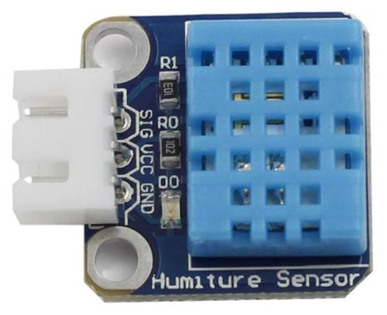
Humidity Sensor Connections
DHT11 | ESP32
GND | GND
VCC | VCC
SIG | 10K resistor in parallel with D5
LCD | ESP32
GND | GND
VCC | VCC
SDA | D21 (GPIO 21)
SCL | D22 (GPIO 22)

Slide 7
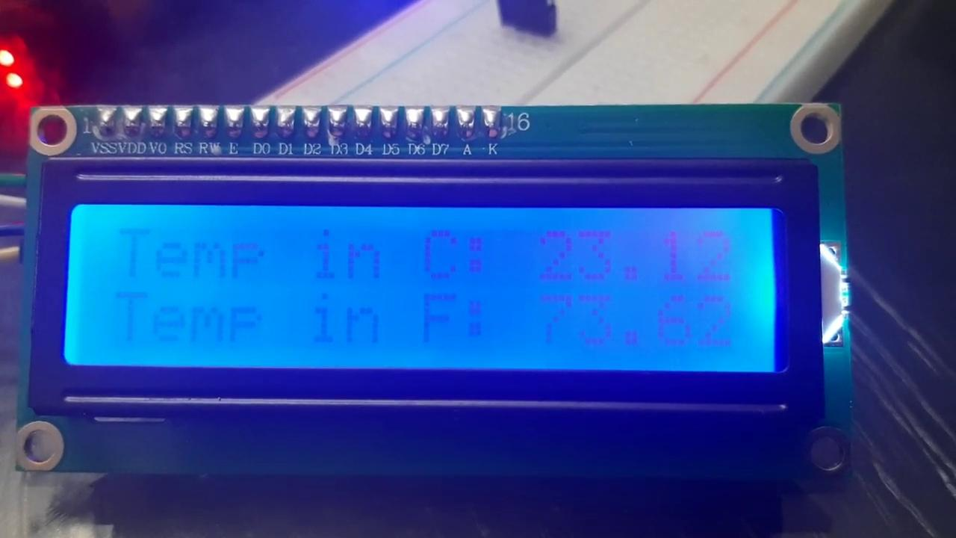
Demo (Temperature)

Slide 8
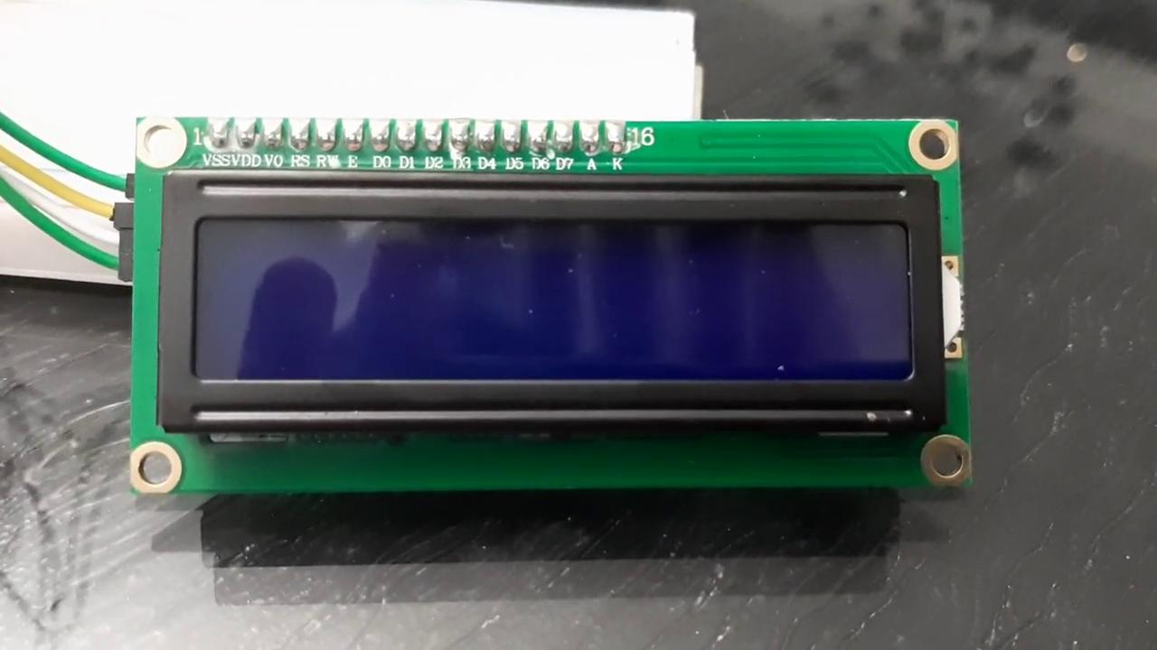
Demo (Humidity)

Slide 9
Second Prototype Plan
Measure Soil Moisture Level
Integrate the three sensors to display the results on the LCD screen
Finalize any remainders

Slide 10
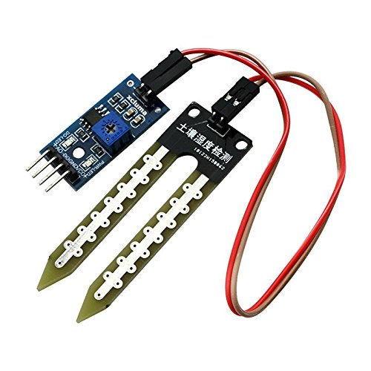
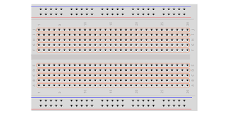
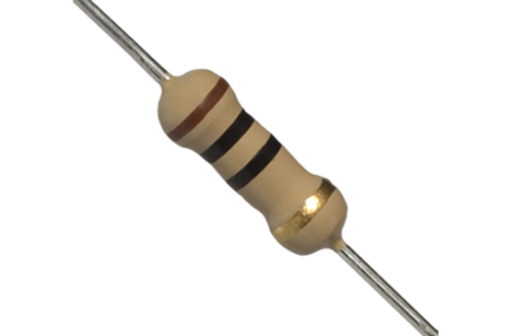

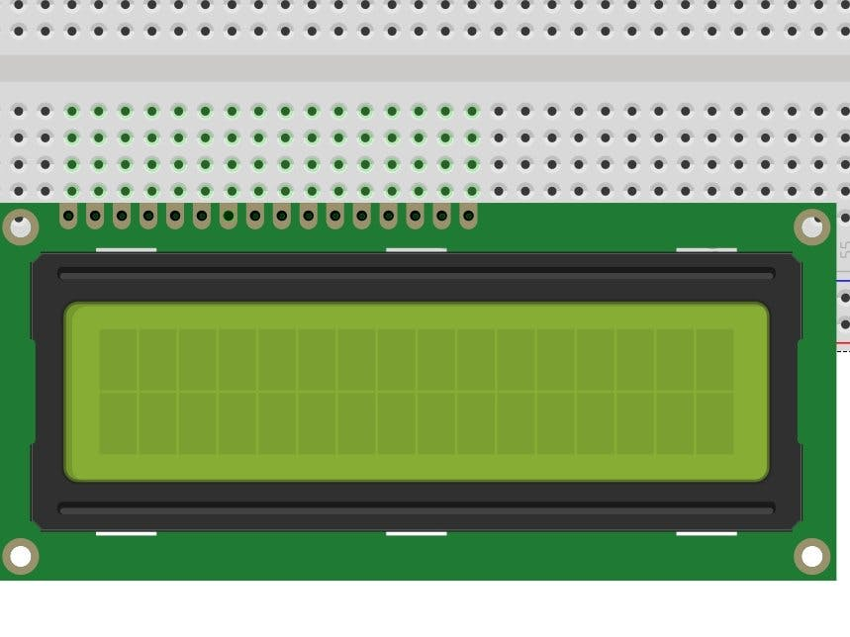
Finial Design

Slide 11
Thank you!

