Slide 1
Temperature/Humidity/Soil Moisture Sensor
By: Marla Ebeid
Omar Helmy
Shireen Afify

Slide 2



The Idea
IoT oriented
Our goal is to measure the temperature and humidity in the corridors of the department as well as the Soil moisture level in the plants and display them on the department’s screens.

Slide 3
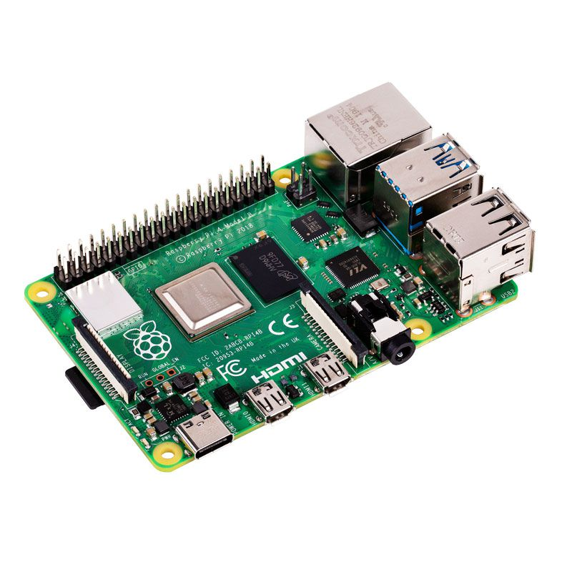
Needed Resources (Hardware)
Raspberry Pi
Temperature Sensor (ex: LM35)
Humidity Sensor (ex: DHT22)
Soil Moisture Sensor (Based on the available components in the lab)
Potentiometers
Wires
Resistors
Power Supply
Breadboard
LCD Screen (along with its essential connections)

Slide 4
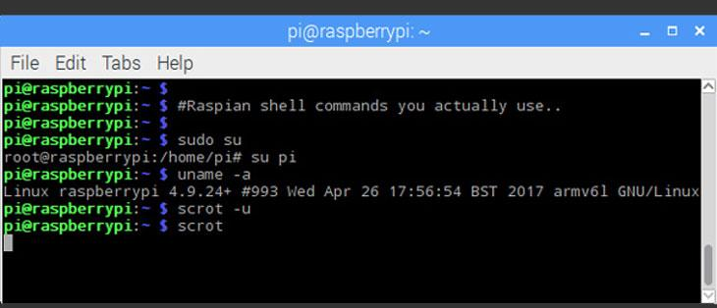
Needed Resources (Software)
Terminal emulator ( LXTerminal )

Slide 5
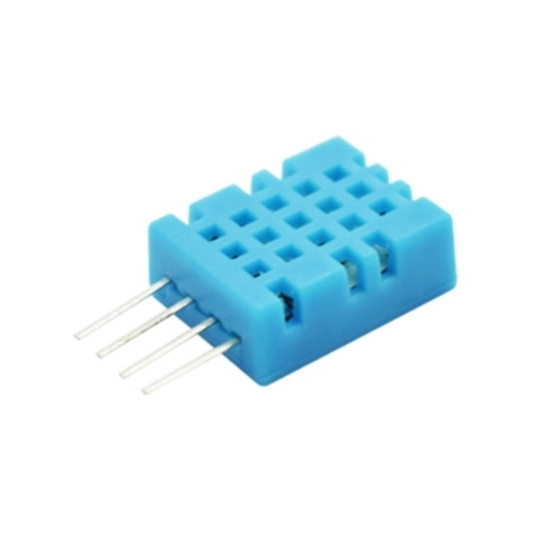
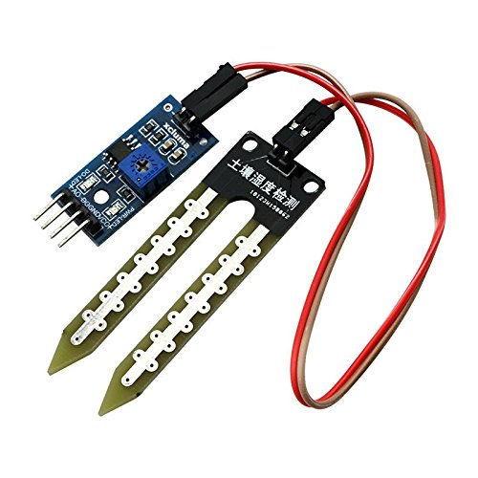
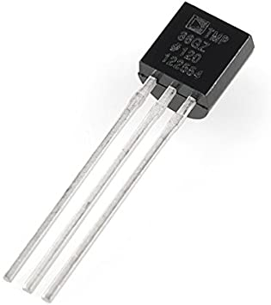
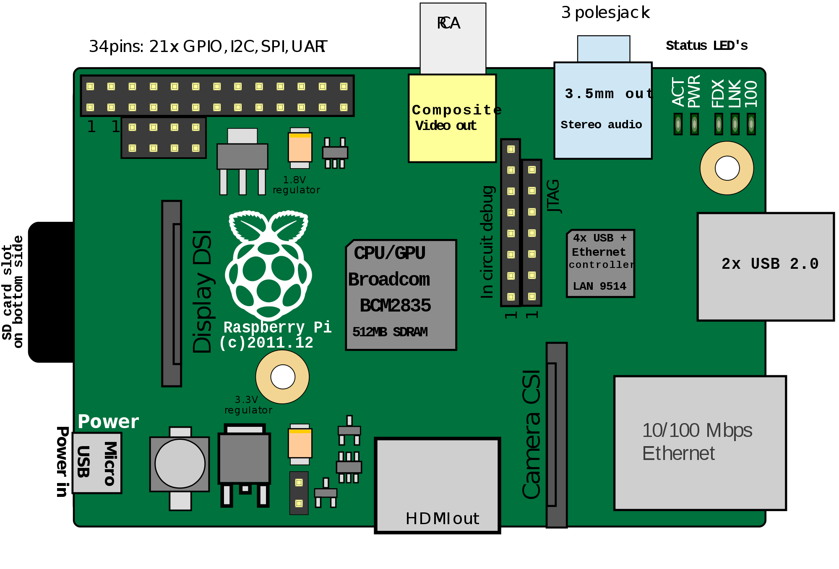
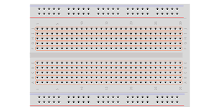

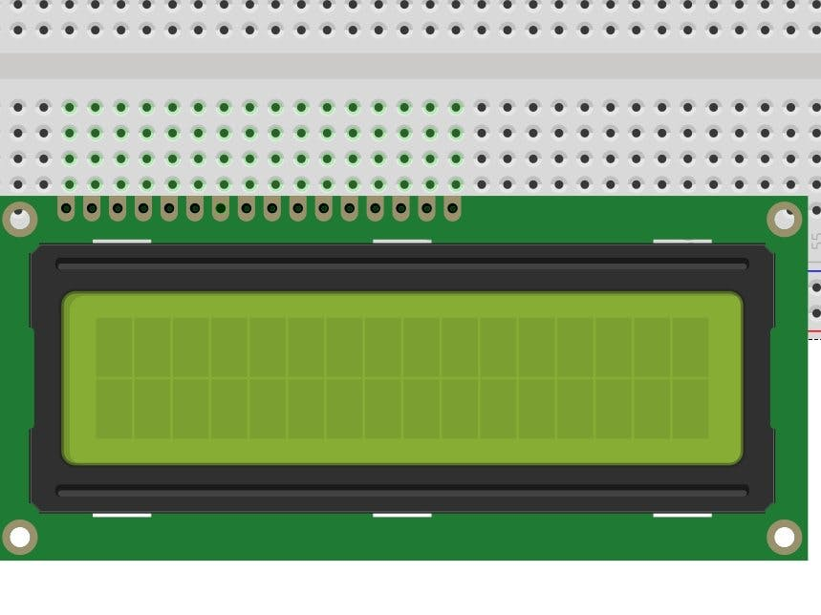
Initial Design

Slide 6
Thank you!

