Slide 1
Temperature/Humidity/Soil Moisture Sensor
Third Prototype
By: Marla Ebeid
Omar Helmy
Shireen Afify

Slide 2



Idea Recap
IoT oriented
Our goal is to measure the temperature and humidity in the corridors of the department as well as the Soil moisture level in the plants and display them on the department’s screens.

Slide 3
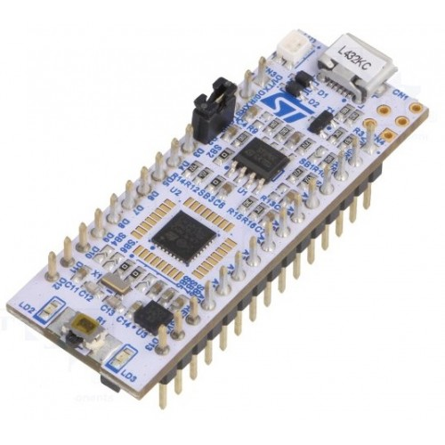
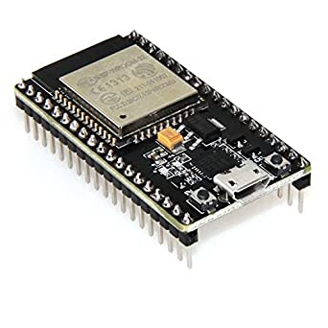
Hardware Components (Updated)
STM32L432KC
ESP-WROOM-32
DS18B20 Sunfounder Temperature Sensor
DHT11 Sunfounder Humiture Sensor
Soil Moisture Sensor AB054
Jumper Wires
10K Resistors
Power Supply (USB to Laptop)
Breadboard

Slide 4




Software Components (Updated)
Arduino IDE
Keil uVision
CubeMX
TeraTerm

Slide 5
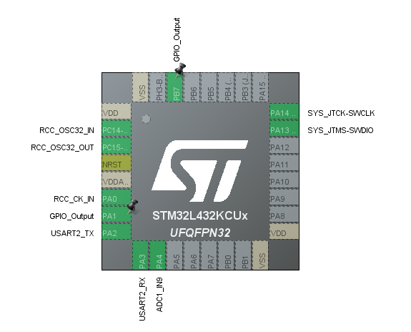
Physical Connections
ESP | STM32
RX2 | A7
TX2 | A2

Slide 6
Limitations
Raspberry Pi to display the data on Screen
We were not able to display the data on the screen
No Soil to test its moisture level
Instead we used a cup of water that should give max Moisture level (100%)
Soil Moisture Sensor is inaccurate
Inaccurate results for the soil moisture level
We don’t have enough wires
Temperature and Humidity Data integrate while Soil moisture is displayed separately

Slide 7
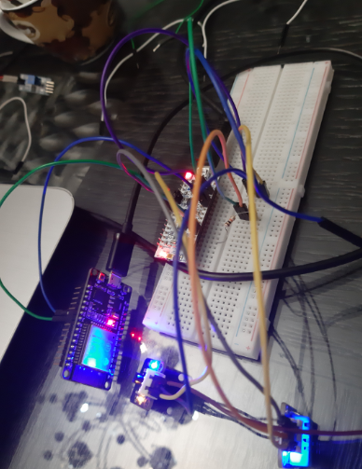
Temperature and Humidity Demo (Connections)

Slide 8

Temperature and Humidity Demo

Slide 9
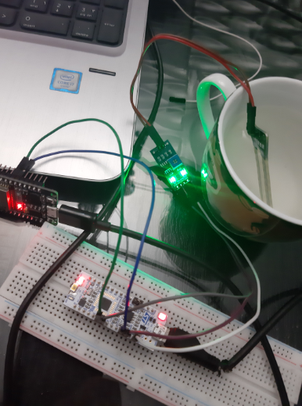
Soil Moisture Level Connections
4095 -> 0% (air)
<=2000 -> 100% (Water)

Slide 10
Soil Moisture Demo

Slide 11
Thank you!

