Slide 1
Five Major Categories of Ratios and the Questions They Answer
Liquidity: Can we make required payments?
Asset management: Right amount of assets vs. sales?
Debt management: Right mix of debt and equity?
Profitability: Do sales prices exceed unit costs, and are sales high enough as reflected in PM, ROE, and ROA?
Market value: Do investors like what they see as reflected in P/E and M/B ratios?
4-<number>

Slide 2
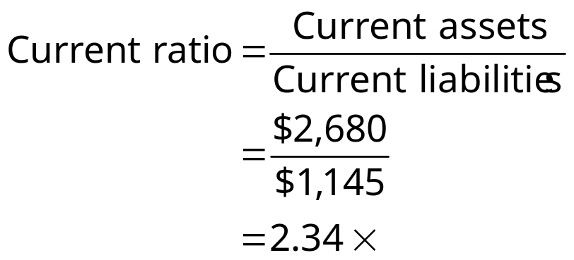
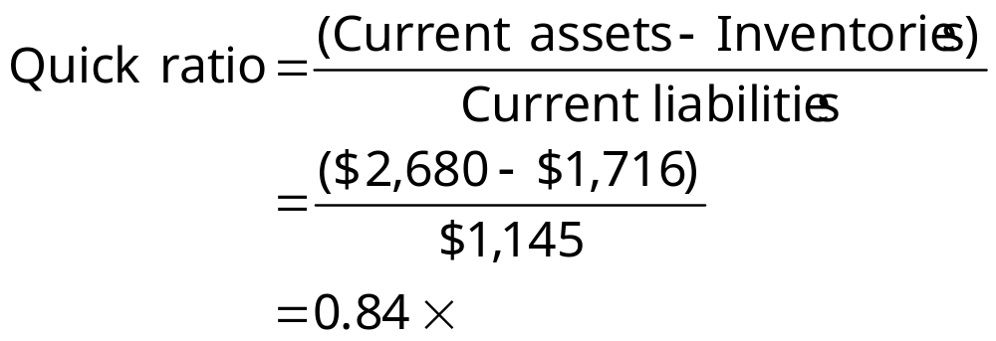
D’Leon’s Forecasted Current Ratio and Quick Ratio for 2013
4-<number>
Notes:
It indicates the extent to which CL are covered by CA. Also, Inventories are the least liquid.

Slide 3
D’Leon’s Inventory Turnover vs. the Industry Average
Inv. turnover = Sales/Inventories
= $7,036/$1,716
= 4.10x
 | 2013E | 2012 | 2011 | Ind.
Inventory turnover | 4.1x | 4.70x | 4.8x | 6.1x
4-<number>
Notes:
Shows how many times inventory is turned over per year. Sold $7,036 of books for the year, and this is leftover inventory. Did this 4 times for the year. If seasonal, may need an average.

Slide 4
DSO: Average Number of Days after Making a Sale before Receiving Cash
DSO = Receivables/Avg. sales per day
= Receivables/(Annual sales/365)
= $878/($7,036/365)
= 45.6 days
4-<number>

Slide 5
Fixed Assets and Total Assets Turnover Ratios vs. the Industry Average
FA turnover = Sales/Net fixed assets
= $7,036/$817 = 8.61x
TA turnover = Sales/Total assets
= $7,036/$3,497 = 2.01x
4-<number>
Notes:
How well the company uses its Fixed or Long term Assets. FA show on the balance sheet at Historical cost…does not consider inflation. Newer firms may have a higher FA ratio because the assets currently purchased at a higher price.
TA Turnover – may show that the problem lies with Current assets (A/rec, Inventories, ) If below industry average.

Slide 6
Calculate the Debt Ratio and
Times-Interest-Earned Ratio
Debt ratio = Total debt/Total assets
= ($1,145 + $400)/$3,497
= 44.2%
TIE = EBIT/Interest charges
= $492.6/$70 = 7.0x
4-<number>
Notes:
Creditors prefer low Debt ratios, but Shareholders may like debt because it makes Earnings larger. See page 106.
TIE – Looks at Operating income to see if the company can pay its interest charges. How low can EBIT go before a concern.

Slide 7
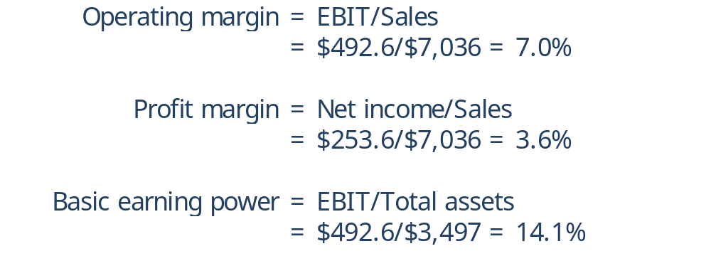
Profitability Ratios: Operating Margin, Profit Margin, and Basic Earning Power
4-<number>
Notes:
Operating Income: how 2 companies compare without financing. Are CGS sold too high.
PM – Income per dollar.
BEP – What you earn – without looking at taxes and interest payments if any.

Slide 8
Profitability Ratios: Return on Assets and Return on Equity
ROA = Net income/Total assets
= $253.6/$3,497 = 7.3%
ROE = Net income/Total common equity
= $253.6/$1,952 = 13.0%
4-<number>
Notes:
ROA – IF it’s low, may mean you are using a great deal of debt. Interest expense deducted from income…lowers income.
ROE - Common shareholders see this as most important. TCE = Common stock at par + RE.
Stockholders Equity ( TCE + Preferred Stock if any)

Slide 9
Calculate the Price/Earnings and Market/Book Ratios
P/E = Price/Earnings per share
= $12.17/$1.014 = 12.0x
M/B = Market price/Book value per share
= $12.17/($1,952/250) = 1.56x
 | 2013E | 2012 | 2011 | Ind.
P/E | 12.0x | -1.4x | 9.7x | 14.2x
M/B | 1.56x | 0.5x | 1.3x | 2.4x
4-<number>
Notes:
P / Earnings: Price per share / Earnings per share… Will $12 for $1 of Earnings $24 / $2.00 basically the same.
Market price – currently trading Book value – Common Equity / # of shares.
M / Book = Just that ratio.
EPS = NI / # of shares.

Slide 10
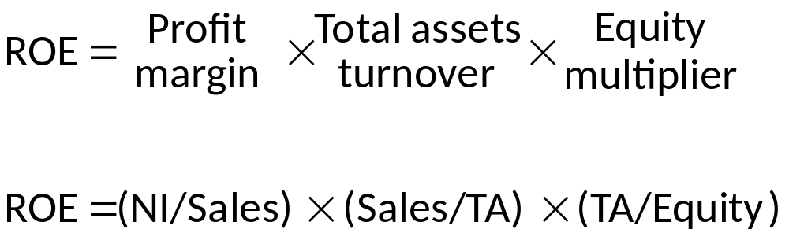
The DuPont Equation
Focuses on expense control (PM), asset utilization (TA TO), and debt utilization (equity multiplier).
4-<number>
Notes:
EQ = TA / Equity = Debt + Equity / Equity

Slide 11
Limitations & Qualitative Components
See Page 120
See Page 123
4-<number>

