Slide 1
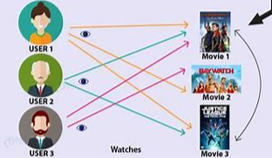
Recommender System
Devan Grey, Daniel Piston, Keeley Ables

Slide 2
specification
OBJECTIVE:
Solve problem of how to create a recommender system that predicts what users streaming movie content would enjoy
SOURCE:
Kaggle competition: Netflix Movie Recommendation
EXPLORATION QUESTIONS:
What kinds of patterns regarding preferences will be seen among users?
Will these patterns accurately predict user movie preference?

Slide 3
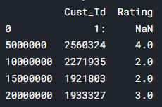
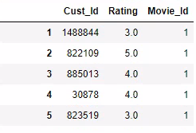
The data
Data Cleaning
Source:
Taken from Kaggle website
Original Structure:
4 text files containing Movie ID, Customer ID and Rating
1 csv look-up table for movie titles
"Probe" and "qualifying" data used for testing model
Cleaning:
Imported text files and append to create total dataset
Export full data set (dictionary) to pickle file for better storage
Re-import pickle file after clearing memory to aid performance
Change from dictionary to data frame: insert movie ID next to each observation
Challenges:
Working with the data without maxing out the machines used to run the cleaning or analysis, efficiency was key
before
After
Notes:
Pickle can be used to serialize Python object structures, which refers to the process of converting an object in the memory to a byte stream that can be stored as a binary file on disk. When we load it back to a Python program, this binary file can be de-serialized back to a Python object.

Slide 4
The data
Exploratory Analysis:
Number of movies included in the set by year of release
Distribution of all movie rating across year
Count of ratings over time
Distribution of movie ratings frequency per user

Slide 5
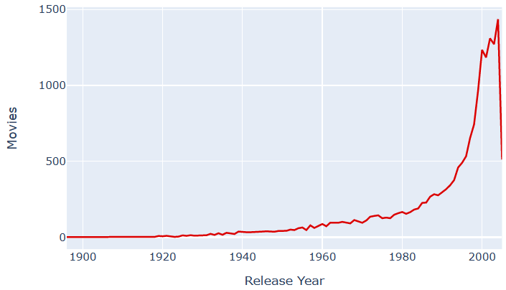
COUNT OF MOVIES BY YEAR OF RELEASE

Slide 6
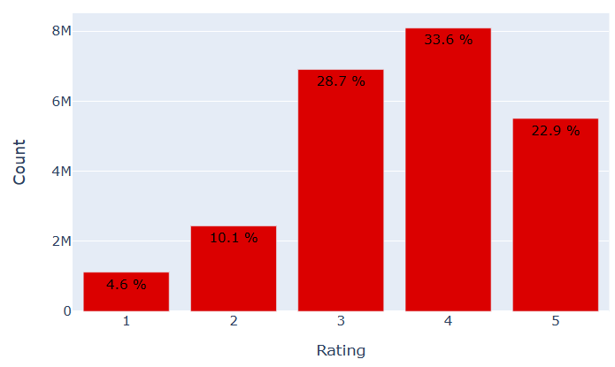
Distribution of all movie ratings across release year

Slide 7
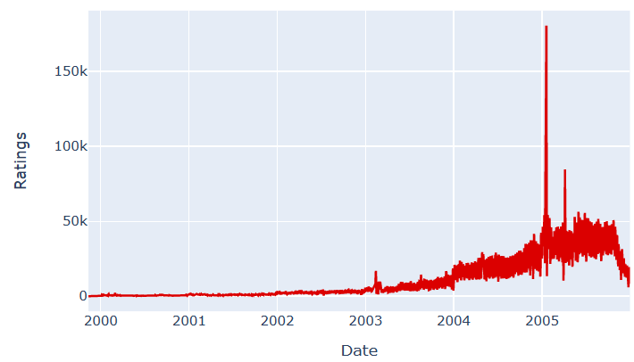
Count of user movie ratings over time

Slide 8
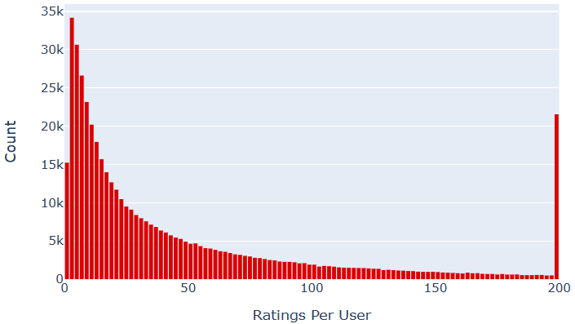
Distribution of ratings frequency per user

Slide 9
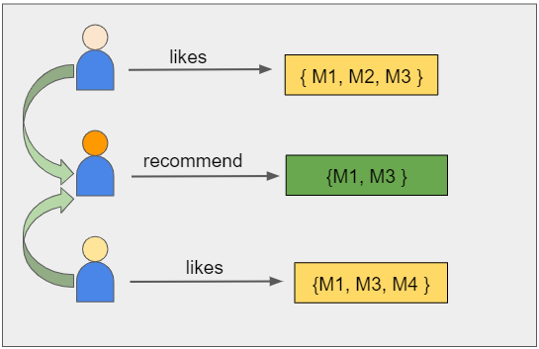
Analysis and recommendation
Using highest mean recommendations as a model: more general usage to determine ratings
Mean: Averages all observations equally
Weighted Mean: Averages but weights some observations more heavily than others (IMDb)
Recommendation System
- Singular Vector Decomposition(SVD Model): Assume what people liked in the past will be the same in the future
- Content based model: Based on movie / actors in movie
Root Mean Squared Error (RMSE) to evaluate models
There is a lot of data which requires time to run the models (100,000,000 total obs)
Ex. 2.5 hours to run 25% of the data for SVD model (approximately 25M obs)
Collaborative Filtering
User 1
User 3
User 2

Slide 10
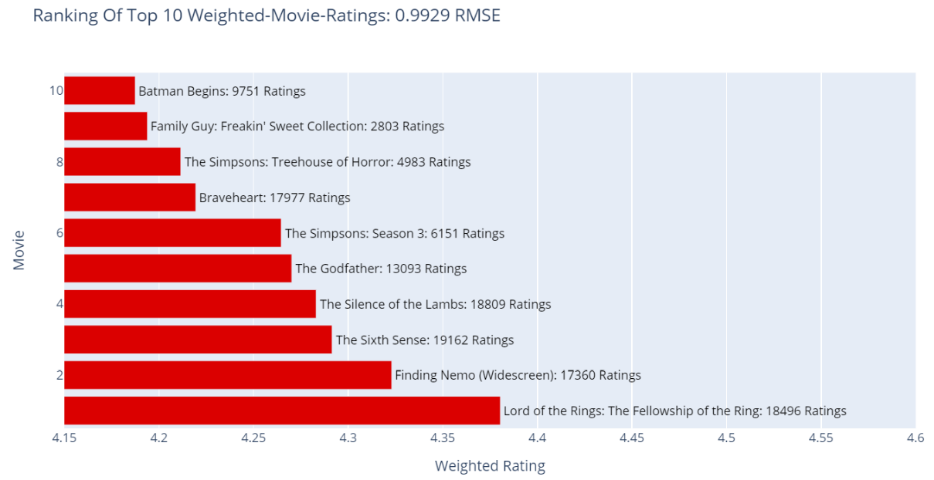
Analysis and recommendation

Slide 11
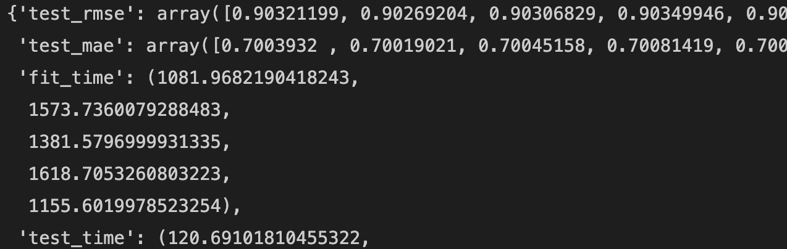
Analysis and recommendation

Slide 12
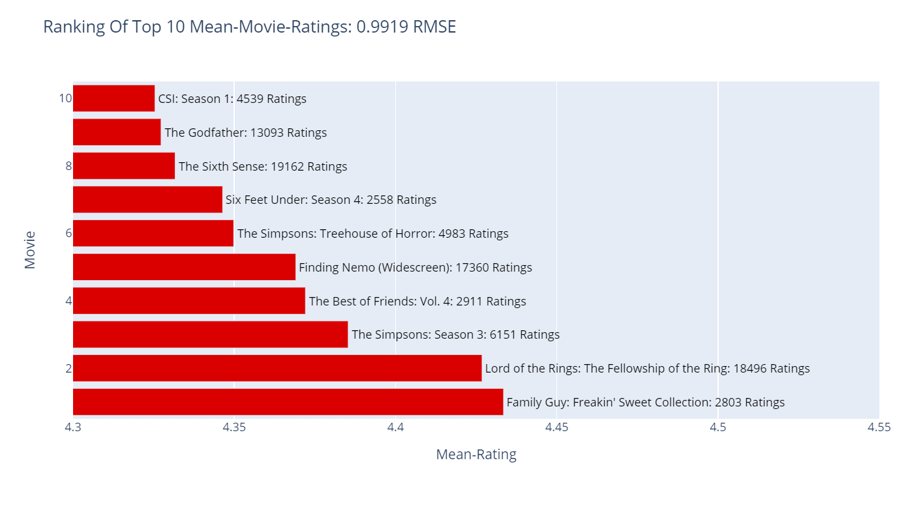
Analysis and recommendation

Slide 13
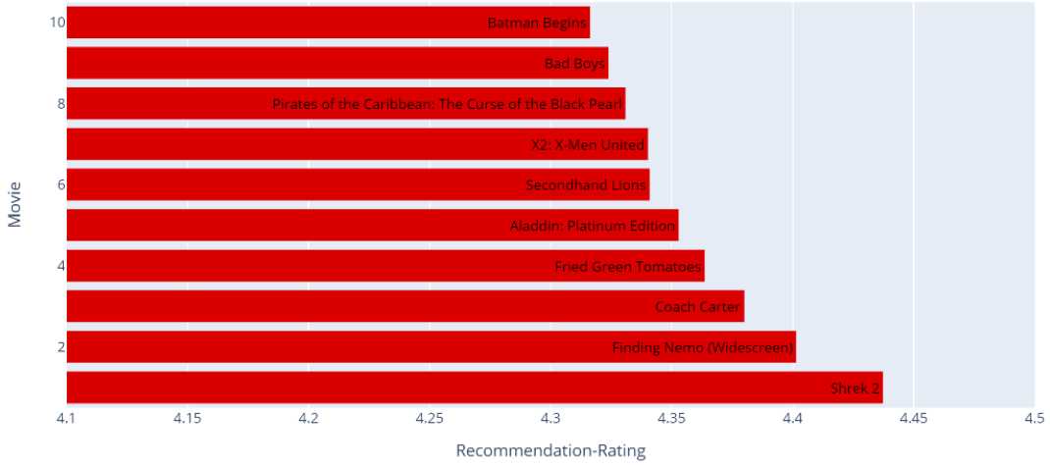
Ranking of top 10 recommended movies for a user based on similarity
RMSE: 1.3354

Slide 14
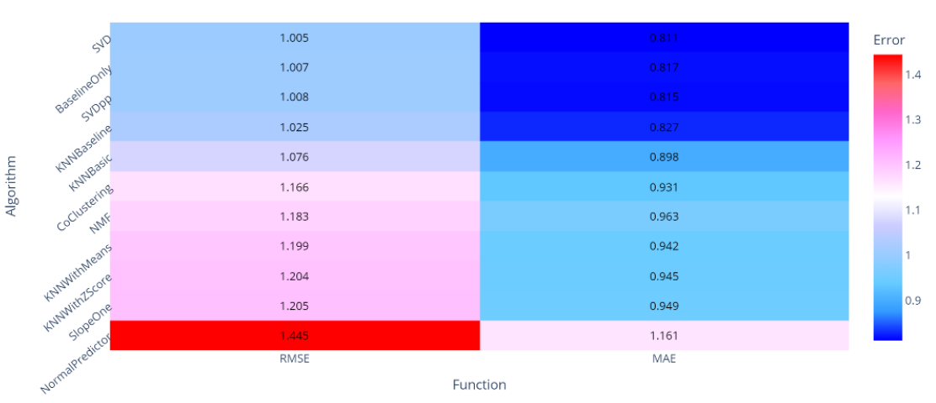
Cross-validated comparison of surprise algorithms

Slide 15
Recommendations
Movie Recommendation System:
The SVD model a low Root Mean Squared Error (RMSE) at 0.90+ (less than 2 considered good)
SVD / Collaborative filtering is a common method of producing recommendations
Recommended for use for a movie recommendation system if you/organization has the computing resources
Content-Base Movie Recommendation System would be an alternative to the collaborative filtering model (RMSE 1.3)
Further Reading: How to Build a Movie Recommendation System | by Ramya Vidiyala | Towards Data Science
Movie Ratings:
For creating movie ratings from large number of users, the RMSE show that the average and weighted average are good methods.
IMDb uses weighted average but does not disclose how the weighting is conducted.
Simple to use, computer resources should be less of an issue than with SVD model.
More research should be done to determine which model would work best for your purposes.

